Slide 1
Concurrent Enrollment Advisory Board Meeting
January 26, 2018
Littleton Public Schools

Slide 2
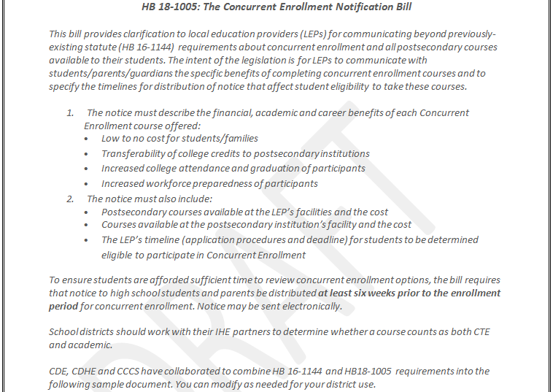
HB18-1005 Notice of postsecondary course enrollment options available to high school students

Slide 3
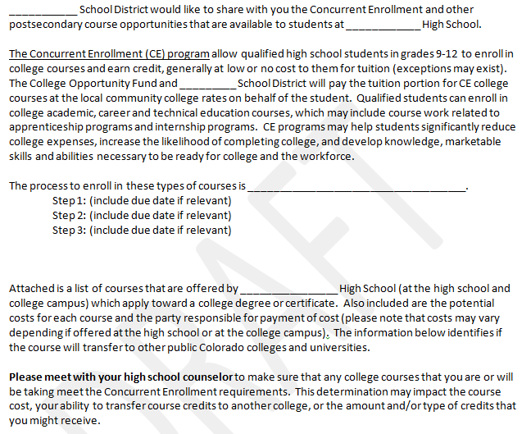
HB18-1005 Notice of postsecondary course enrollment options available to high school students

Slide 4
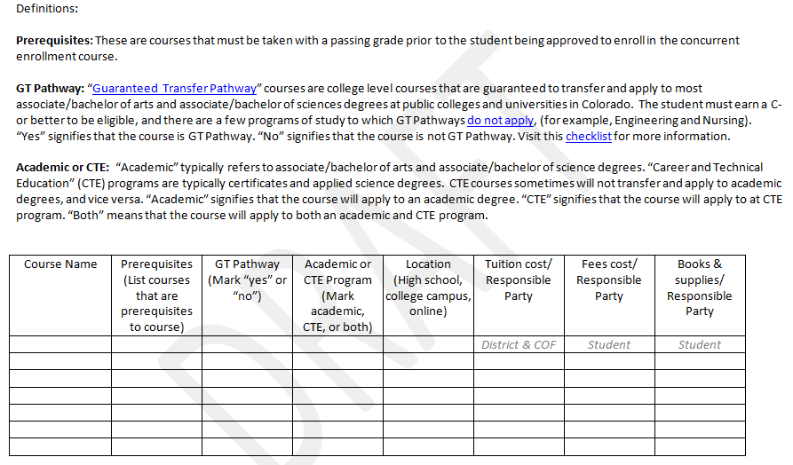
HB18-1005 Notice of postsecondary course enrollment options available to high school students

Slide 5
CDE ASCENT webpage – updated documents
ASCENT Program Guidelines (revised May, 2018)
➢ A student is eligible for ASCENT if the student:
⬥ Has completed, or is on schedule to complete, at least 12 credit hours (semester hours or equivalent) of transcripted, credit-bearing, college-level postsecondary coursework* prior to completing his/her 12th grade year. Remedial/developmental education college courses do not qualify as part of the 12 required credits.
ASCENT Specific FAQs (updated June, 2018)
expanded Attendance & Graduation Count sections
Sample Student Application – ASCENT (Updated June 2018)
Please be aware that grades from any college courses you take through Concurrent Enrollment/ASCENT will be posted to both your high school and college transcript. Courses that you withdraw from, fail to complete or receive a non-passing grade in may affect your ability to be accepted to or receive financial aid from that college in the future.

Slide 6
Students that meet graduation requirements – future funding
1 CCR 301-39-1.07 defines pupil: "Pupil" means a person under age 21 as of the pupil enrollment count date or the alternative count date who has not met the graduation requirements of his/her district as of the pupil enrollment count date or the alternative count date.
Most students are no longer eligible for funding once they meet the graduation requirements. There are exceptions:
If students meet their requirements before they finish their 4th year of high school, they can continue to attend and receive funding through the end of their 4th year of high school. For example, if a student is advanced and met district grad requirements in 3 years, the district could enroll the student in 100% concurrent enrollment under CE during that 4th year, since there are no CE restrictions related to credit hours in the first 4 years.
If a student is participating in ASCENT, the student could have meet their graduation requirements at the end for their 4th year, and then participate in ASCENT and receive funding in the 5th year per those rules.
PTECH generally has different graduation requirements than the district. As long as students have not met their program/school requirements, these students can continue to receive funding.
Students receiving services under an IEP may have met graduation requirements, but if the IEP is still in effect and states the student should still receive services up through age 21 and the student/guardian wants them to, then these students are eligible for funding under the IEP even if district graduation requirements have been met.

Slide 7
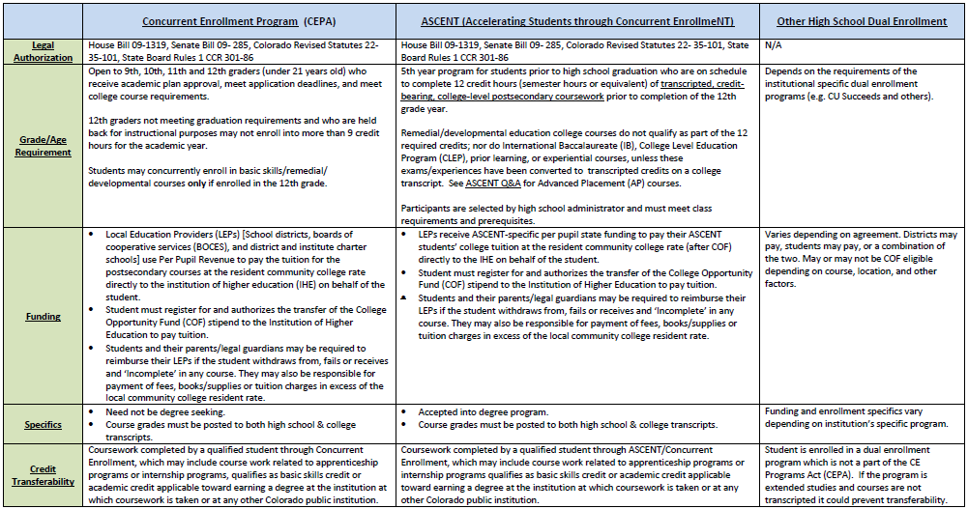
CE/ASCENT/Dual Enrollment Comparison Chart
Chart is linked on CEAB meeting webpage

