Slide 1
Student End of Year
Office Hours
July 2024

Slide 2
Agenda
Timeline Review
General Reminders
Exception Request Reminders
Adequate Documentation of Transfer
Expelled Students
SE301 Graduation Guidelines Errors
Questions
Notes:
School Exit Type 00 in 2023 & first record expectation in 2024
SE104, SE109, SE064, SE404, etc.
SE209 English Learner Errors

Slide 3
Timeline
Date | Event | Event Description | Notes
7/25/2024 | Interim Deadline | Submit any necessary reporting exceptions for review. | Especially critical for English Learner exceptions as these are a time-intensive review and may required additional documentation.
8/8/2024 | Interim Deadline | Error free SEY Snapshot | Critical date as the SEY collection is time intensive.
8/9/2024 to 9/5/2024 | Report Review | • Validate Student End of Year data using CEDAR/COGNOS reports. • Submit snapshot as soon as review is complete | Collaborate with schools to review student lists. Student List: Dropouts Student List: AYG Cohort Student List: District and School Mobility Review initial rates. Graduation: 3-,4-,5-,6-,7-year rates by School Year Graduation Rates: District and School by AYG Dropout: District and School Rates Mobility: District and School Rates
9/5/2024 | State Deadline | Submit SEY snapshot | Only users with the LEA Approver role for the SEY collection can submit the snapshot.
9/19/2024 to 10/17/2024 | Collection Phase | Cross LEA Phase | First of two clean-up phases focused on data validation (SE700 series rules). Final opportunity to correct most data fields, especially student demographic coding.
10/24/2024 to 11/19/2024 | Collection Phase | Post-Cross LEA Phase | Final clean-up phase focused on data validation (SE900 series rules). Cross references Student October 2024-2025. Extremely limited changes, mostly school exit type/date.
11/22/2024 to 12/3/2024 | Collection Phase | Final report review and sign-off forms due | Final review of graduation/completion, dropout, and mobility/stability rates. Collection lead works with LEAs impacted by CDE’s final review.
1/14/2025 | Data Release | SEY Public Data Release | All SEY data is embargoed until CDE’s press release on this date. Data respondents will receive notification when the embargo lifts.

Slide 4
General Reminders:
Website Resources
SEY Website
Student Interchange Website
Primary site for SEY data respondents
Critical Resources:
  SEY Collection Timeline
  SEY File Layout
  SEY Collection Manual
  SEY CEDAR/COGNOS guide
  Adequate Documentation
Exception Request templates and instructions
Information that applies to all student interchange collections
Critical Resources
  Student interchange file layouts
  Student Enrollment Record Guide
  English Learner Coding Guide
  Exception request template
2024-2025 Student Interchange Office Hours meeting links
  7/24/2024, 10:00-11:30am
  8/15/2024, 1:00-2:30pm

Slide 5
General Reminders:
Trainings
Recordings and Slide Decks posted on SEY Website
SEY Collection Overview
Postsecondary Program
SPED 18-21 Transition Services
Short Byte Videos covering various topics
Upcoming Office Hours: Registration Links
Prior SEY Office Hour Topics
  Collaborating with Program Staff
  FRL Business Rules
  BOCES Schools vs BOCES Programs (contract scenarios)
  Capturing Enrollment Status Changes
  Investigating Errors with the report SASID Lookup: SEY and OCT (prior, current, subsequent year)
  Monitoring Potential Summer Graduates/Completers
  Retention Codes
  Grade Reassignment
  School Level Errors
  Mid-Year EL Changes

Slide 6
General Reminders:
CEDAR/ COGNOS Reports
Review SEY CEDAR/COGNOS report guide for a full list of available reports and their uses
Critical reports during Regular Phase
  SASID Lookup: SEY and OCT (prior, current, subsequent year)
  SASID Lookup: Anticipated Year of Graduation
  SEY Error Details and Summary
  Student List: AYG Cohort
  Student List: Dropouts
  Student List: District and School Mobility

Slide 7
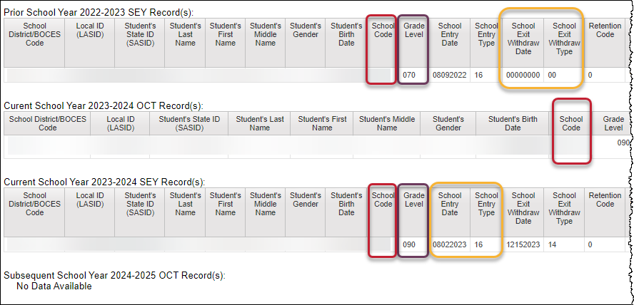
Investigating Errors
SASID Lookup: SEY and OCT record (prior, current, subsequent year)
Code | Issue
SE049/ SE057 | Missing SEY record for student with OCT rec in current year
SE102/ SE105/ SE109/ SE115 | Exit type prior year + entry type/school code current year
SE113/ SE117/ SE242/ SE243 | Grade level & retention code prior year + current year grade level
SE404/ SE292/ SE293 | Missing Record: Student included in prior year with exit type 00 (or retention 2 or 3) should have record in current year
SE060 | Missing OCT record when SEY shows enrollment on OCT 1st
SE050 | Current year exit type expects another record with matching entry type
… | SPED Transition Coding
… | Postsecondary Program Coding
… | OCT compared to SEY demographic
Best report to research cross collection errors related to prior SEY or OCT data.
During post-cross phase, use to research errors related to next year OCT.

Slide 8
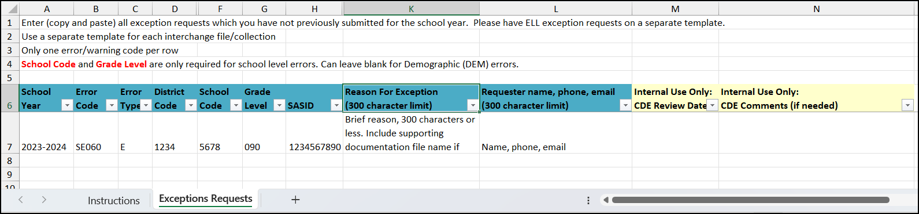
Exception Request Reminders
Process
Request Template
Complete exception request template
Upload to Syncplicity
  Folder: 1234 – DISTRICT NAME – Student
  Subfolder: SEY 2023-24
Email StudentEndOfYear@cde.state.co.us
SEY Collection Lead responds with next steps
Required for ALL reporting exceptions, even when additional documentation is also provided
Use a new template when a new request is made
  SEY Collection lead dates all processed requests or includes next step notes when a request is processed
Do not delete tabs or columns from this template

Slide 9
Adequate Documentation of Transfer
LEAs must maintain copy of this documentation for every student who transfers out of the district (K-12)
Required documentation varies based on school exit type
  All documentation should include the student’s SASID, full name, and date of birth
  Most common type of documentation: Confirmation of Enrollment and Attendance
Documentation should be readily available upon request
  Reviewed by SEY Collection lead on a case-by-case basis, typically when addressing SE903 errors in the Post-Cross LEA Phase
SEY Adequate Documentation Site
  Sample forms and templates
  List of documentation required for each school exit type

Slide 10
Adequate Documentation cont.
Exit Type(s) | Documentation
02 | Obituary, Notification from parent/guardian Written confirmation from school administrator
05 | Written records request Confirmation of enrollment and attendance Written confirmation from school administrator Parent/guardian written notification
13 | Confirmation of enrollment and attendance
14, 15, 18, 19, 21, 26, 70 | Written records request Confirmation of enrollment and attendance
16 | Written intent to homeschool notification signed by parent/guardian
30 | Doctor’s note

Slide 11
Expelled Students
The enrollment records for students who are expelled (per Local Board Policy) are impacted by the following components
  Term of expulsion
  Educational services received during the time of expulsion (no/yes/type)
School Exit/Entry types along with the corresponding School Exit/Entry dates reflect the term of expulsion and indicate if educational services are received or not
Additional data fields are utilized when a student is receiving educational services.
  Expelled Education (SSA file)
  Non-School Program (SSA file)
    01 – Single District Online Program
    02 – District-Run Program
    04 – Third Party Program

Slide 12
Expelled Coding Scenarios
Without services: term ends within current year
School Code | School Entry Date | School Entry Type | School Exit Date | School Exit Type
5678 | 08152023 | 02 | 09252023 | 55
5678* | 05012024 | 55 | 00000000 | 00
Without services: term ends next year
School Year | School Code | School Entry Date | School Entry Type | School Exit Date | School Exit Type
Current | 5678 | 08152023 | 02 | 04012024 | 50
Subsequent | 5678* | 01092025 | 50 | 00000000 | 00
With Services: term ends within current year
District Code | School Code | School Entry Date | School Entry Type | School Exit Date | School Exit Type | Expelled Student | Non-School Program
1234 | 5678 | 08152023 | 02 | 09252023 | 56 | 0 | 00
1234 | 5678* | 09262023 | 56 | 04012024 | 11 | 1 | 01, 02, 04
1234 | 5678 | 04022024 | 11 | 00000000 | 00 | 0 | 00
With Services: term ends within next year
School Year | District Code | School Code | School Entry Date | School Entry Type | School Exit Date | School Exit Type | Expelled Student | Non-School Program
Current | 1234 | 5678 | 08152023 | 02 | 09252023 | 56 | 0 | 00
Current | 1234 | 5678* | 09262023 | 56 | 00000000 | 00 | 1 | 01, 02, 04
Subsequent | 1234 | 5678* | 08102024 | 02 | 09252024 | 11 | 1 | 01, 02, 04
Subsequent | 1234 | 5678 | 09262024 | 11 | 00000000 | 00 | 0 | 00

Slide 13
SE301 Graduation Guidelines Errors
Check
Add
Change
CEDAR Report: Graduation Guidelines Student Lookup
  Do the reported measures meet the benchmark score?
  Does the student have an English and a Math measure?
  Is the ‘completion year’ blank?
Add the missing GG information to your 2023-2024 GG file
  Measures that count for both English and Math (e.g., ACT WorkKeys, ASVAB) must be reported for both GUIDELINE_TYPE = 1 (Math), GUIDELINE_TYPE = 0 (English)
  Check with the student’s high school – they may have forgotten to input a completed GG measure into your Student Information System
Change the student’s exit type and/or retention code as applicable to your district’s policy and plan for supporting this student
  Retained to continue education (exit type 00, retention code 1)
  Student receiving non-diploma certificate of completion (school exit type 92)
  Change to other applicable School Exit Type
Notes:
Submit exception request:
EXCEEDINGLY RARE – Legislation surrounding graduation guidelines makes it abundantly clear that students with AYG 2021 and beyond must meet GG to be defined as a graduate
Contact SEY Collection Lead if you believe this might apply to your LEA

Slide 14
Q & A

