Slide 1
READ Literacy Programs and Assessment Data Collection
Tara Rhodes READActData@cde.state.co.us April 8, 2025

Slide 2
Topics in Today’s Webinar
Part 1: Background Information and Updates for 25-26
Data Privacy & Security
Purpose of the READ Literacy Programs and Assessment Collection
Timeline
2025-26 File Layout and Definitions
Website Updates
Q&A
Part 2: Step-by-Step Process in Pipeline
Pipeline Walkthrough
Cognos Reports
Resolving Errors
Common Problems
Q&A

Slide 3
Data Privacy and Security

Slide 4
PII Definitions and Requirements
Student Personally Identifiable Information (PII) is defined by state and federal laws as information that, alone or in combination, personally identifies an individual
This includes direct identifiers (i.e. name, SASID, etc.)
Includes information that when combined is identifiable
Colorado’s Student Data Transparency and Security Act introduces several new requirements for how Student PII is collected, used and shared
CDE has prepared guidance on how to comply with this and other privacy laws which can be found here: http://www.cde.state.co.us/dataprivacyandsecurity

Slide 5
Data Sharing Processes
Check local policies for restrictions, requirements, etc.
Ensure that you are following local policies when transmitting PII to any third party
Use secure methods to transfer any PII to CDE
Contact Data Collection lead with questions about how to transmit PII securely
Use Syncplicity to encrypt emails to CDE
Avoid sending PII via unencrypted emails or to unsecured faxes when sharing data between or within districts
Do not use PII in trainings, presentations, etc.
Do not share PII with unauthorized individuals
Do not share passwords

Slide 6
Purpose of the READ Literacy Programs and Assessment Data Collection

Slide 7
Background: The READ Act
The Colorado Reading to Ensure Academic Development Act (READ Act) focuses on early literacy development for all students and especially for students at risk to not read at grade level by the end of third grade. Students are assessed for reading skills, and those who are identified as reading significantly below grade level are given individual READ plans.
In order to support students with significant reading deficiencies (SRDs), the READ Act provides per-pupil intervention funds to assist districts with providing intervention support.

Slide 8
READ Act Reporting Requirements for Districts: Literacy Programs and Assessment
22-7-1208. Local education providers – procedures – plans – training. (8)(a) Each local education provider shall submit to the department, and update as necessary to remain current, the following information, and the department shall post the information on the department’s website, as provided in section 22-7-1209(9):
(I)The core and supplemental reading curriculum, as described in subsection (5)(a)(I) of this section, or a detailed description of the reading curriculum, by grade, used at each of the schools operated by the local education provider;
(II)The targeted, evidence-based or scientifically based core and supplemental reading instructional programs and intervention reading instruction, services, and other supports, as described in subsection (5)(a)(II) of this section[.]
https://www.cde.state.co.us/coloradoliteracy/literacycurriculumtransparency

Slide 9
Data Components of the READ Act
Data Components of the READ Act
Components Collected through Data Pipeline
Spring READ Assessment
(Spring)
READ Literacy Programs and Assessment
(Spring)
Components Collected through GAINS
READ Budgets
(Spring)
READ Training
(Fall)

Slide 10
READ Literacy Programs and Assessment Collection Timeline

Slide 11
READ Literacy Programs and Assessment Data Collection Phase
There is only one phase:
Data Collection Phase: 4/15/25 – 6/13/2025
Sign-off forms are due by the end of the data collection phase.
Date | Event | Event Description
4/8/2025 | Training Event | This training event will cover changes for the 25-26 READ Literacy Programs and Assessment data collection. This is a live event from 1-2pm and will be recorded.
4/15/2025 | Open | The 25-26 READ Literacy Programs and Assessment data collection opens in Data Pipeline.
5/15/2025 | Other Date | This is the target upload date for the collection. Please complete an upload by this date.
6/6/2025 | Other Date | This is the target date for an error-free submission for the collection. Please resolve errors by this date.
6/6/2025 | Report Review | Assuming the district has uploaded a file and is error-free, this report review window allows districts to review Cognos reports about their data, verifying accuracy.
6/13/2025 | Deadline | The 25-26 READ Literacy Programs and Assessment data collection closes in Data Pipeline.

Slide 12
25-26 File Layout and Defintions

Slide 13
Changes for the 25-26 READ Literacy Programs and Assessment File Layout
No structural changes to the file layout (i.e., no new columns and no columns were removed.
Tried to clean up language and standardize field names.
Made the file layout accessible.
Added a few codes from last year’s collection.
Added a business rule that checks to see if your district’s Spring READ Assessment data collection has been done.
This is a separate upload process from the Spring READ Assessment data collection. Both need to be completed in order to receive district funding.

Slide 14
READ Literacy Programs and Assessment Data Collection Elements
Name of Field | Field Length | Text Start Position | Text End Position | CSV Order | Excel Column | Example(s) | Remarks
School District/BOCES Code* | 4 | 1 | 4 | 1 | A | 1111
School Code* | 4 | 5 | 8 | 2 | B | 2222
Grade Level* | 3 | 9 | 11 | 3 | C | 010 | Only grades K-3 should be reported
READ Interim Assessment 1* | 2 | 12 | 13 | 4 | D | 03
READ Interim Assessment 2 | 2 | 14 | 15 | 5 | E | 07 | Leave blank if not applicable
READ Diagnostic Assessment 1* | 2 | 16 | 17 | 6 | F | 01
READ Diagnostic Assessment 2 | 2 | 18 | 19 | 7 | G | 02 | Leave blank if not applicable
Core Programming 1* | 3 | 20 | 22 | 8 | H | 01
Core Programming 2 | 3 | 23 | 25 | 9 | I | 02 | Leave blank if not applicable
Supplemental Programming 1* | 3 | 26 | 28 | 10 | J | 04
Supplemental Programming 2 | 3 | 29 | 31 | 11 | K | 01 | Leave blank if not applicable
Supplemental Programming 3 | 3 | 32 | 34 | 12 | L | 02 | Leave blank if not applicable
Intervention Programming 1* | 3 | 35 | 37 | 13 | M | 03
Intervention Programming 2 | 3 | 38 | 40 | 14 | N | 01 | Leave blank if not applicable
Intervention Programming 3 | 3 | 41 | 43 | 15 | O | 02 | Leave blank if not applicable
Intervention Supports and Services | 500 | 44 | 543 | 16 | P |  | Leave blank if not applicable
Literacy Curriculum Transparency Narrative | 500 | 544 | 1,043 | 17 | Q |  | Leave blank if not applicable – only required for 00 codes

Slide 15
Additional Information on Data Elements
Points of Clarification:
The first column for each set of programming (core, supplemental, intervention) is required. Business rules were adjusted this year to ensure this, but please note that it is only the first column for each programming set that is required.
Additionally, do not zero-fill your file. This will cause an error that forces a narrative.
Instructions for when to ask CDE to add a code:
If your school/district is using published curriculum that is not part of the list for that particular type of programming (core, supplemental, intervention), then please reach out to CDE via READActData@cde.state.co.us to get a code added. It does take about a week or so to do this and for it to show up in production.
Please also remember that this collection looks ahead to the 25-26 school year. It is anticipated that districts and schools are reporting the programming that they intend on using in the 25-26 school year.

Slide 16
Website Review and Updates

Slide 17
Website Updates
If you’re the data respondent for more than just the READ collections, you’ll notice that all of the READ data collection websites have been updated to follow the standard Data Pipeline website layout.
On the website, you can find:
The file layout
The collection manual (coming soon)
The business rules (coming soon)
Recordings of trainings and other resources
Here’s the link to the READ Literacy Programs and Assessment Data Collection webpage.

Slide 18
Questions on Background?

Slide 19
Step-by-Step Guide in Data Pipeline

Slide 20
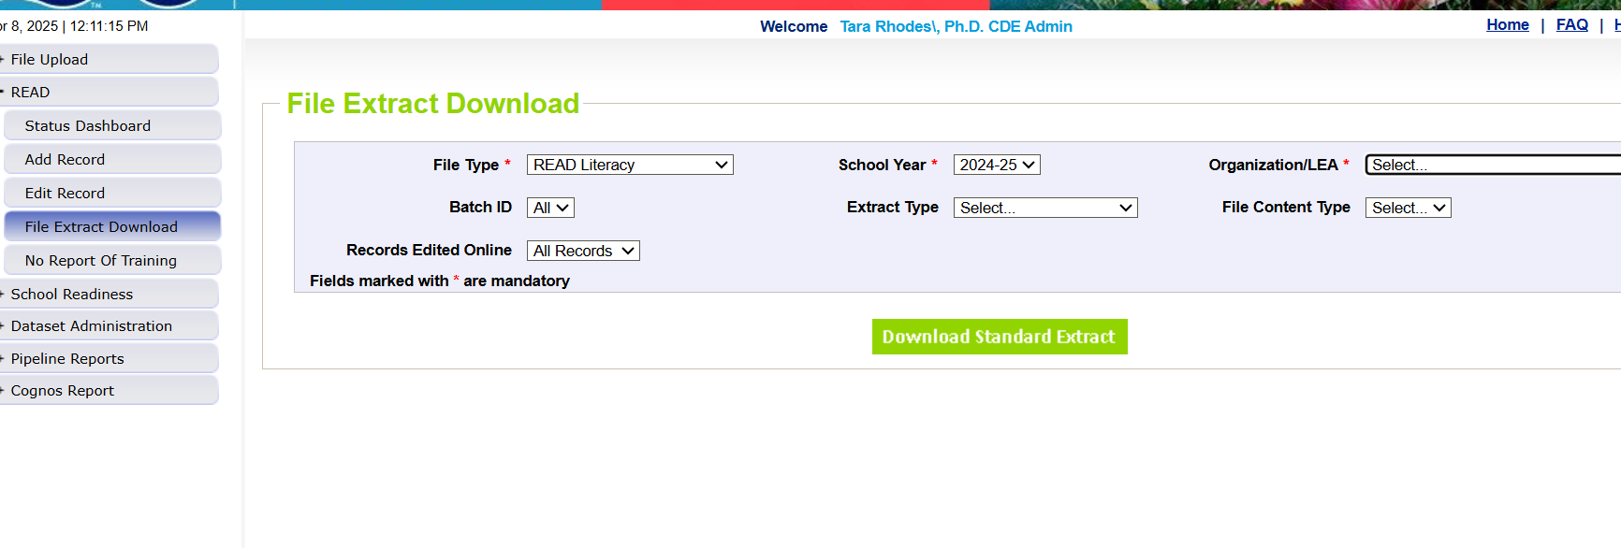
Steps 1 and 2: Pull 24-25 Information and Adjust Coding
This collection begins with pulling the extract of your district’s 24-25 information.
After pulling this, you can then update and adjust the codes as needed to reflect programming choices for the 25-26 school year.

Slide 21
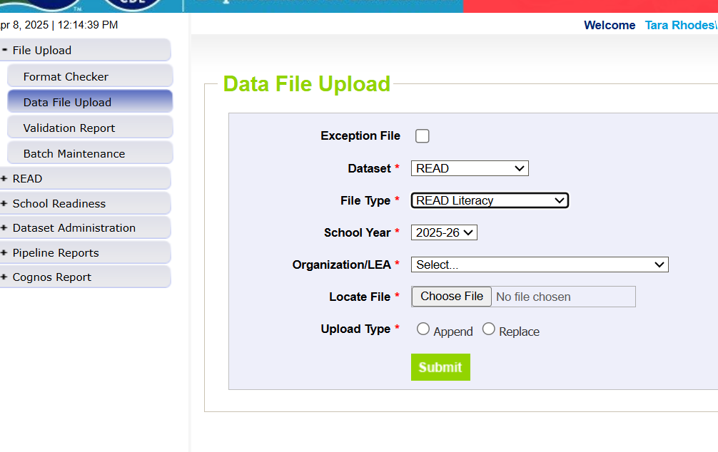
Step 3: Upload Data
Please ensure that you have adjusted any codes to indicate programming choices for the 25-26 school year.

Slide 22
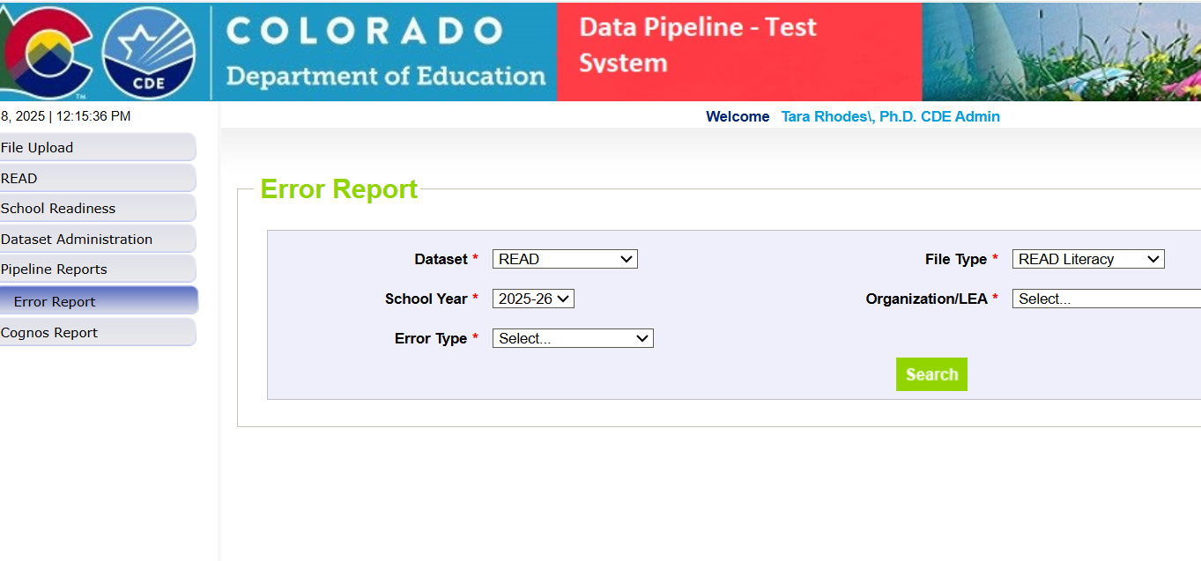
Step 4: Check Pipeline Error Report
After uploading, Pipeline will send an automated email that will tell you how many errors exist in your file.
After receiving this email, you can check your error report in Pipeline through using the options shown in the screenshot.

Slide 23
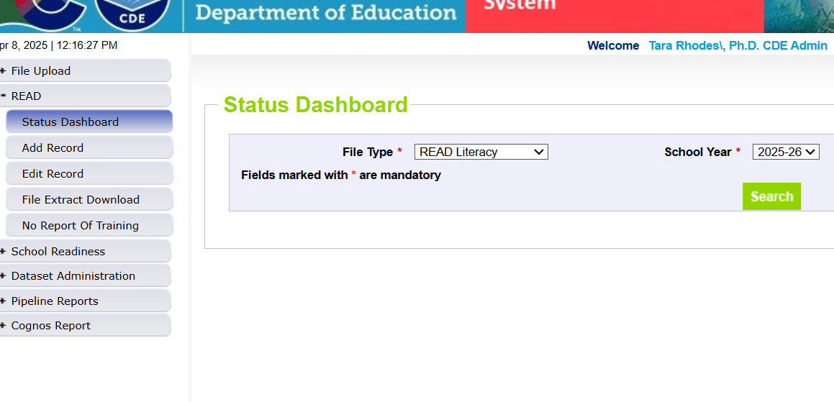
Step 5: Correct Errors and Reupload
Please continue this process of uploading and checking your error report until you reach zero errors. To confirm that you have zero errors, please use the Status Dashboard, as shown to the right.

Slide 24
Resolving Errors
Why do we get errors? Errors are edits that are in place to assist with providing most accurate information to CDE which is published, analyzed and reviewed by legislators, stakeholders, researchers, etc
Errors must be corrected in the file before finalizing the data
Error message should provide adequate information to assist you with determining the corrections needed
Each error message will list the data field(s) that is an issue
Find the data field(s) in the data file upload and make appropriate adjustment
Upload fixed data file again into data pipeline and run error reports

Slide 25
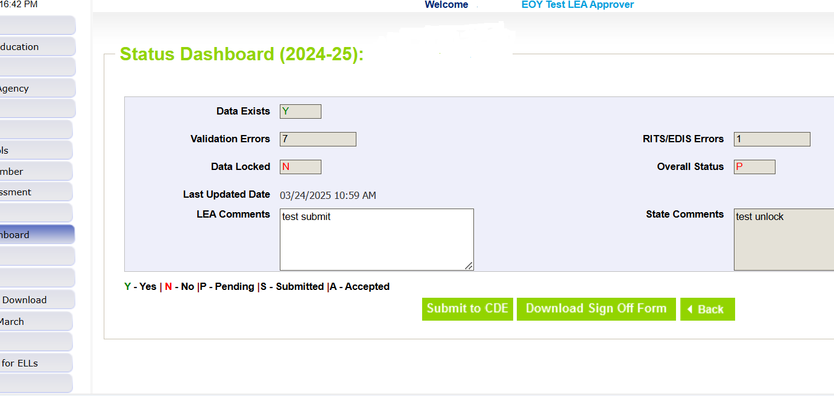
Step 6: Lock Your Submission
After you have reached zero errors and have reviewed your data for accuracy, please lock your submission in Data Pipeline. This will ensure that no further changes are made to your file.

Slide 26
Step 7: Download and Submit Sign-Off Form
After you have confirmed your data, please submit your sign-off form to the READ Act Data email at READActData@cde.state.co.us by 6/13/2025.

Slide 27
Questions on Data Pipeline?

Slide 28
READ Collection Resources
READ Collection resources can be found at:
https://www.cde.state.co.us/coloradoliteracy/readdatapipeline
Webinar recordings
Timeline
Additional resources such as assessment cut scores and guidance documents (specific to the Spring READ Assessment data collection)
Questions?
Contact Tara Rhodes, READ Data Collection Lead
Email: READActData@cde.state.co.us
Cell: 720-601-4125

