Slide 1
November 14, 2024
Data Pipeline Town Hall
The goal of the webinar is to provide updates on the Data Pipeline, current, and upcoming data collections. These webinars also provide a forum for districts, BOCES, and Administrative Units to have questions answered about Data Pipeline.

Slide 2
Colorado Department of Education
Identity Management (IdM)
Identity Management Site
Frequently Asked Questions
How do I add myself or others to the email listserv for town hall emails and/or a specific collection?
  Email lists are dependent on a person’s access rights in IdM. Contact your LAM to get an account or be assigned to a specific collection.
Where can I find the IdM role mappings for Data Pipeline and other applications?
  Role Mapping (XLS)
I am a LAM. How do I update the user permissions for someone in my district?
  Follow the steps outlined in the IdM Quick Guide for Access Management (DOCX)
Important: Users are not automatically removed from IdM when their email address is no longer active in your district. The LAM must deactivate their IdM account to ensure only designated staff can access CDE’s data reporting system.
Notes:
LAMs, please check the IdM roles for your district. Remove permissions for users who have retired, left your district, or are no longer assigned to a collection. Add roles for new hires and newly assigned respondents for specific collections.

Slide 3

What is PII?
Student and Staff Personally Identifiable Information (PII) is defined by state and federal laws as information that, alone or in combination, personally identifies an individual
  This includes direct identifiers
  (i.e. student and staff names, SASID, EDID, etc.)
  Includes information that when combined is identifiable
Colorado’s Student Data Transparency and Security Act outlines requirements for how Student PII is collected, used and shared
See the Data Privacy and Security website for prepared guidance on how to comply with this and other privacy laws.

Slide 4

Sharing Data
Use secure methods to transfer any PII to CDE
  Contact Data Collection leads with questions about how to transmit PII securely
    Each Data Collection leads maintains their own Syncplicity folders for specific collections, reach out to the collection lead for access
  Use Syncplicity to encrypt emails to CDE
Avoid sending PII via unencrypted email or to unsecured faxes when sharing data between or within districts
  Use Syncplicity to encrypt emails to CDE
Check local policies for restrictions, requirements, etc. regarding PII
  Do not use PII in trainings, presentations, etc.
  Do not share PII with unauthorized individuals
  Do not share passwords
  Follow local policies when transmitting PII to any third party

Slide 5
Today’s Agenda
Agenda Topic | Presenter
Open Data Collections and Upcoming Deadlines in Data Pipeline
Kindergarten School Readiness | Peter Hoffman (Tara Rhodes)
Human Resources | Dawna Gudka
Special Education December Count | Lindsey Heitman
School Auditing Updates | Rebecca McRee
Student October | Annette Severson (Brooke Wenzel)
Student End of Year | Reagan Ward

Slide 6
Open Collections and
Upcoming Deadlines in
Data Pipeline

Slide 7
Open Collections and Upcoming Dates:
Year-Round & Interchanges
Name | Category | Status | Key Dates
RITS | Year Round | Open | N/A
EDIS | Year Round | Open | N/A
Directory | Year Round | Open | N/A
Student | Interchange | Open | 2023-2024 and 2024-2025 are open
At-Risk | Interchange | Open | 2024-2025 open
Title I | Interchange | Open | 2024-2025 open
Special Education IEP | Interchange | Open | 2024-2025 open
Staff | Interchange | Open | 2024-2025 open
Data Pipeline Resources: Data Pipeline Collection Dates (XLS)

Slide 8
Open Collections and Upcoming Dates:
Snapshots
Name | Category | Status | Final Deadline Date | Next Milestone | Looking Ahead
Student October | Snapshot | Closed Until November 18th | Nov. 27, 2024 | Other Date: 11/18/2024 School Auditing Office makes decisions on funding duplicates | Deadline: 11/27/2024 Resubmit Student October Snapshot data to CDE based on decisions from School Auditing
Student End of Year | Snapshot | Open | Nov. 19, 2024 | Deadline: 11/19/2024 Post-Cross Phase Ends, Snapshots must be error free | Deadline: 12/3/2024 Superintendent Verification Due
Special Education December Count | Snapshot | Soft Open | Feb. 21, 2025 | Interim Deadline: 11/13/2024 Interchange Files Uploaded | Interim Deadline: 12/18/2024 Interchange files error free
Human Resources | Snapshot | Open | Feb. 21, 2025 | Interchange files should be uploaded into Data Pipeline at least once | Interim Deadline: Count Day 12/1/24
Data Pipeline Resources: Data Pipeline Collection Dates (XLS)

Slide 9
Open Collections and Upcoming Dates:
Periodic
Name | Category | Status | Final Deadline Date | Next Milestone | Looking Ahead
Non-Public Schools Fall Enrollment Count | Periodic | Open | Dec. 2, 2024 | N/A | N/A
Kindergarten School Readiness | Periodic | Open | Dec. 11, 2024 | Collection Opens: 10/23/2024 | N/A
Data Pipeline Resources: Data Pipeline Collection Dates (XLS)

Slide 10
Kindergarten School Readiness
Tara Rhodes

Slide 11
Kindergarten School Readiness (KSR)
Important Dates and Changes for 24-25 Collection
Important Dates:
11/19/2024: Please complete an upload by this date. Doing this communicates back to me that you are receiving my emails and are aware of the 12/11 deadline.
12/11/2024: KSR Data Collection Due Date (~4 weeks to go!)
  Please note that this information is part of the CAP4K Legislative Report that is due in February to the legislature. Consequently, I will need all submissions in by the deadline so that analysis can be completed in January, along with executive leadership review prior to publication.
Changes for the 24-25 Collection:
One additional column was added to the file layout to denote the assessment used. This replaced the front-end screen in Data Pipeline.
This change was made to accommodate the State Board's approval of single-domain assessment tools.
A short tutorial (~6min) of how to add and populate this column has been posted here.
Kindergarten School Readiness (KSR)
KSRData@cde.state.co.us

Slide 12
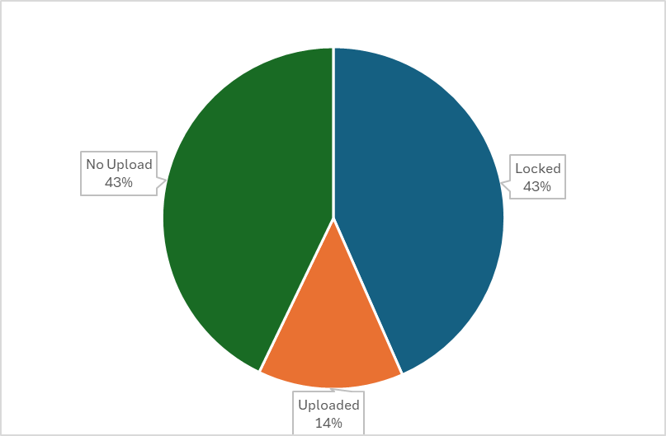
Kindergarten School Readiness (KSR)
Collection Status
Thanks to all of you that have completed this collection before the deadline!
Please make sure that you are also submitting your sign-off forms to KSRData@cde.state.co.us.
Kindergarten School Readiness (KSR)
KSRData@cde.state.co.us

Slide 13
Reminders and Current To-Do's
Kindergarten School Readiness (KSR)
Current To-Do's:
Watch recordings of trainings posted here
Watch the tutorial of how to add the additional column, if needed
Talk with your School Readiness contact
  Learn which assessment tool is being used
  Learn whether manual aggregation of data will be required
  Learn the status of the assessment
  Begin uploads and resolving errors
Please reach out with any questions!
Kindergarten School Readiness (KSR)
KSRData@cde.state.co.us

Slide 14
Questions & Resources
Kindergarten School Readiness (KSR)
Contact: Tara Rhodes
Email: KSRData@cde.state.co.us
Phone: 720.601.4125
Kindergarten School Readiness Website

Slide 15
Human Resources Snapshot
Dawna Gudka

Slide 16
Human Resources Timeline
Date | Event | Event Description
10/31/24 | Interim Deadline | Upload at least one Staff Profile file
11/1/24 | Open | Human Resources Snapshot Opens
11/7/24 | Interim Deadline | Upload at least one Staff Assignment file
12/1/24 | Count Day | Official Annual Staff Count Day
12/18/24 | Interim Deadline | Interchange files error free
1/10/25 | Interim Deadline | Create at least one Human Resources Snapshot
1/24/25 | Interim Deadline | Human Resources Snapshot Error Free
1/24-1/31/25 | Report Review | Review Special Education Staff Report via Cognos in the Human Resources folder) for accuracy to ensure all special education staff reported within your district is appropriate. Collaborate with your LEA’s Administrative Unite during this process. Verify that all staff are accurately reported
2/14/25 | Interim Deadline | Staff Profile and Staff Assignment interchange files, and Human Resources Snapshot Error Free
2/21/25 | Deadline | Human Resources Snapshot must be submitted to CDE and verification emailed to Human Resources Snapshot
Human Resources Snapshot HumanResourcesData@cde.state.co.us

Slide 17
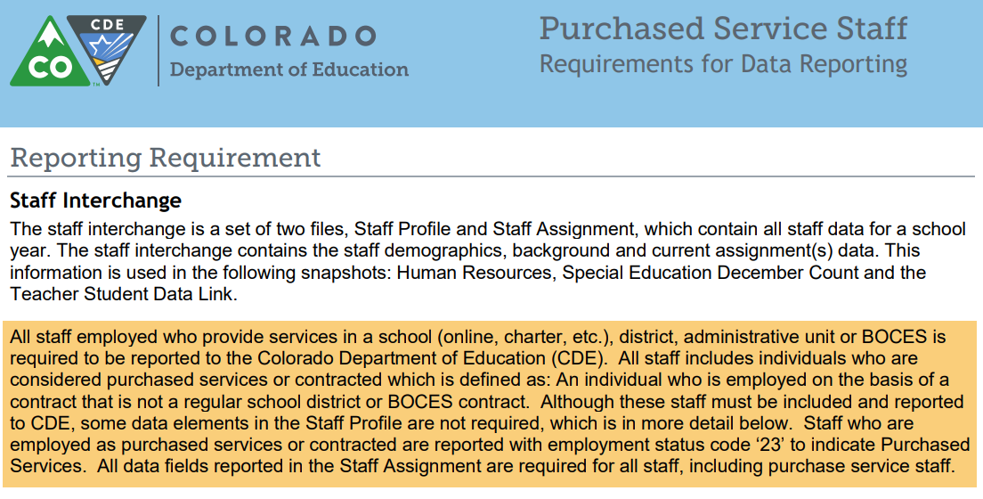
Purchase Service Staff
Purchased Service staff resource document
Employment status 23 Purchased Services
Staff Profile required fields
AU Code, District Code
Demographics (SSN, EDID, Name, Gender, DOB, Ethnicity)
Background Information: Start Date, Years Teaching Experience
Years Education Experience, Years principal if staff is a principal
Staff Assignment required fields
All data fields for the assignment are required
Human Resources Snapshot Collection
HumanResourcesData@cde.state.co.us

Slide 18
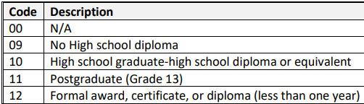


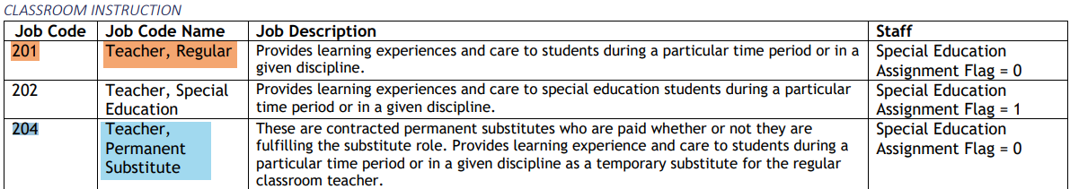
Staff Assignments-How to code Teacher that does not have a bachelor’s degree
Use the job code that best matches the job responsibilities of the staff member. Do not code the staff member according to their license or endorsements.
Coding
Staff Profile
Highest level of education 15 or lower
Subject area of degree: 2100 to indicate No Degree
Staff Assignment
Job Code 201 if in Teaching Position
Job Code 204 if in a Permanent Substitute Position
Human Resources Snapshot Collection
HumanResourcesData@cde.state.co.us

Slide 19
Educators Shortage Survey is open
2024-2025 Educators Shortage Survey
Colorado state statute and Federal law require CDE to report educator shortage data annually to provide support for shortage areas and for continuation of financial benefits. Each district must complete the annual Educator Shortage Survey prior to obtaining CDE approval on the 2024-2025 Human Resources Snapshot. The survey should only be completed once for each district by appropriate staff. The district’s Human Resource team may be in the best position to respond to the survey.
2024-2025 Educators Shortage Survey link
Educators Shortage screenshots
Educators Shortage FAQ
Human Resources Snapshot Collection
HumanResourcesData@cde.state.co.us

Slide 20
Human Resources Snapshot Collection
Staff Interchange website
Human Resources Snapshot website
Questions contact: Dawna Gudka-collection lead
Email HumanResourcesData@cde.state.co.us
(303) 598-7901
Reminder to include your 4-digit LEA code in all CDE emails

Slide 21
Special Education
December Count Snapshot
Lindsey Heitman

Slide 22
Special Education December Count
Training
Trainings posted and available to listen or review slides:
2024-2025 Special Education IEP Interchange Training posted here
2024-2025 Special Ed December Count Snapshot Annual Training posted here
Upcoming
Special Education December Count Office Hours
  Wednesday, November 20th from 10:30 – 11:30
  Topics to be determined
  Microsoft Teams Meeting Join the meeting now
Special Education December Count Office Hours
  Wednesday, December 4th from 1:00 – 2:00
  Staff Approval Matrix
  Microsoft Teams Meeting Join the meeting now
Special Education December Count – Lindsey Heitman
SpedDecCount@cde.state.co.us

Slide 23
Special Education December Count
First interim deadline was this week!
November Deadline
Wednesday, November 13th: all Interchange files uploaded at least once
  Special Education IEP Interchange (AU respondent)
  Child File
  Participation File
  Staff Interchange
  Staff Profile File– District and/or AU respondent
  Staff Assignment File– District and/or AU respondent
December Deadline
Wednesday, December 18th: all interchange files error free
  Includes Child, Participation, Staff Profile, Staff Assignment
Special Education December Count – Lindsey Heitman
SpedDecCount@cde.state.co.us

Slide 24
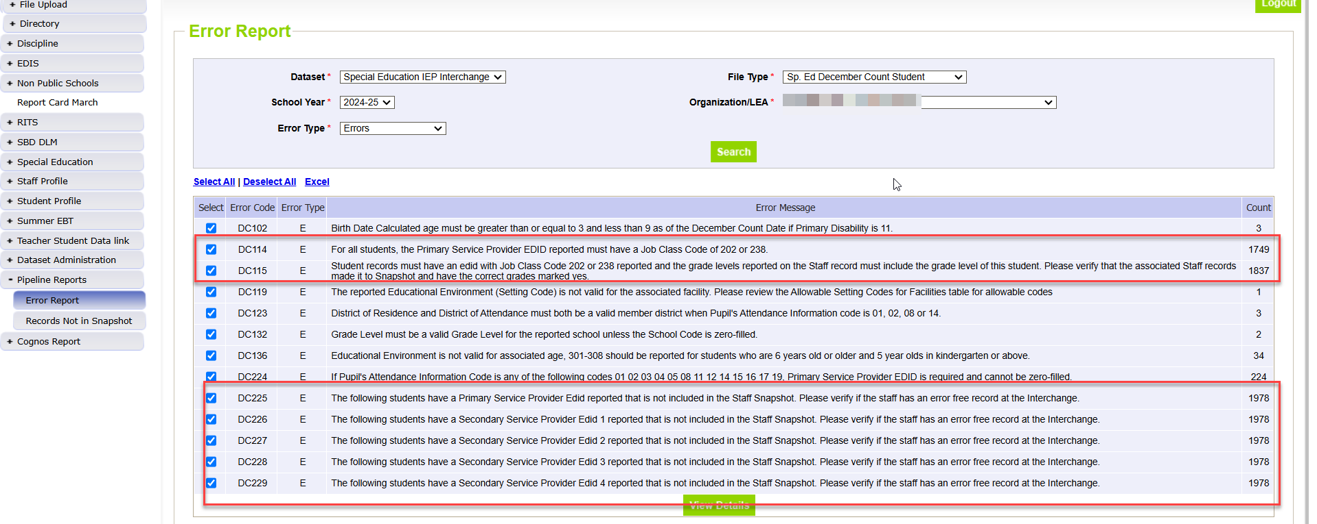
Special Education December Count
Pipeline Error Reports
To find DEC Snapshot Errors, the File Types are:
Sp. Ed December Count Staff
Sp. Ed December Count Student
Both are ‘DC’ error codes
For pulling both IEP Interchange and Dec Snapshot errors, Dataset is always Special Education IEP Interchange
Until your staff data is uploaded and error free in the Staff Interchange, you will trigger a lot of error #’s DC114, DC113, DC225, DC226, DC227, DC228!
Special Education December Count – Lindsey Heitman
SpedDecCount@cde.state.co.us

Slide 25
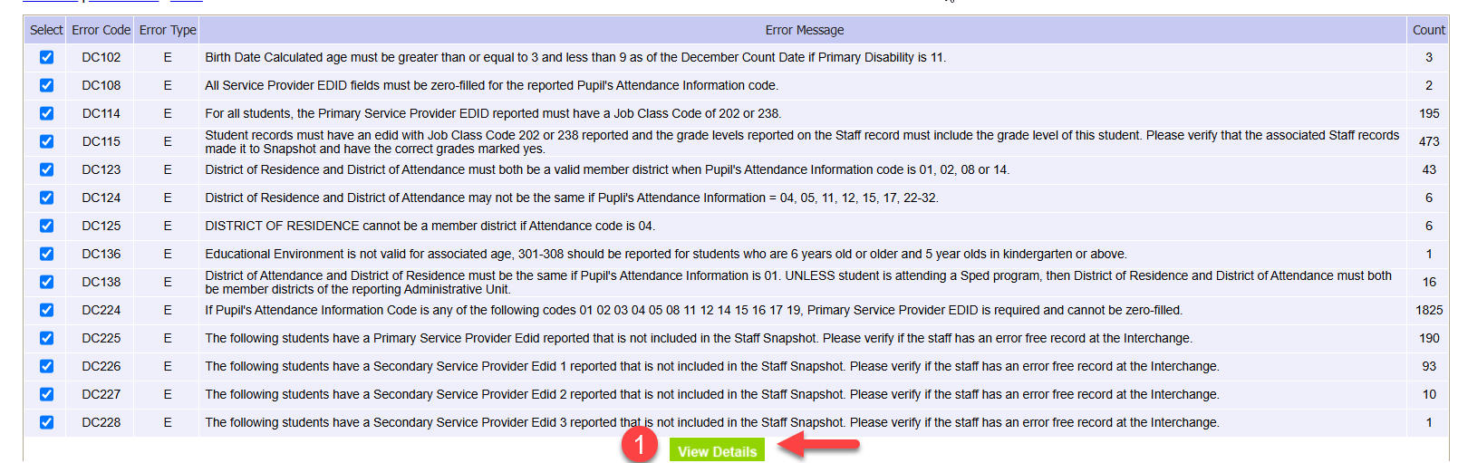
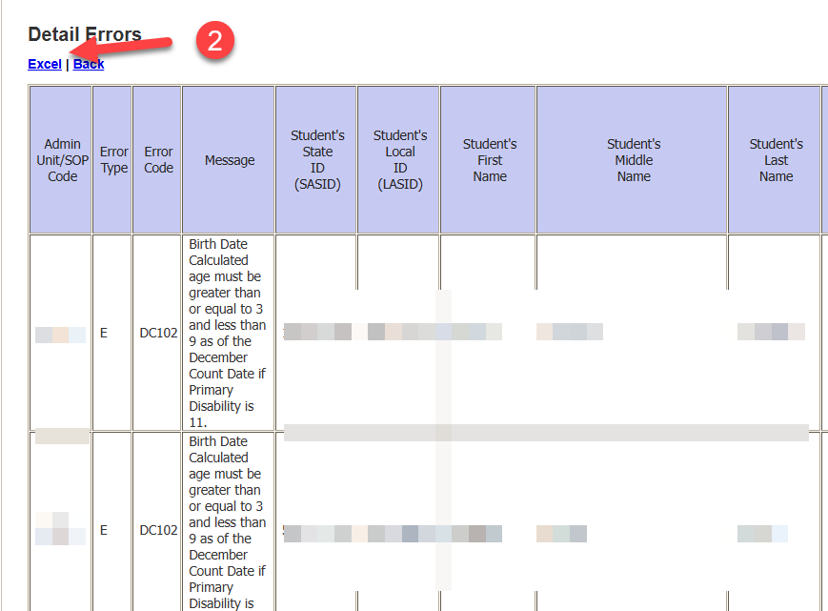
Special Education December Count
Pipeline Error Reports (cont.)
Click Excel
Click View Details
*Pipeline error report shows all summary results in the screen to left, but will only export the first 1000 errors to detail level in Excel
Special Education December Count- Lindsey Heitman
SpedDecCount@cde.state.co.us

Slide 26
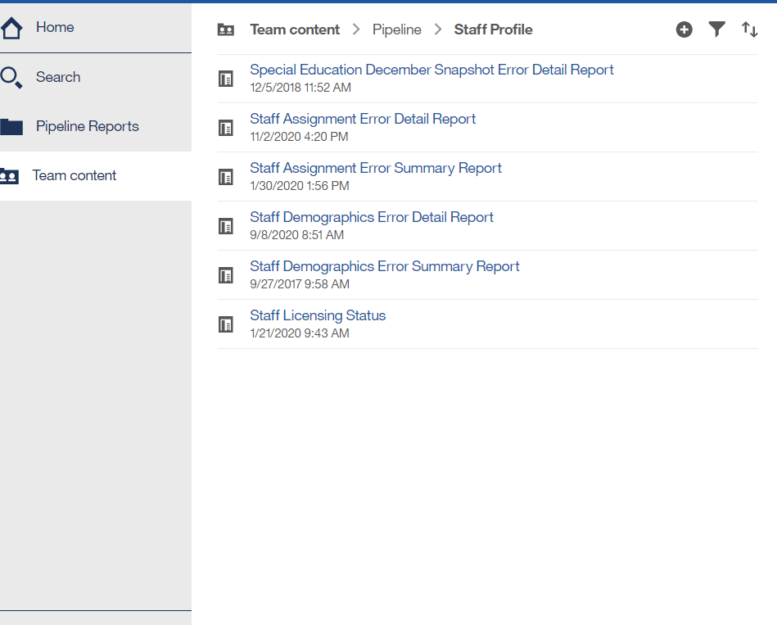
Special Education December Count – report available for Staff Interchange user to see Dec snapshot errors
Staff Interchange Users and Viewers are able to see their district’s December Count snapshot errors by downloading this report under:
  Cognos Reports→ Staff Profile- Special Education December Snapshot Error Detail Report
Those with the STF role have access to this error report
Special Education December Count – Lindsey Heitman
SpedDecCount@cde.state.co.us

Slide 27
Questions & Resources:
Special Education December Count
Lindsey Heitman
SpedDecCount@cde.state.co.us
(720) 456-2033
Special Education IEP Interchange Webpage
Special Education December Snapshot Webpage

Slide 28
School Auditing Office
Rebecca McRee

Slide 29
Duplicate Count
Deadline to upload documentation was Tuesday, November 12.
The School Auditing Office is in the process of reviewing documentation.
Decisions will be communicated out on Monday, November 18.
  Emails will be sent out when decisions are available.
  Districts will be instructed to download final duplicate count decisions from the "Duplicate Count" subfolder. These decisions are final.
  Districts wanting to change funding and FRL statuses not associated with duplicate count will need to request permission from Data Services (StudentOctober@cde.state.co.us) before making those changes.
School Auditing Office
Audit@cde.state.co.us

Slide 30
Annual Audit Review
Starting with the 2024-2025 fiscal year, the School Auditing Office will be shifting its audit approach.
All districts and BOCES (that operate their own schools and/or submit data during the Student October data collection) will participate in the Annual Audit Review.
No later than December 11, 2024, all districts and BOCES must:
  Complete all funded count audit questionnaires (pupil, at-risk, and ELL), and
  Upload initial audit documentation (as described in the corresponding questionnaires) to Syncplicity.
The School Auditing Office anticipates that the new audit approach will evolve over the next few years - questionnaires and initial audit documentation will also update each year as needed.
Training: Preparing for the New Annual Audit Review (PDF) (Recording)
School Auditing Office
Audit@cde.state.co.us

Slide 31
Annual Audit Review (continued)
Between December 2024 and March 2025 the School Auditing Office will be reviewing each district/BOCES (1) submitted Student October Count data, (2) responses provided on the audit questionnaires, and (3) the initial audit documentation provided as outlined on the questionnaires to determine which districts/BOCES/schools will be engaged for one of the following expanded audits:
Focused Audit Review
Comprehensive Audit Review
Next step communication regarding expanded audits is expected to be sent via email no later than April 1, 2025.
School Auditing Office
audit@cde.state.co.us

Slide 32
Questions & Resources:
Duplicate Count/ Annual Audit Review
audit@cde.state.co.us
Pupil Count website
2024 Student October Audit Resource Guide

Slide 33
Student October
Brooke Wenzel

Slide 34
Student October Timeline
Duplicate Phase
Date | Event | Event Description
11/12/2024 12:00 p.m. | Deadline | Duplicate funding documentation due to School Auditing Office
11/18/2024 | Other Date | School Auditing makes decisions on funding duplicates
11/27/2024 | Deadline | Resubmit Student October Snapshot data to CDE based on decisions from School Auditing
12/06/2024 | Deadline | Collection closes Sign-off form due. Data remains embargoed until the official release in January.
01/15/2025 | Data Release | Official data release
Student October – Brooke Wenzel
StudentOctober@cde.state.co.us

Slide 35
Goal of Duplicate Phase
Emails will be sent once the School Auditing Office wraps up their decisions.
Districts that are required to make updates (based on the School Auditing Office’s decisions) will be automatically unlocked.
  Those that need to make other updates, i.e. update FRL, must request to have their data unlocked and provide me with a summary of the updates that you will be making. – Some updates need approval!
  Please update your data (at the Interchange level) before requesting your data to be unlocked. It will quicken the process.
Those that make changes must make those updates at the Interchange level, take a new snapshot, validate your data, and resubmit to CDE immediately. (all by November 27th)
Student October – Brooke Wenzel
StudentOctober@cde.state.co.us

Slide 36
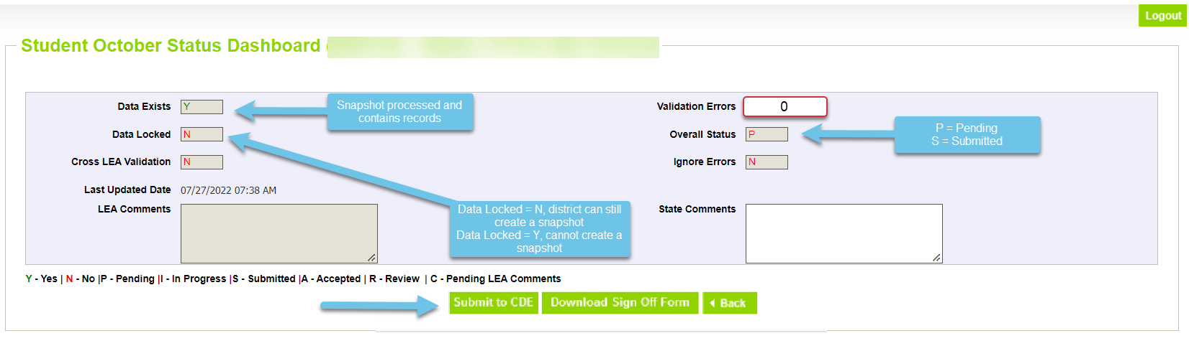
Ready to Submit (again)
Student Profile -> Status Dashboard and click ‘Submit to CDE’
Must have LEAAPPROVER role in IDM to complete this step
Once data is submitted it will be locked
Signoff Form Due December 6th Signed by Secretary of Board of Education and Chief Financial Officer
Student October – Brooke Wenzel
StudentOctober@cde.state.co.us

Slide 37
2024-2025 Student October Data Release
Final Student October data will be publicly released on Wednesday, January 15th, 2025
Data is embargoed until the public release date!
Pupil Membership Website
Student October – Brooke Wenzel
StudentOctober@cde.state.co.us

Slide 38
Questions & Resources:
Questions & Resources:
Student October
Brooke Wenzel
StudentOctober@cde.state.co.us
720-441-7963
Student October Webpage
Student Interchange Webpage

Slide 39
Student End of Year
Reagan Ward

Slide 40
SEY Collection Timeline:
Upcoming Events
Date | Event | Event Description
11/13/2024 | Interim Deadline | Error free SEY snapshot
11/13/2024 2:30-3:30pm | Training Event | November SEY Office Hours: Final Dates and Data Release 11/13 Registration Link
11/14/2024 to 11/19/2024 | Report Review | Validate SEY data using CEDAR/COGNOS reports Begin submitting Superintendent Verification (sign-off) forms
11/19/2024 (noon) | Deadline | Post-Cross phase ends. Districts must have error free SEY snapshot and have addressed any necessary post-cross changes.
12/3/2024 | Deadline | Collection closes. • Superintendent Verification (sign-off) form due. • Data remains embargoed until the official release in January
1/14/2024 | Data Release | Planned official data release. Data is embargoed until notified by SEY lead that data has been released and is posted on the Education Statistics Website.
Visit the SEY Website to download the complete SEY Collection Timeline with Training Dates
Student End of Year – Reagan Ward
StudentEndOfYear@cde.state.co.us

Slide 41
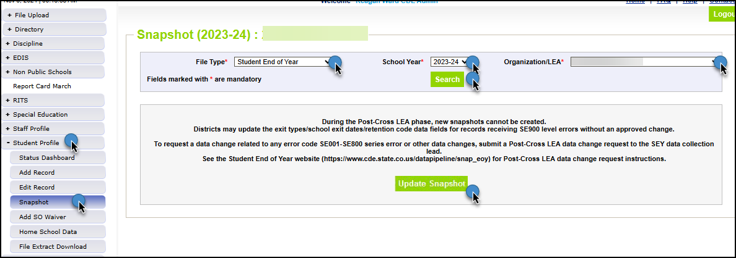
Reminders and Snapshot Status as of 8am on 11/14
Snapshots are NOT unlocked, only updated
  All LEAs must update snapshot at least once during this phase
Limited Data Changes
  School exit types for SASIDs with SE900 errors
  Approved post-cross LEA data changes
SSA updates completed manually through the edit record screen in pipeline
DEM updates: Talk to SEY collection lead first
GG & Adj files: continue to use the file upload screen in pipeline
Student End of Year – Reagan Ward
StudentEndOfYear@cde.state.co.us

Slide 42
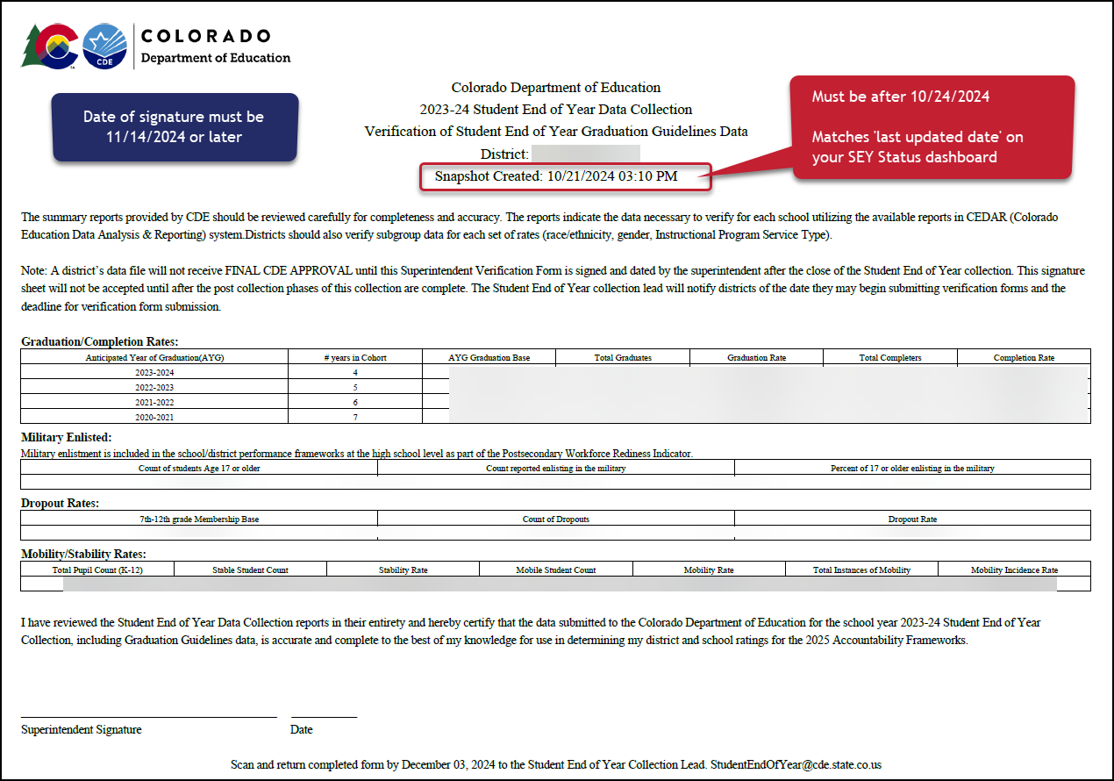
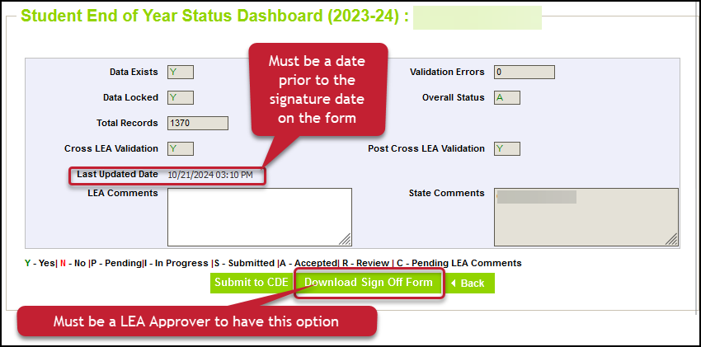
Superintendent Verification (Sign-Off)
Checklist before submitting form:
Snapshot Updated at least once (10/24/24 date or later)
Error Free
All additional changes addressed
Data Validated
Form contains rates for all categories
Signature date after the ‘last updated date’ on your status dashboard
Snapshot created date on top of form matches last updated date on status dashboard
Signature Date 11/14/2024 or later
Email completed forms to StudentEndOfYear@cde.state.co.us
Or upload to Syncplicity and notify StudentEndOfYear@cde.state.co.us
Student End of Year – Reagan Ward
StudentEndOfYear@cde.state.co.us

Slide 43
SEY Public Data Release
Scheduled Date – January 14, 2025
Education statistics based upon the 2023-2024 SEY data are embargoed until the public data release in January 2025
  District data available through COGNOS/CEDAR reports
Districts receive a preview of the state-wide data a few days prior to the public data release
  Sent to SEY Data Respondents from the SEY Collection Lead
  SEY Data Respondents should share with applicable administrative staff within their district (i.e. superintendent, accountability contact, etc.)
CDE sends out a press release and notifications through their communication department when this data is publicly released
  SEY Data Collection lead will send an email to data respondents when the embargo has lifted and data has been publicly released as well
Mobility/Stability Rates & Statistics
  Annual calculation
  Reflect students in grades K-12
Dropout Rates & Statistics
  Annual calculation
  Reflect students in grades 7-12
  Annual Instructional Program Service Type (IPST) status
Graduation/Completion Rates & Statistics
  Cohort based calculation
  Reflect students in given Anticipated Year of Graduation (AYG) cohort
  IPST cohort based upon qualifying IPST status at some point during
  9-12th grade
SEY Privacy Guidelines Site
  New guidelines implemented 2022-2023 that remain in place
  Mixed methods (blurring small populations, top and bottom masking, limited suppression) designed to protect student privacy while providing transparent information regarding rates
Student End of Year – Reagan Ward
StudentEndOfYear@cde.state.co.us

Slide 44
Questions & Resources:
Student End of Year
StudentEndOfYear@cde.state.co.us
720-484-9057
Student End of Year Website
Student Interchange Website
Graduation Guidelines Website

Slide 45
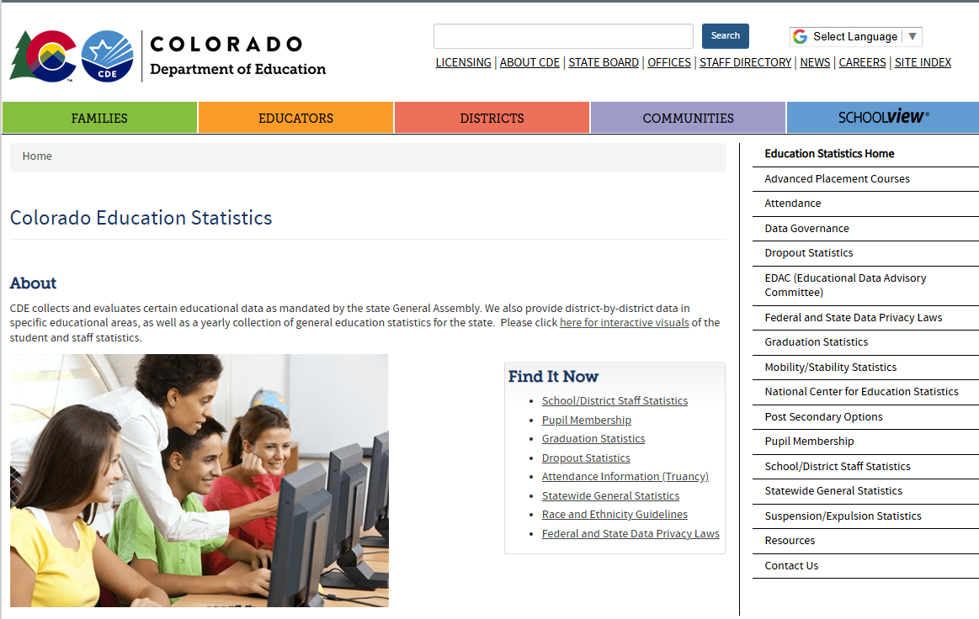
Thank you for joining today!
Next Town Hall will be November 21st
Reminder: Published Data can be found on our website and available on the School View Dashboard

