Slide 1
October 24, 2024
Data Pipeline Town Hall
The goal of the webinar is to provide updates on the Data Pipeline, current, and upcoming data collections. These webinars also provide a forum for districts, BOCES, and Administrative Units to have questions answered about Data Pipeline.

Slide 2
Colorado Department of Education
Identity Management (IdM)
Identity Management Site
Frequently Asked Questions
How do I add myself or others to the email listserv for town hall emails and/or a specific collection?
  Email lists are dependent on a person’s access rights in IdM. Contact your LAM to get an account or be assigned to a specific collection.
Where can I find the IdM role mappings for Data Pipeline and other applications?
  Role Mapping (XLS)
I am a LAM. How do I update the user permissions for someone in my district?
  Follow the steps outlined in the IdM Quick Guide for Access Management (DOCX)
Important: Users are not automatically removed from IdM when their email address is no longer active in your district. The LAM must deactivate their IdM account to ensure only designated staff can access CDE’s data reporting system.
Notes:
LAMs, please check the IdM roles for your district. Remove permissions for users who have retired, left your district, or are no longer assigned to a collection. Add roles for new hires and newly assigned respondents for specific collections.

Slide 3

What is PII?
Student and Staff Personally Identifiable Information (PII) is defined by state and federal laws as information that, alone or in combination, personally identifies an individual
  This includes direct identifiers
  (i.e. student and staff names, SASID, EDID, etc.)
  Includes information that when combined is identifiable
Colorado’s Student Data Transparency and Security Act outlines requirements for how Student PII is collected, used and shared
See the Data Privacy and Security website for prepared guidance on how to comply with this and other privacy laws.

Slide 4

Sharing Data
Use secure methods to transfer any PII to CDE
  Contact Data Collection leads with questions about how to transmit PII securely
    Each Data Collection leads maintains their own Syncplicity folders for specific collections, reach out to the collection lead for access
  Use Syncplicity to encrypt emails to CDE
Avoid sending PII via unencrypted email or to unsecured faxes when sharing data between or within districts
  Use Syncplicity to encrypt emails to CDE
Check local policies for restrictions, requirements, etc. regarding PII
  Do not use PII in trainings, presentations, etc.
  Do not share PII with unauthorized individuals
  Do not share passwords
  Follow local policies when transmitting PII to any third party

Slide 5
Today’s Agenda
Agenda Topic | Presenter
Open Data Collections and Upcoming Deadlines in Data Pipeline
Kindergarten School Readiness | Tara Rhodes
Special Education December Count | Lindsey Heitman
Student End of Year | Reagan Ward
Student October | Brooke Wenzel
At Risk Interchange | Rebecca McRee

Slide 6
Open Collections and
Upcoming Deadlines in
Data Pipeline

Slide 7
Open Collections and Upcoming Dates:
Year-Round & Interchanges
Name | Category | Status | Key Dates
RITS | Year Round | Open | n/a
EDIS | Year Round | Open | n/a
Directory | Year Round | Open | n/a
Student | Interchange | Open | 2023-2024 and 2024-2025 are open
At-Risk | Interchange | Open | n/a
Title I | Interchange | Open | 2024-2025 open
Special Education IEP | Interchange | Open | 2024-2025 open
Staff | Interchange | Open | 2023-2024 and 2024-2025 are open
Data Pipeline Resources: Data Pipeline Collection Dates (XLS)

Slide 8
Open Collections and Upcoming Dates:
Snapshots
Name | Category | Status | Final Deadline Date | Next Milestone | Looking Ahead
Student October | Snapshot | Open | Nov. 8, 2024 | Report Review: 11/1/2024 Review Cognos Reports for data validation. Submit Student October Snapshot data as soon as review is complete. | State Deadline: 11/8/2024 Submit Student October Snapshot
Student End of Year | Snapshot | Deadline Today | Nov. 19, 2024 | Post-Cross Phase Opens: 10/24/2024 | Interim Deadline: 11/13/2024 Error Free SEY Snapshot
Special Education December Count | Snapshot | Soft Open | Feb. 21, 2025 | Official Snapshot Open: 11/01/2024 | Interchange Files Uploaded: 11/13/2024
Human Resources | Snapshot | Coming Soon | Feb. 21, 2025 |  | Snapshot Opens: 11/01/2024
Data Pipeline Resources: Data Pipeline Collection Dates (XLS)

Slide 9
Open Collections and Upcoming Dates:
Periodic
Name | Category | Status | Final Deadline Date | Next Milestone | Looking Ahead
Non-Public Schools Fall Enrollment Count | Periodic | Open | Dec. 2, 2024 | N/A | N/A
Kindergarten School Readiness | Periodic | Open | Dec. 11, 2024 | Collection Opens: 10/23/2024 | N/A
Data Pipeline Resources: Data Pipeline Collection Dates (XLS)

Slide 10
Kindergarten School Readiness
Tara Rhodes

Slide 11
KSR: Background Information
Assessment Domains
As required by Colorado law (Section 22-7-1004 (1)(b) C.R.S.), school readiness includes the following domains:
Physical well-being and motor development
Social and emotional development
Language and comprehension
Cognition
Math
Literacy
The assessment tools linked here have been approved by the State Board of Education for use.
Data reported to CDE is from the initial fall assessment window for school readiness, which is the first 60 calendar days of the school year, as required by HB15-1323.
Kindergarten School Readiness (KSR)
KSRData@cde.state.co.us

Slide 12
Kindergarten School Readiness (KSR)
Important Dates and Changes for 24-25 Collection
Important Dates:
10/23/2024: KSR Data Collection is open
12/11/2024: KSR Data Collection Due Date
  Please note that this information is part of the CAP4K Legislative Report that is due in February to the legislature. Consequently, I will need all submissions in by the deadline so that analysis can be completed in January, along with executive leadership review prior to publication.
Changes for the 24-25 Collection:
One additional column was added to the file layout to denote the assessment used. This replaced the front-end screen in Data Pipeline.
This change was made to accommodate the State Board's approval of single-domain assessment tools.
A short tutorial (~6min) of how to add and populate this column has been posted here.
Kindergarten School Readiness (KSR)
KSRData@cde.state.co.us

Slide 13
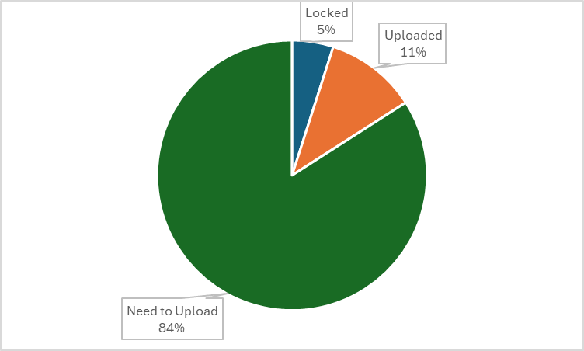
Kindergarten School Readiness (KSR)
Collection Status
Kindergarten School Readiness (KSR)
KSRData@cde.state.co.us

Slide 14
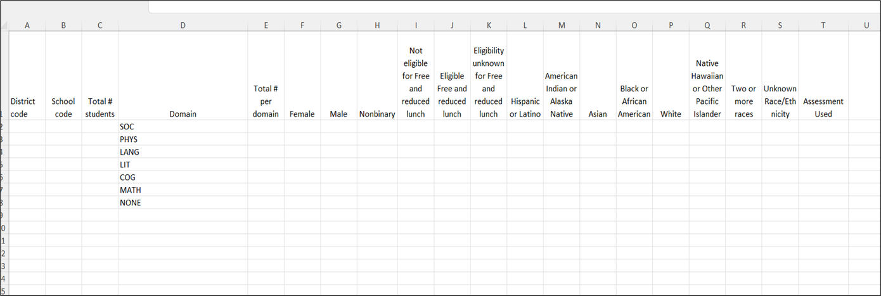
Kindergarten School Readiness (KSR)
File Template
Kindergarten School Readiness (KSR)
KSRData@cde.state.co.us

Slide 15
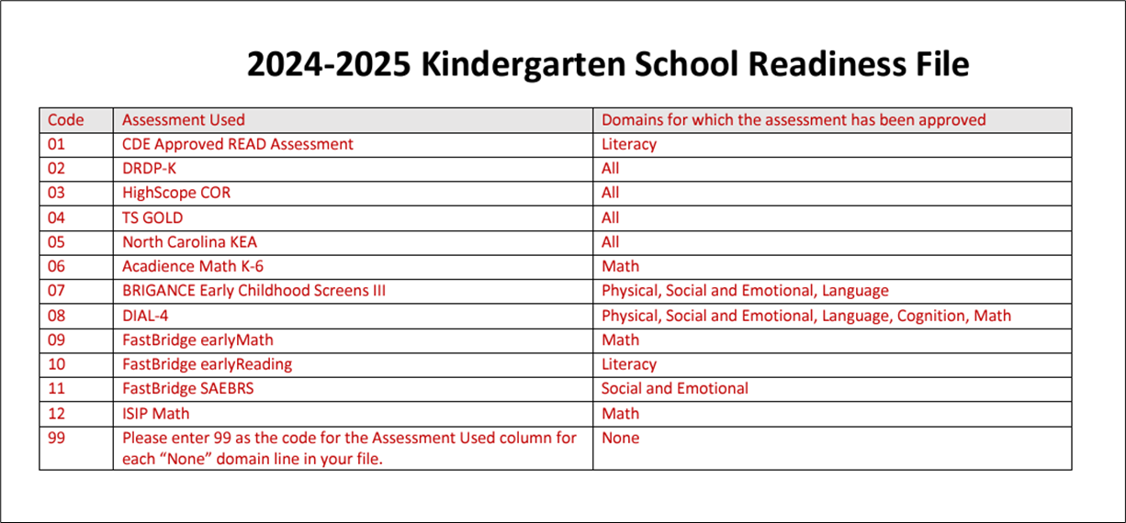
Kindergarten School Readiness (KSR)
Codes for New Assessment Used Column
Kindergarten School Readiness (KSR)
KSRData@cde.state.co.us

Slide 16
Upcoming Trainings
Kindergarten School Readiness (KSR)
Upcoming Trainings:
The recordings, slides, and business rules have all been updated and posted on our website.
Current To-Do's:
Watch recordings of trainings, if needed
Watch the tutorial of how to add the additional column, if needed
Talk with your School Readiness contact
  Learn which assessment tool is being used
  Learn whether manual aggregation of data will be required
  Learn the status of the assessment
  Begin uploads and resolving errors
Kindergarten School Readiness (KSR)
KSRData@cde.state.co.us

Slide 17
Questions & Resources
Kindergarten School Readiness (KSR)
Contact: Tara Rhodes
Email: KSRData@cde.state.co.us
Phone: 720.601.4125
Kindergarten School Readiness Website

Slide 18
Special Education IEP Interchange and
December Count Snapshot
Lindsey Heitman

Slide 19
Special Education IEP Interchange
Collection Year Timeline
2024-2025 Special Education IEP Interchange
Open from 10/01/2024 – 09/30/2025
Collects data for reporting period of 07/01/2024 – 06/30/2025
There were no changes to the Participation or Child File Layouts in 24-25
10/01/24 – Sped IEP Interchange opens
December Count Snapshot Due 2/21/25
11/01/24 – Sped December Count Snapshot opens
5/01/25 – Sped Discipline and Sped EOY Snapshots open
Sped Discipline Snapshot Due 7/31/25
Sped EOY Snapshot Due 9/30/25
2024-2025 Special Education Snapshots
December Count contains active SPED students and staff as of 12/01
Sped Discipline contains SPED students who had a discipline action during the school year
SPED End of Year contains all students in which your AU conducted an initial evaluation for special education and those you provided services to throughout the school year
Special Education December Count – Lindsey Heitman
SpedDecCount@cde.state.co.us

Slide 20
Special Education IEP Interchange and December Count Snapshot:
Trainings
Special Education IEP Interchange Training - slides posted on the Special Education IEP Interchange webpage under the Trainings section. Please take some time to the review information posted on this webpage!
  December Count Timeline
  24-25 Participation File Layout and Definitions
  Trainings
Upcoming Trainings
Special Education December Count Snapshot Training
  Wednesday, November 6th from 2:00 – 3:30
  Focus will be snapshot content and the process within the Data Pipeline
    Microsoft Teams Meeting Join the meeting now
Special Education December Count – Lindsey Heitman
SpedDecCount@cde.state.co.us

Slide 21
Special Education December Count- Student and Staff Snapshot:
2024 -2025 Official Open Friday, November 1st
Students in Special Ed who were receiving services per a current IEP as of 12/01/2024
Parentally Placed Private School Students with a disability – those receiving services per an IEP, ISP, and those not receiving services from the AU (ages 3 -21)
All staff serving Special Education Students as of 12/01
Please Include:
all AU residents, regardless of where they attend
all students who attend your AU, regardless of where they live
residents in approved facilities
any possible educational orphans in a residential facility within your AU
November Due Dates
December Due Dates
January Due Dates
30th - Thursday - All errors resolved – complete snapshot
February Due Dates
10th – 18th - Monday – Tuesday - Resolving Duplicates
1st - Sunday - Official count date (or last date prior your school was in session)
30th - Feb 7th Thursday – Friday - Report Review
18th – 21st - Tuesday - Friday - Final Report Review
21st - Friday - Final Submission Due
1st - Friday – Sped December Count Snapshot available in Data Pipeline
13th – Wednesday - Interchange files uploaded - Sped Child, Sped Participation, Staff Profile, Staff Assign
18th - Wednesday: Interchange files error free and at least one snapshot created
Special Education December Count – Lindsey Heitman
SpedDecCount@cde.state.co.us

Slide 22
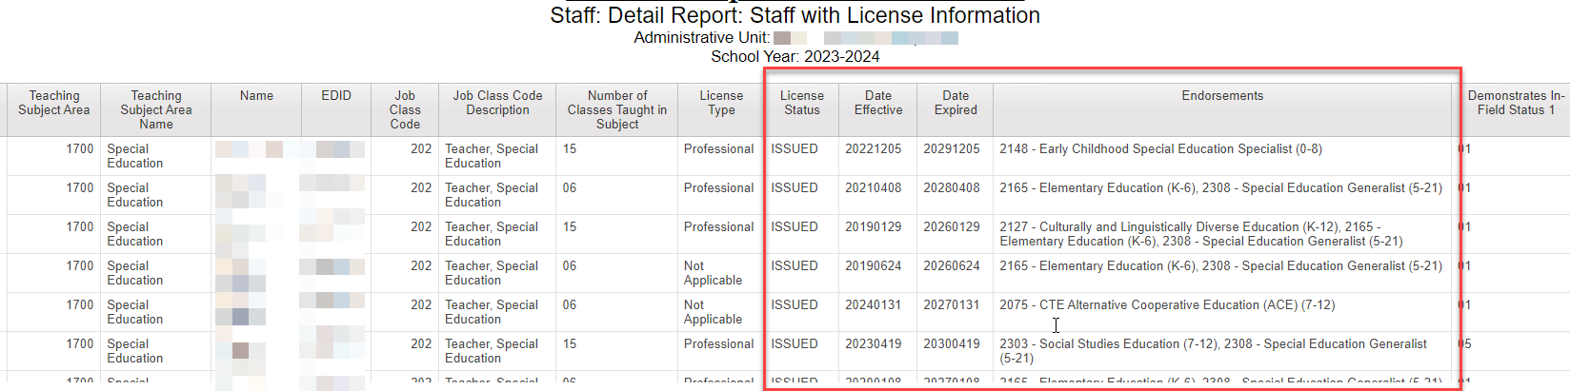
December Count – Proactively Find Expired Licenses
Find expired or expiring teacher (Job Code 202) licenses before the December Count date
  Renewal applications must be submitted to Educator Licensing before December 1st
Cognos Reports -> Special Education December -> Staff:Detail Report: Staff with License Information
Export the report to Excel and sort by “Date Expired” column
Follow up with any teacher employed in your AU or district whose license or credential will expire before 12/1/24 and ask them to submit their renewal application as soon as possible and before 12/01/2024
Special Education December Count – Lindsey Heitman
SpedDecCount@cde.state.co.us

Slide 23
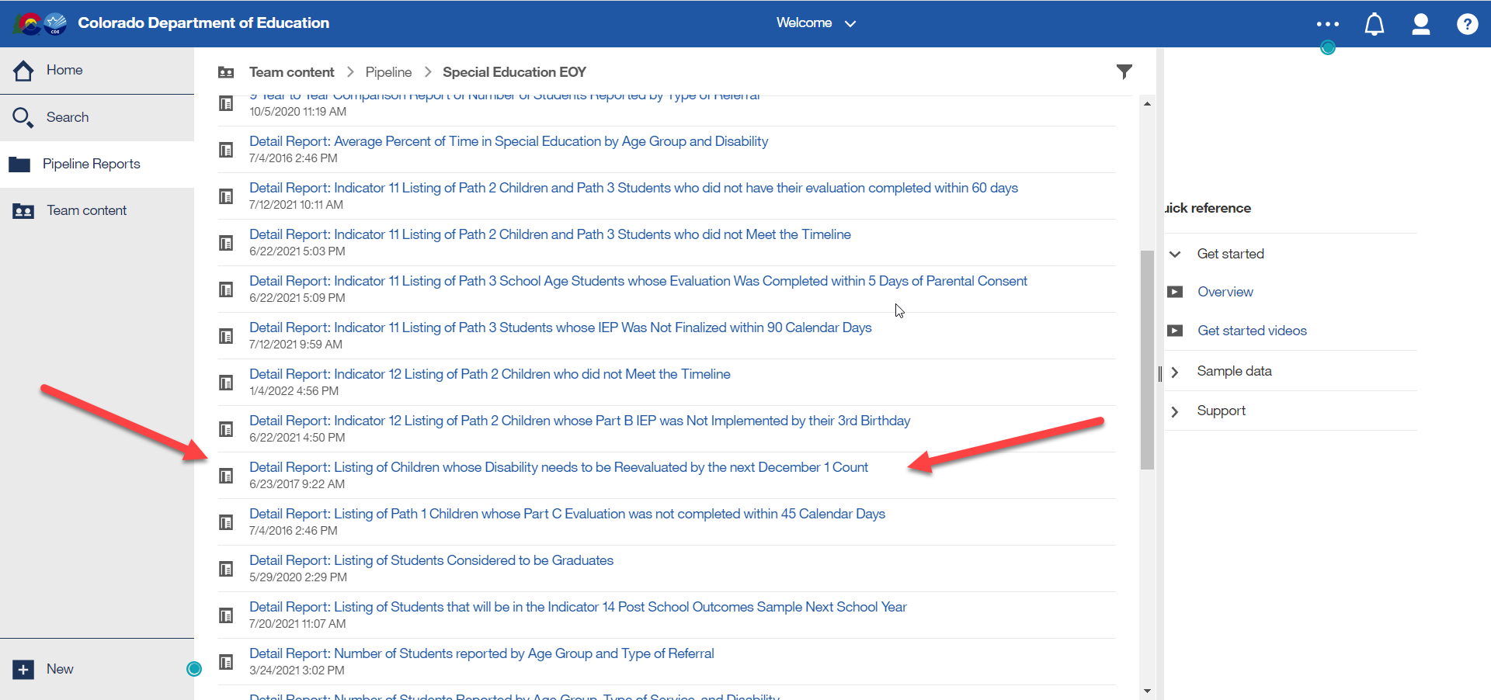
Special Education December Count:
Find Students Whose Disability Needs to be Reevaluated by 12/01
Cognos Reports -> Special Education EOY folder:
Special Education December Count – Lindsey Heitman
SpedDecCount@cde.state.co.us

Slide 24
Questions & Resources:
Special Education December Count
Lindsey Heitman
SpedDecCount@cde.state.co.us
(720) 456-2033
Special Education IEP Interchange Webpage
Special Education December Snapshot Webpage

Slide 25
Student End of Year
Reagan Ward

Slide 26
SEY Collection Timeline:
Upcoming Events
Date | Event | Event Description
10/23/2024 2:30-3:30pm | Training Event | October SEY Office Hours: Post-Cross LEA Phase Recording posted on SEY Website
10/24/2024 | Post-Cross LEA Open | Districts may begin updating their snapshot to address Post-Cross LEA business rules. Snapshots are NOT unlocked during this phase Any update outside of a SE900 error requires a Post-Cross Data Change request
11/13/2024 | Interim Deadline | Error free SEY snapshot
11/13/2024 2:30-3:30pm | Training Event | November SEY Office Hours: Final Dates and Data Release 11/13 Registration Link
11/14/2024 to 11/19/2024 | Report Review | Validate SEY data using CEDAR/COGNOS reports Begin submitting Superintendent Verification (sign-off) forms
11/19/2024 (noon) | Deadline | Post-Cross phase ends. Districts must have error free SEY snapshot and have addressed any necessary post-cross changes.
12/3/2024 | Deadline | Collection closes. • Superintendent Verification (sign-off) form due. • Data remains embargoed until the official release in January
1/14/2024 | Data Release | Planned official data release. Data is embargoed until notified by SEY lead that data has been released and is posted on the Education Statistics Website.
Visit the SEY Website to download the complete SEY Collection Timeline with Training Dates
Student End of Year – Reagan Ward
StudentEndOfYear@cde.state.co.us

Slide 27
Post-Cross LEA: Overview
Third and final phase of the Student End of Year data collection
Focus:
  Grades 7-12 school exit types (enrollment records) to ensure accurate graduation, completion, and dropout rates
  Interplay between SEY 2024 Retention Codes and October 2025 records
Initiated by a process run by CDE after districts submit their data for the Cross LEA Phase
  Triggers SE900 series errors/warnings
  Any SE001-SE700 errors that arise must also be addressed
During this phase, snapshots are not unlocked, only ‘updated’
  All districts must ‘update’ their snapshot at least once during this phase, even if no SE900 business rules were triggered.
Limited Data Updates
  Independent: School exit types for students with SE900 series errors
  Supported: Updates to correct SE001-SE700 series errors, correcting SEY retention codes in response to 2024-2025 October errors, correcting SEY data fields in response to SE900 warnings
Final opportunity for districts to validate their SEY data
Student End of Year – Reagan Ward
StudentEndOfYear@cde.state.co.us

Slide 28
Post-Cross LEA: Steps
Review errors and warnings
  SE900 series and any remaining SE001-SE700 series
Edit SSA records as needed (Data Pipeline > Edit Record Screen)
  Notes:
    Contact SEY collection lead before making Student Demographic changes
    Graduation Guidelines and Adjustment Files still use the ‘file upload’ option
Update SEY snapshot, repeating steps 1 through 3 as needed
Review SEY Data using CEDAR/COGNOS reports
Submit Superintendent Sign-Off Form
  LEA Approver role required to download form
  Forms accepted November 14th through December 3rd only
  Email signed forms to StudentEndOfYear@cde.state.co.us or upload signed form to Syncplicity and notify StudentEndOfYear@cde.state.co.us
Student End of Year – Reagan Ward
StudentEndOfYear@cde.state.co.us

Slide 29
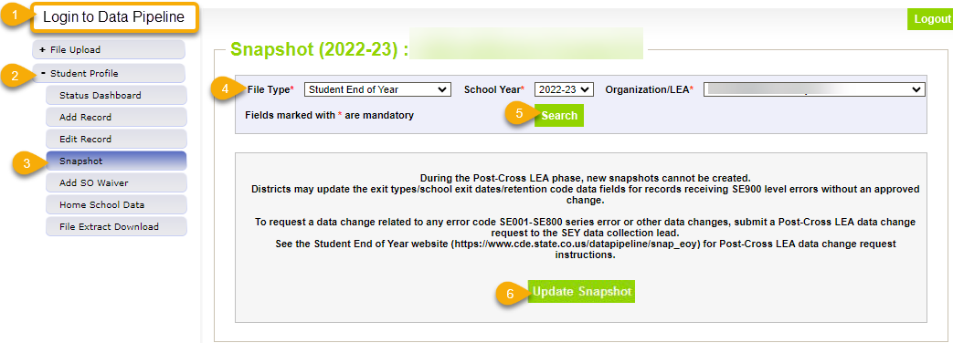
Phase Mechanics
Snapshots are NOT unlocked, only updated
Limited Data Changes
  School exit types for SASIDs with SE900 errors
  Approved post-cross LEA data changes
SSA updates completed manually through the edit record screen in pipeline
DEM updates: Talk to SEY collection lead first
GG & Adj files: continue to use the file upload screen in pipeline
Update Snapshot:
  Pulls in exit types to clear SE900 errors
  Recognizes approved exceptions for SE900 errors
  Recognizes approved exceptions for other rules
  Pulls in data changes for approved post-cross changes
  Checks SE900 warnings against most recent OCT snapshot
  Rechecks all business rules
  Rechecks AYG
Student End of Year – Reagan Ward
StudentEndOfYear@cde.state.co.us

Slide 30
Exception Requests & Data Change Requests
Data Issue
SE900 error
Submit Post-Cross LEA Data Change Request
Data is accurate as reported
Data is incorrect and must be updated
Manually edit SSA data field
(DEM updates, contact SEY first)
Submit Exception Request
Note: SE900 errors require a copy of the student’s adequate documentation to be included as supporting evidence
Manually edit school exit type on SSA file
Update SEY Snapshot
Student End of Year – Reagan Ward
StudentEndOfYear@cde.state.co.us

Slide 31
Questions & Resources:
Student End of Year
StudentEndOfYear@cde.state.co.us
720-484-9057
Student End of Year Website
Student Interchange Website
Graduation Guidelines Website

Slide 32
Student October
Brooke Wenzel

Slide 33
Student October Timeline – Regular Phase
Date | Event | Event Description
10/24/2024 | Training Event | Data Validation, Transfer Enrollment Exceptions and Cognos Reports 1-2 p.m.
10/28/2024 | Training Event | Data Pipeline Duplicate Process and Submission 9-10 a.m.
11/01/2024 | Report Review | Review Student October Cognos Reports for data validation. Submit Student October Snapshot data as soon as review is complete.
11/08/2024 12:00 p.m. | State Deadline | Submit Student October Snapshot data
Student October – Brooke Wenzel
StudentOctober@cde.state.co.us

Slide 34
Student October Timeline – Duplicate Process
Date | Event | Event Description
11/12/2024 12:00 p.m. | Deadline | Duplicate funding documentation due to School Auditing Office
11/18/2024 | Other Date | School Auditing makes decisions on funding duplicates
11/27/2024 | Deadline | Resubmit Student October Snapshot data to CDE based on decisions from School Auditing
12/06/2024 | Deadline | Collection closes Secretary of the Board of Education Verification (sign-off) form due. Data remains embargoed until the official release in January.
01/15/2025 | Data Release | Official data release
Student October – Brooke Wenzel
StudentOctober@cde.state.co.us

Slide 35
Student October Training Schedule
Note: Join live training on the Student October Website. Training and PPT will be posted after the training.
Data Validation, Transfer Enrollment Exceptions and Cognos Reports Training
Date/Time: 10/24/2024 1-2 p.m.
Click here to join the Data Validation teams meeting.
Data Pipeline Duplicate Process and Submission Training
Date/Time: 10/28/2024 9-10 a.m.
Click here to join the Duplicate Process teams meeting.
Student October – Brooke Wenzel
StudentOctober@cde.state.co.us

Slide 36
Snapshot Status Update 7:00 a.m. 10/24
Student October – Brooke Wenzel
StudentOctober@cde.state.co.us

Slide 37
OC50/OC198 Errors
OC50: The Percentage of K-12 Students classified as Free ('01') and Reduced ('02') exceeds expected tolerances. This 10% tolerance includes K-12 funded students regardless of Pupil Attendance Information Code.
OC198: The Percentage of K-12 funded students (Public School Finance Status = '80', '82', '85', '91', '92', '94', '95') exceeds expected tolerances regarding FTE. This 10% tolerance includes K-12 funded students regardless of Pupil Attendance Information Code..
What do you do next?
Make sure you are close to your final dataset
Verify your data via Cognos Reports (make sure you are not under or over reporting)
Request Exception
Be aware that the error will not pop up again through the completion of the collection (even if you report 0 FRL counts for example!)
Student October – Brooke Wenzel
StudentOctober@cde.state.co.us

Slide 38
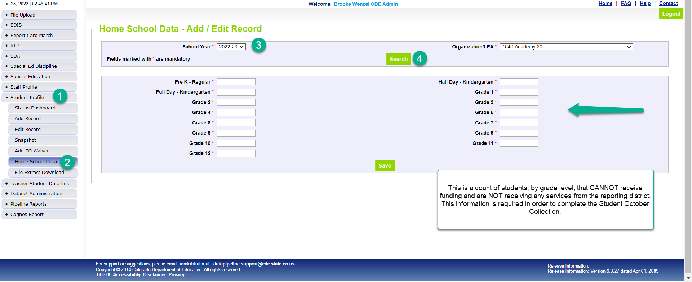
Home School Data
*Please note that you’ll need to include any homeschool students receiving some regular education services provided by the district in your interchange files. They are only eligible for a maximum of part-time funding. For homeschool student receiving no services report them in Home School Data under Student Profile. These students who are not taking any classes offered through the district are not eligible for funding.
Student October – Brooke Wenzel
StudentOctober@cde.state.co.us

Slide 39
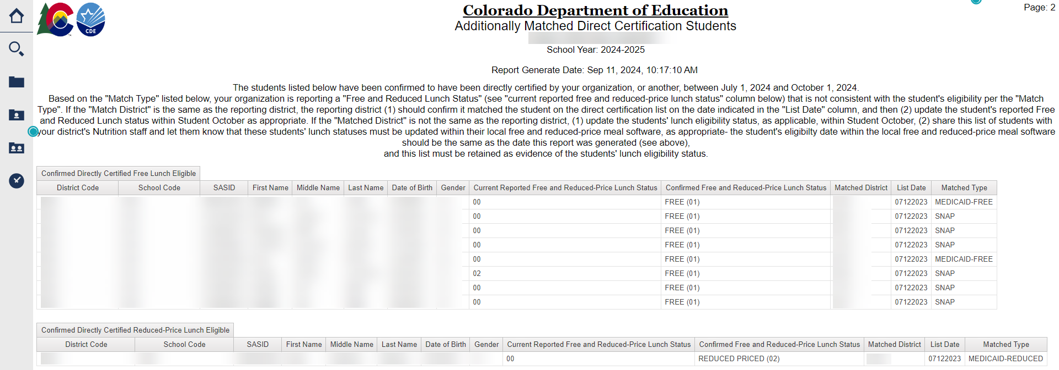
Additionally Matched Direct Certification Students OCT Cognos Report
Students have been confirmed to have been directly certified by your organization, or another, between July 1 and October 1 of the reporting school year.
If you have looked at this report prior to Friday, October 18th, that data is outdated.
An official email will be sent from Auditing to provide further details
Student October – Brooke Wenzel
StudentOctober@cde.state.co.us

Slide 40
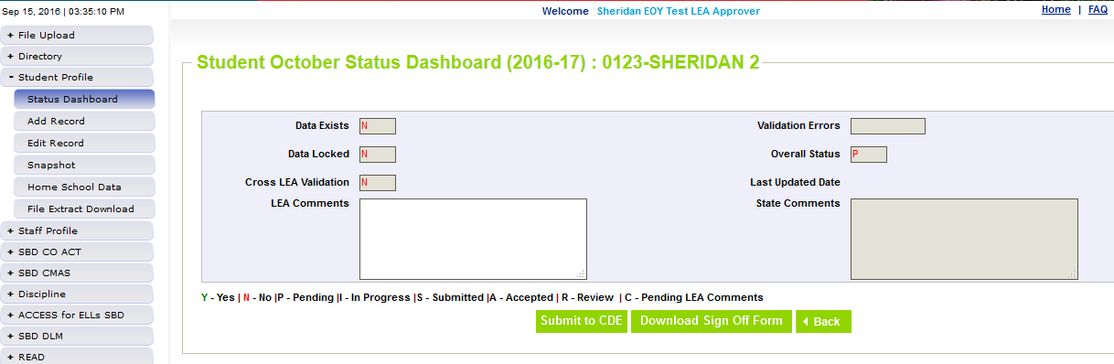
Ready to Submit
Once you have verified the data, submit the snapshot to CDE. Go to:
  Student Profile -> Status Dashboard and click ‘Submit to CDE’
  Must have LEAAPPROVER role in IDM to complete this step
  Once data is submitted it will be locked, must request unlock to make changes (email me to request)

Slide 41
Questions & Resources:
Questions & Resources:
Student October
Brooke Wenzel
StudentOctober@cde.state.co.us
720-441-7963
Student October Webpage
Student Interchange Webpage

Slide 42
At-Risk Interchange
Rebecca McRee

Slide 43
New: At-Risk Measure Interchange File -
Overview
Beginning with the 2024/2025 school year, there is a new Data Pipeline At-Risk Interchange.
The purpose of the At-Risk Interchange is to obtain student-level census block data (based on primary residential addresses) that is needed to implement the new at-risk measure as described in HB22-1202 with data collection to begin with the 2024-2025 school year as provided for under SB24-188.
The new at-risk measure will be implemented starting with the 2025/2026 school year, and included in the Total Program funding calculation as described in the Public-School Finance Act which will continue to utilize student level data reported through the Student October Count data collection.
This interchange opened on July 15, 2024 and closes November 8, 2024. It will only be open during the Student October Count Collection.
At-Risk Interchange
ARMeasure@cde.state.co.us

Slide 44
New: Census Block Data
Required and valid census block data combinations include 4 data fields:
  State Code
  County Code
  Tract Code
  Block Code
To obtain this data, districts will need to first gather, clean and validate student address data.
Then districts will need to "geocode" each student's primary physical residential address to obtain this information.
  District's GIS system (such as ARC)
  Census Geocoder Tool
  Other (if your district has some other tool, please reach out to ARMeasure@cde.state.co.us)
At-Risk Interchange
ARMeasure@cde.state.co.us

Slide 45
New: At-Risk Measure Interchange File -
Resources
At-Risk Interchange Website
  File Layout
  Business Rules
  Interchange Upload Template (XLS)
  Timeline
  Trainings
    Overview of the Geocoder Tool (PDF) (Recorded Training)
    Overview of the Data Pipeline At-Risk Interchange File (PDF) (Recorded Training)
    Office Hours Session covering the Geocoder Tool and Interchange File was held yesterday, Sept.11, 2024. (PDF) (Recording will be posted on or about 9/16)
  Additional Resources
    UPDATED 9/10/24: Instructions for Using the Geocode Tool
    Valid Census Block Data Combinations (XLS)
At-Risk Interchange
ARMeasure@cde.state.co.us

Slide 46
File Layout and Definitions (page 3):
Missing Census Block Data- Coding Patterns
Description | State Code | County Code | Tract Code | Block Code
Address on File- Did Not Attempt to Obtain Census Block Data: The district has a primary physical address on file but did NOT attempt to obtain census block data using the geocode tool. | 08 | 000 | 000001 | 0001
Address on File- No Census Block Data Returned: The district confirmed that the primary physical address is valid using USPS but the geocode tool did not return census block data. | 08 | 000 | 000002 | 0002
Confidentiality Program: No census block data was provided because the district has confirmed the student is participating in a confidentiality program. | 08 | 000 | 000003 | 0003
No Physical Primary Address on File- Identified Group: The district does not have a primary physical address on file and the student is confirmed homeless, migrant, foster child, or attending a detention center. | 08 | 000 | 000004 | 0004
No Physical Primary Address on File- No Identified Group: The district does not have a primary physical address on file and the student is not confirmed homeless, migrant, foster child, or attending a detention center. | 08 | 000 | 000005 | 0005
Out of State codes: The district has a primary physical address on file that is not in Colorado. | 08 | 000 | 000006 | 0006
At-Risk Interchange
ARMeasure@cde.state.co.us

Slide 47
New: At-Risk Measure Interchange File - Syncplicity Folders
Syncplicity folders are being shared on a rolling basis with ARM LEAUSERS and LEAVEWIERS.
The folder naming convention is:
  District Code_ District Name_ ARMeasure Interchange
These folders can be used to share files containing PII between the district or BOCES and CDE when requesting assistance with the At-Risk Interchange or Census Geocoding tool.
If you have been assigned the user or viewer role for this interchange file and your district's Syncplicity folder has not been shared with you, email ARMeasure@cde.state.co.us.
At-Risk Interchange
ARMeasure@cde.state.co.us

Slide 48
Questions & Resources:
At Risk Interchange
ARMeasure@cde.state.co.us
Data Pipeline At-Risk Interchange website

Slide 49
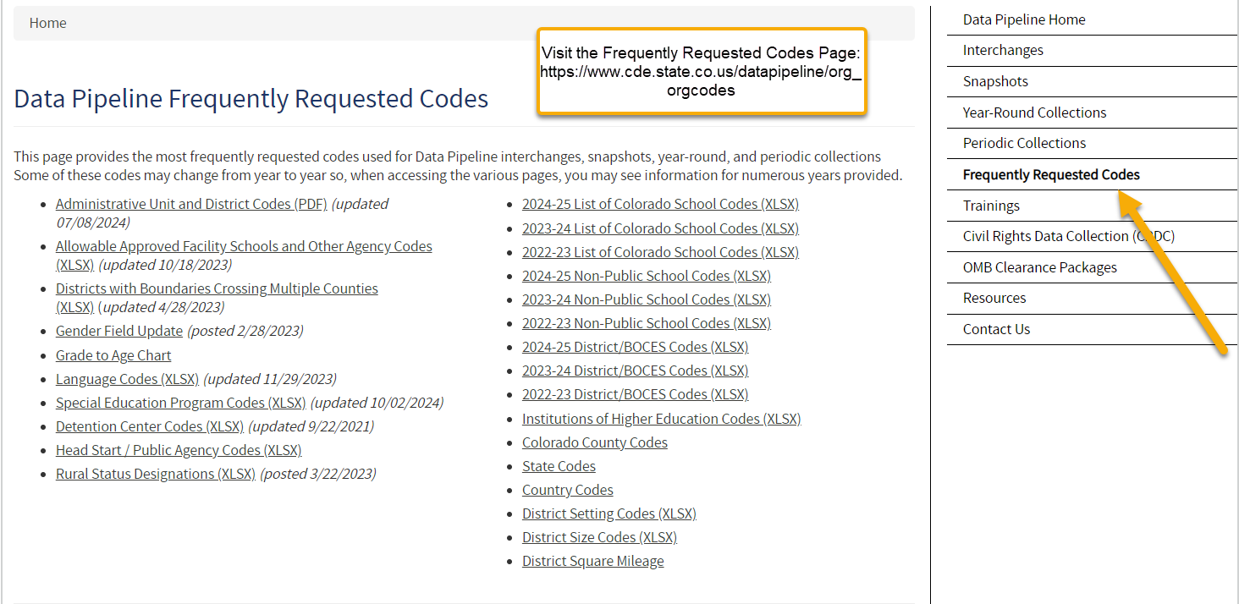
Thank you for joining today!
Next Town Hall will be October 31st
Reminder:
The Frequently Requested Codes Page has school codes, language codes, special education program codes and more!

