Slide 1
October 17, 2024 Data Pipeline Town Hall
The goal of the webinar is to provide updates on the Data Pipeline, current, and upcoming data collections. These webinars also provide a forum for districts, BOCES, and Administrative Units to have questions answered about Data Pipeline.

Slide 2
Colorado Department of Education Identity Management (IdM)
Identity Management Site
Frequently Asked Questions
How do I add myself or others to the email listserv for town hall emails and/or a specific collection?
Email lists are dependent on a person’s access rights in IdM. Contact your LAM to get an account or be assigned to a specific collection.
Where can I find the IdM role mappings for Data Pipeline and other applications?
Role Mapping (XLS)
I am a LAM. How do I update the user permissions for someone in my district?
Follow the steps outlined in the IdM Quick Guide for Access Management (DOCX)
Important: Users are not automatically removed from IdM when their email address is no longer active in your district. The LAM must deactivate their IdM account to ensure only designated staff can access CDE’s data reporting system.
Notes:
LAMs, please check the IdM roles for your district. Remove permissions for users who have retired, left your district, or are no longer assigned to a collection. Add roles for new hires and newly assigned respondents for specific collections.

Slide 3
What is PII?
Student and Staff Personally Identifiable Information (PII) is defined by state and federal laws as information that, alone or in combination, personally identifies an individual
This includes direct identifiers (i.e. student and staff names, SASID, EDID, etc.)
Includes information that when combined is identifiable
Colorado’s Student Data Transparency and Security Act outlines requirements for how Student PII is collected, used and shared
See the Data Privacy and Security website for prepared guidance on how to comply with this and other privacy laws.

Slide 4
Sharing Data
Use secure methods to transfer any PII to CDE
Contact Data Collection leads with questions about how to transmit PII securely
Each Data Collection leads maintains their own Syncplicity folders for specific collections, reach out to the collection lead for access
Use Syncplicity to encrypt emails to CDE
Avoid sending PII via unencrypted email or to unsecured faxes when sharing data between or within districts
Use Syncplicity to encrypt emails to CDE
Check local policies for restrictions, requirements, etc. regarding PII
Do not use PII in trainings, presentations, etc.
Do not share PII with unauthorized individuals
Do not share passwords
Follow local policies when transmitting PII to any third party

Slide 5
Today’s Agenda
Agenda Topic | Presenter
Open Data Collections and Upcoming Deadlines in Data Pipeline
Civil Rights Data Collection (CRDC) | Annette Severson
Kindergarten School Readiness | Tara Rhodes
Staff Evaluation | Dawna Gudka
Student End of Year | Reagan Ward
Student October | Brooke Wenzel
At Risk Interchange Updates | Rebecca McRee

Slide 6
Open Collections and Upcoming Deadlines in Data Pipeline

Slide 7
Open Collections and Upcoming Dates: Year-Round & Interchanges
Name | Category | Status | Key Dates
RITS | Year Round | Open | n/a
EDIS | Year Round | Open | n/a
Directory | Year Round | Open | n/a
Student | Interchange | Open | 2023-2024 and 2024-2025 are open
At-Risk | Interchange | Open | n/a
Title I | Interchange | Open | 2023-2024 closes 10/17/24 2024-2025 open
Special Education IEP | Interchange | Open | 2024-2025 is open
Staff | Interchange | Open | 2023-2024 and 2024-2025 are open
Data Pipeline Resources: Data Pipeline Collection Dates (XLS)

Slide 8
Open Collections and Upcoming Dates: Snapshots
Name | Category | Status | Final Deadline Date | Next Milestone | Looking Ahead
Staff Evaluation | Snapshot | Open | Oct. 15, 2024 | State Deadline: 10/15/2024 Submit data to CDE and submit sign-off page | N/A
Student October | Snapshot | Open | Nov. 8, 2024 | Interim Deadline: 10/22/2024 Error-Free Student October Snapshot | Report Review: 11/1/2024 Review Cognos Reports for data validation. Submit Student October Snapshot data as soon as review is complete.
Student End of Year | Snapshot | Deadline Today | Nov. 19, 2024 | Deadline: 10/17/2024 Submit snapshot, Cross LEA ends | Training Event: 10/23/2024, 2:30-3:30pm Oct SEY Office Hours
Special Education December Count | Snapshot | Coming Soon | Feb. 21, 2025 |  | Snapshot Opens: 11/01/2024
Data Pipeline Resources: Data Pipeline Collection Dates (XLS)

Slide 9
Open Collections and Upcoming Dates: Periodic
Name | Category | Status | Final Deadline Date | Next Milestone | Looking Ahead
Non-Public Schools Fall Enrollment Count | Periodic | Open | Dec. 2, 2024 | N/A | N/A
Kindergarten School Readiness | Periodic | Coming Soon | Dec. 11, 2024 | Training Event: 10/16/2024, 11:30 am-12:15 pm Data Pipeline Uploads Sourcing Data from Multiple Platforms | Collection Opens: 10/23/2024
Data Pipeline Resources: Data Pipeline Collection Dates (XLS)

Slide 10
Civil Rights Data Collection
Annette Severson

Slide 11
Overview
The U.S. Department of Education [ED] conducts the Civil Rights Data Collection (CRDC)
Collects data on key education and civil rights issues in our nation's public schools. The CRDC collects a variety of information including, student enrollment and educational programs and services, disaggregated by race/ethnicity, sex, limited English proficiency and disability.
Information collected by the CRDC is also used by other ED offices as well as policymakers and researchers outside of ED.

Slide 12
2023-24 CRDC Timeline
Opening December 9, 2024
Deadline March 7, 2025
Resources from CRDC posted and available at: CRDC Resource Center

Slide 13
CDE’s Role
CDE will pre-populate as much data as possible prior to Dec 9th
CRDC file layout with CDE field logic is available online for review
Information will be posted on the CRDC tab for Data Pipeline -
CRDC Colorado Data Provision

Slide 14
LEA’s Role
NOW:
Verify contact information by Oct 31st
Review CRDC documentation, guides, etc. available online
COLLECTION WINDOW:
Log into CRDC reporting tool
Review pre-populated data to verify accuracy
Input additional data required
Finalize data submission on or before deadline (March 7th)

Slide 15
Questions & Resources: Civil Rights Data Collection
CRDC Resource Center
CRDC Partner Support Center - crdc@aemcorp.com
CDE Contact: Annette Severson – Severson_a@cde.state.co.us

Slide 16
Kindergarten School Readiness
Tara Rhodes

Slide 17
KSR: Background Information Assessment Domains
As required by Colorado law (Section 22-7-1004 (1)(b) C.R.S.), school readiness includes the following domains:
Physical well-being and motor development
Social and emotional development
Language and comprehension
Cognition
Math
Literacy
The assessment tools linked here have been approved by the State Board of Education for use.
Data reported to CDE is from the initial fall assessment window for school readiness, which is the first 60 calendar days of the school year, as required by HB15-1323.
Kindergarten School Readiness (KSR)
KSRData@cde.state.co.us

Slide 18
Kindergarten School Readiness (KSR) Important Dates and Changes for 24-25 Collection
Important Dates:
10/23/2024: KSR Data Collection Opens (Next week!)
12/11/2024: KSR Data Collection Due Date
Please note that this information is part of the CAP4K Legislative Report that is due in February to the legislature. Consequently, I will need all submissions in by the deadline so that analysis can be completed in January, along with executive leadership review prior to publication.
Changes for the 24-25 Collection:
One additional column was added to the file layout to denote the assessment used. This replaced the front-end screen in Data Pipeline.
This change was made to accommodate the State Board's approval of single-domain assessment tools.
A short tutorial (~6min) of how to add and populate this column has been posted here.
Kindergarten School Readiness (KSR)
KSRData@cde.state.co.us

Slide 19
Kindergarten School Readiness (KSR) File Template
Kindergarten School Readiness (KSR)
KSRData@cde.state.co.us

Slide 20
Kindergarten School Readiness (KSR) Codes for New Assessment Used Column
Kindergarten School Readiness (KSR)
KSRData@cde.state.co.us

Slide 21
Upcoming Trainings Kindergarten School Readiness (KSR)
Upcoming Trainings:
10/02/2024: Recording and slides have been posted on our website.
10/09/2024: Recording and slides have been posted on our website.
10/16/2024: Recording will be posted shortly.
Current To-Do's:
Watch recordings of trainings, if needed
Watch the tutorial of how to add the additional column, if needed
Talk with your School Readiness contact
Learn which assessment tool is being used
Learn whether manual aggregation of data will be required
Learn the status of the assessment
Kindergarten School Readiness (KSR)
KSRData@cde.state.co.us

Slide 22
Questions & Resources Kindergarten School Readiness (KSR)
Contact: Tara Rhodes
Email: KSRData@cde.state.co.us
Phone: 720.601.4125
Kindergarten School Readiness Website

Slide 23
Staff Evaluation
Dawna Gudka

Slide 24
Staff Evaluation Snapshot Deadline October 15th, 2024
Staff Evaluation Snapshot Collection
StaffEvaluation@cde.state.co.us

Slide 25
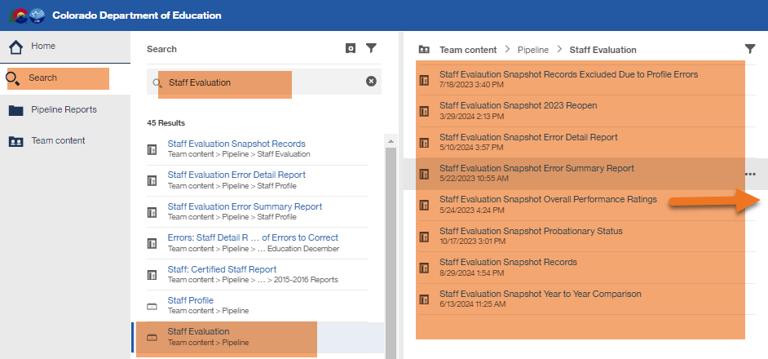
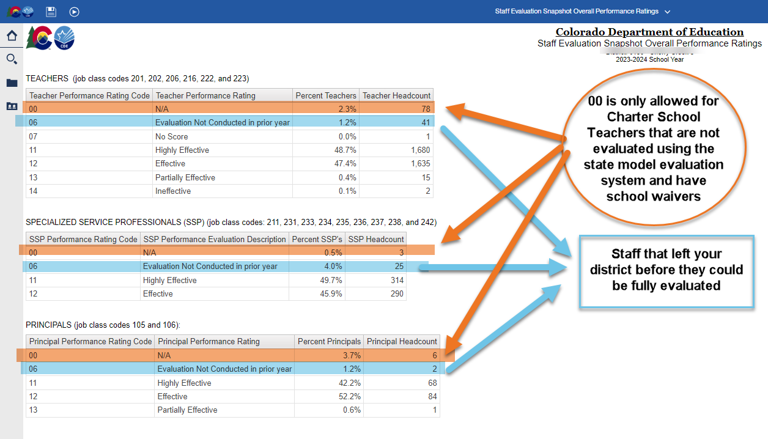
Staff Evaluation Validating Data
Staff Evaluation Snapshot Collection
StaffEvaluation@cde.state.co.us

Slide 26
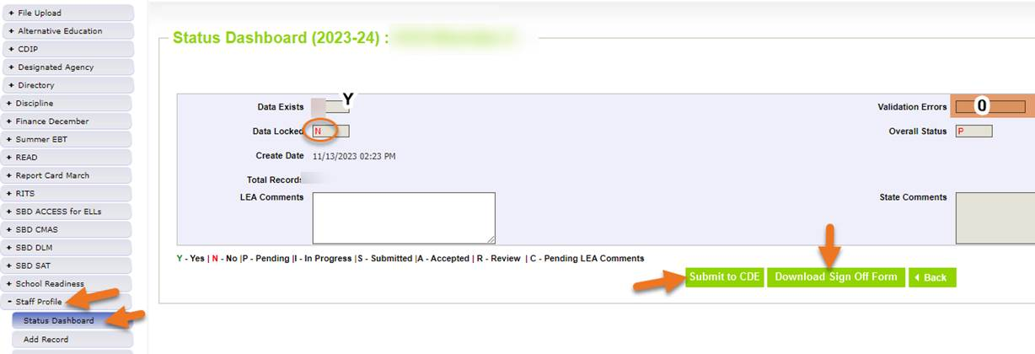
Submitting Staff Evaluation Data
Staff Evaluation Snapshot Collection
StaffEvaluation@cde.state.co.us

Slide 27
Staff Evaluation Snapshot Collection Resources
Staff Evaluation Timeline
Staff Evaluation file layout
StaffEvaluation@cde.state.co.us
Dawna Gudka-Collection lead
(303) 598-7901

Slide 28
Student End of Year
Reagan Ward

Slide 29
SEY Collection Timeline: Upcoming Events
Date | Event | Event Description
10/17/2024 | Deadline | Resubmit SEY snapshot
10/23/2024 2:30-3:30pm | Training Event | October SEY Office Hours: Post-Cross LEA Phase 10/24 Registration Link
10/24/2024 | Post-Cross LEA Open | Districts may begin updating their snapshot to address Post-Cross LEA business rules. Snapshots are NOT unlocked during this phase Any update outside of a SE900 error requires a Post-Cross Data Change request
11/13/2024 | Interim Deadline | Error free SEY snapshot
11/13/2024 2:30-3:30pm | Training Event | November SEY Office Hours: Final Dates and Data Release 11/13 Registration Link
11/14/2024 to 11/19/2024 | Report Review | Validate SEY data using CEDAR/COGNOS reports Begin submitting Superintendent Verification (sign-off) forms
11/19/2024 (noon) | Deadline | Post-Cross phase ends. Districts must have error free SEY snapshot and have addressed any necessary post-cross changes.
12/3/2024 | Deadline | Collection closes. • Superintendent Verification (sign-off) form due. • Data remains embargoed until the official release in January
1/14/2024 | Data Release | Planned official data release. Data is embargoed until notified by SEY lead that data has been released and is posted on the Education Statistics Website.
Visit the SEY Website to download the complete SEY Collection Timeline with Training Dates
Student End of Year – Reagan Ward
StudentEndOfYear@cde.state.co.us

Slide 30
SEY Cross LEA Status as of 7:20 am on 10/17
Snapshot Status
Notes
All LEAs must create a SEY snapshot during this phase, even if they were error free at the start of the phase.
All LEAs must resubmit an error-free snapshot by the 10/17 deadline.
Some errors/warnings require collaboration between LEAs to resolve
Student End of Year – Reagan Ward
StudentEndOfYear@cde.state.co.us

Slide 31
Looking ahead to the Post-Cross Phase
Third and final phase of SEY collection
CDE turns on SE900 series errors/warnings
Snapshots are NOT unlocked, only ‘updated’
All LEAs must ‘update’ their snapshot at least once during this phase
Final opportunity for districts to make updates to their SEY data based upon any issues they find during their data review
Sign-off forms will be accepted from 11/14/2024 to 12/3/2024.
Extremely different mechanics
Manual edits to DEM/SSA files only
File upload allowed for GG/ADJ
LEAs can update exit types to clear SE900 errors without assistance
LEAs request exceptions for SE900 errors when they want to keep the student’s exit type as reported. This requires additional documentation.
Updates to any other data field, including errors outside the SE900 series, requires a Post-Cross LEA Data Change Request
Student End of Year – Reagan Ward
StudentEndOfYear@cde.state.co.us

Slide 32
SEY 2024 and OCT 2025: Addressing data issues in Post-Cross
SEY Collection Closed:
10/18/2024 to 10/23/2024
Post-Cross Phase*:
10/24/2024 to 11/19/2024
*Error-free 11/13/2024
SEY Warnings
OCT Errors
SE906
Attending in 2025: Add an OCT record. Then, create a SEY snapshot to clear the warning
Withdrew before 10/1: Ensure SSA record for 2025 captures exit, then ignore warning
SE908
Postsecondary student in 2025: Add an OCT record. Then, create SEY snapshot to clear the warning
Not attending in 2025: Submit post-cross change request to remove retention code 2 in SEY 2024
SE912
Transition student in 2025: Add an OCT record. Then, create SEY snapshot to clear the warning
Not attending in 2025: Submit post-cross change request to remove retention code 3 in SEY 2024
Transferred to another CO district in 2025 before 10/1: Ensure SSA record in 2025 captures exit, then ignore warning.
OC185: Postsecondary student missing retention 2 in SEY OC173: Transition student missing retention 3 in SEY
Manually update retention code on SSA file
Submit a Post-Cross Data Change Request (XLS)
Once request is approved, Update SEY snapshot
Create OCT snapshot
Student End of Year – Reagan Ward
StudentEndOfYear@cde.state.co.us

Slide 33
Questions & Resources: Student End of Year
StudentEndOfYear@cde.state.co.us
720-484-9057
Student End of Year Website
Student Interchange Website
Graduation Guidelines Website

Slide 34
Student October
Brooke Wenzel

Slide 35
Student October Timeline – Regular Phase
Date | Event | Event Description
10/22/2024 | Interim Deadline | Error free Student October Snapshot
10/24/2024 | Training Event | Data Validation, Transfer Enrollment Exceptions and Cognos Reports 1-2 p.m.
10/28/2024 | Training Event | Data Pipeline Duplicate Process and Submission 9-10 a.m.
11/01/2024 | Report Review | Review Student October Cognos Reports for data validation. Submit Student October Snapshot data as soon as review is complete.
11/08/2024 12:00 p.m. | State Deadline | Submit Student October Snapshot data
Student October – Brooke Wenzel
StudentOctober@cde.state.co.us

Slide 36
Student October Timeline – Duplicate Process
Date | Event | Event Description
11/12/2024 12:00 p.m. | Deadline | Duplicate funding documentation due to School Auditing Office
11/18/2024 | Other Date | School Auditing makes decisions on funding duplicates
11/27/2024 | Deadline | Resubmit Student October Snapshot data to CDE based on decisions from School Auditing
12/06/2024 | Deadline | Collection closes Secretary of the Board of Education Verification (sign-off) form due. Data remains embargoed until the official release in January.
01/15/2025 | Data Release | Official data release
Student October – Brooke Wenzel
StudentOctober@cde.state.co.us

Slide 37
Student October Training Schedule
Note: Join live training on the Student October Website. Training and PPT will be posted after the training.
Data Validation, Transfer Enrollment Exceptions and Cognos Reports Training
Date/Time: 10/24/2024 1-2 p.m.
Click here to join the Data Validation teams meeting.
Data Pipeline Duplicate Process and Submission Training
Date/Time: 10/28/2024 9-10 a.m.
Click here to join the Duplicate Process teams meeting.
Student October – Brooke Wenzel
StudentOctober@cde.state.co.us

Slide 38
Snapshot Status Update 6:30 a.m. 10/17
Student October – Brooke Wenzel
StudentOctober@cde.state.co.us

Slide 39
OC50/OC198 Errors
OC50: The Percentage of K-12 Students classified as Free ('01') and Reduced ('02') exceeds expected tolerances. This 10% tolerance includes K-12 funded students regardless of Pupil Attendance Information Code.
OC198: The Percentage of K-12 funded students (Public School Finance Status = '80', '82', '85', '91', '92', '94', '95') exceeds expected tolerances regarding FTE. This 10% tolerance includes K-12 funded students regardless of Pupil Attendance Information Code..
What do you do next?
Make sure you are close to your final dataset
Verify your data via Cognos Reports (make sure you are not under or over reporting)
Request Exception
Be aware that the error will not pop up again through the completion of the collection (even if you report 0 FRL counts for example!)
Student October – Brooke Wenzel
StudentOctober@cde.state.co.us

Slide 40
CEDAR (Cognos) Reports – Pre, Mid and Post Collection
Two Levels of Reports
Student Interchange ~STD and Student October ~OCT
Use Reports throughout the Student October Collection
Monitor data as you upload/take new snapshots
Some reports cross check with other districts (Summary of Pupils Being Reported by Another District)
Share Reports with Colleagues
Many summary reports out there!
District Summary of Pupil Counts/Comparison
School Summary of Pupil Counts/Comparison
District Summary of Postsecondary Programs
Summary of Homeless Students
Student October – Brooke Wenzel
StudentOctober@cde.state.co.us

Slide 41
Home School Data
*Please note that you’ll need to include any homeschool students receiving some regular education services provided by the district in your interchange files. They are only eligible for a maximum of part-time funding. For homeschool student receiving no services report them in Home School Data under Student Profile. These students who are not taking any classes offered through the district are not eligible for funding.
Student October – Brooke Wenzel
StudentOctober@cde.state.co.us

Slide 42
Questions & Resources:
Questions & Resources: Student October
Brooke Wenzel StudentOctober@cde.state.co.us 720-441-7963
Student October Webpage
Student Interchange Webpage

Slide 43
At-Risk Interchange Updates
Rebecca McRee

Slide 44
New: At-Risk Measure Interchange File - Overview
Beginning with the 2024/2025 school year, there is a new Data Pipeline At-Risk Interchange.
The purpose of the At-Risk Interchange is to obtain student-level census block data (based on primary residential addresses) that is needed to implement the new at-risk measure as described in HB22-1202 with data collection to begin with the 2024-2025 school year as provided for under SB24-188.
The new at-risk measure will be implemented starting with the 2025/2026 school year, and included in the Total Program funding calculation as described in the Public-School Finance Act which will continue to utilize student level data reported through the Student October Count data collection.
This interchange opened on July 15, 2024 and closes November 8, 2024. It will only be open during the Student October Count Collection.
At-Risk Interchange
ARMeasure@cde.state.co.us

Slide 45
New: Census Block Data
Required and valid census block data combinations include 4 data fields:
State Code
County Code
Tract Code
Block Code
To obtain this data, districts will need to first gather, clean and validate student address data.
Then districts will need to "geocode" each student's primary physical residential address to obtain this information.
District's GIS system (such as ARC)
Census Geocoder Tool
Other (if your district has some other tool, please reach out to ARMeasure@cde.state.co.us)
At-Risk Interchange
ARMeasure@cde.state.co.us

Slide 46
New: At-Risk Measure Interchange File - Resources
At-Risk Interchange Website
File Layout
Business Rules
Interchange Upload Template (XLS)
Timeline
Trainings
Overview of the Geocoder Tool (PDF) (Recorded Training)
Overview of the Data Pipeline At-Risk Interchange File (PDF) (Recorded Training)
Office Hours Session covering the Geocoder Tool and Interchange File was held yesterday, Sept.11, 2024. (PDF) (Recording will be posted on or about 9/16)
Additional Resources
UPDATED 9/10/24: Instructions for Using the Geocode Tool
Valid Census Block Data Combinations (XLS)
At-Risk Interchange
ARMeasure@cde.state.co.us

Slide 47
File Layout and Definitions (page 3): Missing Census Block Data- Coding Patterns
Description | State Code | County Code | Tract Code | Block Code
Address on File- Did Not Attempt to Obtain Census Block Data: The district has a primary physical address on file but did NOT attempt to obtain census block data using the geocode tool. | 08 | 000 | 000001 | 0001
Address on File- No Census Block Data Returned: The district confirmed that the primary physical address is valid using USPS but the geocode tool did not return census block data. | 08 | 000 | 000002 | 0002
Confidentiality Program: No census block data was provided because the district has confirmed the student is participating in a confidentiality program. | 08 | 000 | 000003 | 0003
No Physical Primary Address on File- Identified Group: The district does not have a primary physical address on file and the student is confirmed homeless, migrant, foster child, or attending a detention center. | 08 | 000 | 000004 | 0004
No Physical Primary Address on File- No Identified Group: The district does not have a primary physical address on file and the student is not confirmed homeless, migrant, foster child, or attending a detention center. | 08 | 000 | 000005 | 0005
Out of State codes: The district has a primary physical address on file that is not in Colorado. | 08 | 000 | 000006 | 0006
At-Risk Interchange
ARMeasure@cde.state.co.us

Slide 48
New: At-Risk Measure Interchange File - Syncplicity Folders
Syncplicity folders are being shared on a rolling basis with ARM LEAUSERS and LEAVEWIERS.
The folder naming convention is:
District Code_ District Name_ ARMeasure Interchange
These folders can be used to share files containing PII between the district or BOCES and CDE when requesting assistance with the At-Risk Interchange or Census Geocoding tool.
If you have been assigned the user or viewer role for this interchange file and your district's Syncplicity folder has not been shared with you, email ARMeasure@cde.state.co.us.
At-Risk Interchange
ARMeasure@cde.state.co.us

Slide 49
Questions & Resources: At Risk Interchange
ARMeasure@cde.state.co.us
Data Pipeline At-Risk Interchange website

Slide 50
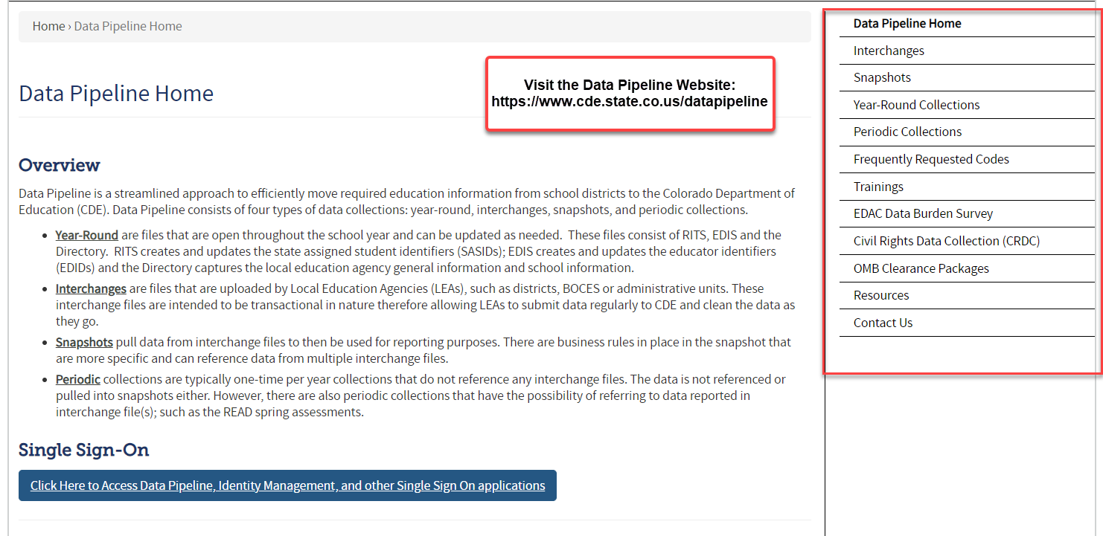
Thank you for joining today!
Next Town Hall will be October 24th
Reminder:
Each Data Collection has a more detailed timeline posted on their corresponding website (as well as other helpful resources)!

