Slide 1
October 10, 2024
Data Pipeline Town Hall
The goal of the webinar is to provide updates on the Data Pipeline, current, and upcoming data collections. These webinars also provide a forum for districts, BOCES, and Administrative Units to have questions answered about Data Pipeline.

Slide 2
Colorado Department of Education
Identity Management (IdM)
Identity Management Site
Frequently Asked Questions
How do I add myself or others to the email listserv for town hall emails and/or a specific collection?
  Email lists are dependent on a person’s access rights in IdM. Contact your LAM to get an account or be assigned to a specific collection.
Where can I find the IdM role mappings for Data Pipeline and other applications?
  Role Mapping (XLS)
I am a LAM. How do I update the user permissions for someone in my district?
  Follow the steps outlined in the IdM Quick Guide for Access Management (DOCX)
Important: Users are not automatically removed from IdM when their email address is no longer active in your district. The LAM must deactivate their IdM account to ensure only designated staff can access CDE’s data reporting system.
Notes:
LAMs, please check the IdM roles for your district. Remove permissions for users who have retired, left your district, or are no longer assigned to a collection. Add roles for new hires and newly assigned respondents for specific collections.

Slide 3

What is PII?
Student and Staff Personally Identifiable Information (PII) is defined by state and federal laws as information that, alone or in combination, personally identifies an individual
  This includes direct identifiers
  (i.e. student and staff names, SASID, EDID, etc.)
  Includes information that when combined is identifiable
Colorado’s Student Data Transparency and Security Act outlines requirements for how Student PII is collected, used and shared
See the Data Privacy and Security website for prepared guidance on how to comply with this and other privacy laws.

Slide 4

Sharing Data
Use secure methods to transfer any PII to CDE
  Contact Data Collection leads with questions about how to transmit PII securely
    Each Data Collection leads maintains their own Syncplicity folders for specific collections, reach out to the collection lead for access
  Use Syncplicity to encrypt emails to CDE
Avoid sending PII via unencrypted email or to unsecured faxes when sharing data between or within districts
  Use Syncplicity to encrypt emails to CDE
Check local policies for restrictions, requirements, etc. regarding PII
  Do not use PII in trainings, presentations, etc.
  Do not share PII with unauthorized individuals
  Do not share passwords
  Follow local policies when transmitting PII to any third party

Slide 5
Today’s Agenda
Agenda Topic | Presenter
Open Data Collections and Upcoming Deadlines in Data Pipeline
Civil Rights Data Collection (CRDC) | Annette Severson
Teacher Student Data Link (TSDL) / HB24-1282 – Focus Group | Peter Hoffman
Kindergarten School Readiness | Tara Rhodes
Staff Evaluation | Dawna Gudka
Student End of Year | Reagan Ward
Student October | Brooke Wenzel
At Risk Interchange Updates | Rebecca McRee

Slide 6
Open Collections and
Upcoming Deadlines in
Data Pipeline

Slide 7
Open Collections and Upcoming Dates:
Year-Round & Interchanges
Name | Category | Status | Key Dates
RITS | Year Round | Open | n/a
EDIS | Year Round | Open | n/a
Directory | Year Round | Open | n/a
Student | Interchange | Open | 2023-2024 and 2024-2025 are open
At-Risk | Interchange | Open | n/a
Title I | Interchange | Open | 2023-2024 and 2024-2025 are open
Special Education IEP | Interchange | Open | 2024 – 2025 is open
Staff | Interchange | Open | 2023-2024 and 2024-2025 are open
Data Pipeline Resources: Data Pipeline Collection Dates (XLS)

Slide 8
Open Collections and Upcoming Dates:
Snapshots
Name | Category | Status | Final Deadline Date | Next Milestone | Looking Ahead
Staff Evaluation | Snapshot | Open | Oct. 15, 2024 | State Deadline: 10/15/2024 Submit data to CDE and submit sign-off page | N/A
Student October | Snapshot | Open | Nov. 8, 2024 | Interim Deadline: 10/14/2024 Take at least one Student Oct Snapshot | Interim Deadline: 10/22/2024 Error-Free Student October Snapshot
Student End of Year | Snapshot | Open | Nov. 19, 2024 | Report Review: 10/8/24 to 10/17/24 | Deadline: 10/17/2024 Submit snapshot, Cross LEA ends
Non-Public Schools Fall Enrollment Count | Periodic | Open | Dec. 2, 2024 | N/A | N/A
Kindergarten School Readiness | Periodic | Coming Soon | Dec. 11, 2024 | Training Event: 10/16/2024, 11:30 am-12:15 pm Data Pipeline Uploads Sourcing Data from Multiple Platforms | Collection Opens: 10/23/2024
Data Pipeline Resources: Data Pipeline Collection Dates (XLS)

Slide 9
Civil Rights Data Collection
Annette Severson

Slide 10
Overview
The U.S. Department of Education [ED] conducts the Civil Rights Data Collection (CRDC)
Collects data on key education and civil rights issues in our nation's public schools. The CRDC collects a variety of information including, student enrollment and educational programs and services, disaggregated by race/ethnicity, sex, limited English proficiency and disability.
Information collected by the CRDC is also used by other ED offices as well as policymakers and researchers outside of ED.

Slide 11
2023-24 CRDC Timeline
Opening December 9, 2024
Deadline March 7, 2025
  Resources from CRDC posted and available at: CRDC Resource Center

Slide 12
CDE’s Role
CDE will pre-populate as much data as possible prior to Dec 9th
CRDC file layout with CDE field logic is available online for review
Information will be posted on the CRDC tab for Data Pipeline -
CRDC Colorado Data Provision

Slide 13
LEA’s Role
NOW:
Verify contact information by Oct 31st
Review CRDC documentation, guides, etc. available online
COLLECTION WINDOW:
Log into CRDC reporting tool
Review pre-populated data to verify accuracy
Input additional data required
Finalize data submission on or before deadline (March 7th)

Slide 14
Questions & Resources:
Civil Rights Data Collection
  CRDC Resource Center
CRDC Partner Support Center - crdc@aemcorp.com
CDE Contact: Annette Severson – Severson_a@cde.state.co.us

Slide 15
TSDL / HB24-1282 Focus Group
Peter Hoffman

Slide 16
HB24-1282
(I) FOR EACH PUBLIC SCHOOL THAT SERVES THE NINTH GRADE, THE NUMBER AND PERCENTAGE OF FIRST-TIME NINTH GRADE STUDENTS WHO AT THE END OF THE SCHOOL YEAR HAVE NOT EARNED AT LEAST FOUR CORE CREDITS OR HAVE FAILED ONE OR MORE CORE CREDITS, REPORTED FOR THE SCHOOL IN TOTAL AND DISAGGREGATED BY RACE, ETHNICITY, GENDER, ENGLISH LANGUAGE LEARNER STATUS, AND WHETHER OR NOT THE STUDENT HAS AN INDIVIDUALIZED EDUCATION PROGRAM;
(II) FOR EACH SCHOOL DISTRICT, THE NUMBER AND PERCENTAGE OF FIRST-TIME NINTH GRADE STUDENTS WHO AT THE END OF THE SCHOOL YEAR HAVE NOT EARNED AT LEAST FOUR CORE CREDITS OR HAVE FAILED ONE OR MORE CORE CREDITS, REPORTED FOR THE SCHOOL DISTRICT IN TOTAL AND DISAGGREGATED BY RACE, ETHNICITY, GENDER, ENGLISH LANGUAGE LEARNER STATUS, AND WHETHER OR
Link to HB24-1282 Colorado Ninth-Grade Success Grant and Performance Reporting
TSDL / HB24-1282
TeacherStudentDataLink@cde.state.co.us

Slide 17
Focus Group
Ninth Grade course passage reporting - Focus group volunteers
The Dropout Prevention and Student Re-engagement team has new reporting requirements for Ninth Grade course passage starting in the 2025-26 school year.
We are looking for 5-10 volunteers who are interested in being in a focus group over the next few months to help us look at the Teacher-Student Data Link collection and develop our process for analysis and reporting.
We anticipate four 1.5-hour meetings over the next 6-7 months.
Please email Bonnie Brett (brett_b@cde.state.co.us) if you are interested.
TSDL / HB24-1282
TeacherStudentDataLink@cde.state.co.us

Slide 18
Kindergarten School Readiness
Tara Rhodes

Slide 19
Kindergarten School Readiness (KSR)
Important Dates and Changes for 24-25 Collection
Important Dates:
10/23/2024: KSR Data Collection Opens
12/11/2024: KSR Data Collection Due Date
  Please note that this information is part of the CAP4K Legislative Report that is due in February to the legislature. Consequently, I will need all submissions in by the deadline so that analysis can be completed in January, along with executive leadership review prior to publication.
Changes for the 24-25 Collection:
One additional column was added to the file layout to denote the assessment used. This replaced the front-end screen in Data Pipeline.
This change was made to accommodate the State Board's approval of single-domain assessment tools.
A short tutorial (~6min) of how to populate this column will be posted shortly.
Kindergarten School Readiness (KSR)
KSRData@cde.state.co.us

Slide 20
Upcoming Trainings
Kindergarten School Readiness (KSR)
Upcoming Trainings:
10/02/2024: Recording has been posted on our website.
10/09/2024: Recording will be posted to our website shortly.
10/16/2024: KSR: Data Pipeline Uploads Sourcing Data from Multiple Platforms
All trainings will be held from 11:30am-12:15pm on the above dates.
Current To-Do's:
Attend trainings
Talk with your School Readiness contact
  Learn which assessment tool is being used
  Learn whether manual aggregation of data will be required
  Learn the status of the assessment
Kindergarten School Readiness (KSR)
KSRData@cde.state.co.us

Slide 21
Questions & Resources
Kindergarten School Readiness (KSR)
Contact: Tara Rhodes
Email: KSRData@cde.state.co.us
Phone: 720.601.4125
Kindergarten School Readiness Website

Slide 22
Staff Evaluation
Dawna Gudka

Slide 23

Staff Evaluation Snapshot data is due, October 15th, 2024
Staff Evaluation Snapshot Collection
StaffEvaluation@cde.state.co.us

Slide 24
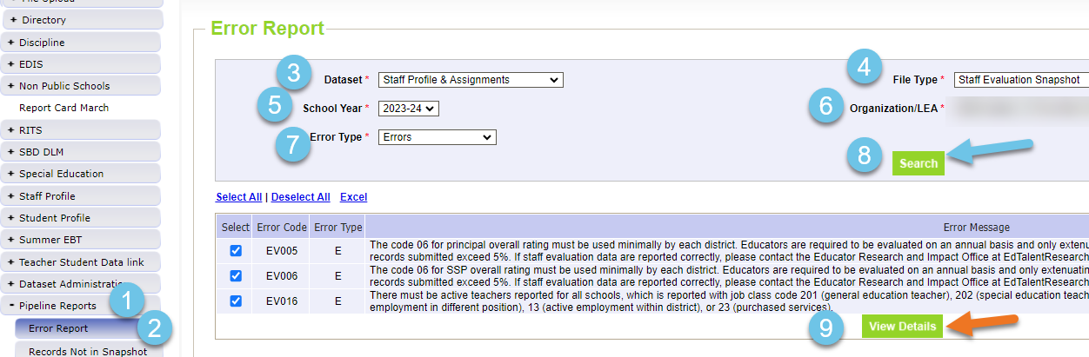
Staff Evaluation
Viewing Interchange or Snapshot Errors in Pipeline Reports
Staff Evaluation Snapshot Collection
StaffEvaluation@cde.state.co.us

Slide 25
Staff Evaluation Snapshot Errors
EV004, EV005, EV006=06 overall rating must be used minimally by each district. Exceptions can be approved by EdTalentResearch@cde.state.co.us email address in error message. Please copy StaffEvaluation@cde.state.co.us
EV030=Staff member was reported in Human Resources or Special Education December count as a Teacher, Special Service Provider or Principal therefore we are expecting evaluation data for them.
  If they left prior to evaluation being completed, please use 06 in their overall rating indicating they were not fully evaluated.
Staff Evaluation Snapshot Collection
StaffEvaluation@cde.state.co.us

Slide 26
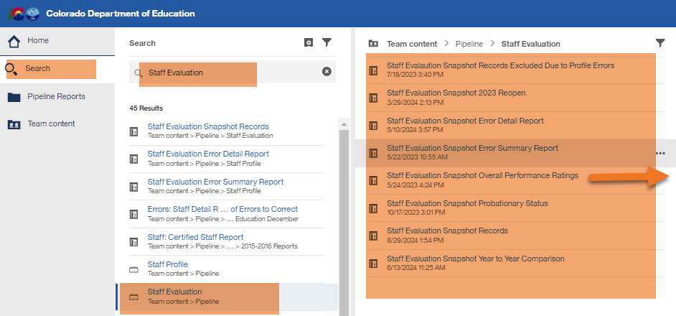
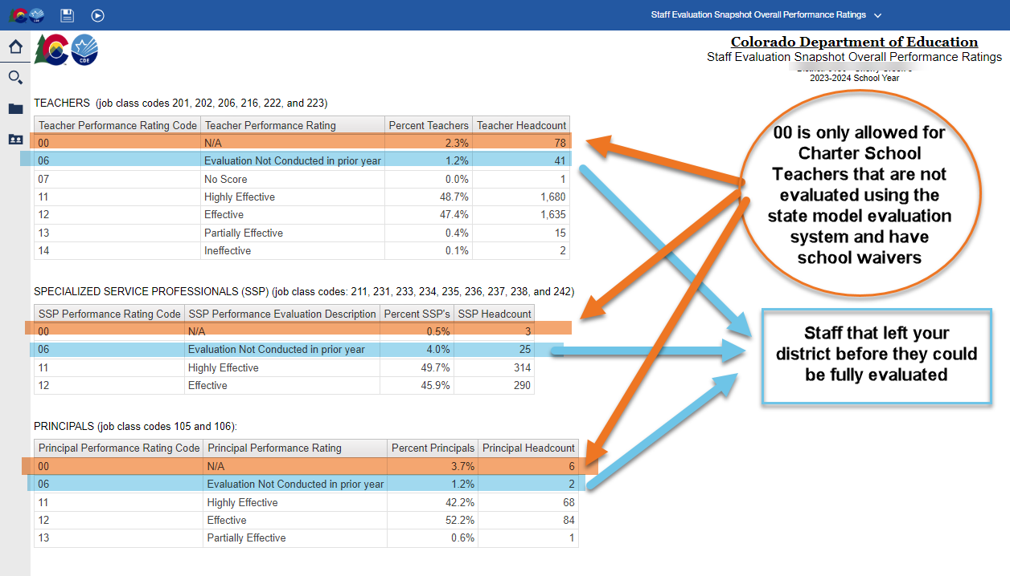
Staff Evaluation
Validating Data
Staff Evaluation Snapshot Collection
StaffEvaluation@cde.state.co.us

Slide 27
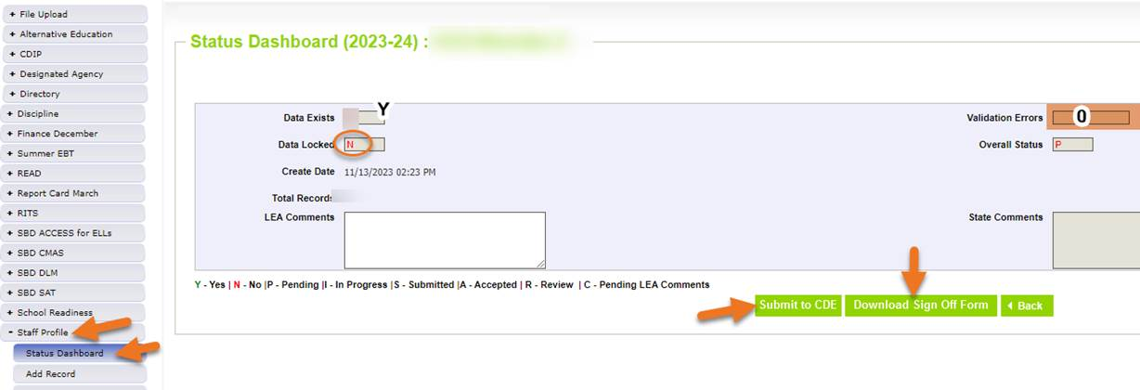
Submitting Staff Evaluation Data
Staff Evaluation Snapshot Collection
StaffEvaluation@cde.state.co.us

Slide 28
Staff Evaluation Snapshot
Collection Resources
Staff Evaluation Timeline
Staff Evaluation file layout
StaffEvaluation@cde.state.co.us
Dawna Gudka-Collection lead
(303) 598-7901

Slide 29
Student End of Year
Reagan Ward

Slide 30
SEY Collection Timeline:
Upcoming Events
Date | Event | Event Description
10/08/2024 to 10/17/2024 | Report Review | Validate SEY data using CEDAR/COGNOS reports Final opportunity to correct all data fields, including DEM fields Submit snapshot as soon as review is complete
10/17/2024 | Deadline | Resubmit SEY snapshot
10/23/2024 2:30-3:30pm | Training Event | October SEY Office Hours: Post-Cross LEA Phase 10/24 Registration Link
10/24/2024 | Post-Cross LEA Open | Districts may begin updating their snapshot to address Post-Cross LEA business rules.
11/13/2024 | Interim Deadline | Error free SEY snapshot
11/13/2024 2:30-3:30pm | Training Event | November SEY Office Hours: Final Dates and Data Release 11/13 Registration Link
11/14/2024 to 11/19/2024 | Report Review | Validate SEY data using CEDAR/COGNOS reports Begin submitting Superintendent Verification (sign-off) forms
11/19/2024 (noon) | Deadline | Post-Cross phase ends. Districts must have error free SEY snapshot and have addressed any necessary post-cross changes.
12/3/2024 | Deadline | Collection closes. • Superintendent Verification (sign-off) form due. • Data remains embargoed until the official release in January
Visit the SEY Website to download the complete SEY Collection Timeline with Training Dates
Student End of Year – Reagan Ward
StudentEndOfYear@cde.state.co.us

Slide 31
SEY Cross LEA Status as of 4pm on 10/9
Snapshot Status
Notes
All LEAs must create a SEY snapshot during this phase, even if they were error free at the start of the phase.
All LEAs must resubmit an error-free snapshot by the 10/17 deadline.
Some errors/warnings require collaboration between LEAs to resolve
Student End of Year – Reagan Ward
StudentEndOfYear@cde.state.co.us

Slide 32
Report Review: SEY Reports
Operational
Preview Rates
Student List: AYG Cohort
Student List: Dropouts
Student List: District and School Mobility Instances
Cross LEA List – Students Removed from AYG Cohort
Student List: AYG Cohort Adjustments
Mobility: District and School Rates
Dropout: District and School Rates
Graduation: 3-,4-,5-,6-,7-year rates by school year
Graduation Rates: District and School by AYG
Still Enrolled Rates: District and School by AYG
Student End of Year – Reagan Ward
StudentEndOfYear@cde.state.co.us

Slide 33
Cross LEA Phase: Steps
Review errors and warnings
  SE700 series and any remaining SE001-SE500 series
Update interchange files as needed to resolve errors/warnings
  Any data field may be changed during this phase
  Final opportunity to address demographic updates
Upload Adjustment file
  If needed to address SE700 errors
Create SEY snapshot, repeating steps 1 through 4 as needed
Review SEY Data using CEDAR/COGNOS reports
Submit error-free SEY snapshot
  LEA Approver role required
Note: Steps 1, 4, 5, and 6 are required for all LEAs, even if they are error free at the beginning of this phase
Student End of Year – Reagan Ward
StudentEndOfYear@cde.state.co.us

Slide 34
Questions & Resources:
Student End of Year
StudentEndOfYear@cde.state.co.us
720-484-9057
Student End of Year Website
Student Interchange Website
Graduation Guidelines Website

Slide 35
Student October
Brooke Wenzel

Slide 36
Student October Timeline – Regular Phase
Date | Event | Event Description
10/14/2024 | Training Event | Mid-Collection Office Hours 1-2 p.m.
10/14/2024 | Interim Deadline | Create an initial Student October Snapshot
10/22/2024 | Interim Deadline | Error free Student October Snapshot
10/24/2024 | Training Event | Data Validation, Transfer Enrollment Exceptions and Cognos Reports 1-2 p.m.
10/28/2024 | Training Event | Data Pipeline Duplicate Process and Submission 9-10 a.m.
11/01/2024 | Report Review | Review Student October Cognos Reports for data validation. Submit Student October Snapshot data as soon as review is complete.
11/08/2024 12:00 p.m. | State Deadline | Submit Student October Snapshot data
Student October
StudentOctober@cde.state.co.us

Slide 37
Student October Timeline – Duplicate Process
Date | Event | Event Description
11/12/2024 12:00 p.m. | Deadline | Duplicate funding documentation due to School Auditing Office
11/18/2024 | Other Date | School Auditing makes decisions on funding duplicates
11/27/2024 | Deadline | Resubmit Student October Snapshot data to CDE based on decisions from School Auditing
12/06/2024 | Deadline | Collection closes Secretary of the Board of Education Verification (sign-off) form due. Data remains embargoed until the official release in January.
01/15/2025 | Data Release | Official data release
Student October
StudentOctober@cde.state.co.us

Slide 38
Student October Training Schedule
Note: Join live training on the Student October Website. Training and PPT will be posted after the training.
Mid-Collection Office Hours
Date/Time: 10/14/2024 1-2 p.m. (UPDATED)
Click here to join the Mid-Collection teams meeting.
Data Validation, Transfer Enrollment Exceptions and Cognos Reports Training
Date/Time: 10/24/2024 1-2 p.m.
Click here to join the Data Validation teams meeting.
Data Pipeline Duplicate Process and Submission Training
Date/Time: 10/28/2024 9-10 a.m.
Click here to join the Duplicate Process teams meeting.
Student October
StudentOctober@cde.state.co.us

Slide 39
Snapshot Status Update 7:00 a.m. 10/10
Student October
StudentOctober@cde.state.co.us

Slide 40
Why Should I Upload Files/Take a Snapshot Early?
We have errors/warnings that flag based on information that was (is) reported in Student End of Year
Catch inconsistencies within Student October to update Student End of Year data now!
  OC185 - Students with Postsecondary Program Codes indicating ASCENT, P-TECH Years 5-6, TREP Years 5-6 must have a district code in the current year that matches their last district of attendance in the prior year. Note: This error will also flag if retention code '2' is not used appropriately in the Student End of Year Collection.
  OC173 - The student has a special education transition code of 1, 2, 3, 4 in the current year but does not have a retention code of 3 in the prior year Student End of Year Collection.
Student October
StudentOctober@cde.state.co.us

Slide 41
Common Contract Students
Contract with another district or BOCES school that has a school code
  Resident District
    Pupil Attendance Information 31 for the enrollment record showing the contract for funding purposes(brick and mortar).
  Attending District or BOCES
    Will have a record with PAI 02 or 04 to show student is attending their district. This record will have a non-funded code because they are paid through the contract instead.
Contract with another district or BOCES program that doesn’t have a school code
  Resident District
    Pupil Attendance Information 01-08 and Non-School Program of 03 to indicate that the resident district is taking accountability with the non-school 03 indicating the student is receiving all their educational services through a program that is run and operated by another district (i.e., non-reporting district) or BOCES with which the district has a contractual agreement.
Facility School
  Resident District
    Most likely, you won’t have a record for this student because funding for facility schools is different. More information on these rare scenarios can be found in the Audit Resource Guide.
Posted: Contract student document on the Student Interchange Website under Additional Resources with common scenarios for all student-level collections (including special education).
Student October
StudentOctober@cde.state.co.us

Slide 42
Questions & Resources:
Questions & Resources:
Student October
Brooke Wenzel
StudentOctober@cde.state.co.us
720-441-7963
Student October Webpage
Student Interchange Webpage

Slide 43
At-Risk Interchange Updates
Rebecca McRee

Slide 44
New: At-Risk Measure Interchange File -
Overview
Beginning with the 2024/2025 school year, there is a new Data Pipeline At-Risk Interchange.
The purpose of the At-Risk Interchange is to obtain student-level census block data (based on primary residential addresses) that is needed to implement the new at-risk measure as described in HB22-1202 with data collection to begin with the 2024-2025 school year as provided for under SB24-188.
The new at-risk measure will be implemented starting with the 2025/2026 school year, and included in the Total Program funding calculation as described in the Public-School Finance Act which will continue to utilize student level data reported through the Student October Count data collection.
This interchange opened on July 15, 2024 and closes November 8, 2024. It will only be open during the Student October Count Collection.
At-Risk Interchange
ARMeasure@cde.state.co.us

Slide 45
New: Census Block Data
Required and valid census block data combinations include 4 data fields:
  State Code
  County Code
  Tract Code
  Block Code
To obtain this data, districts will need to first gather, clean and validate student address data.
Then districts will need to "geocode" each student's primary physical residential address to obtain this information.
  District's GIS system (such as ARC)
  Census Geocoder Tool
  Other (if your district has some other tool, please reach out to ARMeasure@cde.state.co.us)
At-Risk Interchange
ARMeasure@cde.state.co.us

Slide 46
New: At-Risk Measure Interchange File -
Resources
At-Risk Interchange Website
  File Layout
  Business Rules
  Interchange Upload Template (XLS)
  Timeline
  Trainings
    Overview of the Geocoder Tool (PDF) (Recorded Training)
    Overview of the Data Pipeline At-Risk Interchange File (PDF) (Recorded Training)
    Office Hours Session covering the Geocoder Tool and Interchange File was held yesterday, Sept.11, 2024. (PDF) (Recording will be posted on or about 9/16)
  Additional Resources
    UPDATED 9/10/24: Instructions for Using the Geocode Tool
    Valid Census Block Data Combinations (XLS)
At-Risk Interchange
ARMeasure@cde.state.co.us

Slide 47
New: At-Risk Measure Interchange File -
Timeline
Date | Event | Event Description
7/15/2024 | Open | Districts may begin to upload the At-Risk Interchange file to the data pipeline.
8/23/2024 | Open | Districts may begin creating Student October Snapshots. This Snapshot is dependent on the Student Demographic File, Student School Association File, Title 1 File (if applicable) and the At-Risk File.
8/13/2024 | Training Event | Overview of the Census Geocoder Tool (10-11am)
8/20/2024 | Training Event | Overview of the At-Risk Interchange File (1-2pm)
9/13/2024 | Other Date | Gather, review, clean-up and validate student addresses
9/27/2024 | Other Date | Obtain census block data for all student addresses
10/2/2024 | Interim Deadline | Upload the At-Risk Interchange File
10/9/2024 | Interim Deadline | Obtain error-free At-Risk Interchange File upload
10/22/2024 | Interim Deadline | Obtain error-free Student October Snapshot
11/1/2024 | Report Review | Review Student October Cognos Reports for data validation. Submit Student October Snapshot data as soon as review is complete
11/8/2024 | State Deadline | Submit Student October Snapshot data
At-Risk Interchange
ARMeasure@cde.state.co.us

Slide 48
File Layout and Definitions (page 3):
Missing Census Block Data- Coding Patterns
Description | State Code | County Code | Tract Code | Block Code
Address on File- Did Not Attempt to Obtain Census Block Data: The district has a primary physical address on file but did NOT attempt to obtain census block data using the geocode tool. | 08 | 000 | 000001 | 0001
Address on File- No Census Block Data Returned: The district confirmed that the primary physical address is valid using USPS but the geocode tool did not return census block data. | 08 | 000 | 000002 | 0002
Confidentiality Program: No census block data was provided because the district has confirmed the student is participating in a confidentiality program. | 08 | 000 | 000003 | 0003
No Physical Primary Address on File- Identified Group: The district does not have a primary physical address on file and the student is confirmed homeless, migrant, foster child, or attending a detention center. | 08 | 000 | 000004 | 0004
No Physical Primary Address on File- No Identified Group: The district does not have a primary physical address on file and the student is not confirmed homeless, migrant, foster child, or attending a detention center. | 08 | 000 | 000005 | 0005
Out of State codes: The district has a primary physical address on file that is not in Colorado. | 08 | 000 | 000006 | 0006
At-Risk Interchange
ARMeasure@cde.state.co.us

Slide 49
New: At-Risk Measure Interchange File - Syncplicity Folders
Syncplicity folders are being shared on a rolling basis with ARM LEAUSERS and LEAVEWIERS.
The folder naming convention is:
  District Code_ District Name_ ARMeasure Interchange
These folders can be used to share files containing PII between the district or BOCES and CDE when requesting assistance with the At-Risk Interchange or Census Geocoding tool.
If you have been assigned the user or viewer role for this interchange file and your district's Syncplicity folder has not been shared with you, email ARMeasure@cde.state.co.us.
At-Risk Interchange
ARMeasure@cde.state.co.us

Slide 50
Questions & Resources:
At Risk Interchange
ARMeasure@cde.state.co.us
Data Pipeline At-Risk Interchange website

Slide 51
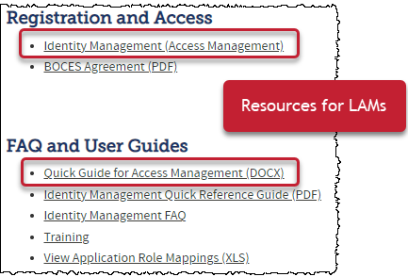
Thank you for joining today!
Next Town Hall will be October 17th
Helpful resources to bookmark:
Identity Management Website
Data Pipeline Website

