Slide 1
October 3, 2024
Data Pipeline Town Hall
The goal of the webinar is to provide updates on the Data Pipeline, current, and upcoming data collections. These webinars also provide a forum for districts, BOCES, and Administrative Units to have questions answered about Data Pipeline.

Slide 2
Colorado Department of Education
Identity Management (IdM)
Identity Management Site
Frequently Asked Questions
How do I add myself or others to the email listserv for town hall emails and/or a specific collection?
  Email lists are dependent on a person’s access rights in IdM. Contact your LAM to get an account or be assigned to a specific collection.
Where can I find the IdM role mappings for Data Pipeline and other applications?
  Role Mapping (XLS)
I am a LAM. How do I update the user permissions for someone in my district?
  Follow the steps outlined in the IdM Quick Guide for Access Management (DOCX)
Important: Users are not automatically removed from IdM when their email address is no longer active in your district. The LAM must deactivate their IdM account to ensure only designated staff can access CDE’s data reporting system.
Notes:
LAMs, please check the IdM roles for your district. Remove permissions for users who have retired, left your district, or are no longer assigned to a collection. Add roles for new hires and newly assigned respondents for specific collections.

Slide 3

What is PII?
Student and Staff Personally Identifiable Information (PII) is defined by state and federal laws as information that, alone or in combination, personally identifies an individual
  This includes direct identifiers
  (i.e. student and staff names, SASID, EDID, etc.)
  Includes information that when combined is identifiable
Colorado’s Student Data Transparency and Security Act outlines requirements for how Student PII is collected, used and shared
See the Data Privacy and Security website for prepared guidance on how to comply with this and other privacy laws.

Slide 4

Sharing Data
Use secure methods to transfer any PII to CDE
  Contact Data Collection leads with questions about how to transmit PII securely
    Each Data Collection leads maintains their own Syncplicity folders for specific collections, reach out to the collection lead for access
  Use Syncplicity to encrypt emails to CDE
Avoid sending PII via unencrypted email or to unsecured faxes when sharing data between or within districts
  Use Syncplicity to encrypt emails to CDE
Check local policies for restrictions, requirements, etc. regarding PII
  Do not use PII in trainings, presentations, etc.
  Do not share PII with unauthorized individuals
  Do not share passwords
  Follow local policies when transmitting PII to any third party

Slide 5
Today’s Agenda
Agenda Topic | Presenter
Open Data Collections and Upcoming Deadlines in Data Pipeline
Non-Public Schools | Jessica Tribbett
Kindergarten School Readiness | Tara Rhodes
Staff Evaluation | Dawna Gudka
Title I | Melissa Chaffin
Student End of Year | Reagan Ward
2024-2025 Graduation Guidelines: SAT Math | Reagan Ward
Student October | Brooke Wenzel
At Risk Interchange Updates | Rebecca McRee

Slide 6
Open Collections and
Upcoming Deadlines in
Data Pipeline

Slide 7
Open Collections and Upcoming Dates:
Year-Round & Interchanges
Name | Category | Status | Key Dates
RITS | Year Round | Open
EDIS | Year Round | Open
Directory | Year Round | Open
Student | Interchange | Open | 2023-2024 and 2024-2025 are open
At-Risk | Interchange | Open
Title I | Interchange | Open
Special Education IEP | Interchange | Open | 2023 – 2024 still open and 2024 – 2025 will open 10/07/24
Staff | Interchange | Open | 2023-2024 and 2024-2025 are open
Data Pipeline Resources: Data Pipeline Collection Dates (XLS)

Slide 8
Open Collections and Upcoming Dates:
Snapshots
Name | Category | Status | Final Deadline Date | Next Milestone | Looking Ahead
Staff Evaluation | Snapshot | Open | Oct. 15, 2024 | Interim Deadline: 8/7/2024-9/30/2024 Report Review | Collection Deadline: 10/15/2024
Student October | Snapshot | Open | Nov. 8, 2024 | Interim Deadline: 10/9/2024 Interchange files error-free | Interim Deadline: 10/14/2024 Take at least 1 Student Oct Snapshot
Student End of Year | Snapshot | Open | Nov. 19, 2024 | Interim Deadline: 10/7/2024 error free SEY snapshot | Report Review: 10/8/24 to 10/17/24
Special Education End of Year | Snapshot | Closing Soon | Sept. 27, 2024 | Interim Deadline: N/A | Final Deadline: 9/27/2024 Final report review and submission due to CDE
Data Pipeline Resources: Data Pipeline Collection Dates (XLS)

Slide 9
Non-Public School Fall Enrollment Count
Jessica Tribbett

Slide 10
Non-Public Schools Enrollment Fall Count
Wednesday, Oct. 2nd thru Monday, December 2nd
Non-public schools must have school code to participate.
Request for New School Code for Non-Public Schools:
https://www.cde.state.co.us/schoolcoderequest-nonpublic
District contacts must have Data Pipeline Non-Public Schools Collection permissions.
Permissions can be set in Identity Management (Access Management):
https://www.cde.state.co.us/idm
Non-Public Schools Enrollment Fall Count
Tribbett_Jessica@cde.state.co.us

Slide 11
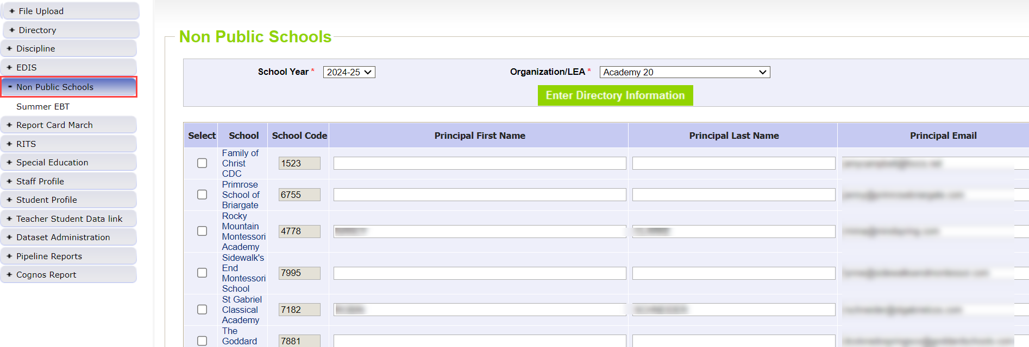
Non-Public Schools Enrollment Fall Count
10/02 - 12/02
Non-Public Schools Enrollment Fall Count
Tribbett_Jessica@cde.state.co.us

Slide 12
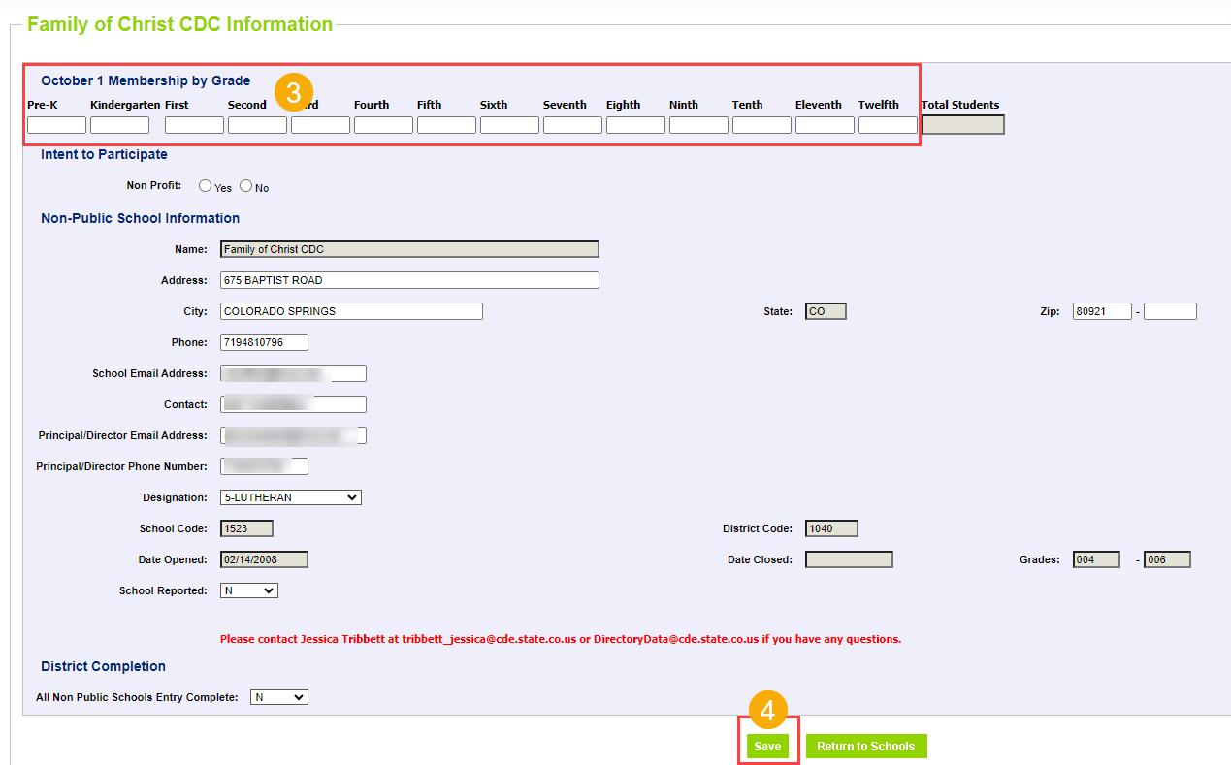
Non-Public Schools Enrollment Fall Count
10/02 - 12/02
Non-Public Schools Enrollment Fall Count
Tribbett_Jessica@cde.state.co.us

Slide 13
Non-Public Schools
Questions & Resources
Non-Public School Fall Enrollment Count Form
Request a CDE assigned Non-public School Code
Find School District Contact
Tribbett_Jessica@cde.state.co.us

Slide 14
Kindergarten School Readiness
Tara Rhodes

Slide 15
Upcoming Trainings
Kindergarten School Readiness (KSR)
Upcoming Trainings:
10/02/2024: Recording will be posted soon.
10/09/2024: KSR: Data Pipeline Uploads Sourcing Data from a Single Platform
10/16/2024: KSR: Data Pipeline Uploads Sourcing Data from Multiple Platforms
All trainings will be held from 11:30am-12:15pm on the above dates.
Important Dates:
10/23/2024: KSR Data Collection Opens
12/11/2024: KSR Data Collection Due Date
Current To-Do's:
Attend trainings
Talk with your School Readiness contact
  Learn which assessment tool is being used
  Learn whether manual aggregation of data will be required
  Learn the status of the assessment
Kindergarten School Readiness (KSR)
KSRData@cde.state.co.us

Slide 16
Questions & Resources
Kindergarten School Readiness (KSR)
Contact: Tara Rhodes
Email: KSRData@cde.state.co.us
Phone: 720.601.4125
Kindergarten School Readiness Website

Slide 17
Staff Evaluation
Dawna Gudka

Slide 18
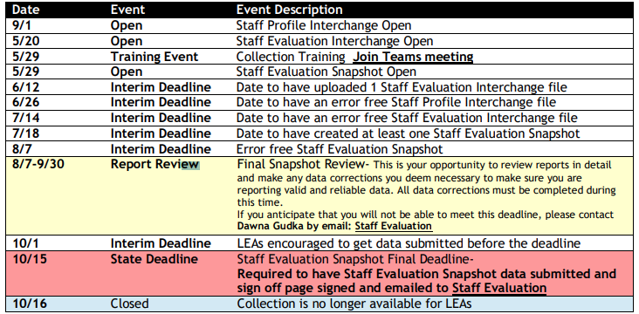
Staff Evaluation Collection Timeline
Staff Evaluation – Dawna Gudka
StaffEvaluation@cde.state.co.us

Slide 19
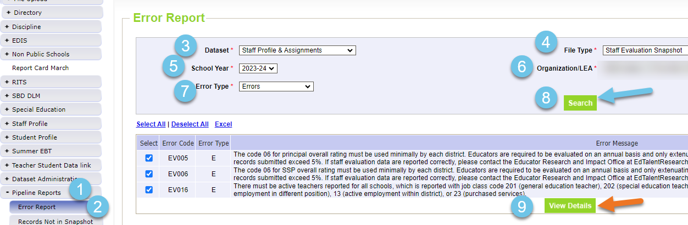
Staff Evaluation
Viewing Interchange or Snapshot Errors in Pipeline Reports
Staff Evaluation Snapshot Collection
StaffEvaluation@cde.state.co.us

Slide 20
Staff Evaluation Snapshot Errors
EV004, EV005, EV006=06 overall rating must be used minimally by each district. Exceptions can be approved by EdTalentResearch@cde.state.co.us email address in error message. Please copy StaffEvaluation@cde.state.co.us
EV030=Staff member was reported in Human Resources or Special Education December count as a Teacher, Special Service Provider or Principal therefore we are expecting evaluation data for them.
  If they left prior to evaluation being completed, please use 06 in their overall rating indicating they were not fully evaluated.
Staff Evaluation Snapshot Collection
StaffEvaluation@cde.state.co.us

Slide 21
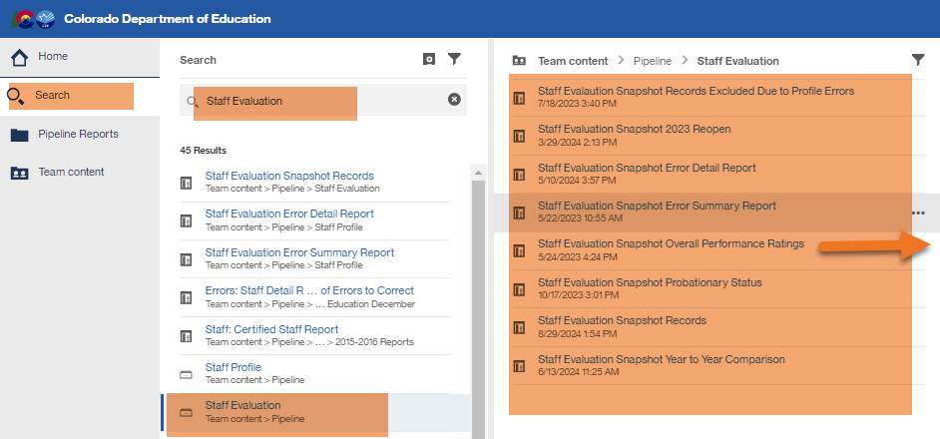
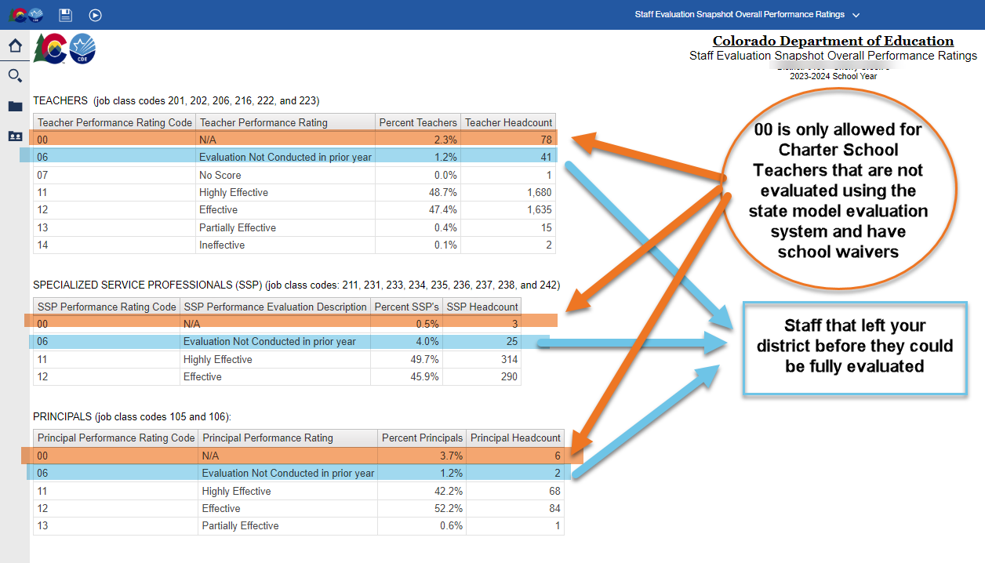
Staff Evaluation
Validating Data
Staff Evaluation Snapshot Collection
StaffEvaluation@cde.state.co.us

Slide 22
Submitting your Data

Slide 23
Staff Evaluation Snapshot Collection Resources
Staff Evaluation Timeline
Staff Evaluation file layout
StaffEvaluation@cde.state.co.us
Dawna Gudka-Collection lead
(303) 598-7901

Slide 24
Title I
Melissa Chaffin, Federal Programs

Slide 25
2023-2024 Collection Timeline
Date | Event | Event Description
Currently | Final Update Window | SEY 2023-2024 Cross LEA phase begins. Final opportunity for LEAs to update their 2023-2024 Title I Interchange file. This file should reflect all students who received Title I Targeted Assistance at any point during the 2023-2024 school year. Most LEAs won't need to, but LEAs should validate their data during this phase and make updates if needed.
10/17/2024 | DEADLINE | SEY 2023-2024 Cross LEA phase ends and the 2023-2024 Title I Interchange closes for 23-24 EOY.
Title I
Chaffin_m@cde.state.co.us

Slide 26
2024-2025 Collection Timeline
Date | Event | Event Description
Current | Title I 24-25 Interchange open in Data Pipeline | LEAs can begin to upload their Title I file to address any errors. This would be for the school year 24-25 for Student October.
10/02/2024 | Upload Title I file | Upload Title I file to address any errors if you haven’t already.
10/09/2024 | Interim Deadline Title I | Interim Deadline for Title I file uploaded and error-free.
10/22/2024 | Title I Deadline | Have Title I uploaded and error free for Student October snapshot.
11/08/2021 | Official State Deadline | Have Title I uploaded and error free for Student October snapshot.
Title I
Chaffin_m@cde.state.co.us

Slide 27
Title I Important To-Do
I will be emailing LEAs that have not uploaded a file as of today.
List of schools and grade spans to check status (TA, SW, NS): Title I-A School Lists (24-25 is now posted).
Only TA schools and grade spans need to be submitted in the file.
Include students in TA grade schools/grade spans who received Title I services/resources any time during the instructional school year, even if student left school/district or services were stopped.
Title I
Chaffin_m@cde.state.co.us

Slide 28
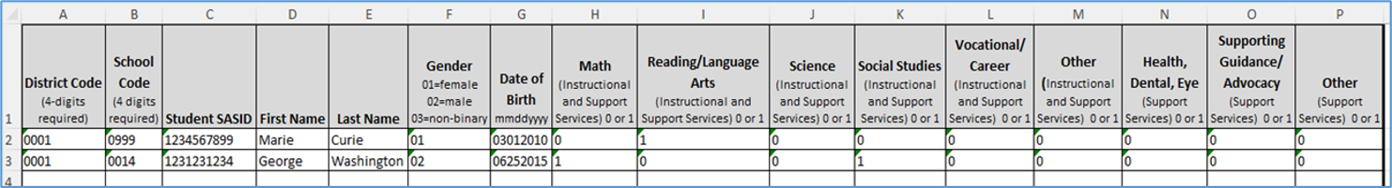
Title I Interchange Targeted Assistance (TA)
IMPORTANT: The student data must match the Student School Association file in the Data Pipeline.
Many of the errors I am seeing are due to no Student School Association file being uploaded into the Data Pipeline.
If you upload the SSA file after the Title I file, or make changes to the SSA file T1 students after uploading Title I file, you need to refresh the Title I file for the errors to disappear.
The new Title I file template can be found here: Data Pipeline Interchanges – Title I
The Student School Association file can be found here: Student School Association File
Example of the Title I template:
Title I
Chaffin_m@cde.state.co.us

Slide 29
Questions & Resources:
Title I
Melissa Chaffin
chaffin_m@cde.state.co.us
720-908-1379

Slide 30
Student End of Year
Reagan Ward

Slide 31
SEY Collection Timeline:
Upcoming Events
Date | Event | Event Description
10/07/2024 | Interim Deadline | Error free Cross LEA snapshot
10/08/2024 to 10/17/2024 | Report Review | Validate SEY data using CEDAR/COGNOS reports Final opportunity to correct all data fields, including DEM fields Submit snapshot as soon as review is complete
10/17/2024 | Deadline | Resubmit SEY snapshot
10/23/2024 2:30-3:30pm | Training Event | October SEY Office Hours: Post-Cross LEA Phase Registration Link
10/24/2024 | Post-Cross LEA Open | Districts may begin updating their snapshot to address Post-Cross LEA business rules.
11/13/2024 | Interim Deadline | Error free SEY snapshot
11/13/2024 2:30-3:30pm | Training Event | November SEY Office Hours: Final Dates and Data Release Registration Link
11/14/2024 to 11/19/2024 | Report Review | Validate SEY data using CEDAR/COGNOS reports Begin submitting Superintendent Verification (sign-off) forms
11/19/2024 (noon) | Deadline | Post-Cross phase ends. Districts must have error free SEY snapshot and have addressed any necessary post-cross changes.
12/3/2024 | Deadline | Collection closes. • Superintendent Verification (sign-off) form due. • Data remains embargoed until the official release in January
Visit the SEY Website to download the complete SEY Collection Timeline with Training Dates
Student End of Year – Reagan Ward
StudentEndOfYear@cde.state.co.us

Slide 32
SEY Cross LEA Status as of 4:15 pm on 10/2
Snapshot Status
Notes
LEAs need to collaborate to address some errors and warnings. Don’t wait to work on this phase.
All LEAs must create a SEY snapshot during this phase, even if they were error free at the start of the phase.
All LEAs must resubmit an error-free snapshot by the 10/17 deadline.
Student End of Year – Reagan Ward
StudentEndOfYear@cde.state.co.us

Slide 33
Cross LEA SE700 errors and warnings
SE700 Errors
SE700 Warnings
SE702 requires LEAs to collaborate. Only one district can count a student as a graduate or completer, the other uses exit type 13
SE704 and SE706 require an adjustment file
SE710 may require and adjustment file
SE711 had an update last week.
  Snapshots created 7/25 and beyond are accurately reflecting this fix
  Reach out if need assistance determining facility school impacting record
SE500 errors can only be cleared by correcting your interchange data and reaching out to SEY Collection lead to request the error is cleared. After your next snapshot, it should go away.
Some become SE900 errors in Post-Cross
  SE722 becomes SE903:
    7th-12th grade student with exit 13 who hasn’t been reported by another CO district
  SE707 does not have a follow up error, despite the rule message (fix pending)
  SE708 becomes SE904 (fixed 10/1)
  SE720 becomes SE901
  SE721 becomes SE902
  SE727 becomes SE907
SE725 indicates possible errors when working on 2024-2025 SSA file
SE726 and SE727 are new warnings that do not have follow up Post-Cross errors
  SE726 over triggering for PK-6. If grade 7-12, please check student’s exit type.
Student End of Year – Reagan Ward
StudentEndOfYear@cde.state.co.us

Slide 34
Questions & Answers:
Student End of Year
StudentEndOfYear@cde.state.co.us
720-484-9057
Student End of Year Website
Student Interchange Website
Graduation Guidelines Website

Slide 35
2024-2025 Graduation Guidelines:
SAT Math Benchmark
Reagan Ward

Slide 36
Graduation Guidelines 2024-2025
SAT Math cut score change
Shared 9/19/24 Town Hall
September State Board of Education meeting; SBE temporarily adjusted cut score for digital SAT math on the GG menu
  News Release Site
  Due to the changes with the digital SAT, the board unanimously approved moving the digital SAT math cut score for graduation guidelines to 480 from 500 for students graduating in 2025 and 2026 and directed CDE to work with the Colorado Commission of Higher Education to determine a proficiency level for future years.
Visit the PWR Graduation Guidelines site for more information
  PWR Contacts: Michelle Romero and Robin Russel
No change to GG data reporting.
Change impacts the use of the GG data in SEY 2025 and SEY 2026.
Coming Soon: Technical Information
  Technical explanation of impacted AYG cohorts, completion year of SAT, etc.
  Updating CEDAR/COGNOS GG reports to reflect new cut score
  Ensure SEY 2025 and SEY 2026 utilize the new cut score for SE301 business rule
Graduation Guidelines
Romero_M@cde.state.co.us or Russel_R@cde.state.co.us
Notes:
More information expected in:
PWR News, The SCOOP, and October CDE Update

Slide 37
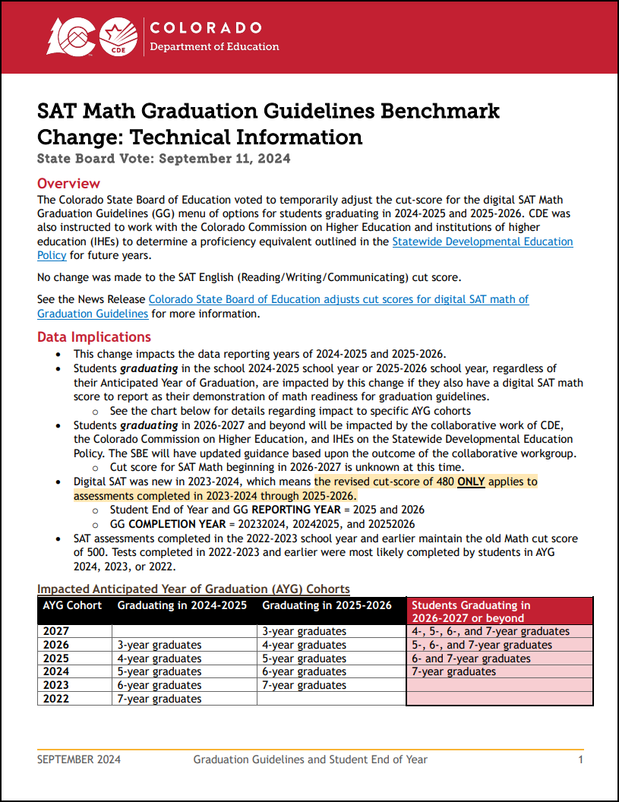
Technical Information
Impacts students GRADUATING in 2025 and 2026 (exit 90, 95, 96)
Digital SAT was new in 2024
  Revised cut-score of 480 ONLY applies to tests completed in 2024 through 2026
    Student End of Year and GG REPORTING YEAR 2025 and 2026
    GG COMPLETION YEAR 20232024, 20242025, and 20252026
  SAT Math cut-score for tests completed in 2023 and earlier remains 500
TBD: Impact for students graduating in 2027 and beyond
Technical Information (PDF) posted on Student Interchange and SEY Website
AYG Cohort | Graduating in 2024-2025 | Graduating in 2025-2026 | Students Graduating in 2026-2027 or beyond
2027 |  | 3-year graduates | 4-, 5-, 6-, and 7-year graduates
2026 | 3-year graduates | 4-year graduates | 5-, 6-, and 7-year graduates
2025 | 4-year graduates | 5-year graduates | 6- and 7-year graduates
2024 | 5-year graduates | 6-year graduates | 7-year graduates
2023 | 6-year graduates | 7-year graduates
2022 | 7-year graduates
Graduation Guidelines
Romero_M@cde.state.co.us or Russel_R@cde.state.co.us

Slide 38
Graduation Guidelines
Questions & Resources
Michelle Romero: Romero_M@cde.state.co.us
Robin Russel: Russel_R@cde.state.co.us
Graduation Guidelines Website
Student End of Year Website
Student Interchange Website

Slide 39
Student October
Brooke Wenzel

Slide 40
Student October Timeline – Regular Phase
Date | Event | Event Description
10/08/2024 | Other Date | Last day of Student October Count Window for districts with 5-day school week.
10/09/2024 | Interim Deadline | Error free Student Interchange File uploads
10/14/2024 | Training Event | Mid-Collection Office Hours 10-11 a.m.
10/14/2024 | Interim Deadline | Create an initial Student October Snapshot
10/22/2024 | Interim Deadline | Error free Student October Snapshot
10/24/2024 | Training Event | Data Validation, Transfer Enrollment Exceptions and Cognos Reports 1-2 p.m.
10/28/2024 | Training Event | Data Pipeline Duplicate Process and Submission 9-10 a.m.
11/01/2024 | Report Review | Review Student October Cognos Reports for data validation. Submit Student October Snapshot data as soon as review is complete.
11/08/2024 12:00 p.m. | State Deadline | Submit Student October Snapshot data
Student October
StudentOctober@cde.state.co.us

Slide 41
Student October Timeline – Duplicate Process
Date | Event | Event Description
11/12/2024 12:00 p.m. | Deadline | Duplicate funding documentation due to School Auditing Office
11/18/2024 | Other Date | School Auditing makes decisions on funding duplicates
11/27/2024 | Deadline | Resubmit Student October Snapshot data to CDE based on decisions from School Auditing
12/06/2024 | Deadline | Collection closes Secretary of the Board of Education Verification (sign-off) form due. Data remains embargoed until the official release in January.
01/15/2025 | Data Release | Official data release
Student October
StudentOctober@cde.state.co.us

Slide 42
Student October Training Schedule
Note: Join live training on the Student October Website. Training and PPT will be posted after the training.
Mid-Collection Office Hours
Date/Time: 10/14/2024 10-11 a.m.
Click here to join the teams meeting.
Data Validation, Transfer Enrollment Exceptions and Cognos Reports Training
Date/Time: 10/24/2024 1-2 p.m.
Click here to join the teams meeting.
Data Pipeline Duplicate Process and Submission Training
Date/Time: 10/28/2024 9-10 a.m.
Click here to join the teams meeting.
Student October
StudentOctober@cde.state.co.us

Slide 43
What Should I Be Doing Now?
Extract Interchange Files
  Student Demographic
  Student School Association
  At-Risk (if you can extract)
  Title I (if applicable)
Upload Interchange Files into Data Pipeline
  You do not have to wait until October 1st to start uploading files (recommended to start now)
  Clean up errors within SIS and extract/upload files again
Take Student October Snapshot
Student October
StudentOctober@cde.state.co.us

Slide 44
Why Should I Upload Files/Take a Snapshot Early?
We have errors/warnings that flag based on information that was (is) reported in Student End of Year
Catch inconsistencies within Student October to update Student End of Year data now!
  OC185 - Students with Postsecondary Program Codes indicating ASCENT, P-TECH Years 5-6, TREP Years 5-6 must have a district code in the current year that matches their last district of attendance in the prior year. Note: This error will also flag if retention code '2' is not used appropriately in the Student End of Year Collection.
  OC173 - The student has a special education transition code of 1, 2, 3, 4 in the current year but does not have a retention code of 3 in the prior year Student End of Year Collection.
Student October
StudentOctober@cde.state.co.us

Slide 45
Common Contract Students
Contract with another district or BOCES school that has a school code
  Resident District
    Pupil Attendance Information 31 for the enrollment record showing the contract for funding purposes(brick and mortar).
  Attending District or BOCES
    Will have a record with PAI 02 or 04 to show student is attending their district. This record will have a non-funded code because they are paid through the contract instead.
Contract with another district or BOCES program that doesn’t have a school code
  Resident District
    Pupil Attendance Information 01-08 and Non-School Program of 03 to indicate that the resident district is taking accountability with the non-school 03 indicating the student is receiving all their educational services through a program that is run and operated by another district (i.e., non-reporting district) or BOCES with which the district has a contractual agreement.
Facility School
  Resident District
    Most likely, you won’t have a record for this student because funding for facility schools is different. More information on these rare scenarios can be found in the Audit Resource Guide.
Posted: Contract student document on the Student Interchange Website under Additional Resources with common scenarios for all student-level collections (including special education).
Student October
StudentOctober@cde.state.co.us

Slide 46
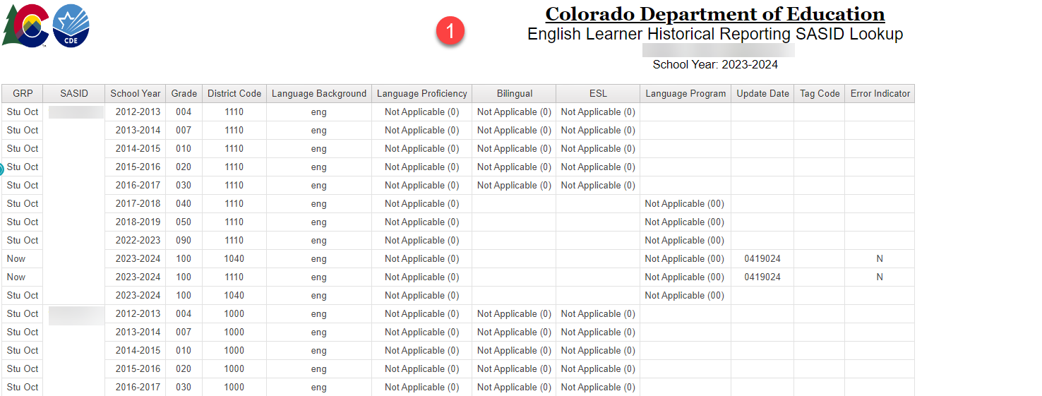
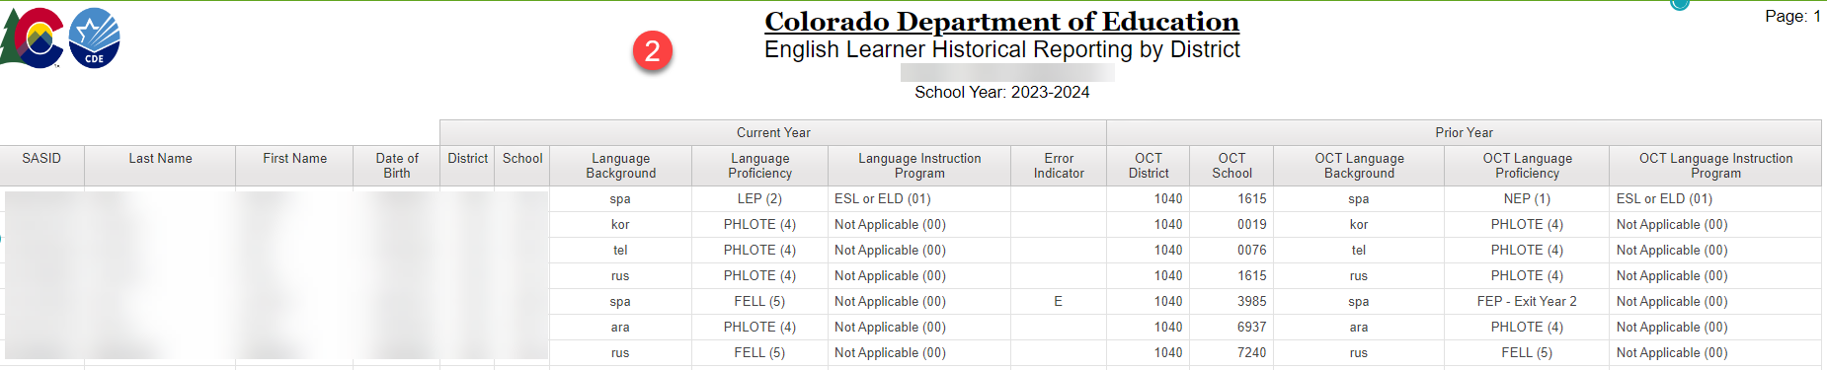
Student Profile ELL Reports
English Learner Historical Reporting by SASID
  Lookup one or multiple SASIDs to view ELL school career for student
English Learner Historical Reporting by District
  Lookup all students in reporting district and what they were coded last year vs. this year
Student October
StudentOctober@cde.state.co.us

Slide 47
Questions & Resources:
Questions & Answers:
Student October
Brooke Wenzel
StudentOctober@cde.state.co.us
720-441-7963
Student October Webpage
Student Interchange Webpage

Slide 48
At-Risk Interchange Updates
Rebecca McRee

Slide 49
New: At-Risk Measure Interchange File -
Overview
Beginning with the 2024/2025 school year, there is a new Data Pipeline At-Risk Interchange.
The purpose of the At-Risk Interchange is to obtain student-level census block data (based on primary residential addresses) that is needed to implement the new at-risk measure as described in HB22-1202 with data collection to begin with the 2024-2025 school year as provided for under SB24-188.
The new at-risk measure will be implemented starting with the 2025/2026 school year, and included in the Total Program funding calculation as described in the Public-School Finance Act which will continue to utilize student level data reported through the Student October Count data collection.
This interchange opened on July 15, 2024 and closes November 8, 2024. It will only be open during the Student October Count Collection.
At-Risk Interchange
ARMeasure@cde.state.co.us

Slide 50
New: Census Block Data
Required and valid census block data combinations include 4 data fields:
  State Code
  County Code
  Tract Code
  Block Code
To obtain this data, districts will need to first gather, clean and validate student address data.
Then districts will need to "geocode" each student's primary physical residential address to obtain this information.
  District's GIS system (such as ARC)
  Census Geocoder Tool
  Other (if your district has some other tool, please reach out to ARMeasure@cde.state.co.us)
At-Risk Interchange
ARMeasure@cde.state.co.us

Slide 51
New: At-Risk Measure Interchange File -
Resources
At-Risk Interchange Website
  File Layout
  Business Rules
  Interchange Upload Template (XLS)
  Timeline
  Trainings
    Overview of the Geocoder Tool (PDF) (Recorded Training)
    Overview of the Data Pipeline At-Risk Interchange File (PDF) (Recorded Training)
    Office Hours Session covering the Geocoder Tool and Interchange File was held yesterday, Sept.11, 2024. (PDF) (Recording will be posted on or about 9/16)
  Additional Resources
    UPDATED 9/10/24: Instructions for Using the Geocode Tool
    Valid Census Block Data Combinations (XLS)
At-Risk Interchange
ARMeasure@cde.state.co.us

Slide 52
New: At-Risk Measure Interchange File -
Timeline
Date | Event | Event Description
7/15/2024 | Open | Districts may begin to upload the At-Risk Interchange file to the data pipeline.
8/23/2024 | Open | Districts may begin creating Student October Snapshots. This Snapshot is dependent on the Student Demographic File, Student School Association File, Title 1 File (if applicable) and the At-Risk File.
8/13/2024 | Training Event | Overview of the Census Geocoder Tool (10-11am)
8/20/2024 | Training Event | Overview of the At-Risk Interchange File (1-2pm)
9/13/2024 | Other Date | Gather, review, clean-up and validate student addresses
9/27/2024 | Other Date | Obtain census block data for all student addresses
10/2/2024 | Interim Deadline | Upload the At-Risk Interchange File
10/9/2024 | Interim Deadline | Obtain error-free At-Risk Interchange File upload
10/22/2024 | Interim Deadline | Obtain error-free Student October Snapshot
11/1/2024 | Report Review | Review Student October Cognos Reports for data validation. Submit Student October Snapshot data as soon as review is complete
11/8/2024 | State Deadline | Submit Student October Snapshot data
At-Risk Interchange
ARMeasure@cde.state.co.us

Slide 53
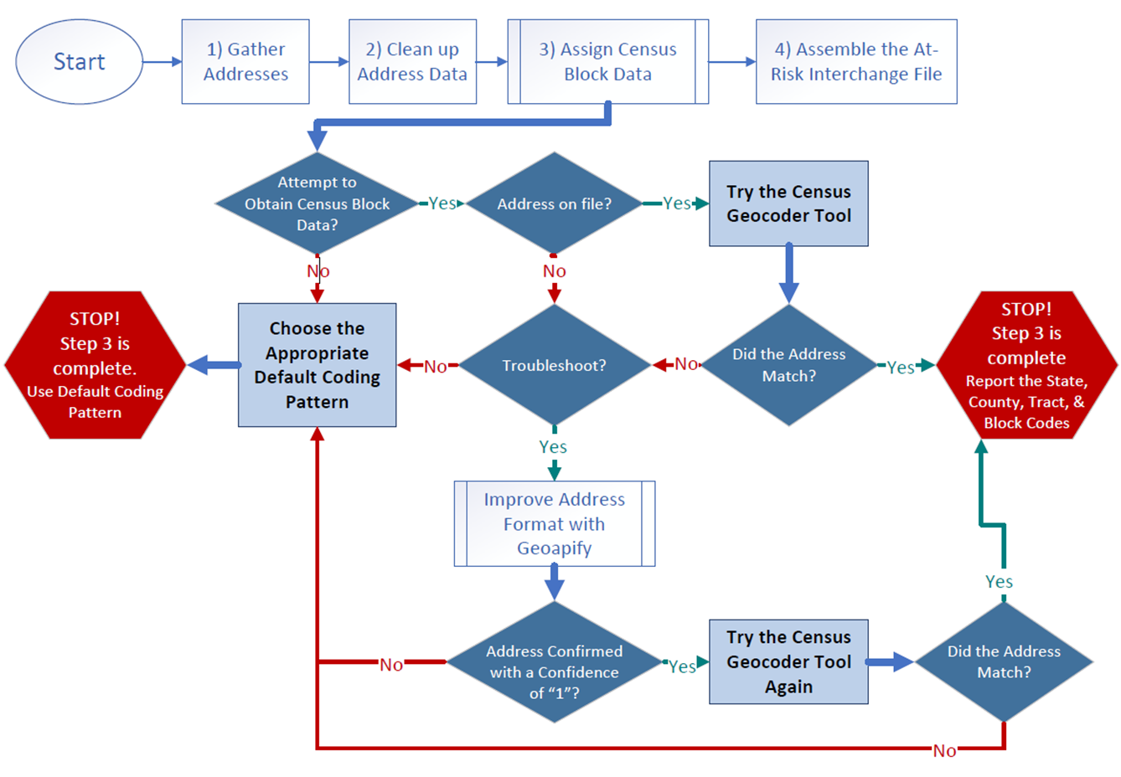
Flowchart: Obtaining and Reporting Census Data

Slide 54
File Layout and Definitions (page 3):
Missing Census Block Data- Coding Patterns
Description | State Code | County Code | Tract Code | Block Code
Address on File- Did Not Attempt to Obtain Census Block Data: The district has a primary physical address on file but did NOT attempt to obtain census block data using the geocode tool. | 08 | 000 | 000001 | 0001
Address on File- No Census Block Data Returned: The district confirmed that the primary physical address is valid using USPS but the geocode tool did not return census block data. | 08 | 000 | 000002 | 0002
Confidentiality Program: No census block data was provided because the district has confirmed the student is participating in a confidentiality program. | 08 | 000 | 000003 | 0003
No Physical Primary Address on File- Identified Group: The district does not have a primary physical address on file and the student is confirmed homeless, migrant, foster child, or attending a detention center. | 08 | 000 | 000004 | 0004
No Physical Primary Address on File- No Identified Group: The district does not have a primary physical address on file and the student is not confirmed homeless, migrant, foster child, or attending a detention center. | 08 | 000 | 000005 | 0005
Out of State codes: The district has a primary physical address on file that is not in Colorado. | 08 | 000 | 000006 | 0006
At-Risk Interchange
ARMeasure@cde.state.co.us

Slide 55
New: At-Risk Measure Interchange File - Syncplicity Folders
Syncplicity folders are being shared on a rolling basis with ARM LEAUSERS and LEAVEWIERS.
The folder naming convention is:
  District Code_ District Name_ ARMeasure Interchange
These folders can be used to share files containing PII between the district or BOCES and CDE when requesting assistance with the At-Risk Interchange or Census Geocoding tool.
If you have been assigned the user or viewer role for this interchange file and your district's Syncplicity folder has not been shared with you, email ARMeasure@cde.state.co.us.
At-Risk Interchange
ARMeasure@cde.state.co.us

Slide 56
Questions & Answers:
ARMeasure@cde.state.co.us
Data Pipeline At-Risk Interchange website

Slide 57
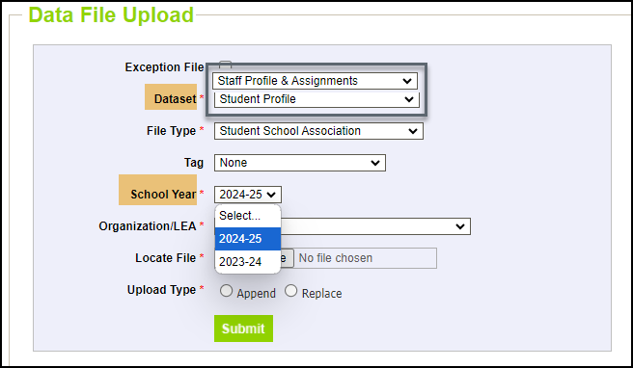
Thank you for joining today!
Next Town Hall will be October 10th
Reminder: Both the Student and Staff Interchanges have two years open. When uploading a file, double check that you have selected the correct school year of your file.

