Slide 1
September 26, 2024
Data Pipeline Town Hall
The goal of the webinar is to provide updates on the Data Pipeline, current, and upcoming data collections. These webinars also provide a forum for districts, BOCES, and Administrative Units to have questions answered about Data Pipeline.

Slide 2
Colorado Department of Education
Identity Management (IdM)
Identity Management Site
Frequently Asked Questions
How do I add myself or others to the email listserv for town hall emails and/or a specific collection?
  Email lists are dependent on a person’s access rights in IdM. Contact your LAM to get an account or be assigned to a specific collection.
Where can I find the IdM role mappings for Data Pipeline and other applications?
  Role Mapping (XLS)
I am a LAM. How do I update the user permissions for someone in my district?
  Follow the steps outlined in the IdM Quick Guide for Access Management (DOCX)
Important: Users are not automatically removed from IdM when their email address is no longer active in your district. The LAM must deactivate their IdM account to ensure only designated staff can access CDE’s data reporting system.
Notes:
LAMs, please check the IdM roles for your district. Remove permissions for users who have retired, left your district, or are no longer assigned to a collection. Add roles for new hires and newly assigned respondents for specific collections.

Slide 3

What is PII?
Student and Staff Personally Identifiable Information (PII) is defined by state and federal laws as information that, alone or in combination, personally identifies an individual
  This includes direct identifiers
  (i.e. student and staff names, SASID, EDID, etc.)
  Includes information that when combined is identifiable
Colorado’s Student Data Transparency and Security Act outlines requirements for how Student PII is collected, used and shared
See the Data Privacy and Security website for prepared guidance on how to comply with this and other privacy laws.

Slide 4

Sharing Data
Use secure methods to transfer any PII to CDE
  Contact Data Collection leads with questions about how to transmit PII securely
    Each Data Collection leads maintains their own Syncplicity folders for specific collections, reach out to the collection lead for access
  Use Syncplicity to encrypt emails to CDE
Avoid sending PII via unencrypted email or to unsecured faxes when sharing data between or within districts
  Use Syncplicity to encrypt emails to CDE
Check local policies for restrictions, requirements, etc. regarding PII
  Do not use PII in trainings, presentations, etc.
  Do not share PII with unauthorized individuals
  Do not share passwords
  Follow local policies when transmitting PII to any third party

Slide 5
Today’s Agenda
Agenda Topic | Presenter
Open Data Collections and Upcoming Deadlines in Data Pipeline
Kindergarten School Readiness | Tara Rhodes
Staff Evaluation | Dawna Gudka
Title I | Melissa Chaffin
Student End of Year | Reagan Ward
Student October | Brooke Wenzel
At Risk Interchange Updates | Rebecca McRee

Slide 6
Open Collections and
Upcoming Deadlines in
Data Pipeline

Slide 7
Open Collections and Upcoming Dates:
Year-Round & Interchanges
Name | Category | Status | Key Dates
RITS | Year Round | Open
EDIS | Year Round | Open
Directory | Year Round | Open
Student | Interchange | Open | 2023-2024 and 2024-2025 are open
At-Risk | Interchange | Open
Title I | Interchange | Open
Special Education IEP | Interchange | Open
Staff | Interchange | Open | 2023-2024 and 2024-2025 are open
Data Pipeline Resources: Data Pipeline Collection Dates (XLS)

Slide 8
Open Collections and Upcoming Dates:
Snapshots
Name | Category | Status | Final Deadline Date | Next Milestone | Looking Ahead
Staff Evaluation | Snapshot | Open | Oct. 15, 2024 | Interim Deadline: 8/7/2024-9/30/2024 Report Review | Collection Deadline: 10/15/2024
Student October | Snapshot | Open | Nov. 8, 2024 | Official Count Date: 10/1/2024 | Interim Deadline: 10/2/2024 Upload initial interchange files
Student End of Year | Snapshot | Open | Nov. 19, 2024 | Interim Deadline: 10/7/2024 error free SEY snapshot | Report Review: 10/8/24 to 10/17/24
Special Education End of Year | Snapshot | Open | Sept. 27, 2024 | Interim Deadline: 9/19/2024 All changes made and errors resolved | Interim Deadline: 9/23 - 9/27/2024 Final report review and submission due to CDE
Data Pipeline Resources: Data Pipeline Collection Dates (XLS)

Slide 9
Kindergarten School Readiness
Tara Rhodes

Slide 10
Upcoming Trainings
Kindergarten School Readiness (KSR)
Upcoming Trainings:
10/02/2024: Overview of the KSR Collection for Data Respondents New to KSR
10/09/2024: KSR: Data Pipeline Uploads Sourcing Data from a Single Platform
10/16/2024: KSR: Data Pipeline Uploads Sourcing Data from Multiple Platforms
All trainings will be held from 11:30am-12:15pm on the above dates.
Important Dates:
10/23/2024: KSR Data Collection Opens
12/11/2024: KSR Data Collection Due Date
Current To-Do's:
Attend trainings
Talk with your School Readiness contact
  Learn which assessment tool is being used
  Learn whether manual aggregation of data will be required
  Learn the status of the assessment
Kindergarten School Readiness (KSR)
KSRData@cde.state.co.us

Slide 11
Questions & Resources
Kindergarten School Readiness (KSR)
Contact: Tara Rhodes
Email: KSRData@cde.state.co.us
Phone: 720.601.4125
Kindergarten School Readiness Website

Slide 12
Staff Evaluation
Dawna Gudka

Slide 13
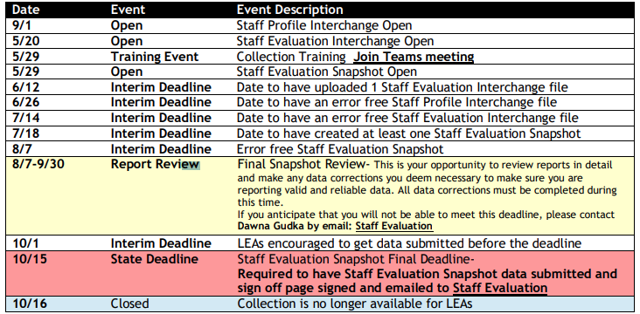
Staff Evaluation Collection Timeline
Staff Evaluation – Dawna Gudka
StaffEvaluation@cde.state.co.us

Slide 14
Staff Evaluation Snapshot Errors
EV004, EV005, EV006=06 overall rating must be used minimally by each district. Exceptions can be approved by EdTalentResearch@cde.state.co.us email address in error message. Please copy StaffEvaluation@cde.state.co.us
EV030=Staff member was reported in Human Resources or Special Education December count as a Teacher, Special Service Provider or Principal therefore we are expecting evaluation data for them.
  If they left prior to evaluation being completed, please use 06 in their overall rating indicating they were not fully evaluated.
Staff Evaluation Snapshot Collection
StaffEvaluation@cde.state.co.us

Slide 15
Staff Evaluation Snapshot Collection Resources
Staff Evaluation Timeline
Staff Evaluation file layout
StaffEvaluation@cde.state.co.us
Dawna Gudka-Collection lead
(303) 598-7901

Slide 16
Title I
Melissa Chaffin, Federal Programs

Slide 17
2023-2024 Collection Timeline
Date | Event | Event Description
09/19/2024 | Final Update Window | SEY 2023-2024 Cross LEA phase begins. Final opportunity for LEAs to update their 2023-2024 Title I Interchange file. This file should reflect all students who received Title I Targeted Assistance at any point during the 2023-2024 school year. Most LEAs won't need to, but LEAs should validate their data during this phase and make updates if needed.
10/17/2024 | DEADLINE | SEY 2023-2024 Cross LEA phase ends and the 2023-2024 Title I Interchange closes for 23-24 EOY.
Title I
Chaffin_m@cde.state.co.us

Slide 18
2024-2025 Collection Timeline
Date | Event | Event Description
Current | Title I 24-25 Interchange open in Data Pipeline | LEAs can begin to upload their Title I file to address any errors. This would be for the school year 24-25 for Student October.
10/02/2024 | Upload Title I file | Upload Title I file to address any errors if you haven’t already.
10/09/2024 | Interim Deadline Title I | Interim Deadline for Title I file uploaded and error-free.
10/22/2024 | Title I Deadline | Have Title I uploaded and error free for Student October snapshot.
11/08/2021 | Official State Deadline | Have Title I uploaded and error free for Student October snapshot.
Title I
Chaffin_m@cde.state.co.us

Slide 19
Title I Important To-Do
Please if you haven't already, check to see if you have schools and grade spans that are listed as Targeted Assistance (TA) on the school list (link below).
I will be emailing LEAs that have not uploaded a file as of yet this afternoon.
Schools and grade spans are identified as either SW (Schoolwide), TA (Targeted Assistance), or NS (Not Serviced) during the Consolidated Application period.
List of schools and grade spans to check status (TA, SW, NS): Title I-A School Lists (24-25 is now posted).
Title I
Chaffin_m@cde.state.co.us

Slide 20
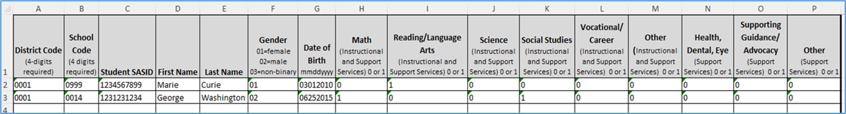
Title I Interchange Targeted Assistance (TA)
IMPORTANT: Only students within eligible TA schools and grade spans are reported in a file which is uploaded to the Data Pipeline.
Include students in TA grade schools/grade spans who received Title I services/resources any time during the year, even if student left school/district or services were stopped.
The student data must match the Student School Association file in the Data Pipeline.
The new Title I file template can be found here: Data Pipeline Interchanges – Title I
If you think there is a discrepancy in the Title I Part A school/grade span list for your LEA, first consult your person who completes the Consolidated Application, then if needed please email me: Chaffin_m@cde.state.co.us
Title I
Chaffin_m@cde.state.co.us

Slide 21
Questions & Resources:
Title I
Melissa Chaffin
chaffin_m@cde.state.co.us
720-908-1379

Slide 22
Student End of Year
Reagan Ward

Slide 23
SEY Collection Timeline:
Upcoming Events
Date | Event | Event Description
10/07/2024 | Interim Deadline | Error free Cross LEA snapshot
10/08/2024 to 10/17/2024 | Report Review | Validate SEY data using CEDAR/COGNOS reports Final opportunity to correct all data fields, including DEM fields Submit snapshot as soon as review is complete
10/17/2024 | Deadline | Resubmit SEY snapshot
10/23/2024 2:30-3:30pm | Training Event | October SEY Office Hours: Post-Cross LEA Phase Registration Link
10/24/2024 | Post-Cross LEA Open | Districts may begin updating their snapshot to address Post-Cross LEA business rules.
11/13/2024 | Interim Deadline | Error free SEY snapshot
11/13/2024 2:30-3:30pm | Training Event | November SEY Office Hours: Final Dates and Data Release Registration Link
11/14/2024 to 11/19/2024 | Report Review | Validate SEY data using CEDAR/COGNOS reports Begin submitting Superintendent Verification (sign-off) forms
11/19/2024 (noon) | Deadline | Post-Cross phase ends. Districts must have error free SEY snapshot and have addressed any necessary post-cross changes.
12/3/2024 | Deadline | Collection closes. • Superintendent Verification (sign-off) form due. • Data remains embargoed until the official release in January
Visit the SEY Website to download the complete SEY Collection Timeline with Training Dates
Student End of Year – Reagan Ward
StudentEndOfYear@cde.state.co.us

Slide 24
Cross LEA Phase
Critical Resources
Steps
SEY Website
  SEY Collection Manual
  September SEY Office Hours Recording and Slides
  Adjustment File Layout, Directions, Template
Data Pipeline Error Report
(Errors and Warnings)
CEDAR/COGNOS Reports
  SASID Lookup: Cross LEA
  Cross LEA List – Students with SE700 errors and warnings
  SEY Respondent Contact List
Review errors and warnings
  SE700 series and any remaining SE001-SE500 series
Update interchange files as needed to resolve errors/warnings
  Any data field may be changed during this phase
  Final opportunity to address demographic updates
Upload Adjustment file
  If needed to address SE700 errors
Create SEY snapshot, repeating steps 1 through 4 as needed
Review SEY Data using CEDAR/COGNOS reports
Submit error-free SEY snapshot
  LEA Approver role required
  DEADLINE 10/17/24
StudentEndOfYear@cde.state.co.us
Student End of Year – Reagan Ward

Slide 25
Recent Fix: SE711 error
Rule was over trigger for the following scenarios
  PK-6 students
  Students with exit 13 who have an enrollment record at another CO public school before their facility record
Create a SEY Snapshot to rerun this rule and clear the fixed scenarios
Remaining SE711 errors:
  Change student to exit type 19
  Reach out to facility school for adequate documentation if you don’t already have it
    Email StudentEndofYear@cde.state.co.us if you need assistance know the facility school to contact for a specific student
  Request an exception if you have adequate documentation to support exit type 13 and this error is still triggering after the fix.
Student End of Year – Reagan Ward
StudentEndOfYear@cde.state.co.us

Slide 26

COGNOS Report Fixes
Cross LEA List – Students with SE700 errors and warnings
SEY Error Summary and Details
General Tip: Create a SEY snapshot to ensure you have the most up-to-date information as your SE700 rules may clear or update as other districts work on their data
  Report updates when snapshots are created
Functionality Update: Added ‘error message’ and ‘error details’ to this report to make it easier to interpret.
Fix: Some rules not showing the ‘other’ district when expected
  Should be resolved after next time district create a SEY snapshot.
  Not all rules have an ‘other district’ by design
Issue: ‘no data reported’ message for some sections without context
  Resolved, now displays the name of the section and no data reported (SASID Level: no data reported)
  Use the page down button to cycle through sections.
Outstanding issue:
  The ‘phase’ dropdown that is supposed to sort rules isn’t as effective as desired. For SEY 2024, use the phase ‘All’.
General Tip: Extract this report to excel. It will show the four report sections as separate tabs on the excel file.
Reminder: The Data Pipeline Error Report is the preferred method for checking errors/warnings.
StudentEndOfYear@cde.state.co.us
Student End of Year – Reagan Ward

Slide 27
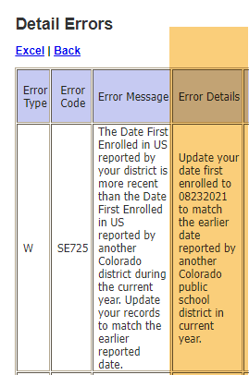
SE725 Warning: Date First Enrolled in US
Warning is based on 2023-2024 SEY data.
These are students who may trigger SSA errors in the 2024-2025 collection because the CDE Auto Calculated date will update based upon the SEY 2023-2024 collection.
  Warning is designed to give LEAs a heads up about the conflict. LEAs may choose to wait until 2024-2025 SSA file errors to correct the situation.
The new date is listed on the ‘Error Details’ portion of the SEY Error report.
CEDAR/COGNOS report Date First Enrolled in US is not showing the new calculated date when selecting 2023-2024 year because it is still calculating based on the prior year data.
  Researching the logic on this report for possible updates in the future.
StudentEndOfYear@cde.state.co.us
Student End of Year – Reagan Ward

Slide 28
Questions & Answers:
Student End of Year
StudentEndOfYear@cde.state.co.us
720-484-9057
Student End of Year Website
Student Interchange Website
Graduation Guidelines Website

Slide 29
Student October
Brooke Wenzel

Slide 30
Student October Timeline – Regular Phase
Date | Event | Event Description
09/24/2024 | Other Date | First day of Student October Count Window for districts with 5-day school week.
10/01/2024 | Other Date | Official Count Day 2024
10/02/2024 | Interim Deadline | Upload Student Demographic and Student School Association Files. Upload Title I Interchange File (if applicable). Upload At-Risk Interchange File.
10/08/2024 | Other Date | Last day of Student October Count Window for districts with 5-day school week.
10/09/2024 | Interim Deadline | Error free Student Interchange File uploads
10/14/2024 | Training Event | Mid-Collection Office Hours 10-11 a.m.
10/14/2024 | Interim Deadline | Create an initial Student October Snapshot
10/22/2024 | Interim Deadline | Error free Student October Snapshot
10/24/2024 | Training Event | Data Validation, Transfer Enrollment Exceptions and Cognos Reports 1-2 p.m.
10/28/2024 | Training Event | Data Pipeline Duplicate Process and Submission 9-10 a.m.
11/01/2024 | Report Review | Review Student October Cognos Reports for data validation. Submit Student October Snapshot data as soon as review is complete.
11/08/2024 12:00 p.m. | State Deadline | Submit Student October Snapshot data
Student October
StudentOctober@cde.state.co.us

Slide 31
Student October Timeline – Duplicate Process
Date | Event | Event Description
11/12/2024 12:00 p.m. | Deadline | Duplicate funding documentation due to School Auditing Office
11/18/2024 | Other Date | School Auditing makes decisions on funding duplicates
11/27/2024 | Deadline | Resubmit Student October Snapshot data to CDE based on decisions from School Auditing
12/06/2024 | Deadline | Collection closes Secretary of the Board of Education Verification (sign-off) form due. Data remains embargoed until the official release in January.
01/15/2025 | Data Release | Official data release
Student October
StudentOctober@cde.state.co.us

Slide 32
Student October Training Schedule
Note: Join live training on the Student October Website. Training and PPT will be posted after the training.
Mid-Collection Office Hours
Date/Time: 10/14/2024 10-11 a.m.
Click here to join the teams meeting.
Data Validation, Transfer Enrollment Exceptions and Cognos Reports Training
Date/Time: 10/24/2024 1-2 p.m.
Click here to join the teams meeting.
Data Pipeline Duplicate Process and Submission Training
Date/Time: 10/28/2024 9-10 a.m.
Click here to join the teams meeting.
Student October
StudentOctober@cde.state.co.us

Slide 33
What Should I Be Doing Now?
Get SASIDs for new students in RITS (Record Integration Tracking System)
Make sure Student Information System is up to date
Extract Interchange Files
  Student Demographic
  Student School Association*
  At-Risk (if you can extract)**
  Title I (if applicable)
Upload Interchange Files into Data Pipeline
  You do not have to wait until October 1st to start uploading files (recommended to start now)
  Clean up errors within SIS and extract/upload files again
  *Some Student Information Systems do not have new 2024-2025 SSA file implemented. Please reach out to your SIS vendor if this is not implemented just yet.
  **Some Student Information Systems do not have the capability to extract At-Risk. More information in upcoming slide.
Student October
StudentOctober@cde.state.co.us

Slide 34
Known Issues
SP561 - Your district may only use valid Joint County Codes applicable to your district's boundaries when students reside in the district.
  Resolved. Please upload another SSA file.
At-Risk Interchange File Duplicates (AR03 – SASID Duplicates are not allowed.)
  Receiving the AR03 error and attempted a Student October Snapshot?
  You will get invalid Student October errors (OC200 - This student is currently missing from your district's At-Risk Interchange File. Please add this student's record to the At-Risk Interchange data and take a new Student October Snapshot.)
  Try to resolve all AR03 errors before taking a Student October Snapshot.
Student October
StudentOctober@cde.state.co.us

Slide 35
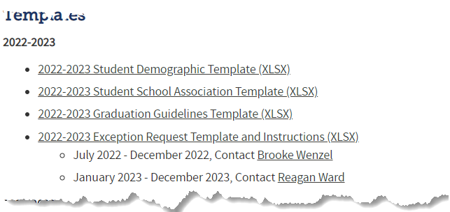

Reporting Exception Process
Complete exception request template
Upload exception request template to your district’s Syncplicity student folder
Folder: 1234 – DISTRICT NAME – Student
Notify the OCT collection lead (StudentOctober@cde.state.co.us) that you’ve uploaded a document for review
Collection lead will review your request and notify you of the outcome
Approved requests – reupload interchange file and/or create a new OCT snapshot
Denied requests – collection lead will provide next steps for clearing the error
Additional information needed – collection lead will request information
Available on Student Interchange Website
Pro Tip: Include the date in name of your exception request file as you may upload more than one exception during the collection cycle

Slide 36
Student October PK Reporting Expectations
LEAs Will Report
LEAs Will Not Report
All PK students receiving services from the LEA (regardless of UPK funding status)
  These students should have a SASID assigned
All PK students as Not Funded (Public School Finance Funding Status ‘86’, ’87’ or ‘96’) for enrollment purposes
All related Demographic and School information
Any PK students not receiving services from the LEA (optional)
An alternate count date for PK students (if applicable)
  All students will fall under the October Count Date
CPP/ECARE Funding Information – no longer applicable
More information on PK student level collections can be found on the Student Interchange Website under Additional Resources

Slide 37
Questions & Resources:
Questions & Answers:
Student October
Brooke Wenzel
StudentOctober@cde.state.co.us
720-441-7963
Student October Webpage
Student Interchange Webpage

Slide 38
At-Risk Interchange Updates
Rebecca McRee

Slide 39
New: At-Risk Measure Interchange File -
Overview
Beginning with the 2024/2025 school year, there is a new Data Pipeline At-Risk Interchange.
The purpose of the At-Risk Interchange is to obtain student-level census block data (based on primary residential addresses) that is needed to implement the new at-risk measure as described in HB22-1202 with data collection to begin with the 2024-2025 school year as provided for under SB24-188.
The new at-risk measure will be implemented starting with the 2025/2026 school year, and included in the Total Program funding calculation as described in the Public-School Finance Act which will continue to utilize student level data reported through the Student October Count data collection.
This interchange opened on July 15, 2024 and closes November 8, 2024. It will only be open during the Student October Count Collection.
At-Risk Interchange
ARMeasure@cde.state.co.us

Slide 40
New: Census Block Data
Required and valid census block data combinations include 4 data fields:
  State Code
  County Code
  Tract Code
  Block Code
To obtain this data, districts will need to first gather, clean and validate student address data.
Then districts will need to "geocode" each student's primary physical residential address to obtain this information.
  District's GIS system (such as ARC)
  Census Geocoder Tool
  Other (if your district has some other tool, please reach out to ARMeasure@cde.state.co.us)
At-Risk Interchange
ARMeasure@cde.state.co.us

Slide 41
New: At-Risk Measure Interchange File -
Resources
At-Risk Interchange Website
  File Layout
  Business Rules
  Interchange Upload Template (XLS)
  Timeline
  Trainings
    Overview of the Geocoder Tool (PDF) (Recorded Training)
    Overview of the Data Pipeline At-Risk Interchange File (PDF) (Recorded Training)
    Office Hours Session covering the Geocoder Tool and Interchange File was held yesterday, Sept.11, 2024. (PDF) (Recording will be posted on or about 9/16)
  Additional Resources
    UPDATED 9/10/24: Instructions for Using the Geocode Tool
    Valid Census Block Data Combinations (XLS)
At-Risk Interchange
ARMeasure@cde.state.co.us

Slide 42
New: At-Risk Measure Interchange File -
Timeline
Date | Event | Event Description
7/15/2024 | Open | Districts may begin to upload the At-Risk Interchange file to the data pipeline.
8/23/2024 | Open | Districts may begin creating Student October Snapshots. This Snapshot is dependent on the Student Demographic File, Student School Association File, Title 1 File (if applicable) and the At-Risk File.
8/13/2024 | Training Event | Overview of the Census Geocoder Tool (10-11am)
8/20/2024 | Training Event | Overview of the At-Risk Interchange File (1-2pm)
9/13/2024 | Other Date | Gather, review, clean-up and validate student addresses
9/27/2024 | Other Date | Obtain census block data for all student addresses
10/2/2024 | Interim Deadline | Upload the At-Risk Interchange File
10/9/2024 | Interim Deadline | Obtain error-free At-Risk Interchange File upload
10/22/2024 | Interim Deadline | Obtain error-free Student October Snapshot
11/1/2024 | Report Review | Review Student October Cognos Reports for data validation. Submit Student October Snapshot data as soon as review is complete
11/8/2024 | State Deadline | Submit Student October Snapshot data
At-Risk Interchange
ARMeasure@cde.state.co.us

Slide 43
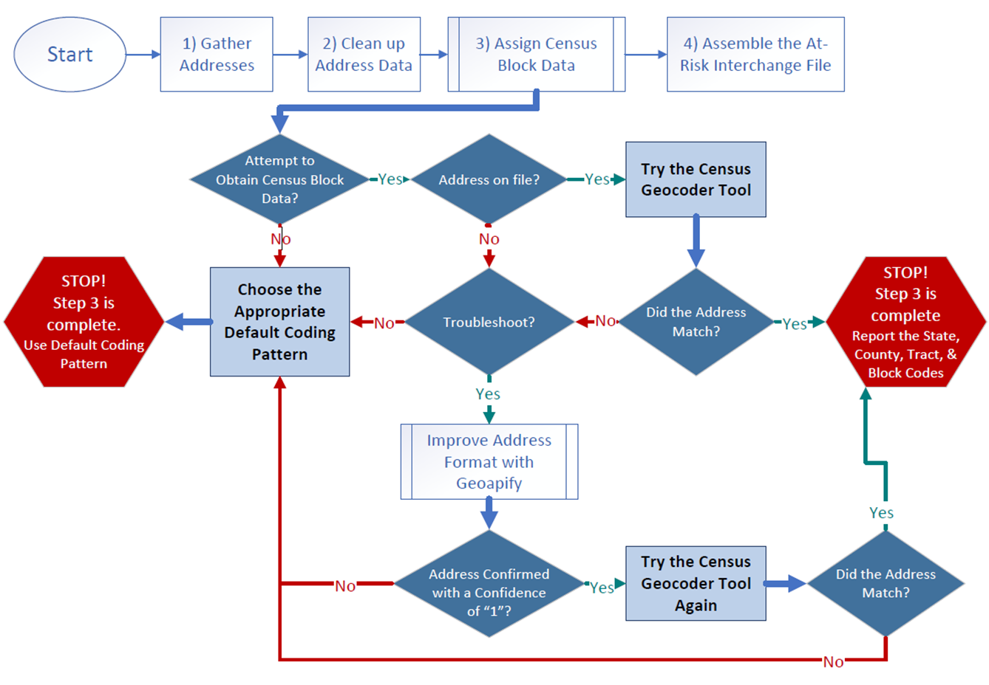
Flowchart: Obtaining and Reporting Census Data

Slide 44
File Layout and Definitions (page 3):
Missing Census Block Data- Coding Patterns
Description | State Code | County Code | Tract Code | Block Code
Address on File- Did Not Attempt to Obtain Census Block Data: The district has a primary physical address on file but did NOT attempt to obtain census block data using the geocode tool. | 08 | 000 | 000001 | 0001
Address on File- No Census Block Data Returned: The district confirmed that the primary physical address is valid using USPS but the geocode tool did not return census block data. | 08 | 000 | 000002 | 0002
Confidentiality Program: No census block data was provided because the district has confirmed the student is participating in a confidentiality program. | 08 | 000 | 000003 | 0003
No Physical Primary Address on File- Identified Group: The district does not have a primary physical address on file and the student is confirmed homeless, migrant, foster child, or attending a detention center. | 08 | 000 | 000004 | 0004
No Physical Primary Address on File- No Identified Group: The district does not have a primary physical address on file and the student is not confirmed homeless, migrant, foster child, or attending a detention center. | 08 | 000 | 000005 | 0005
Out of State codes: The district has a primary physical address on file that is not in Colorado. | 08 | 000 | 000006 | 0006
At-Risk Interchange
ARMeasure@cde.state.co.us

Slide 45
New: At-Risk Measure Interchange File - Syncplicity Folders
Syncplicity folders are being shared on a rolling basis with ARM LEAUSERS and LEAVEWIERS.
The folder naming convention is:
  District Code_ District Name_ ARMeasure Interchange
These folders can be used to share files containing PII between the district or BOCES and CDE when requesting assistance with the At-Risk Interchange or Census Geocoding tool.
If you have been assigned the user or viewer role for this interchange file and your district's Syncplicity folder has not been shared with you, email ARMeasure@cde.state.co.us.
At-Risk Interchange
ARMeasure@cde.state.co.us

Slide 46
Questions & Answers:
ARMeasure@cde.state.co.us
Data Pipeline At-Risk Interchange website

Slide 47

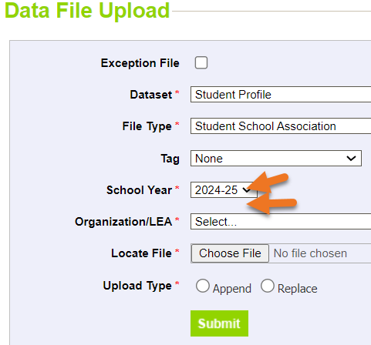
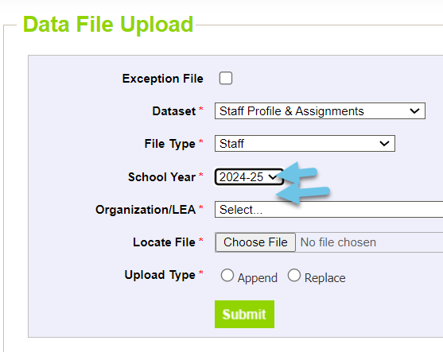

Thank you for joining today!
Next Town Hall will be October 3rd
Reminder: Both the Student and Staff Interchanges have two years open. When uploading a file, double check that you have selected the correct school year of your file.

