Slide 1
September 19, 2024
Data Pipeline Town Hall
The goal of the webinar is to provide updates on the Data Pipeline, current, and upcoming data collections. These webinars also provide a forum for districts, BOCES, and Administrative Units to have questions answered about Data Pipeline.

Slide 2
Colorado Department of Education
Identity Management (IdM)
Identity Management Site
Frequently Asked Questions
How do I add myself or others to the email listserv for town hall emails and/or a specific collection?
  Email lists are dependent on a person’s access rights in IdM. Contact your LAM to get an account or be assigned to a specific collection.
Where can I find the IdM role mappings for Data Pipeline and other applications?
  Role Mapping (XLS)
I am a LAM. How do I update the user permissions for someone in my district?
  Follow the steps outlined in the IdM Quick Guide for Access Management (DOCX)
Important: Users are not automatically removed from IdM when their email address is no longer active in your district. The LAM must deactivate their IdM account to ensure only designated staff can access CDE’s data reporting system.
Notes:
LAMs, please check the IdM roles for your district. Remove permissions for users who have retired, left your district, or are no longer assigned to a collection. Add roles for new hires and newly assigned respondents for specific collections.

Slide 3

What is PII?
Student and Staff Personally Identifiable Information (PII) is defined by state and federal laws as information that, alone or in combination, personally identifies an individual
  This includes direct identifiers
  (i.e. student and staff names, SASID, EDID, etc.)
  Includes information that when combined is identifiable
Colorado’s Student Data Transparency and Security Act outlines requirements for how Student PII is collected, used and shared
See the Data Privacy and Security website for prepared guidance on how to comply with this and other privacy laws.

Slide 4

Sharing Data
Use secure methods to transfer any PII to CDE
  Contact Data Collection leads with questions about how to transmit PII securely
    Each Data Collection leads maintains their own Syncplicity folders for specific collections, reach out to the collection lead for access
  Use Syncplicity to encrypt emails to CDE
Avoid sending PII via unencrypted email or to unsecured faxes when sharing data between or within districts
  Use Syncplicity to encrypt emails to CDE
Check local policies for restrictions, requirements, etc. regarding PII
  Do not use PII in trainings, presentations, etc.
  Do not share PII with unauthorized individuals
  Do not share passwords
  Follow local policies when transmitting PII to any third party

Slide 5
Today’s Agenda
Agenda Topic | Presenter
Open Data Collections and Upcoming Deadlines in Data Pipeline
2025-2026 ASCENT Allotment Cap | Erica Ryan
Non-Public Schools | Jessica Tribbett
Special Education End of Year | Lindsey Heitman
Title I | Melissa Chaffin
Student End of Year | Reagan Ward
Student October | Brooke Wenzel
At Risk Interchange | Rebecca McRee

Slide 6
Open Collections and
Upcoming Deadlines in
Data Pipeline

Slide 7
Open Collections and Upcoming Dates:
Year-Round & Interchanges
Name | Category | Status | Key Dates
RITS | Year Round | Open
EDIS | Year Round | Open
Directory | Year Round | Open
Student | Interchange | Open | 2023-2024 and 2024-2025 are open
At-Risk | Interchange | Open
Title I | Interchange | Open
Special Education IEP | Interchange | Open
Staff | Interchange | Open | 2023-2024 and 2024-2025 are open
Data Pipeline Resources: Data Pipeline Collection Dates (XLS)

Slide 8
Open Collections and Upcoming Dates:
Snapshots
Name | Category | Status | Final Deadline Date | Next Milestone | Looking Ahead
Staff Evaluation | Snapshot | Open | Oct. 15, 2024 | Interim Deadline: 8/7/2024-9/30/2024 Report Review | Collection Deadline: 10/15/2024
Student October | Snapshot | Open | Nov. 8, 2024 | Official Count Date: 10/1/2024 | Interim Deadline: 10/2/2024 Upload initial interchange files
Student End of Year | Snapshot | Reopens Today | Nov. 19, 2024 | Cross LEA Phase Begins: 9/19/2024 | Interim Deadline: 10/7/2024 error free SEY snapshot
Special Education End of Year | Snapshot | Open | Sept. 27, 2024 | Interim Deadline: 9/19/2024 All changes made and errors resolved | Interim Deadline: 9/23 - 9/27/2024 Final report review and submission due to CDE
Data Pipeline Resources: Data Pipeline Collection Dates (XLS)

Slide 9
2025-2026 ASCENT Allotment Cap
Michelle Romero and Erica Ryan

Slide 10
2025-26 ASCENT Allotment Cap
Per HB 24-1393: the number of students that an LEP submits for funding in Student October 2024, is the baseline number for that LEP moving forward.
  If a district does not use all their slots each year, slots cannot be reallocated to other districts.
  District-level cap versus statewide cap
The extended HS PPR rate for ASCENT students is now a flat rate, based on the 2023 extended HS PPR rate ($9,588).
Students need to complete and submit FAFSA/CAFSA to participate.
No change to ASCENT data reporting.
ASCENT students must be accurately coded in SEY.
More information can be found on the Student Interchange Website, under Additional Resources: ASCENT Participation Cap Update
ASCENT Update – Erica Ryan
Ryan_e@cde.state.co.us
Notes:
More information expected in:
PWR News, The SCOOP, and October CDE Update

Slide 11
2026 ASCENT Allotment Cap
Questions & Resources
ASCENT Changes Website
ASCENT Website
Student Interchange Website (Cap Update Doc)
Erica Ryan
Postsecondary Programs Specialist
Ryan_e@cde.state.co.us
720-576-4288

Slide 12
Non-Public Schools
Jessica Tribbett

Slide 13
Non-Public Schools Enrollment Fall Count
Wednesday, Oct. 2nd thru Monday, December 2nd
Non-public schools must have school code to participate.
Request for New School Code for Non-Public Schools:
https://www.cde.state.co.us/schoolcoderequest-nonpublic
District contacts must have Data Pipeline Non-Public Schools Collection permissions.
Permissions can be set in Identity Management (Access Management):
https://www.cde.state.co.us/idm
Non-Public Schools Enrollment Fall Count
Tribbett_Jessica@cde.state.co.us

Slide 14
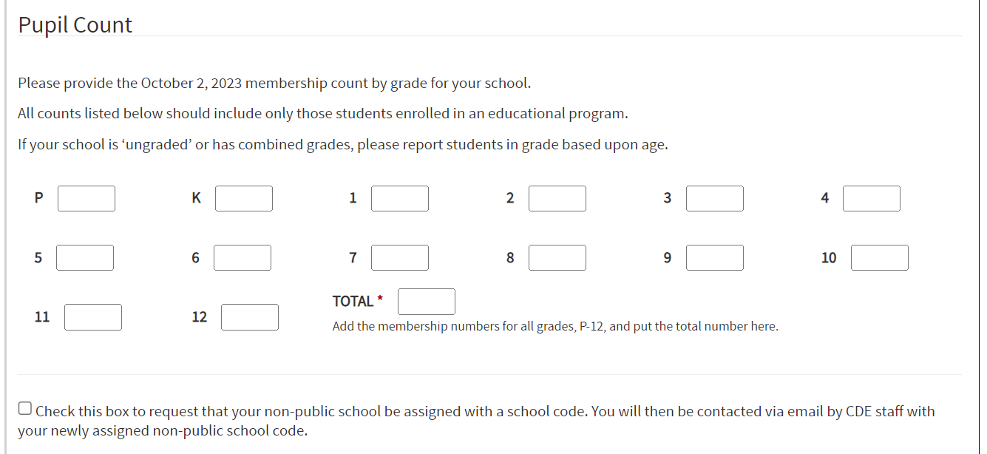
Non-Public Schools Enrollment Fall Count
10/02 - 12/02
Non-Public Schools Enrollment Fall Count
Tribbett_Jessica@cde.state.co.us

Slide 15
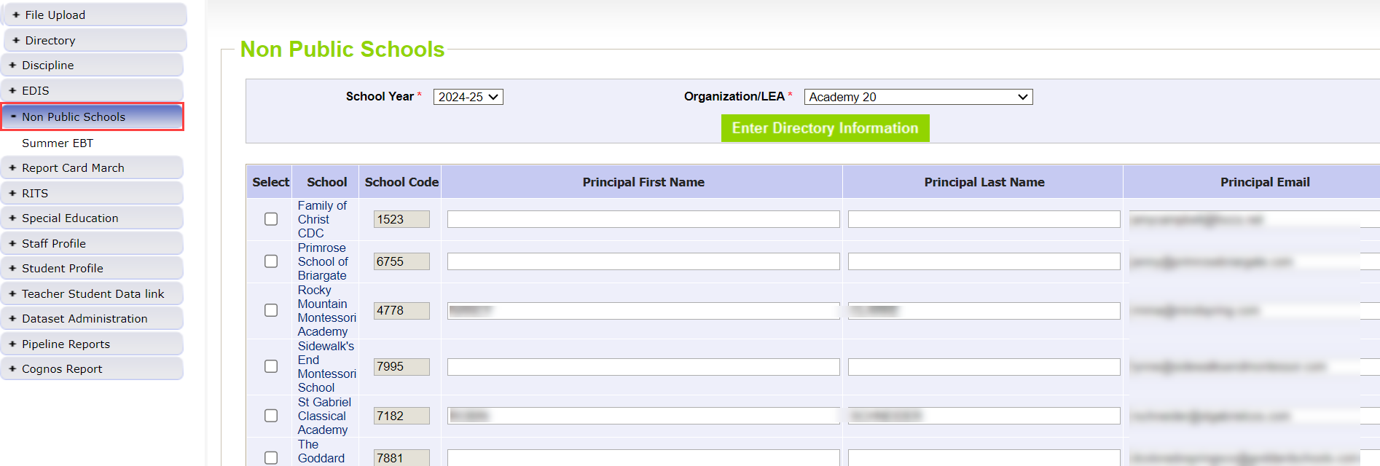
Non-Public Schools Enrollment Fall Count
10/02 - 12/02
Non-Public Schools Enrollment Fall Count
Tribbett_Jessica@cde.state.co.us

Slide 16
Non-Public Schools
Questions & Resources
Tribbett_Jessica@cde.state.co.us

Slide 17
Special Education End of Year
Lindsey Heitman

Slide 18
Special Education End of Year:
Timeline
2023-2024 Special Education EOY Snapshot Timeline
As of this morning there were 2 duplicates statewide and the AUs have both been notified
Great job on getting those cleared ahead of schedule!
HOWEVER, we have lots of SY307 overlapping attendance being reported (details next slide)
May 1, 2024 - SPED EOY Snapshot official open
June 27, 2024 – IEP Interchange files error-free
August 29, 2024 - All Exception requests submitted to CDE
September 5, 2024 – All errors resolved at snapshot/interchange
September 5 -13, 2024 -Initial Report Review
Friday, September 13th –All changes made and data complete and error free (again)
September 16 - 20, 2024 – Resolving duplicates and data validity issues
September 20 - 27, 2024 – Final Report Review
September 27, 2024 - Final approval in Data Pipeline and reports uploaded to DMS
Special Education EOY – Lindsey Heitman
SpedEndofYear@cde.state.co.us

Slide 19
Special Education EOY
Overlapping Attendance Dates
Warning SY307 – overlapping Sped entry and exit dates
  There are a LOT of AUs triggering this warning
  Use Pipeline error report – the Other AU’s Sped start/end dates are listed in the far right column of the error report
  For example:
    AU 1 – student entry date of 07/01/2023
    AU 2 – student entry date of 08/15/2023 and exit date of 01/29/2024
      the attendance overlaps for more than half the school year
  Please be sure everyone in your LEA is aware the entry/exit dates for state reporting should reflect a student’s actual attendance and not their enrollment or unenrollment dates
  If you can get any of these cleaned up/SY307 warning cleared out this year, that would be great!
Special Education EOY – Lindsey Heitman
SpedEndofYear@cde.state.co.us

Slide 20
Special Education End of Year
Final Checks
All AUS – Please complete these final checks – thank you!!
1.‘Records Not in Snapshot’ report for potential missing records (500 level warnings)
  Report is found under Pipeline Reports/Records Not in Snapshot
  these records are excluded due to not meeting the snapshot criteria
  Your path 2 and path 3 referrals can land in here if the SASID is only added to one file (Child or Participation) in Enrich or if the LASIDS differ
2. Please compare your Sped EOY exits to your district’s exits for Sped records to be sure you are catching all exits – transfers, graduates, completers, dropouts, etc (this is imperative if you have been working off of a flat file for several months)! Many districts have updated their exit information in the last couple of months
3. Please clear all SY309 Warnings - If student is continuing in a transition program, no exit from Sped should be reported (until the school year in which they stop attending transition)
4. Please check all SY295 Warnings for potential missing graduates or completers. The only SY295 warnings that should remain are for the transition or continuing students.
5. Please check Warning SY263 –Repeat path 3 referrals should be moved to an 06 referral.
  If you have questions on this warning, please contact me
Special Education EOY – Lindsey Heitman
SpedEndofYear@cde.state.co.us

Slide 21

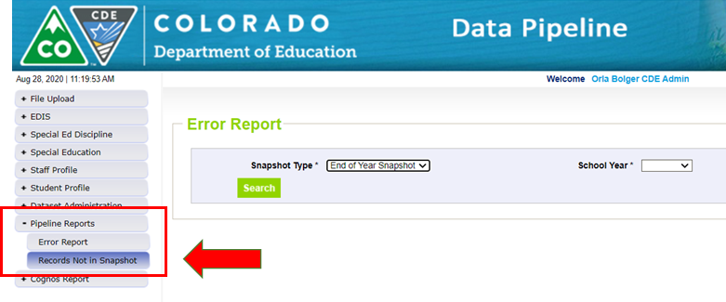
Special Education End of Year
– Missing Snapshot Records
Missing Snapshot Records Report- Must Check!
Identify records missing from snapshot due to:
  Interchange errors
  Criteria issues such as excluded PAI (Pupil Attendance Information) codes or mismatched SASIDs or LASIDs
  Records missing from either Child or Participation file
*These missing records will also show up as 500 level snapshot warnings
Special Education EOY – Lindsey Heitman
SpedEndofYear@cde.state.co.us

Slide 22
Questions & Resources:
Special Education End of Year
Lindsey Heitman
SpedEndofYear@cde.state.co.us
(720) 456-2033
Special Education IEP Interchange Webpage
Special Education End of Year Snapshot Webpage

Slide 23
Title I
Melissa Chaffin, Federal Programs

Slide 24
2024-2025 Collection Timeline
Date | Event | Event Description
Current | Title I 24-25 Interchange open in Data Pipeline | LEAs can begin to upload their Title I file to address any errors. This would be for the school year 24-25 for Student October.
10/02/2024 | Upload Title I file | Upload Title I file to address any errors if you haven’t already.
10/09/2024 | Interim Deadline Title I | Interim Deadline for Title I file uploaded and error-free.
10/22/2024 | Title I Deadline | Have Title I uploaded and error free for Student October snapshot.
11/08/2021 | Official State Deadline | Have Title I uploaded and error free for Student October snapshot.
Title I
Chaffin_m@cde.state.co.us

Slide 25
2023-2024 Collection Timeline
Date | Event | Event Description
09/19/2024 | Final Update Window | SEY 2023-2024 Cross LEA phase begins. Final opportunity for LEAs to update their 2023-2024 Title I Interchange file. This file should reflect all students who received Title I Targeted Assistance at any point during the 2023-2024 school year. Most LEAs won't need to, but LEAs should validate their data during this phase and make updates if needed.
10/17/2024 | DEADLINE | SEY 2023-2024 Cross LEA phase ends and the 2023-2024 Title I Interchange closes for 23-24 EOY.
Title I
Chaffin_m@cde.state.co.us

Slide 26
Brief Overview of Title I Part A
Title I Part A file for 2024-2025 is uploaded in the Data Pipeline during October Count in the Fall and again during EOY collection in the Spring. Many if not most of the students will be the same for both collections since it is the same school year.
Schools and grade spans are identified as either SW (Schoolwide), TA (Targeted Assistance), or NS (Not Serviced) during the Consolidated Application period.
List of schools and grade spans to check status (TA, SW, NS): Title I-A School Lists (24-25 is now posted, this list is preliminary due to some ongoing minor changes and will be updated).
Title I
Chaffin_m@cde.state.co.us

Slide 27
Title I Interchange Targeted Assistance (TA)
IMPORTANT: Only students within eligible TA schools and grade spans are reported in a file which is uploaded to the Data Pipeline.
Include students in TA grade schools/grade spans who received Title I services/resources any time during the year, even if student left school/district or services were stopped.
The student data must match the Student School Association file in the Data Pipeline.
If the file needs to be updated, then override or replace the old file with the updated file.
Maintain a complete data file at district or school level, make updates to this file if needed.
Title I
Chaffin_m@cde.state.co.us

Slide 28
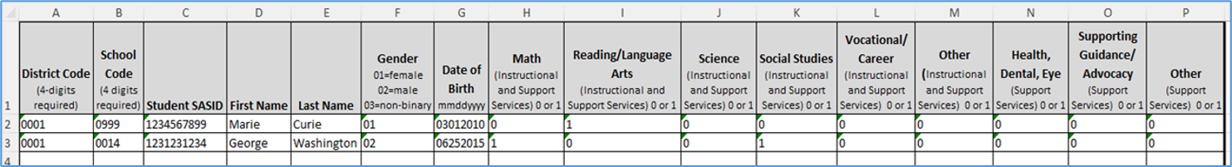
Title I Interchange Targeted Assistance Template
The new Title I file template can be found here: Data Pipeline Interchanges – Title I
Please use the new template as it contains a new option in the Gender column (03 for non-binary).
Make sure to include leading zeros, for example, district codes, school codes, gender, DOB.
Indicate resource(s) students received (reading, math, etc.): 1 for yes, 0 for no. All service cells must be either 1 or 0.
More than 1 school can be listed on the same file for the same district.
Title I
Chaffin_m@cde.state.co.us

Slide 29
Title I Interchange Schoolwide (SW)
Again, SW schools and students are not reported, as they are automatically provided to the Student October Count when the snapshot is taken.
If you report them, you will get an error.
Title I
Chaffin_m@cde.state.co.us

Slide 30
Title I Status Designation List
Note: 2 different grade spans at the same school can have 2 different Title I status designations, so please make sure your template has students within the TA status grade span.
List of schools and grade spans to check status (TA, SW, NS): Title I-A School Lists (24-25 is now posted, this list is preliminary due to some ongoing minor changes and will be updated).
If you think there is a discrepancy in the Title I Part A school/grade span list for your LEA, first consult your person who completes the Consolidated Application, then if needed please email me: Chaffin_m@cde.state.co.us
Title I
Chaffin_m@cde.state.co.us

Slide 31
Title I Common Errors
Most common Title I Interchange data does not match Student Interchange data
  TI003: This school is not a Targeted Assistance school for the grade of the student’s enrollment in the Student Profile.
    Check the Title I Status Designation list for the school and grade span status.
  TI004: There must be a School Association record for this student in the Student Profile at this school for the current School Year.
    Make sure the Student School Association file is uploaded first.
  OC067: At least one student should be reported in the Title I Interchange as participating in Title I services within a school that implements a Targeted Assistance program. Please update/upload your Title I Interchange file.
  May have to refresh October Count file for system to re-read the files.
Wrong formats
  Missing leading zeros: Gender (01,02,03) must have zeros as well as the Birthdate format mmddyyyy.
General data errors
  Invalid SASID, first and last name swapped, missing letters.
Services not marked 0 or 1 in template; blanks=errors.
The full list of business rules for Title I can be found here: Data Pipeline Interchanges – Title I
Title I
Chaffin_m@cde.state.co.us

Slide 32
Questions & Resources:
Title I
Melissa Chaffin
chaffin_m@cde.state.co.us
720-908-1379

Slide 33
Student End of Year
Reagan Ward

Slide 34
SEY Collection Timeline:
Upcoming Events
Date | Event | Event Description
9/18/2024 2:30-3:30pm | Training Event | September SEY Office Hours: Focus – Cross LEA Phase Recording posted on SEY website
9/19/2024 | Cross LEA Open | Districts may begin creating snapshots as soon as they receive a ‘snapshot unlocked’ notification from data pipeline; approximately mid-day.
10/07/2024 | Interim Deadline | Error free Cross LEA snapshot
10/08/2024 to 10/17/2024 | Report Review | Validate SEY data using CEDAR/COGNOS reports Final opportunity to correct all data fields, including DEM fields Submit snapshot as soon as review is complete
10/17/2024 | Deadline | Resubmit SEY snapshot
10/24/2024 | Post-Cross LEA Open | Districts may begin updating their snapshot to address Post-Cross LEA business rules.
11/19/2024 | Deadline | Post-Cross phase ends. Districts must have error free SEY snapshot and have addressed any necessary post-cross changes.
12/3/2024 | Deadline | Collection closes. • Superintendent Verification (sign-off) form due. • Data remains embargoed until the official release in January
Visit the SEY Website to download the complete SEY Collection Timeline with Training Dates
Student End of Year – Reagan Ward
StudentEndOfYear@cde.state.co.us

Slide 35
Cross LEA Phase: Overview
Second phase of SEY collection
CDE runs a process to cross validate student educational history across all school districts/BOCES
  SE700 series errors/warnings are triggered
  NEW: SE800 series has been deactivated since they were duplicates of many SE700 rules
Ensures accuracy of education statistics
  Graduate/completers
  Dropouts
  Exit one district and recovered by another
  Completed HSED
NEW: Updated CEDAR/COGNOS reports for Cross LEA errors/warnings
  Cross LEA List – Students Removed from AYG Cohort
  Cross LEA List – Students with SE700 errors or warnings
  SASID Lookup: Cross LEA
StudentEndOfYear@cde.state.co.us
Student End of Year – Reagan Ward

Slide 36
Cross LEA Phase: Required Steps
Review errors and warnings
  SE700 series and any remaining SE001-SE500 series
Update interchange files as needed to resolve errors/warnings
  Any data field may be changed during this phase
  Final opportunity to address demographic updates
Upload Adjustment file
  If needed to address SE700 errors
Create SEY snapshot, repeating steps 1 through 4 as needed
Review SEY Data using CEDAR/COGNOS reports
Submit error-free SEY snapshot
  LEA Approver role required
Note: Steps 1, 4, 5, and 6 are required for all LEAs, even if they are error free at the beginning of this phase
Student End of Year – Reagan Ward
StudentEndOfYear@cde.state.co.us

Slide 37
Cross LEA Phase: Data to Review
Summer Graduate/Completers
Retained K-11 students
ASCENT/PTECH years 5-6/TREP
  Retention code/exit code in 2023-2024 compared to 2024-2025 enrollment
  SE233 & SE239 warnings
SPED Transition
  Retention code/exit code in SEY 2023-2024 compared to 2024-2025 enrollment
  SPED EOY basis of exit compared to SEY school exit type 2023-2024
Dual Enrolled or Late Exits
  SE137 Warning (exit 13 after May 1)
  SE138 Warning (exit 00 in multiple LEAs)
Exit 13 without another LEA claiming student
  SE722 grades 7-12
  SE727 grades K-6
Address SASID merges
Student End of Year – Reagan Ward
StudentEndOfYear@cde.state.co.us

Slide 38
Graduation Guidelines 2024-2025
SAT Math cut score change
September State Board of Education meeting; SBE adjusted cut score for digital SAT math on the GG menu
  News Release Site
  Due to the changes with the digital SAT, the board unanimously approved moving the digital SAT math cut score for graduation guidelines to 480 from 500 for students graduating in 2025 and 2026 and directed CDE to work with the Colorado Commission of Higher Education to determine a proficiency level for future years.
Visit the PWR Graduation Guidelines site for more information
  PWR Contacts: Michelle Romero and Robin Russel
No change to GG data reporting.
Change impacts the use of the GG data in SEY 2025 and SEY 2026.
Coming Soon: Technical Information
  Technical explanation of impacted AYG cohorts, completion year of SAT, etc.
  Updating CEDAR/COGNOS GG reports to reflect new cut score
  Ensure SEY 2025 and SEY 2026 utilize the new cut score for SE301 business rule
Student End of Year – Reagan Ward
StudentEndOfYear@cde.state.co.us
Notes:
More information expected in:
PWR News, The SCOOP, and October CDE Update

Slide 39
Questions & Answers:
Student End of Year
StudentEndOfYear@cde.state.co.us
720-484-9057
Student End of Year Website
Student Interchange Website
Graduation Guidelines Website

Slide 40
Student October
Brooke Wenzel

Slide 41
Student October Timeline – Regular Phase
Date | Event | Event Description
09/24/2024 | Other Date | First day of Student October Count Window for districts with 5-day school week.
10/01/2024 | Other Date | Official Count Day 2024
10/02/2024 | Interim Deadline | Upload Student Demographic and Student School Association Files. Upload Title I Interchange File (if applicable). Upload At-Risk Interchange File.
10/08/2024 | Other Date | Last day of Student October Count Window for districts with 5-day school week.
10/09/2024 | Interim Deadline | Error free Student Interchange File uploads
10/14/2024 | Training Event | Mid-Collection Office Hours 10-11 a.m.
10/14/2024 | Interim Deadline | Create an initial Student October Snapshot
10/22/2024 | Interim Deadline | Error free Student October Snapshot
10/24/2024 | Training Event | Data Validation, Transfer Enrollment Exceptions and Cognos Reports 1-2 p.m.
10/28/2024 | Training Event | Data Pipeline Duplicate Process and Submission 9-10 a.m.
11/01/2024 | Report Review | Review Student October Cognos Reports for data validation. Submit Student October Snapshot data as soon as review is complete.
11/08/2024 12:00 p.m. | State Deadline | Submit Student October Snapshot data
Student October
StudentOctober@cde.state.co.us

Slide 42
Student October Timeline – Duplicate Process
Date | Event | Event Description
11/12/2024 12:00 p.m. | Deadline | Duplicate funding documentation due to School Auditing Office
11/18/2024 | Other Date | School Auditing makes decisions on funding duplicates
11/27/2024 | Deadline | Resubmit Student October Snapshot data to CDE based on decisions from School Auditing
12/06/2024 | Deadline | Collection closes Secretary of the Board of Education Verification (sign-off) form due. Data remains embargoed until the official release in January.
01/15/2025 | Data Release | Official data release
Student October
StudentOctober@cde.state.co.us

Slide 43
Student October Training Schedule
Note: Join live training on the Student October Website. Training and PPT will be posted after the training.
Mid-Collection Office Hours
Date/Time: 10/14/2024 10-11 a.m.
Click here to join the teams meeting.
Data Validation, Transfer Enrollment Exceptions and Cognos Reports Training
Date/Time: 10/24/2024 1-2 p.m.
Click here to join the teams meeting.
Data Pipeline Duplicate Process and Submission Training
Date/Time: 10/28/2024 9-10 a.m.
Click here to join the teams meeting.
Student October
StudentOctober@cde.state.co.us

Slide 44
What Should I Be Doing Now?
Get SASIDs for new students in RITS (Record Integration Tracking System)
Make sure Student Information System is up to date
Extract Interchange Files
  Student Demographic
  Student School Association*
  At-Risk (if you can extract)**
  Title I (if applicable)
Upload Interchange Files into Data Pipeline
  You do not have to wait until October 1st to start uploading files (recommended to start now)
  Clean up errors within SIS and extract/upload files again
  *Some Student Information Systems do not have new 2024-2025 SSA file implemented. Please reach out to your SIS vendor if this is not implemented just yet.
  **Some Student Information Systems do not have the capability to extract At-Risk. More information in upcoming slide.
Student October
StudentOctober@cde.state.co.us

Slide 45
Known Issues
SP561 - Your district may only use valid Joint County Codes applicable to your district's boundaries when students reside in the district.
  Resolved. Please upload another SSA file.
At-Risk Interchange File Duplicates (AR03 – SASID Duplicates are not allowed.)
  Receiving the AR03 error and attempted a Student October Snapshot?
  You will get invalid Student October errors (OC200 - This student is currently missing from your district's At-Risk Interchange File. Please add this student's record to the At-Risk Interchange data and take a new Student October Snapshot.)
  Try to resolve all AR03 errors before taking a Student October Snapshot.
Student October
StudentOctober@cde.state.co.us

Slide 46
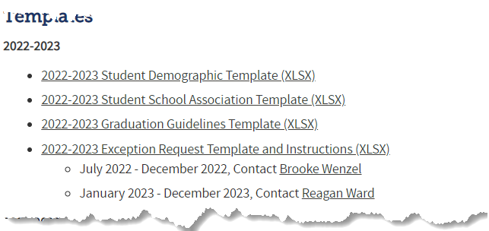

Reporting Exception Process
Complete exception request template
Upload exception request template to your district’s Syncplicity student folder
Folder: 1234 – DISTRICT NAME – Student
Notify the OCT collection lead (StudentOctober@cde.state.co.us) that you’ve uploaded a document for review
Collection lead will review your request and notify you of the outcome
Approved requests – reupload interchange file and/or create a new OCT snapshot
Denied requests – collection lead will provide next steps for clearing the error
Additional information needed – collection lead will request information
Available on Student Interchange Website
Pro Tip: Include the date in name of your exception request file as you may upload more than one exception during the collection cycle

Slide 47
Student October PK Reporting Expectations
LEAs Will Report
LEAs Will Not Report
All PK students receiving services from the LEA (regardless of UPK funding status)
  These students should have a SASID assigned
All PK students as Not Funded (Public School Finance Funding Status ‘86’, ’87’ or ‘96’) for enrollment purposes
All related Demographic and School information
Any PK students not receiving services from the LEA (optional)
An alternate count date for PK students (if applicable)
  All students will fall under the October Count Date
CPP/ECARE Funding Information – no longer applicable
More information on PK student level collections can be found on the Student Interchange Website under Additional Resources

Slide 48
Questions & Resources:
Questions & Answers:
Student October
Brooke Wenzel
StudentOctober@cde.state.co.us
720-441-7963
Student October Webpage
Student Interchange Webpage

Slide 49
At-Risk Interchange
Rebecca McRee

Slide 50
New: At-Risk Measure Interchange File -
Overview
Beginning with the 2024/2025 school year, there is a new Data Pipeline At-Risk Interchange.
The purpose of the At-Risk Interchange is to obtain student-level census block data (based on primary residential addresses) that is needed to implement the new at-risk measure as described in HB22-1202 with data collection to begin with the 2024-2025 school year as provided for under SB24-188.
The new at-risk measure will be implemented starting with the 2025/2026 school year, and included in the Total Program funding calculation as described in the Public-School Finance Act which will continue to utilize student level data reported through the Student October Count data collection.
This interchange opened on July 15, 2024 and closes November 8, 2024. It will only be open during the Student October Count Collection.
At-Risk Interchange
ARMeasure@cde.state.co.us

Slide 51
New: Census Block Data
Required and valid census block data combinations include 4 data fields:
  State Code
  County Code
  Tract Code
  Block Code
To obtain this data, districts will need to first gather, clean and validate student address data.
Then districts will need to "geocode" each student's primary physical residential address to obtain this information.
  District's GIS system (such as ARC)
  Census Geocoder Tool
  Other (if your district has some other tool, please reach out to ARMeasure@cde.state.co.us)
At-Risk Interchange
ARMeasure@cde.state.co.us

Slide 52
New: At-Risk Measure Interchange File -
Resources
At-Risk Interchange Website
  File Layout
  Business Rules
  Interchange Upload Template (XLS)
  Timeline
  Trainings
    Overview of the Geocoder Tool (PDF) (Recorded Training)
    Overview of the Data Pipeline At-Risk Interchange File (PDF) (Recorded Training)
    Office Hours Session covering the Geocoder Tool and Interchange File was held yesterday, Sept.11, 2024. (PDF) (Recording will be posted on or about 9/16)
  Additional Resources
    UPDATED 9/10/24: Instructions for Using the Geocode Tool
    Valid Census Block Data Combinations (XLS)
At-Risk Interchange
ARMeasure@cde.state.co.us

Slide 53
New: At-Risk Measure Interchange File -
Timeline
Date | Event | Event Description
7/15/2024 | Open | Districts may begin to upload the At-Risk Interchange file to the data pipeline.
8/23/2024 | Open | Districts may begin creating Student October Snapshots. This Snapshot is dependent on the Student Demographic File, Student School Association File, Title 1 File (if applicable) and the At-Risk File.
8/13/2024 | Training Event | Overview of the Census Geocoder Tool (10-11am)
8/20/2024 | Training Event | Overview of the At-Risk Interchange File (1-2pm)
9/13/2024 | Other Date | Gather, review, clean-up and validate student addresses
9/27/2024 | Other Date | Obtain census block data for all student addresses
10/2/2024 | Interim Deadline | Upload the At-Risk Interchange File
10/9/2024 | Interim Deadline | Obtain error-free At-Risk Interchange File upload
10/22/2024 | Interim Deadline | Obtain error-free Student October Snapshot
11/1/2024 | Report Review | Review Student October Cognos Reports for data validation. Submit Student October Snapshot data as soon as review is complete
11/8/2024 | State Deadline | Submit Student October Snapshot data
At-Risk Interchange
ARMeasure@cde.state.co.us

Slide 54
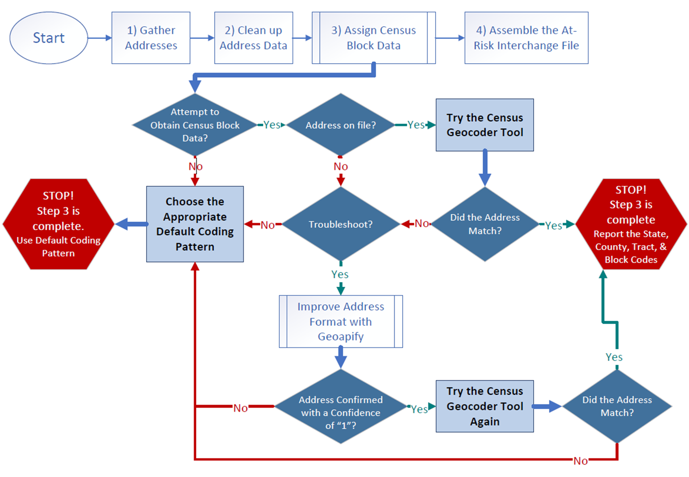
Flowchart: Obtaining and Reporting Census Data

Slide 55
File Layout and Definitions (page 3):
Missing Census Block Data- Coding Patterns
Description | State Code | County Code | Tract Code | Block Code
Address on File- Did Not Attempt to Obtain Census Block Data: The district has a primary physical address on file but did NOT attempt to obtain census block data using the geocode tool. | 08 | 000 | 000001 | 0001
Address on File- No Census Block Data Returned: The district confirmed that the primary physical address is valid using USPS but the geocode tool did not return census block data. | 08 | 000 | 000002 | 0002
Confidentiality Program: No census block data was provided because the district has confirmed the student is participating in a confidentiality program. | 08 | 000 | 000003 | 0003
No Physical Primary Address on File- Identified Group: The district does not have a primary physical address on file and the student is confirmed homeless, migrant, foster child, or attending a detention center. | 08 | 000 | 000004 | 0004
No Physical Primary Address on File- No Identified Group: The district does not have a primary physical address on file and the student is not confirmed homeless, migrant, foster child, or attending a detention center. | 08 | 000 | 000005 | 0005
Out of State codes: The district has a primary physical address on file that is not in Colorado. | 08 | 000 | 000006 | 0006
At-Risk Interchange
ARMeasure@cde.state.co.us

Slide 56
New: At-Risk Measure Interchange File - Syncplicity Folders
Syncplicity folders are being shared on a rolling basis with ARM LEAUSERS and LEAVEWIERS.
The folder naming convention is:
  District Code_ District Name_ ARMeasure Interchange
These folders can be used to share files containing PII between the district or BOCES and CDE when requesting assistance with the At-Risk Interchange or Census Geocoding tool.
If you have been assigned the user or viewer role for this interchange file and your district's Syncplicity folder has not been shared with you, email ARMeasure@cde.state.co.us.
At-Risk Interchange
ARMeasure@cde.state.co.us

Slide 57
Questions & Answers:
ARMeasure@cde.state.co.us
Data Pipeline At-Risk Interchange website

Slide 58
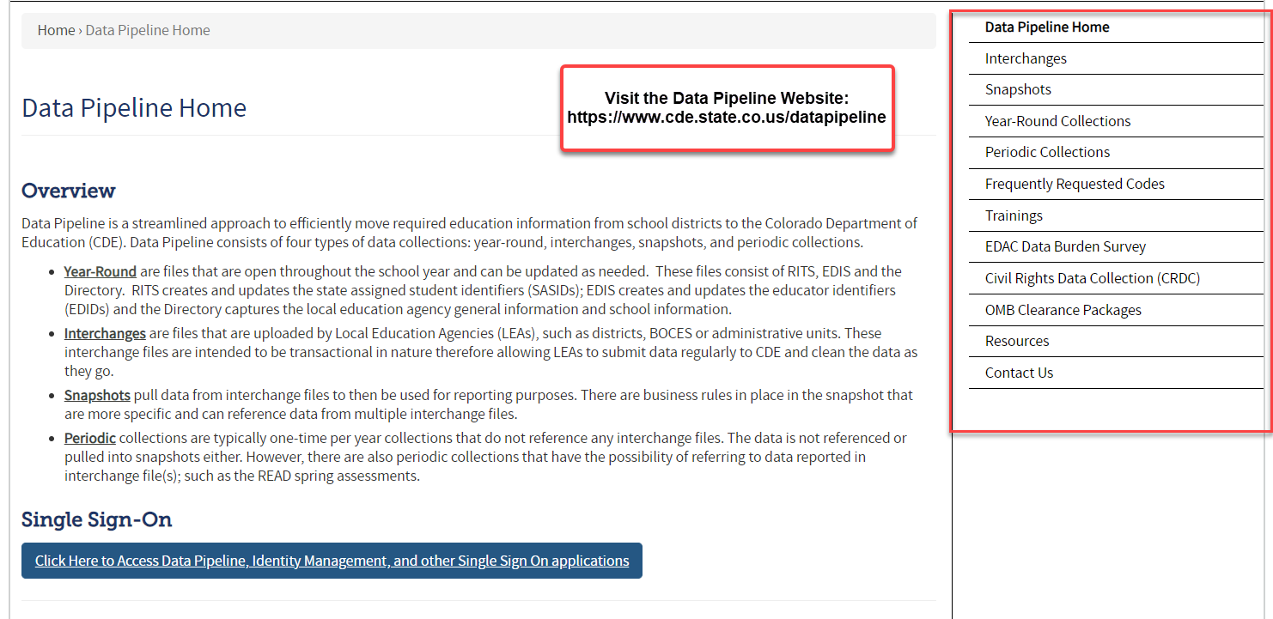
Thank you for joining today!
Next Town Hall will be September 26th
Reminder:
Each Data Collection has a more detailed timeline posted on their corresponding website (as well as other helpful resources)!

