Slide 1
September 12, 2024
Data Pipeline Town Hall
The goal of the webinar is to provide updates on the Data Pipeline, current, and upcoming data collections. These webinars also provide a forum for districts, BOCES, and Administrative Units to have questions answered about Data Pipeline.

Slide 2
Colorado Department of Education
Identity Management (IdM)
Identity Management Site
Frequently Asked Questions
How do I add myself or others to the email listserv for town hall emails and/or a specific collection?
  Email lists are dependent on a person’s access rights in IdM. Contact your LAM to get an account or be assigned to a specific collection.
Where can I find the IdM role mappings for Data Pipeline and other applications?
  Role Mapping (XLS)
I am a LAM. How do I update the user permissions for someone in my district?
  Follow the steps outlined in the IdM Quick Guide for Access Management (DOCX)
Important: Users are not automatically removed from IdM when their email address is no longer active in your district. The LAM must deactivate their IdM account to ensure only designated staff can access CDE’s data reporting system.
Notes:
LAMs, please check the IdM roles for your district. Remove permissions for users who have retired, left your district, or are no longer assigned to a collection. Add roles for new hires and newly assigned respondents for specific collections.

Slide 3

What is PII?
Student and Staff Personally Identifiable Information (PII) is defined by state and federal laws as information that, alone or in combination, personally identifies an individual
  This includes direct identifiers
  (i.e. student and staff names, SASID, EDID, etc.)
  Includes information that when combined is identifiable
Colorado’s Student Data Transparency and Security Act outlines requirements for how Student PII is collected, used and shared
See the Data Privacy and Security website for prepared guidance on how to comply with this and other privacy laws.

Slide 4

Sharing Data
Use secure methods to transfer any PII to CDE
  Contact Data Collection leads with questions about how to transmit PII securely
    Each Data Collection leads maintains their own Syncplicity folders for specific collections, reach out to the collection lead for access
  Use Syncplicity to encrypt emails to CDE
Avoid sending PII via unencrypted email or to unsecured faxes when sharing data between or within districts
  Use Syncplicity to encrypt emails to CDE
Check local policies for restrictions, requirements, etc. regarding PII
  Do not use PII in trainings, presentations, etc.
  Do not share PII with unauthorized individuals
  Do not share passwords
  Follow local policies when transmitting PII to any third party

Slide 5
Today’s Agenda
Agenda Topic | Presenter
Open Data Collections and Upcoming Deadlines in Data Pipeline
Civil Rights Data Collection (CRDC) | Annette Severson
Student End of Year | Reagan Ward
Special Education End of Year | Lindsey Heitman
Student October | Brooke Wenzel
School Auditing Office Updates | Rebecca McRee
At Risk Interchange | Rebecca McRee
READ Staff Training | Tara Rhodes
Title I | Melissa Chaffin

Slide 6
Open Collections and
Upcoming Deadlines in
Data Pipeline

Slide 7
Open Collections and Upcoming Dates:
Year-Round & Interchanges
Name | Category | Status | Key Dates
RITS | Year Round | Open
EDIS | Year Round | Open
Directory | Year Round | Open
Student | Interchange | Open | 2023-2024 and 2024-2025 are open
At-Risk | Interchange | Open
Title I | Interchange | Open
Special Education IEP | Interchange | Open
Staff | Interchange | Open | 2023-2024 and 2024-2025 are open
TSDL | Interchange | Open
Discipline | Interchange | Open
Data Pipeline Resources: Data Pipeline Collection Dates (XLS)

Slide 8
Open Collections and Upcoming Dates:
Snapshots
Name | Category | Status | Final Deadline Date | Next Milestone | Looking Ahead
TSDL | Snapshot | Open | Aug. 30, 2024 | Report Review: 8/23/2024 – 8/30/2024 Review TSDL data | Collection Deadline: 8/30/2024
Staff Evaluation | Snapshot | Open | Oct. 15, 2024 | Interim Deadline: 8/7/2024-9/30/2024 Report Review | Collection Deadline: 10/15/2024
Student October | Snapshot | Open | Nov. 8, 2024 | Official Count Date: 10/1/2024 | Interim Deadline: 10/2/2024 Upload initial interchange files
Student End of Year | Snapshot | Closed until 9/19 | Nov. 19, 2024 | Training Event: Office Hours 9/18/24, 2:30-3:30pm | Cross LEA Phase: 9/19/2024 to 10/17/2024
Special Education End of Year | Snapshot | Open | Sept. 27, 2024 | Interim Deadline: 9/13/2024 All changes made and errors resolved | Interim Deadline: 9/16 - 9/20/2024 Resolving duplicates and data validity issues
Data Pipeline Resources: Data Pipeline Collection Dates (XLS)

Slide 9
Civil Rights Data Collection
Annette Severson

Slide 10
Overview
The U.S. Department of Education [ED] conducts the Civil Rights Data Collection (CRDC)
Collects data on key education and civil rights issues in our nation's public schools. The CRDC collects a variety of information including, student enrollment and educational programs and services, disaggregated by race/ethnicity, sex, limited English proficiency and disability.
Information collected by the CRDC is also used by other ED offices as well as policymakers and researchers outside of ED.

Slide 11
2023-24 CRDC Timeline
Scheduled from December 9, 2024, through March 7, 2025, for LEAs
  Resources from CRDC posted and available at: https://crdc.communities.ed.gov/#program
CDE will pre-populate as much data as possible prior to Dec 9th open date
  CRDC file layout with CDE field logic will be available later in September
  Opt-Out forms will be available in October
  Information will be posted on the CRDC tab for Data Pipeline

Slide 12
Questions & Resources:
Civil Rights Data Collection
https://crdc.communities.ed.gov/#program
CRDC Partner Support Center - crdc@aemcorp.com
CDE Contact: Annette Severson – Severson_a@cde.state.co.us

Slide 13
Student End of Year
Reagan Ward

Slide 14
SEY Collection Timeline:
Upcoming Events
Date | Event | Event Description
8/18/2024 2:30-3:30pm | Training Event | September SEY Office Hours: Focus – Cross LEA Phase Registration Link
9/19/2024 | Cross LEA Open | Districts may begin creating snapshots as soon as they receive a ‘snapshot unlocked’ notification from data pipeline; approximately mid-day.
10/07/2024 | Interim Deadline | Error free Cross LEA snapshot
10/08/2024 to 10/17/2024 | Report Review | Validate SEY data using CEDAR/COGNOS reports Final opportunity to correct all data fields, including DEM fields Submit snapshot as soon as review is complete
10/17/2024 | Deadline | Resubmit SEY snapshot
10/24/2024 | Post-Cross LEA Open | Districts may begin updating their snapshot to address Post-Cross LEA business rules.
11/19/2024 | Deadline | Post-Cross phase ends. Districts must have error free SEY snapshot and have addressed any necessary post-cross changes.
12/3/2024 | Deadline | Collection closes. • Superintendent Verification (sign-off) form due. • Data remains embargoed until the official release in January
Visit the SEY Website to download the complete SEY Collection Timeline with Training Dates
Student End of Year – Reagan Ward
StudentEndOfYear@cde.state.co.us

Slide 15
Graduation, Dropout, and Completion Rates:
Understanding and Use for Continuous Improvement
Upcoming Webinar
Host: Accountability Unit and SEY Collection Lead
Topics:
  Overview of how graduation, completion, and dropout rates are used for state accountability determinations and improvement efforts.
  Explore how graduation, completion, and dropout rates are calculated in the state of Colorado
Audience:
  District Accountability Contacts
  District Leaders
  District data staff who support SEY rates
  Interested district staff
Date/Time: September 12, 2024, 1:00-2:00pm
Registration Link
Student End of Year – Reagan Ward
StudentEndOfYear@cde.state.co.us

Slide 16
Cross LEA Phase: Overview
Second phase of SEY collection
CDE runs a process to cross validate student educational history across all school districts/BOCES
  SE700 series errors/warnings are triggered
  NEW: SE800 series has been deactivated since they were duplicates of many SE700 rules
Ensures accuracy of education statistics
  Graduate/completers
  Dropouts
  Exit one district and recovered by another
  Completed HSED
NEW: Updated CEDAR/COGNOS reports for Cross LEA errors/warnings
  Cross LEA List – Students Removed from AYG Cohort
  Cross LEA List – Students with SE700 errors or warnings
  SASID Lookup: Cross LEA
StudentEndOfYear@cde.state.co.us
Student End of Year – Reagan Ward

Slide 17
Cross LEA Phase: Required Steps
Review errors and warnings
  SE700 series and any remaining SE001-SE500 series
Update interchange files as needed to resolve errors/warnings
  Any data field may be changed during this phase
  Final opportunity to address demographic updates
Upload Adjustment file
  If needed to address SE700 errors
Create SEY snapshot, repeating steps 1 through 4 as needed
Review SEY Data using CEDAR/COGNOS reports
Submit error-free SEY snapshot
  LEA Approver role required
Note: Steps 1, 4, 5, and 6 are required for all LEAs, even if they are error free at the beginning of this phase
Student End of Year – Reagan Ward
StudentEndOfYear@cde.state.co.us

Slide 18
Cross LEA Phase: Data to Review
Summer Graduate/Completers
Retained K-11 students
ASCENT/PTECH years 5-6/TREP
  Retention code/exit code in 2023-2024 compared to 2024-2025 enrollment
  SE233 & SE239 warnings
SPED Transition
  Retention code/exit code in SEY 2023-2024 compared to 2024-2025 enrollment
  SPED EOY basis of exit compared to SEY school exit type 2023-2024
Dual Enrolled or Late Exits
  SE137 Warning (exit 13 after May 1)
  SE138 Warning (exit 00 in multiple LEAs)
Exit 13 without another LEA claiming student
  SE722 grades 7-12
  SE727 grades K-6
Address SASID merges
Student End of Year – Reagan Ward
StudentEndOfYear@cde.state.co.us

Slide 19
Questions & Answers:
Student End of Year
StudentEndOfYear@cde.state.co.us
720-484-9057
Student End of Year Website
Student Interchange Website
Graduation Guidelines Website

Slide 20
Special Education End of Year
Lindsey Heitman

Slide 21
Special Education End of Year:
Timeline
2023-2024 Special Education EOY Snapshot Timeline
This is the week for AUs to review their validation reports and warnings and making any updates necessary.
CDE will continue reaching out with data validity concerns.
As of this morning there were only about 40 duplicates statewide
May 1, 2024 - SPED EOY Snapshot official open
June 27, 2024 – IEP Interchange files error-free
August 29, 2024 - All Exception requests submitted to CDE
September 5, 2024 – All errors resolved at snapshot/interchange
September 5 -13, 2024 -Initial Report Review
Friday, September 13th –All changes made and data complete and error free (again)
September 16 - 20, 2024 – Resolving duplicates and data validity issues
September 20 - 27, 2024 – Final Report Review
September 27, 2024 - Final approval in Data Pipeline and reports uploaded to DMS
Special Education EOY – Lindsey Heitman
SpedEndofYear@cde.state.co.us

Slide 22
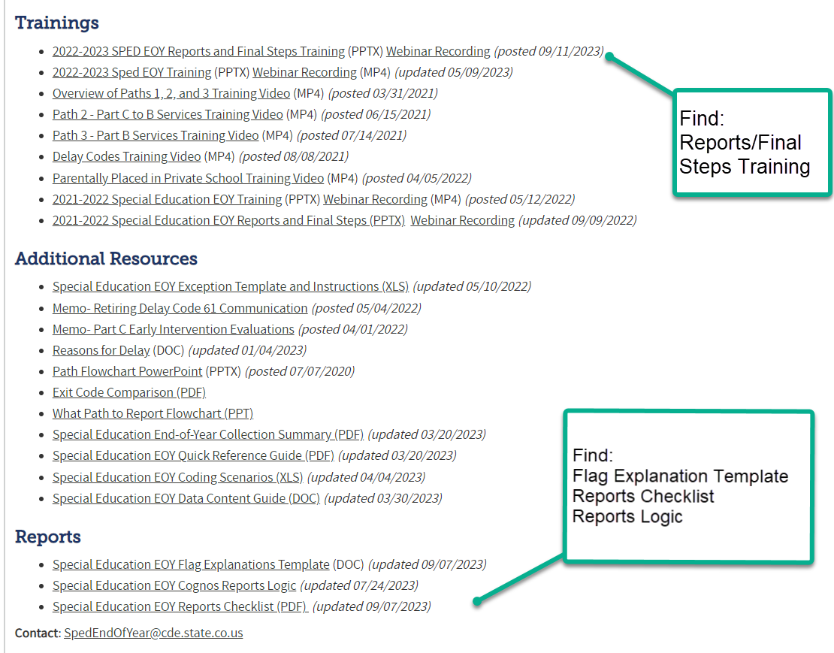
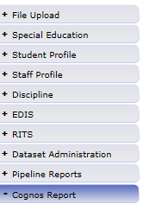
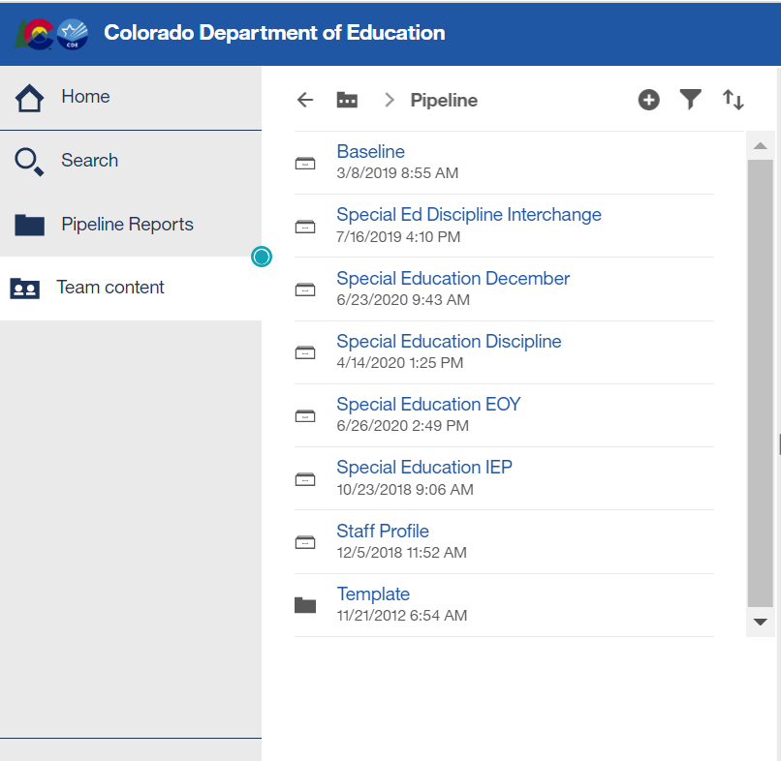
Special Education EOY:
Report Review Resources
  Resources on SPED EOY Snapshot webpage to help with Report Review:
To download reports from Pipeline system:
From Single Sign On → select Data Pipeline → Click Cognos Report → Special Education EOY:
Special Education EOY – Lindsey Heitman
SpedEndofYear@cde.state.co.us

Slide 23
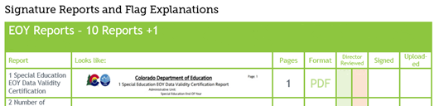
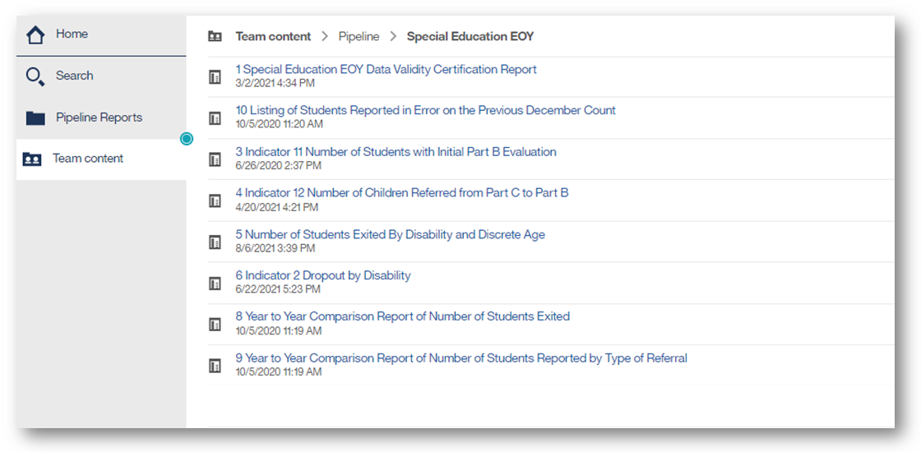
Special Education EOY:
Signature Reports in Cognos
Signature Reports start on page 6 of the Checklist
Special Education EOY – Lindsey Heitman
SpedEndofYear@cde.state.co.us

Slide 24
Special Education EOY:
Reminder to locate and report all exits from Special Education
Reporting Concern Reminder:
Several AUs have a large number of “EOY Missing Exits” - records that did exit by the end of the school year and weren’t exited in your 22-23 Sped EOY or exited over last summer (2023)
Reminder that all SPED students who exit the AU by 6/30/2024 are expected to be reported in the 23-24 SPED EOY with appropriate exit type
The EOY Missing Exits screen was really intended for students that left over the summer
These “missed exits” affect your indicator 14 sample, indicator 1 graduates, Indicator 2 dropout percentage, etc
If you pulled Participation file early in the spring from your SIS, you may be missing valid exits that need to be reported in 23-24.
Reporting Tip:
Be sure to reconcile the exits with your district(s) records/exits (NOW is great time to do this)
Be sure to check your warnings- they can help you locate students that should be exited in 23-24
Special Education EOY – Lindsey Heitman
SpedEndofYear@cde.state.co.us

Slide 25
Special Education EOY:
Warnings to Help Reconcile Exits –Both Ways
Will help you locate potential Missing Exits:
SY295: Student is being reported as exiting with an exit type of 70, 90, 92, 93, or 94 in the regular EOY collection- please double check the student's exit records to ensure you're reporting applicable exits from Special Education.
  Ignore the warning on records that met graduation requirements in regular EOY but are moving to a transition program or attending for another year, this is a valid difference.
  Otherwise, the AU should match the district’s exits for these students
Will help ensure you aren’t exiting a student that will continue in a Sped transition program:
SY309: If student is currently in or will begin a Sped transition program next year, the Sped EOY Basis of Exit should be zero-filled.
Check Special Education Transition Historical Report in IEP Interchange for a list of your Sped transition students
Special Education EOY – Lindsey Heitman
SpedEndofYear@cde.state.co.us

Slide 26
Special Education EOY:
Warnings Reminder
New SY247 errors (student code as dropout under the age of 17)?
  Be sure to keep checking for Warning SY282
    SY282 - Possible Transfer, this student is reported as in attendance (not exited) at another AU/SOP.
      Other AU will be listed in the error report so you can reach out and confirm attendance/enrollment
Please check for warning SY263 and adjust your data to resolve so you aren’t reporting the same initial evaluation again this year:
  SY263 - This Path 3 student was reported in your AU last year as a Path 3 student, please verify whether your current reporting is correct.
Special Education EOY – Lindsey Heitman
SpedEndofYear@cde.state.co.us

Slide 27

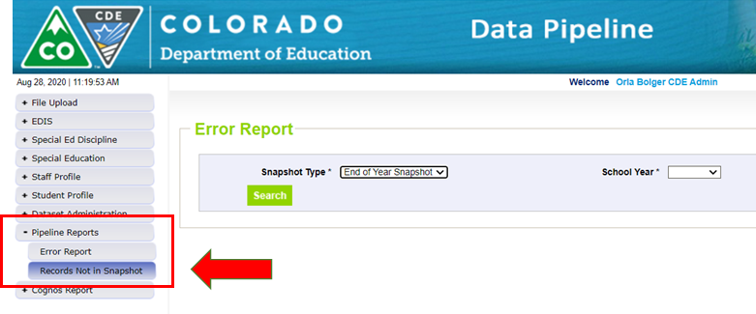
Special Education End of Year
– Missing Snapshot Records
Missing Snapshot Records Report- Must Check!
Identify records missing from snapshot due to:
  Interchange errors
  Criteria issues such as excluded PAI (Pupil Attendance Information) codes or mismatched SASIDs or LASIDs
  Records missing from either Child or Participation file
*These missing records will also show up as 500 level snapshot warnings
Special Education EOY – Lindsey Heitman
SpedEndofYear@cde.state.co.us

Slide 28
Questions & Resources:
Special Education End of Year
Lindsey Heitman
SpedEndofYear@cde.state.co.us
(720) 456-2033
Special Education IEP Interchange Webpage
Special Education End of Year Snapshot Webpage

Slide 29
Student October
Brooke Wenzel

Slide 30
Student October Timeline – Regular Phase
Date | Event | Event Description
09/12/2024 | Training Event | Veteran Respondent Training 11-12 p.m.
09/16/2024 | Training Event | Postsecondary Program Coding Training 11-12 p.m.
09/24/2024 | Other Date | First day of Student October Count Window for districts with 5-day school week.
10/01/2024 | Other Date | Official Count Day 2024
10/02/2024 | Interim Deadline | Upload Student Demographic and Student School Association Files. Upload Title I Interchange File (if applicable). Upload At-Risk Interchange File.
10/08/2024 | Other Date | Last day of Student October Count Window for districts with 5-day school week.
10/09/2024 | Interim Deadline | Error free Student Interchange File uploads
10/14/2024 | Training Event | Mid-Collection Office Hours 10-11 a.m.
10/14/2024 | Interim Deadline | Create an initial Student October Snapshot
10/22/2024 | Interim Deadline | Error free Student October Snapshot
10/24/2024 | Training Event | Data Validation, Transfer Enrollment Exceptions and Cognos Reports 1-2 p.m.
10/28/2024 | Training Event | Data Pipeline Duplicate Process and Submission 9-10 a.m.
11/01/2024 | Report Review | Review Student October Cognos Reports for data validation. Submit Student October Snapshot data as soon as review is complete.
11/08/2024 12:00 p.m. | State Deadline | Submit Student October Snapshot data
Student October
StudentOctober@cde.state.co.us

Slide 31
Student October Timeline – Duplicate Process
Date | Event | Event Description
11/12/2024 12:00 p.m. | Deadline | Duplicate funding documentation due to School Auditing Office
11/18/2024 | Other Date | School Auditing makes decisions on funding duplicates
11/27/2024 | Deadline | Resubmit Student October Snapshot data to CDE based on decisions from School Auditing
12/06/2024 | Deadline | Collection closes Secretary of the Board of Education Verification (sign-off) form due. Data remains embargoed until the official release in January.
01/15/2025 | Data Release | Official data release
Student October
StudentOctober@cde.state.co.us

Slide 32
Student October Training Schedule
Note: Join live training on the Student October Website. Training and PPT will be posted after the training has happened.
Veteran Respondent Training
Date/Time: 09/12/2024 11-12 p.m.
Click here to join the teams meeting.
Postsecondary Program Coding Training
Date/Time: 09/18/2024, 2-3 p.m.
Click here to join the teams meeting.
Mid-Collection Office Hours
Date/Time: 10/14/2024 10-11 a.m.
Click here to join the teams meeting.
Data Validation, Transfer Enrollment Exceptions and Cognos Reports Training
Date/Time: 10/23/2024 1-2 p.m.
Click here to join the teams meeting.
Data Pipeline Duplicate Process and Submission Training
Date/Time: 10/28/2024 9-10 a.m.
Click here to join the teams meeting.
Student October
StudentOctober@cde.state.co.us

Slide 33
Snapshot Visual
Student October
Student Demographic
Student School Association
At-Risk
Title I (if applicable)
Supporting Files (TREP Allocation, Foster, etc.)
Light Green – District Uploads/Provides
Gray – CDE Uploads
Light Blue – District “Triggers”
Home School Data
Student October
StudentOctober@cde.state.co.us

Slide 34
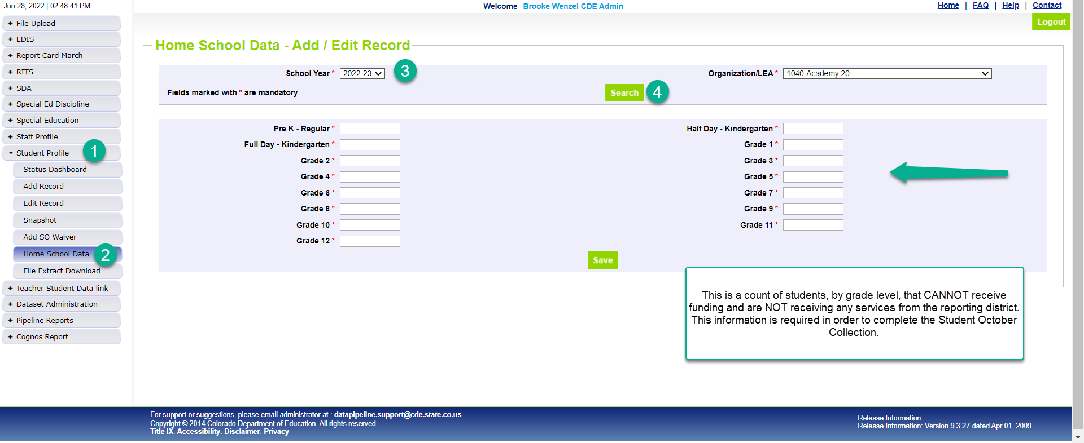
Home School Data
*Please note that you’ll need to include any homeschool students receiving some regular education services provided by the district in your interchange files. They are only eligible for a maximum of part-time funding. For homeschool student receiving no services report them in Home School Data under Student Profile. These students who are not taking any classes offered through the district are not eligible for funding.
Student October
StudentOctober@cde.state.co.us

Slide 35
Known Issues
SP547 (marked inactive this year) - Student was marked gifted last year and is not this year. Students who were indicated as gifted in any of the fields (except for Gifted in General Intellect Ability) should continue to be identified throughout the duration of their school career.
  Was causing problems in Production. Please upload a fresh SSA file to clear this error.
SP561 - Your district may only use valid Joint County Codes applicable to your district's boundaries when students reside in the district.
  Misfiring currently. Ignore this error for now. I will send out an email when it has been fixed. This will only affect Joint County Districts.
At-Risk Interchange File Duplicates (AR03 – SASID Duplicates are not allowed.)
  Receiving the AR03 error and attempted a Student October Snapshot?
  You will get invalid Student October errors (OC200 - This student is currently missing from your district's At-Risk Interchange File. Please add this student's record to the At-Risk Interchange data and take a new Student October Snapshot.)
  Try to resolve all AR03 errors before taking a Student October Snapshot.
Student October
StudentOctober@cde.state.co.us

Slide 36
What Should I Be Doing Now?
Get SASIDs for new students in RITS (Record Integration Tracking System)
Make sure Student Information System is up to date
Extract Interchange Files
  Student Demographic
  Student School Association*
  At-Risk (if you can extract)**
  Title I (if applicable)
Upload Interchange Files into Data Pipeline
  You do not have to wait until October 1st to start uploading files (recommended to start now)
  Clean up errors within SIS and extract/upload files again
  *Some Student Information Systems do not have new 2024-2025 SSA file implemented. Please reach out to your SIS vendor if this is not implemented just yet.
  **Some Student Information Systems do not have the capability to extract At-Risk. More information in upcoming slide.
Student October
StudentOctober@cde.state.co.us

Slide 37
Questions & Resources:
Brooke Wenzel
StudentOctober@cde.state.co.us
720-441-7963
Student October Webpage
Student Interchange Webpage

Slide 38
School Auditing Office Updates
Rebecca McRee

Slide 39
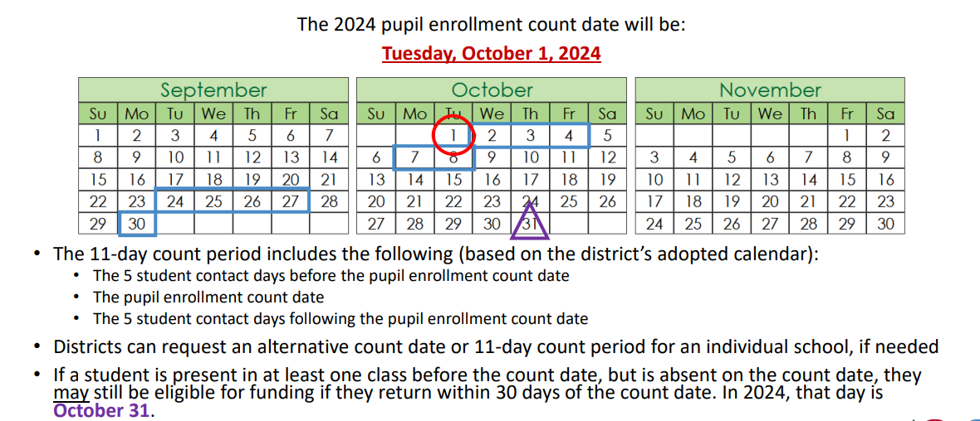
Student October Count Day 2024
School Auditing Office
Audit@cde.state.co.us

Slide 40
Alternative Count Date Requests
Reminder:
The deadline to request an Alternative Count Date is September 15, 2025.
Requests:
All requests should be submitted to audit@cde.state.co.us
For details on what needs to be included, refer to Instructions on "Applying for an Alternative Count Date."
School Auditing Office
Audit@cde.state.co.us

Slide 41
Audit Resource Guides
These Guides contain the funding and audit documentation requirements that districts and BOCES may be required to provide during the Annual Audit Review or subsequent expanded audits.
Student October (Pupil) Count Audit Resource Guide
At-Risk Count Audit Resource Guide
English Language Learner (ELL) Audit Resource Guide
School Auditing Office
Audit@cde.state.co.us

Slide 42
NEW: Annual Audit Reviews beginning 2024/2025
Starting with the 2024-2025 fiscal year, the School Auditing Office will be shifting its audit approach.
All districts and BOCES (that operate their own schools and/or submit data during the Student October data collection) will participate in the Annual Audit Review.
No later than December 11, 2024, all districts and BOCES must:
  Complete all funded count audit questionnaires (pupil, at-risk, and ELL), and
  Upload initial audit documentation (as described in the corresponding questionnaires) to Syncplicity.
Some districts and BOCES will be subject to further focused or comprehensive audit reviews
A Preparing for the New Annual Audit Review training webinar was held 7/23/24; the recording is available on the School Auditing Office Training page.

Slide 43
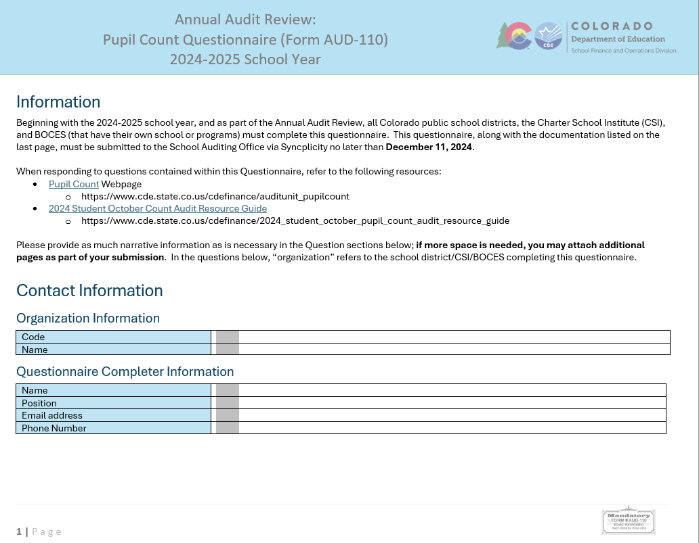
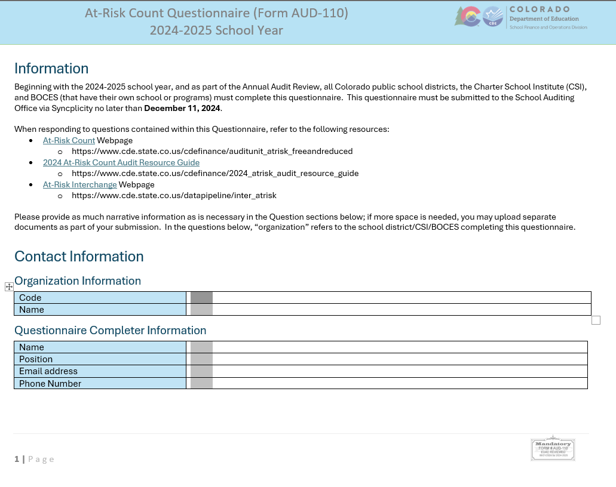
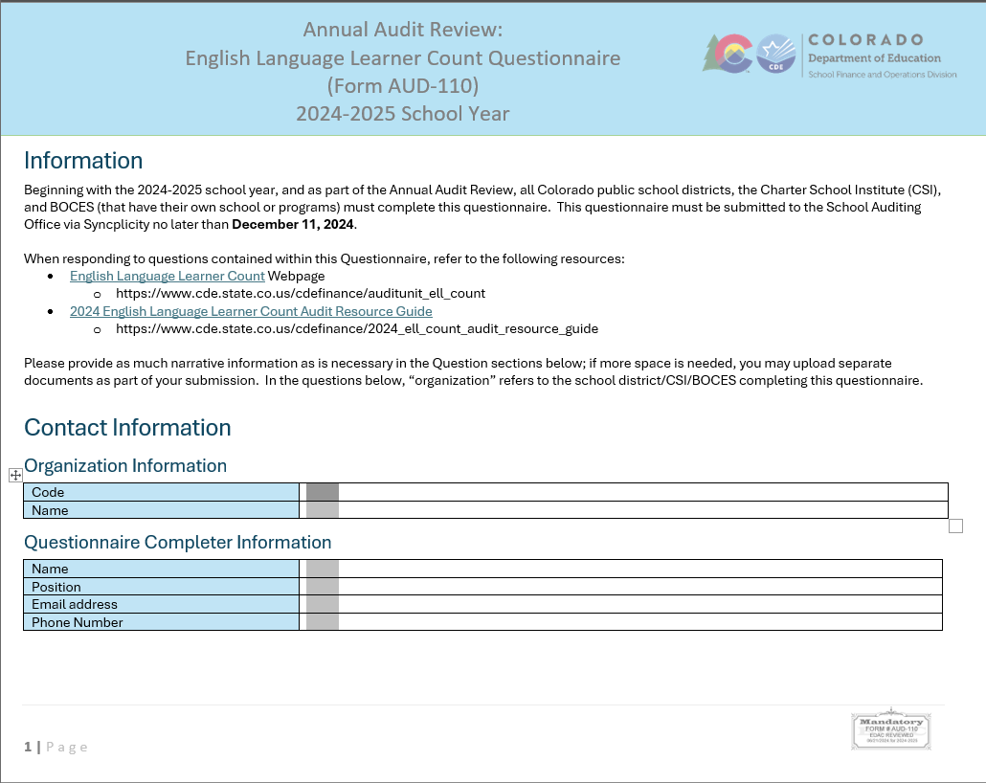
NEW: Annual Audit Questionnaires for Pupil Count, At-Risk Count, and ELL Count
All 3 audit questionnaires are fillable word documents.
If additional space is needed to provide adequate responses, the completer should attach or upload additional pages.
  Label additional pages with the question number found on the questionnaire.
All questionnaires available as Word documents on the on the main School Auditing Office webpage.

Slide 44
Training and Office Hours
Upcoming Trainings:
English Language Learner Count Audit Overview September 17, 2024 (10AM)
Duplicate Count Office Hours November 5, 2024 (10AM)
School Auditing Office's Training and Office Hours website
School Auditing Office
Audit@cde.state.co.us

Slide 45
Questions & Answers:
School Auditing Office
Audit@cde.state.co.us
Pupil Count Website
At-Risk Count Website
English Language Learner Count Website
Training and Office Hours Website

Slide 46
At-Risk Interchange
Rebecca McRee

Slide 47
New: At-Risk Measure Interchange File -
Overview
Beginning with the 2024/2025 school year, there is a new Data Pipeline At-Risk Interchange.
The purpose of the At-Risk Interchange is to obtain student-level census block data (based on primary residential addresses) that is needed to implement the new at-risk measure as described in HB22-1202 with data collection to begin with the 2024-2025 school year as provided for under SB24-188.
The new at-risk measure will be implemented starting with the 2025/2026 school year, and included in the Total Program funding calculation as described in the Public-School Finance Act which will continue to utilize student level data reported through the Student October Count data collection.
This interchange opened on July 15, 2024 and closes November 8, 2024. It will only be open during the Student October Count Collection.
At-Risk Interchange
ARMeasure@cde.state.co.us

Slide 48
Obtaining Census Block Data
To obtain census data, districts will rely on their own geographic information system (GIS) technology (such as ArcGIS),or the Census Geocoder Tool.
The Census Geocoder is a tool that allows users to submit a single address, batch of up to 10,000 addresses, or location coordinates, in order to look up addresses and obtain their corresponding census block data.
At-Risk Interchange
ARMeasure@cde.state.co.us

Slide 49
New: Census Block Data
Required and valid census block data combinations include 4 data fields:
  State Code
  County Code
  Tract Code
  Block Code
To obtain this data, districts will need to first gather, clean and validate student address data.
Then districts will need to "geocode" each student's primary physical residential address to obtain this information.
  District's GIS system (such as ARC)
  Census Geocoder Tool
  Other (if your district has some other tool, please reach out to ARMeasure@cde.state.co.us)
At-Risk Interchange
ARMeasure@cde.state.co.us

Slide 50
New: At-Risk Measure Interchange File -
Resources
At-Risk Interchange Website
  File Layout
  Business Rules
  Interchange Upload Template (XLS)
  Timeline
  Trainings
    Overview of the Geocoder Tool (PDF) (Recorded Training)
    Overview of the Data Pipeline At-Risk Interchange File (PDF) (Recorded Training)
    Office Hours Session covering the Geocoder Tool and Interchange File was held yesterday, Sept.11, 2024. (PDF) (Recording will be posted on or about 9/16)
  Additional Resources
    UPDATED 9/10/24: Instructions for Using the Geocode Tool
    Valid Census Block Data Combinations (XLS)
At-Risk Interchange
ARMeasure@cde.state.co.us

Slide 51
New: At-Risk Measure Interchange File -
Timeline
Date | Event | Event Description
7/15/2024 | Open | Districts may begin to upload the At-Risk Interchange file to the data pipeline.
8/23/2024 | Open | Districts may begin creating Student October Snapshots. This Snapshot is dependent on the Student Demographic File, Student School Association File, Title 1 File (if applicable) and the At-Risk File.
8/13/2024 | Training Event | Overview of the Census Geocoder Tool (10-11am)
8/20/2024 | Training Event | Overview of the At-Risk Interchange File (1-2pm)
9/13/2024 | Other Date | Gather, review, clean-up and validate student addresses
9/27/2024 | Other Date | Obtain census block data for all student addresses
10/2/2024 | Interim Deadline | Upload the At-Risk Interchange File
10/9/2024 | Interim Deadline | Obtain error-free At-Risk Interchange File upload
10/22/2024 | Interim Deadline | Obtain error-free Student October Snapshot
11/1/2024 | Report Review | Review Student October Cognos Reports for data validation. Submit Student October Snapshot data as soon as review is complete
11/8/2024 | State Deadline | Submit Student October Snapshot data
At-Risk Interchange
ARMeasure@cde.state.co.us

Slide 52
Student Information System Update- Infinite Campus
As of today, it is CDE’s understanding that Infinite Campus is working individually with districts as they submit cases related to the At-Risk interchange reporting.
Infinite Campus will provide guidance as needed to navigate their systems when geolocating students’ physical addresses and obtaining census block group information.
Districts will submit cases related to the At-Risk interchange reporting to their IC administrators and are encouraged to reach out to their IC administrators for direct assistance.
At-Risk Interchange
ARMeasure@cde.state.co.us

Slide 53
Student Information System Update- PowerSchool
As of today, it is CDE’s understanding that PowerSchool will introduce a new Census Block Data section that will be added to the CO Demographics page.
This will include a Confidentiality Program Participant checkbox and read-only fields for State Code, County Code, Tract Code, and Block Code (which will be populated later through a Geocode API).
Additionally, a Foster Child checkbox will be added under the Student Demographics Information section.
Users can start entering data for the Foster Child and Confidentiality Program Participant fields, while the Census Block Data fields will be updated in a future release.
Districts are encouraged to reach out to their PowerSchool administrators for information on future updates and other assistance.
At-Risk Interchange
ARMeasure@cde.state.co.us

Slide 54
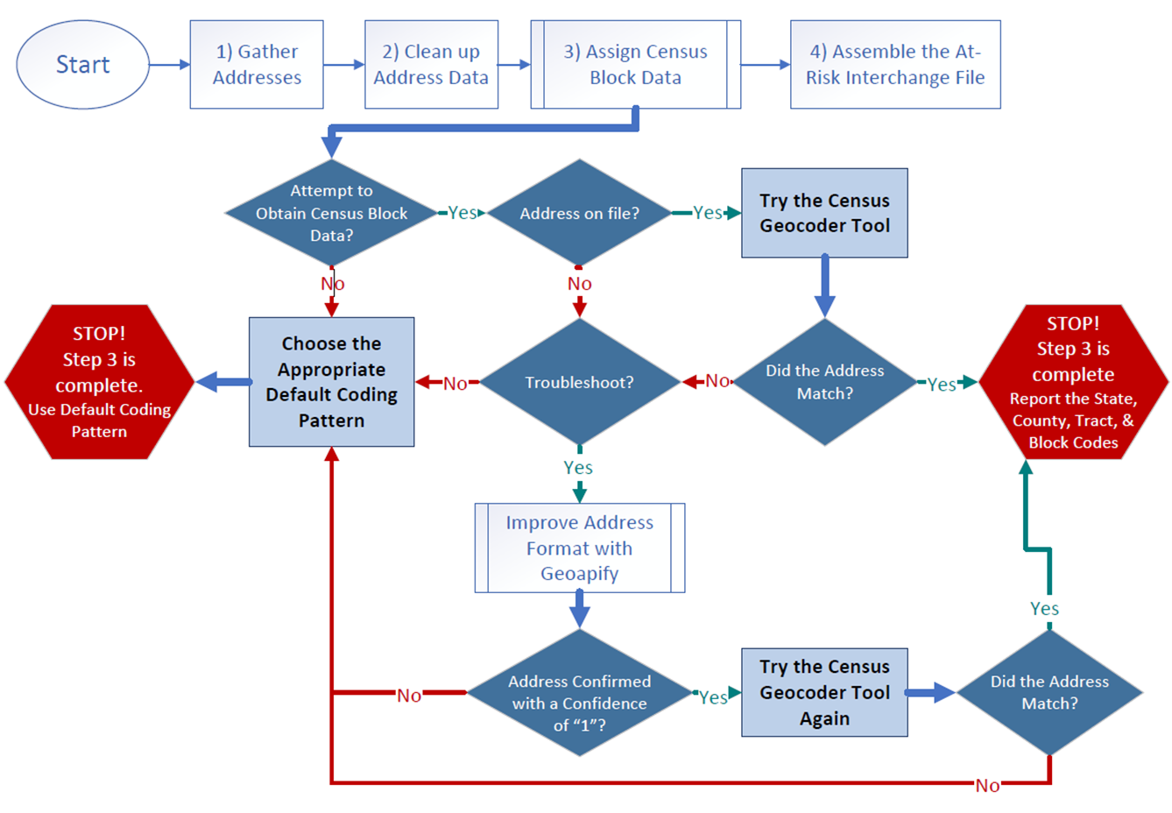
Flowchart: Obtaining and Reporting Census Data

Slide 55
File Layout and Definitions (page 3):
Missing Census Block Data- Coding Patterns
Description | State Code | County Code | Tract Code | Block Code
Address on File- Did Not Attempt to Obtain Census Block Data: The district has a primary physical address on file but did NOT attempt to obtain census block data using the geocode tool. | 08 | 000 | 000001 | 0001
Address on File- No Census Block Data Returned: The district confirmed that the primary physical address is valid using USPS but the geocode tool did not return census block data. | 08 | 000 | 000002 | 0002
Confidentiality Program: No census block data was provided because the district has confirmed the student is participating in a confidentiality program. | 08 | 000 | 000003 | 0003
No Physical Primary Address on File- Identified Group: The district does not have a primary physical address on file and the student is confirmed homeless, migrant, foster child, or attending a detention center. | 08 | 000 | 000004 | 0004
No Physical Primary Address on File- No Identified Group: The district does not have a primary physical address on file and the student is not confirmed homeless, migrant, foster child, or attending a detention center. | 08 | 000 | 000005 | 0005
Out of State codes: The district has a primary physical address on file that is not in Colorado. | 08 | 000 | 000006 | 0006
At-Risk Interchange
ARMeasure@cde.state.co.us

Slide 56
New: At-Risk Measure Interchange File - Syncplicity Folders
Syncplicity folders are being shared on a rolling basis with ARM LEAUSERS and LEAVEWIERS.
The folder naming convention is:
  District Code_ District Name_ ARMeasure Interchange
These folders can be used to share files containing PII between the district or BOCES and CDE when requesting assistance with the At-Risk Interchange or Census Geocoding tool.
If you have been assigned the user or viewer role for this interchange file and your district's Syncplicity folder has not been shared with you, email ARMeasure@cde.state.co.us.
At-Risk Interchange
ARMeasure@cde.state.co.us

Slide 57
Questions & Answers:
ARMeasure@cde.state.co.us
Data Pipeline At-Risk Interchange website

Slide 58
READ Training
Tara Rhodes

Slide 59
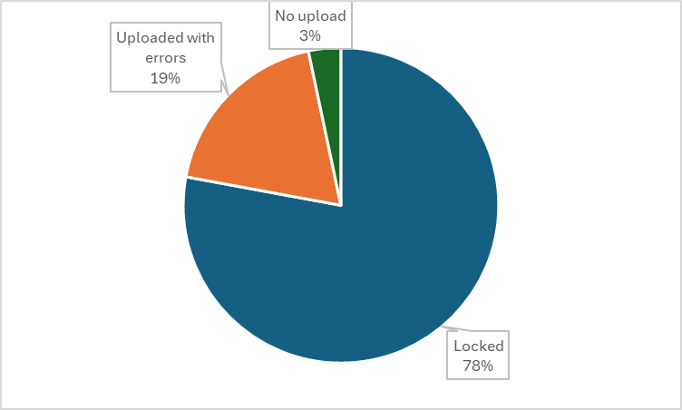
READ Training Collection
Timeline and Status
Current Status:
This collection is past due, so if you have not yet uploaded, please do so.
READ Training Collection
READActData@cde.state.co.us

Slide 60
READ Training Collection
Error Resolution – TR026 and TR035
There are a series of steps that have to happen in order to clear the TR026 and TR035 errors.
Educator has to fill out the designation application in COOL. (This is a very short application.)
This goes to the Ed Talent team to manually review.
Ed Talent notifies educator of approval status via email.
After approval email, COOL must sync to Pipeline. (These happen nightly.)
Then, the district must reupload their file to get Pipeline to reprocess the business rules and clear any of the TR026 and TR035 errors.
READ Training Collection
READActData@cde.state.co.us

Slide 61
READ Training Collection
Manual Review Process
The Manual Review Process is reserved for individuals who are unable to add their evidence of completion and READ Act designation in COOL due to licensure restrictions. Prior to using the form, please ensure the following:
The individuals the district is submitting to EOC for via the Manual Review fit the above criterion (ie, nonlicensed teachers and individuals who took the administrator training but don't have certain credentials)
All unrelated errors on your READ Training Export report have been cleared before submitting EOC
All individuals you are providing EOC for are listed on your READ Training Export Report and there is a 1:1 match between your error report and the submitted EOC
Submitted files follow naming conventions (Last, First_EOC) and are CDE approved forms of EOC.
READ Training Collection
READActData@cde.state.co.us

Slide 62
READ Training Collection
Recordings and Resources
Recordings:
Thursday, 6/27 - Slides have been posted here.
Thursday, 7/11 - Recording has been posted here.
Thursday, 7/25 - Recording has been posted here.
Thursday, 8/8 - Recording has been posted here.
Resources:
Cognos Report 1: READ Training Educators Reported in Prior Years (select 24-25)
Cognos Report 2: HR December Educators and READ Training Status (select 23-24)
24-25 File Layout
Business Rules
READ Training Website
Data Collection Guide – Updated for 2024-25
READ Training Collection
READActData@cde.state.co.us
Notes:
People reported previously by that district
2. People currently in their district and may have been reported in a prior year by their district or another district.

Slide 63
READ Training Collection
Questions & Answers:
Email: READActData@cde.state.co.us
Phone: 720.601.4125
READ Act Training Website

Slide 64
Title I
Melissa Chaffin, Federal Programs

Slide 65
Collection Timeline
Date | Event | Event Description
Current | Title I 24-25 Interchange open in Data Pipeline | LEAs can begin to upload their Title I file to address any errors. This would be for the school year 24-25 for Student October.
10/02/2024 | Upload Title I file | Upload Title I file to address any errors if you haven’t already.
10/09/2024 | Interim Deadline Title I | Interim Deadline for Title I file uploaded and error-free.
10/22/2024 | Title I Deadline | Have Title I uploaded and error free for Student October snapshot.
11/08/2021 | Official State Deadline | Have Title I uploaded and error free for Student October snapshot.
Title I
Chaffin_m@cde.state.co.us

Slide 66
Collection Timeline
Date | Event | Event Description
Current | Title I Interchange still open in Data Pipeline for EOY 23-24 | If needed, LEAs can begin to upload/re-upload their Title I file to address any errors. This would be for the school year 23-24 for End of Year only. All LEAs have uploaded this file and would only need to do so again to make corrections.
11/13/2024 | Interim Deadline Title I for EOY 23-24 | Interim Deadline for Title I EOY 23-24.
11/19/2024 | Deadline Title I for EOY for 23-24 | Deadline for Title I file uploaded and error-free (EOY snapshot for 23-24).
Title I
Chaffin_m@cde.state.co.us

Slide 67
Brief Overview of Title I Part A
Title I Part A file is uploaded in the Data Pipeline during October Count in the Fall and again during EOY collection in the Spring.
Schools and grade spans are identified as either SW (Schoolwide), TA (Targeted Assistance), or NS (Not Serviced) during the Consolidated Application period.
List of schools and grade spans to check status (TA, SW, NS): http://www.cde.state.co.us/fedprograms/dper/tiaschlst (24-25 is now posted, this list is preliminary due to some ongoing minor changes and will be updated, there are a few PK grade spans that still need to be added).
Title I
Chaffin_m@cde.state.co.us

Slide 68
Title I Interchange Targeted Assistance (TA)
Only students within eligible TA schools and grade spans are reported in a file which is uploaded to the Data Pipeline.
Include students in TA grade schools/grade spans who received Title I services/resources any time during the year, even if student left school/district or services were stopped.
The student data must match the Student School Association file in the Data Pipeline.
If the file needs to be updated, then override or replace the old file with the updated file.
Maintain a complete data file at district or school level, make updates to this file if needed.
Title I
Chaffin_m@cde.state.co.us

Slide 69
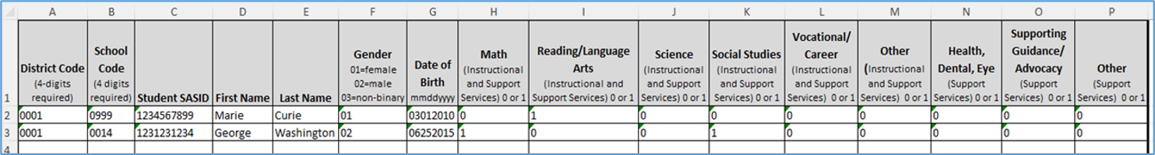
Title I Interchange Targeted Assistance Template
The new Title I file template can be found here: https://www.cde.state.co.us/datapipeline/inter_titlei
Please use the new template as it contains a new option in the Gender column (03 for non-binary).
Make sure to include leading zeros, for example, district codes, school codes, gender, DOB.
Indicate resource(s) students received (reading, math, etc.): 1 for yes, 0 for no. All service cells must be either 1 or 0.
More than 1 school can be listed on the same file for the same district.
Title I
Chaffin_m@cde.state.co.us

Slide 70
Title I Interchange Schoolwide (SW)
SW schools and students are not reported.
There is no need to put SW schools and students in this file as they are automatically provided to the Student October Count when the snapshot is taken.
If you report them, you will get an error.
Title I
Chaffin_m@cde.state.co.us

Slide 71
Title I Status Designation List
Note: 2 different grade spans at the same school can have 2 different Title I status designations, so please make sure your template has students within the TA status grade span.
List of schools and grade spans to check status (TA, SW, NS): http://www.cde.state.co.us/fedprograms/dper/tiaschlst (24-25 is now posted, this list is preliminary due to some ongoing minor changes and will be updated).
If you think there is a discrepancy in the Title I Part A school/grade span list for your LEA, please email me: Chaffin_m@cde.state.co.us
Title I
Chaffin_m@cde.state.co.us

Slide 72
Title I Common Errors
Most common Title I Interchange data does not match Student Interchange data
  TI003: This school is not a Targeted Assistance school for the grade of the student’s enrollment in the Student Profile.
    Check the Title I Status Designation list for the school and grade span status.
  TI004: There must be a School Association record for this student in the Student Profile at this school for the current School Year.
    Make sure the Student School Association file is uploaded first.
  OC067: At least one student should be reported in the Title I Interchange as participating in Title I services within a school that implements a Targeted Assistance program. Please update/upload your Title I Interchange file.
  May have to refresh October Count file for system to re-read the files.
Wrong formats
  Missing leading zeros: Gender (01,02,03) must have zeros as well as the Birthdate format mmddyyyy.
General data errors
  Invalid SASID, first and last name swapped, missing letters.
Services not marked 0 or 1 in template; blanks=errors.
The full list of business rules for Title I can be found here: https://www.cde.state.co.us/datapipeline/inter_titlei
Title I
Chaffin_m@cde.state.co.us

Slide 73
Questions & Resources:
Title I
Melissa Chaffin
chaffin_m@cde.state.co.us
720-908-1379

Slide 74
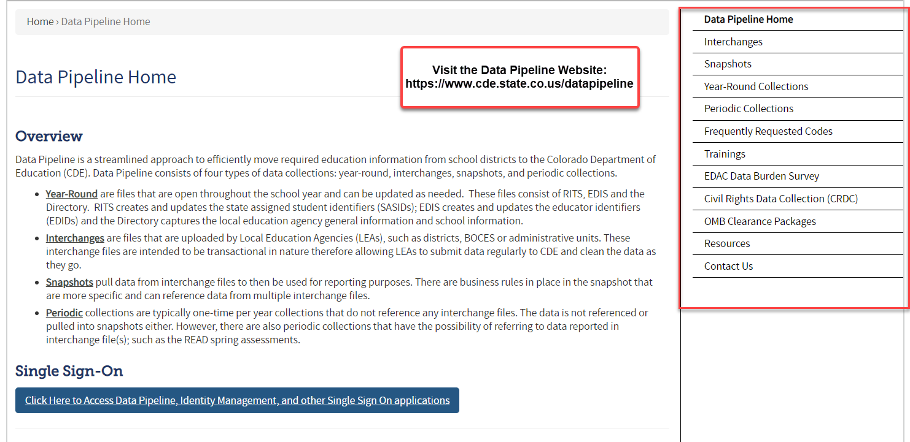
Thank you for joining today!
Next Town Hall will be September 19th
Reminder:
Each Data Collection has a more detailed timeline posted on their corresponding website (as well as other helpful resources)!

