Slide 1
September 5, 2024
Data Pipeline Town Hall
The goal of the webinar is to provide updates on the Data Pipeline, current, and upcoming data collections. These webinars also provide a forum for districts, BOCES, and Administrative Units to have questions answered about Data Pipeline.

Slide 2
Colorado Department of Education
Identity Management (IdM)
Identity Management Site
Frequently Asked Questions
How do I add myself or others to the email listserv for town hall emails and/or a specific collection?
  Email lists are dependent on a person’s access rights in IdM. Contact your LAM to get an account or be assigned to a specific collection.
Where can I find the IdM role mappings for Data Pipeline and other applications?
  Role Mapping (XLS)
I am a LAM. How do I update the user permissions for someone in my district?
  Follow the steps outlined in the IdM Quick Guide for Access Management (DOCX)
Important: Users are not automatically removed from IdM when their email address is no longer active in your district. The LAM must deactivate their IdM account to ensure only designated staff can access CDE’s data reporting system.
Notes:
LAMs, please check the IdM roles for your district. Remove permissions for users who have retired, left your district, or are no longer assigned to a collection. Add roles for new hires and newly assigned respondents for specific collections.

Slide 3

What is PII?
Student and Staff Personally Identifiable Information (PII) is defined by state and federal laws as information that, alone or in combination, personally identifies an individual
  This includes direct identifiers
  (i.e. student and staff names, SASID, EDID, etc.)
  Includes information that when combined is identifiable
Colorado’s Student Data Transparency and Security Act outlines requirements for how Student PII is collected, used and shared
See the Data Privacy and Security website for prepared guidance on how to comply with this and other privacy laws.

Slide 4

Sharing Data
Use secure methods to transfer any PII to CDE
  Contact Data Collection leads with questions about how to transmit PII securely
    Each Data Collection leads maintains their own Syncplicity folders for specific collections, reach out to the collection lead for access
  Use Syncplicity to encrypt emails to CDE
Avoid sending PII via unencrypted email or to unsecured faxes when sharing data between or within districts
  Use Syncplicity to encrypt emails to CDE
Check local policies for restrictions, requirements, etc. regarding PII
  Do not use PII in trainings, presentations, etc.
  Do not share PII with unauthorized individuals
  Do not share passwords
  Follow local policies when transmitting PII to any third party

Slide 5
Today’s Agenda
Agenda Topic | Presenter
Open Data Collections and Upcoming Deadlines in Data Pipeline
Student Discipline | Dawna Gudka
Special Education End of Year | Lindsey Heitman
Student October | Brooke Wenzel
School Auditing Office Updates | Rebecca McRee
At Risk Interchange Updates | Rebecca McRee
READ Staff Training | Tara Rhodes
Title I Interchange | Melissa Chaffin

Slide 6
Open Collections and
Upcoming Deadlines in
Data Pipeline

Slide 7
Open Collections and Upcoming Dates:
Year-Round & Interchanges
Name | Category | Status | Key Dates
RITS | Year Round | Open
EDIS | Year Round | Open
Directory | Year Round | Open | District Calendars Due 9/2/2024
Student | Interchange | Open | 2023-2024 and 2024-2025 are open
At-Risk | Interchange | Open
Title I | Interchange | Open
Special Education IEP | Interchange | Open
Staff | Interchange | Open | 2023-2024 open 2024-2025 will open 9/4
TSDL | Interchange | Open
Discipline | Interchange | Open
Data Pipeline Resources: Data Pipeline Collection Dates (XLS)

Slide 8
Open Collections and Upcoming Dates:
Snapshots
Name | Category | Status | Final Deadline Date | Next Milestone | Looking Ahead
TSDL | Snapshot | Open | Aug. 30, 2024 | Report Review: 8/23/2024 – 8/30/2024 Review TSDL data | Collection Deadline: 8/30/2024
Staff Evaluation | Snapshot | Open | Oct. 15, 2024 | Interim Deadline: 8/7/2024-9/30/2024 Report Review | Collection Deadline: 10/15/2024
Student Discipline | Snapshot | Closed | July 31, 2024 | Embargoed Data Release: 8/27/2024 | Published Reports 8/30/2024 Profile Reports published 9/3/2024
Student October | Snapshot | Open | Nov. 8, 2024 | Official Count Date: 10/1/2024 | Interim Deadline: 10/2/2024 Upload initial interchange files
Student End of Year | Snapshot | State Deadline | Nov. 19, 2024 | State Deadline: 9/5/2024 Submit SEY Snapshot | Cross LEA Phase: 9/19/2024 to 10/17/2024
Special Education End of Year | Snapshot | Open | Sept. 27, 2024 | Interim Deadline: 9/05/2024 All errors resolved – complete snapshot | Interim Deadline: 9/6/24 – 9/13/24 Report Review - all changes made and errors fixed by 9/16/2024
Data Pipeline Resources: Data Pipeline Collection Dates (XLS)

Slide 9
Open Collections and Upcoming Dates: Periodic
Name | Category | Status | Final Deadline Date | Looking Ahead
READ Training | Periodic | Open | Aug. 30, 2024
Designated Agency | Periodic | Open | Aug. 30, 2024
S-EBT (corrections period) | Periodic | Open | Aug. 30, 2024
Data Pipeline Resources: Data Pipeline Collection Dates (XLS)

Slide 10
Student Discipline Snapshot
Dawna Gudka

Slide 11
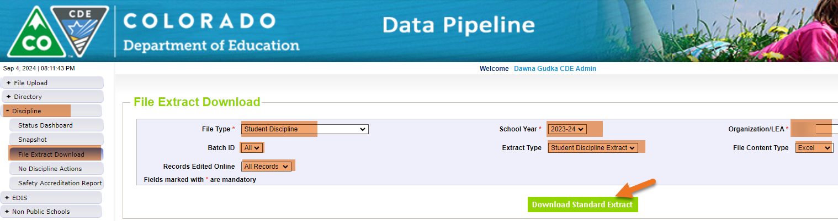
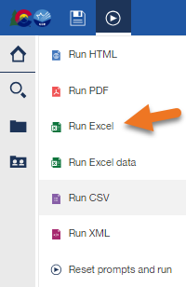
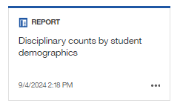
Embargoed Data
Extract your Student Discipline Snapshot records and or use Cognos Reports
Student Discipline-Dawna Gudka collection lead
studentdiscipline@cde.state.co.us

Slide 12
Student Discipline: Questions & Resources
Student Discipline Snapshot
studentdiscipline@cde.state.co.us
Dawna Gudka-Collection lead
(303) 598-7901

Slide 13
Special Education End of Year
Lindsey Heitman

Slide 14
Special Education End of Year
Error Free Snapshot Status
Special Education EOY – Lindsey Heitman
SpedEndofYear@cde.state.co.us

Slide 15

Special Education End of Year:
Timeline and Office Hours
2023-2024 Special Education EOY Snapshot Timeline
May 1, 2024 - SPED EOY Snapshot official open
June 27, 2024 – IEP Interchange files error-free
August 29, 2024 - All Exception requests submitted to CDE
September 5, 2024 – All errors resolved at snapshot/interchange TODAY!
September 5 -13, 2024 -Initial Report Review
September 16 - 20, 2024 – Resolving duplicates
September 20 - 27, 2024 – Final Report Review
September 27, 2024 - Final approval in Data Pipeline and reports uploaded to DMS
  Sped EOY Reports and Final Steps Webinar:
  Thursday Sept 5th 1:00 – 2:00
  Join the meeting now
Special Education EOY – Lindsey Heitman
SpedEndofYear@cde.state.co.us

Slide 16
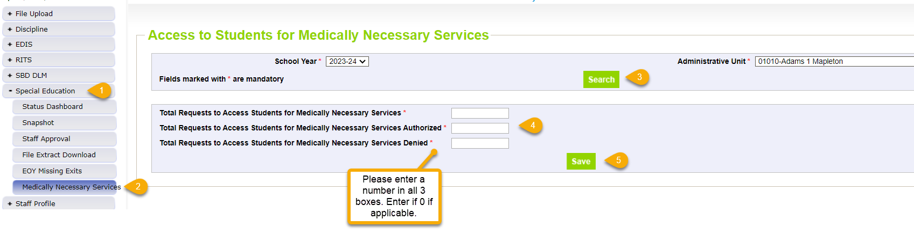
Medically Necessary Services:
Steps to Submit Counts to Data Pipeline
Notes:
Counts must reflect all districts within AU from July 1, 2023 – June 30, 2024
Must be completed by the time Sped EOY is approved – by 9/27/24
AUs are able to modify counts until their final Sped EOY is locked/approved
pop up message will ensure each box is populated with a number
pop up message will ensure total # box (1st box) is the sum of those authorized and denied
Steps
1. Click Special Education tab
2. Click Medically Necessary Services tab
3. Select School Year/AU and click Search button
4. Enter a number in all 3 boxes
5. Click Save button
# Requests Authorized
# Requests Denied
Total # of Requests
Special Education End of Year – Lindsey Heitman
SpedEndofYear@cde.state.co.us

Slide 17
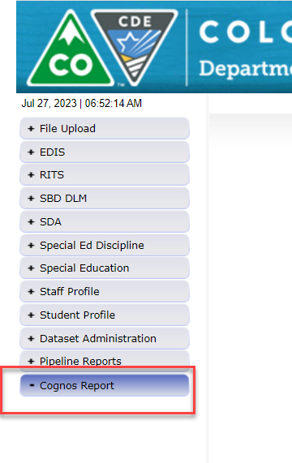
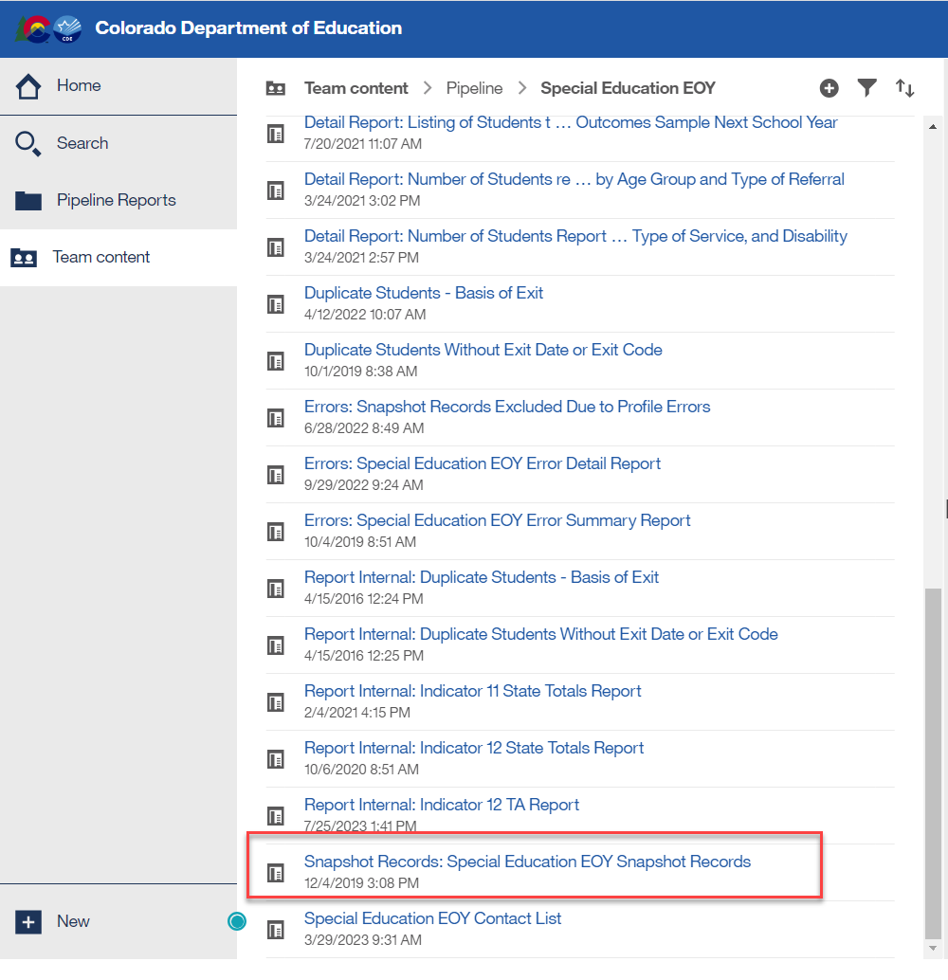
Special Education EOY
Use Prior Year Snapshot Records to Inform Coding for specific scenarios
Reporting Tip:
Download your Sped EOY Snapshot records from last year (22-23) to help you determine how to code records for this year
Export report to Excel and sort by various data fields: Sped Referral Codes, Delay Codes, etc.
This will help you see what fields are required in a particular coding scenario
Special Education End of Year – Lindsey Heitman
SpedEndofYear@cde.state.co.us

Slide 18
Special Education EOY:
Detail Report - Students to Re-evaluate by 12/01
Download report for your reference:
Detail Report: Listing of Children whose disability needs to be reevaluated by the next December 1 Count – Listing of students who will be three-years old or older by the next December 1 and who still have “12 – Infant/Toddler with a Disability” or will be 9 years old or older and who still have “11 – Developmental Delay” as their primary disability.
  Students who are 9 or older cannot be reported in the December Count with disability 11. They will miss out on funding if the re-evaluation is not completed by their 9th birthday.
Special Education End of Year – Lindsey Heitman
SpedEndofYear@cde.state.co.us

Slide 19
Questions & Resources:
Special Education End of Year
Lindsey Heitman
SpedEndofYear@cde.state.co.us
(720) 456-2033
Special Education IEP Interchange Webpage
Special Education End of Year Snapshot Webpage

Slide 20
Student October
Brooke Wenzel

Slide 21
Student October Timeline – Regular Phase
Date | Event | Event Description
09/05/2024 | Training Event | New Respondent Training 1-2 p.m.
09/10/2024 | Training Event | English Language Learner Training 11-12 p.m.
09/12/2024 | Training Event | Veteran Respondent Training 11-12 p.m.
09/16/2024 | Training Event | Postsecondary Program Coding Training 11-12 p.m.
09/24/2024 | Other Date | First day of Student October Count Window for districts with 5-day school week.
10/01/2024 | Other Date | Official Count Day 2024
10/02/2024 | Interim Deadline | Upload Student Demographic and Student School Association Files. Upload Title I Interchange File (if applicable). Upload At-Risk Interchange File.
10/08/2024 | Other Date | Last day of Student October Count Window for districts with 5-day school week.
10/09/2024 | Interim Deadline | Error free Student Interchange File uploads
10/14/2024 | Training Event | Mid-Collection Office Hours 10-11 a.m.
10/14/2024 | Interim Deadline | Create an initial Student October Snapshot
10/22/2024 | Interim Deadline | Error free Student October Snapshot
10/24/2024 | Training Event | Data Validation, Transfer Enrollment Exceptions and Cognos Reports 1-2 p.m.
10/28/2024 | Training Event | Data Pipeline Duplicate Process and Submission 9-10 a.m.
11/01/2024 | Report Review | Review Student October Cognos Reports for data validation. Submit Student October Snapshot data as soon as review is complete.
11/08/2024 12:00 p.m. | State Deadline | Submit Student October Snapshot data
Student October
StudentOctober@cde.state.co.us

Slide 22
Student October Timeline – Duplicate Process
Date | Event | Event Description
11/12/2024 12:00 p.m. | Deadline | Duplicate funding documentation due to School Auditing Office
11/18/2024 | Other Date | School Auditing makes decisions on funding duplicates
11/27/2024 | Deadline | Resubmit Student October Snapshot data to CDE based on decisions from School Auditing
12/06/2024 | Deadline | Collection closes Secretary of the Board of Education Verification (sign-off) form due. Data remains embargoed until the official release in January.
01/15/2025 | Data Release | Official data release
Student October
StudentOctober@cde.state.co.us

Slide 23
Student October Training Schedule
Note: Join live training on the Student October Website. Training and PPT will be posted after the training has happened.
New Respondent Training (TODAY)
Date/Time: 09/05/2024, 1-2 p.m.
Click here to join the teams meeting.
English Language Learner Training
Date/Time: 09/10/2024, 11-12 p.m.
Click here to join the teams meeting.
Veteran Respondent Training
Date/Time: 09/12/2024 11-12 p.m.
Click here to join the teams meeting.
Postsecondary Program Coding Training
Date/Time: 09/18/2024, 2-3 p.m.
Click here to join the teams meeting.
Mid-Collection Office Hours
Date/Time: 10/14/2024 10-11 a.m.
Click here to join the teams meeting.
Data Validation, Transfer Enrollment Exceptions and Cognos Reports Training
Date/Time: 10/23/2024 1-2 p.m.
Click here to join the teams meeting.
Data Pipeline Duplicate Process and Submission Training
Date/Time: 10/28/2024 9-10 a.m.
Click here to join the teams meeting.
Student October
StudentOctober@cde.state.co.us

Slide 24
Snapshot Visual
Student October
Student Demographic
Student School Association
At-Risk
Title I (if applicable)
Supporting Files (TREP Allocation, Foster, etc.)
Light Green – District Uploads
Gray – CDE Uploads
Light Blue – District “Triggers”

Slide 25
Ensure Accurate Data
Complete the basics of the collection early (Get files error free and create snapshots by the middle of October)
An error free snapshot does not guarantee accurately reported data
Review, Review, Review!
Make sure exception requests are needed before submitting them!
Pull in Subject Matter Experts to assist with verifying data (Finance Department, English Learner Department, Special Education, Registrar)
COGNOS Reports for verification

Slide 26
What Should I Be Doing Now?
Get SASIDs for new students in RITS (Record Integration Tracking System)
Make sure Student Information System is up to date
Extract Interchange Files
  Student Demographic
  Student School Association*
  At-Risk (if you can extract)**
  Title I (if applicable)
Upload Interchange Files into Data Pipeline
  You do not have to wait until October 1st to start uploading files (recommended to start now)
  Clean up errors within SIS and extract/upload files again
  *Some Student Information Systems do not have new 2024-2025 SSA file implemented. Please reach out to your SIS vendor if this is not implemented just yet.
  **Some Student Information Systems do not have the capability to extract At-Risk. More information in upcoming slide.

Slide 27
Questions & Resources:
Brooke Wenzel
StudentOctober@cde.state.co.us
720-441-7963
Student October Webpage
Student Interchange Webpage

Slide 28
School Auditing Office Updates
Rebecca McRee

Slide 29
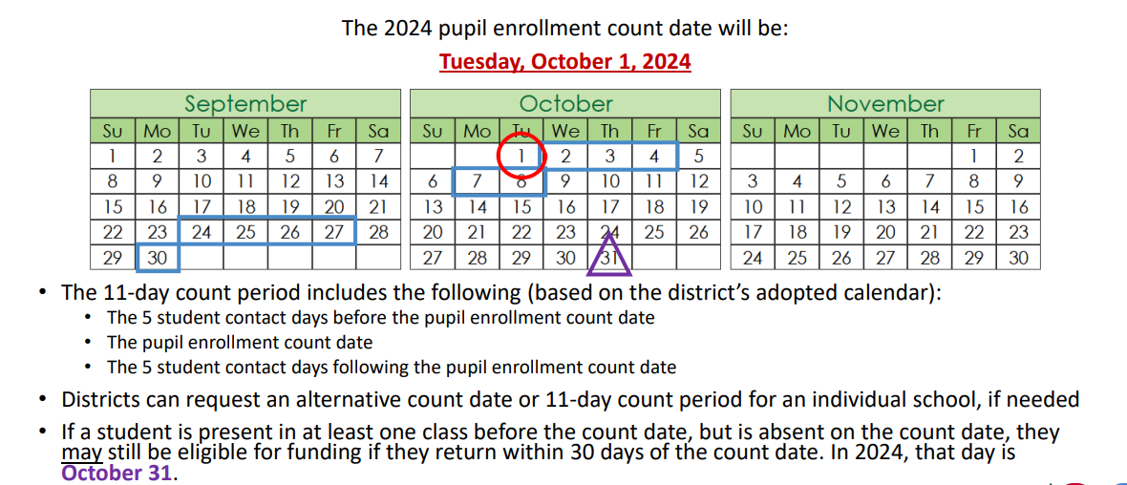
Student October Count Day 2024
School Auditing Office
Audit@cde.state.co.us

Slide 30
Alternative Count Date Requests
Reminder:
The deadline to request an Alternative Count Date is September 15, 2025.
Requests:
All requests should be submitted to audit@cde.state.co.us
For details on what needs to be included, refer to Instructions on "Applying for an Alternative Count Date."
School Auditing Office
Audit@cde.state.co.us

Slide 31
Audit Resource Guides
These Guides contain the funding and audit documentation requirements that districts and BOCES may be required to provide during the Annual Audit Review or subsequent expanded audits.
Student October (Pupil) Count Audit Resource Guide
At-Risk Count Audit Resource Guide
English Language Learner (ELL) Audit Resource Guide
School Auditing Office
Audit@cde.state.co.us

Slide 32
New: Annual Audit Review Process (Required)
Beginning with the 2024 Student October Count data collection, the School Auditing Office is changing its approach to the required compliance audits.
Annual Audit Review Process (Overview- PDF)
  Pupil Count Audit Questionnaire
  At-Risk Count Audit Questionnaire
  English Language Learner (ELL) Count Questionnaire
Audit District Contact Form
Initial audit documentation upload (as described on each questionnaire) will be due by December 11, 2024.
A training on the new process was held on 7/23/24. Visit the School Auditing Office's Training and Office Hours website to access the recording.
School Auditing Office
Audit@cde.state.co.us

Slide 33
Training and Office Hours
Upcoming Trainings:
English Language Learner Count Audit Overview September 17, 2024 (10AM)
Duplicate Count Office Hours November 5, 2024 (10AM)
School Auditing Office's Training and Office Hours website
School Auditing Office
Audit@cde.state.co.us

Slide 34
Questions & Answers:
School Auditing Office
Audit@cde.state.co.us
Pupil Count Website
At-Risk Count Website
English Language Learner Count Website
Training and Office Hours Website

Slide 35
At-Risk Interchange
Rebecca McRee

Slide 36
New: At-Risk Measure Interchange File -
Overview
Beginning with the 2024/2025 school year, there is a new Data Pipeline At-Risk Interchange.
The purpose of the At-Risk Interchange is to obtain student-level census block data needed to implement the new at-risk measure as described in HB22-1202 with data collection to begin with the 2024-2025 school year as provided for under SB24-188.
The new at-risk measure will be implemented starting with the 2025/2026 school year, and included in the Total Program funding calculation as described in the Public-School Finance Act which will continue to utilize student level data reported through the Student October Count data collection.
This interchange opened on July 15, 2024 and closes November 8, 2024. It will only be open during the Student October Count Collection.
At-Risk Interchange
ARMeasure@cde.state.co.us

Slide 37
New: At-Risk Measure Interchange File -
Resources
At-Risk Interchange Website
  File Layout
  Business Rules
  Interchange Upload Template (XLS)
  Timeline
  Trainings
    Overview of the Geocoder Tool (PDF) (Recorded Training)
    Overview of the Data Pipeline At-Risk Interchange File (PDF) (Recorded Training)
    NEW- Office Hours: Geocoder Tool and Interchange File – September 11 at 1pm
  Additional Resources
    Instructions for Using the Geocode Tool
    Valid Census Block Data Combinations (XLS)
At-Risk Interchange
ARMeasure@cde.state.co.us

Slide 38
New: At-Risk Measure Interchange File -
Timeline
Date | Event | Event Description
7/15/2024 | Open | Districts may begin to upload the At-Risk Interchange file to the data pipeline.
8/23/2024 | Open | Districts may begin creating Student October Snapshots. This Snapshot is dependent on the Student Demographic File, Student School Association File, Title 1 File (if applicable) and the At-Risk File.
8/13/2024 | Training Event | Overview of the Census Geocoder Tool (10-11am)
8/20/2024 | Training Event | Overview of the At-Risk Interchange File (1-2pm)
9/13/2024 | Other Date | Gather, review, clean-up and validate student addresses
9/27/2024 | Other Date | Obtain census block data for all student addresses
10/2/2024 | Interim Deadline | Upload the At-Risk Interchange File
10/9/2024 | Interim Deadline | Obtain error-free At-Risk Interchange File upload
10/22/2024 | Interim Deadline | Obtain error-free Student October Snapshot
11/1/2024 | Report Review | Review Student October Cognos Reports for data validation. Submit Student October Snapshot data as soon as review is complete
11/8/2024 | State Deadline | Submit Student October Snapshot data
At-Risk Interchange
ARMeasure@cde.state.co.us

Slide 39
New: At-Risk Measure Interchange File - Syncplicity Folders
Syncplicity folders are being shared on a rolling basis with ARM LEAUSERS and LEAVEWIERS.
The folder naming convention is:
  District Code_ District Name_ ARMeasure Interchange
These folders will be used to share files containing PII between the district or BOCES and CDE when requesting assistance with the At-Risk Interchange or Census Geocoding tool.
If you have been assigned the user or view role for this interchange file and you do not receive notification that this file has been shared with you within 48 hours, email ARMeasure@cde.state.co.us.
At-Risk Interchange
ARMeasure@cde.state.co.us

Slide 40
New: Census Block Data
Required and valid census block data combinations include 4 data fields:
  State Code
  County Code*
  Track Code
  Block Code
To obtain this data, districts will need to first gather, clean and validate student address data.
Then districts will need to "geocode" each student's primary physical residential address to obtain this information.
  District's GIS system (such as ARC)
  Census Geocoder Tool
  Other (if your district has some other tool, please reach out to ARMeasure@cde.state.co.us)
At-Risk Interchange
ARMeasure@cde.state.co.us

Slide 41
Student Information Systems- Update
For many districts, their student informaton system (SIS) has built-in report/extracts for the various interchange files need for upload to Data Pipeline (example: Student Demographic and Student School Association files).
At this time, CDE is not sure if this fuction will be available for the At-Risk Interchange file for the 2024-2025 school year.
Districts should contact their SIS provider directly for clarification.
If this functionality will not be available, then there are some general steps the district will need to take to meet this requirement.
At-Risk Interchange
ARMeasure@cde.state.co.us

Slide 42
General High-Level Steps
Ensure you have physical residential addresses for all studets included in your Student Demographic file.
Export these addressses out of your student information system (SIS).
Verify that the addresses are valid.
Geocode student addresses using the Census Geocoder Tool.
  This tool should return State, County, Track, and Block codes needed.
  However, if tool does not return census block data for valid addresses, districts can opt to use the default coding patters for missing census block data found on page 3 of the At-Risk interchange File Layout
Use the file upload template (xls) located on the Interchange website to create a file to be uploaded to Data Pipeline.
Upload Interchange File to Data Pipeline.
Work through errors.
Retain student census block data for potential upload to SIS at a later date.
At-Risk Interchange
ARMeasure@cde.state.co.us

Slide 43
File Layout and Definitions (page 3):
Missing Census Block Data- Coding Patterns
Description | State Code | County Code | Track Code | Block Code
Address on File- Did Not Attempt to Obtain Census Block Data: The district has a primary physical address on file but did NOT attempt to obtain census block data using the geocode tool. | 08 | 000 | 000001 | 0001
Address on File- No Census Block Data Returned: The district confirmed that the primary physical address is valid using USPS but the geocode tool did not return census block data. | 08 | 000 | 000002 | 0002
Confidentiality Program: No census block data was provided because the district has confirmed the student is participating in a confidentiality program. | 08 | 000 | 000003 | 0003
No Physical Primary Address on File- Identified Group: The district does not have a primary physical address on file and the student is confirmed homeless, migrant, foster child, or attending a detention center. | 08 | 000 | 000004 | 0004
No Physical Primary Address on File- No Identified Group: The district does not have a primary physical address on file and the student is not confirmed homeless, migrant, foster child, or attending a detention center. | 08 | 000 | 000005 | 0005
Out of State codes: The district has a primary physical address on file that is not in Colorado. | 08 | 000 | 000006 | 0006
At-Risk Interchange
ARMeasure@cde.state.co.us

Slide 44
Questions & Answers:
ARMeasure@cde.state.co.us
Data Pipeline At-Risk Interchange website

Slide 45
READ Training
Tara Rhodes

Slide 46
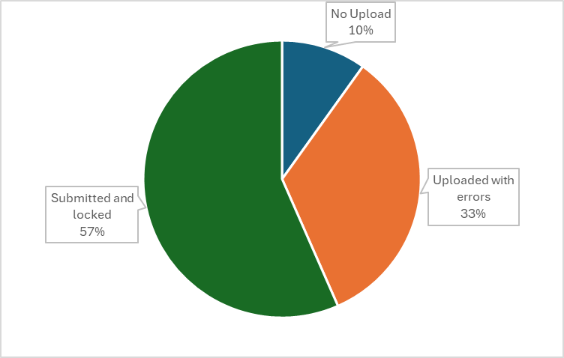
READ Training Collection
Timeline and Status
Current Status:
This collection is past due, so if you have not yet uploaded, please do so.
READ Training Collection
READActData@cde.state.co.us

Slide 47
READ Training Collection
Error Resolution – TR026 and TR035
There are a series of steps that have to happen in order to clear the TR026 and TR035 errors.
Educator has to fill out the designation application in COOL. (This is a very short application.)
This goes to the Ed Talent team to manually review.
Ed Talent notifies educator of approval status via email.
After approval email, COOL must sync to Pipeline. (These happen nightly.)
Then, the district must reupload their file to get Pipeline to reprocess the business rules and clear any of the TR026 and TR035 errors.
READ Training Collection
READActData@cde.state.co.us

Slide 48
READ Training Collection
Manual Review Process
The Manual Review Process is reserved for individuals who are unable to add their evidence of completion and READ Act designation in COOL due to licensure restrictions. Prior to using the form, please ensure the following:
The individuals the district is submitting to EOC for via the Manual Review fit the above criterion (ie, nonlicensed teachers and individuals who took the administrator training but don't have certain credentials)
All unrelated errors on your READ Training Export report have been cleared before submitting EOC
All individuals you are providing EOC for are listed on your READ Training Export Report and there is a 1:1 match between your error report and the submitted EOC
Submitted files follow naming conventions (Last, First_EOC) and are CDE approved forms of EOC.
READ Training Collection
READActData@cde.state.co.us

Slide 49
READ Training Collection
Recordings and Resources
Recordings:
Thursday, 6/27 - Slides have been posted here.
Thursday, 7/11 - Recording has been posted here.
Thursday, 7/25 - Recording has been posted here.
Thursday, 8/8 - Recording has been posted here.
Resources:
Cognos Report 1: READ Training Educators Reported in Prior Years (select 24-25)
Cognos Report 2: HR December Educators and READ Training Status (select 23-24)
24-25 File Layout
Business Rules
READ Training Website
Data Collection Guide – Updated for 2024-25
READ Training Collection
READActData@cde.state.co.us
Notes:
People reported previously by that district
2. People currently in their district and may have been reported in a prior year by their district or another district.

Slide 50
READ Training Collection
Questions & Answers:
Email: READActData@cde.state.co.us
Phone: 720.601.4125
READ Act Training Website

Slide 51
Title I Interchange
Melissa Chaffin, Federal Programs

Slide 52
Collection Timeline
Date | Event | Event Description
08/15/2024 | Title I 24-25 Interchange open in Data Pipeline | LEAs can begin to upload their Title I file to address any errors. This would be for the school year 24-25 for Student October.
10/02/2024 | Upload Title I file | Upload Title I file to address any errors if you haven’t already.
10/09/2024 | Interim Deadline Title I | Interim Deadline for Title I file uploaded and error-free.
10/22/2024 | Title I Deadline | Have Title I uploaded and error free for Student October snapshot.
11/08/2021 | Official State Deadline | Have Title I uploaded and error free for Student October snapshot.
Title I
Chaffin_m@cde.state.co.us

Slide 53
Collection Timeline
Date | Event | Event Description
Currently | Title I Interchange still open in Data Pipeline for EOY 23-24 | If needed, LEAs can begin to upload/re-upload their Title I file to address any errors. This would be for the school year 23-24 for End of Year only. All LEAs have uploaded this file and would only need to do so again to make corrections.
11/13/2024 | Interim Deadline Title I for EOY 23-24 | Interim Deadline for Title I EOY 23-24.
11/19/2024 | Deadline Title I for EOY for 23-24 | Deadline for Title I file uploaded and error-free (EOY snapshot for 23-24).
Title I
Chaffin_m@cde.state.co.us

Slide 54
Brief Overview of Title I Part A
The purpose of Title I Part A is to provide all students significant opportunity to receive a fair, equitable, and high-quality education, and to close achievement gaps.
Title I, Part A of the Elementary and Secondary Education Act (ESEA), as amended by the Every Student Succeeds Act (ESSA) provides financial assistance to local educational agencies (LEAs) and schools with high numbers or high percentages of children from low-income families to help ensure that all children meet challenging academic standards.
Title I Part A file is uploaded in the Data Pipeline during October Count in the Fall and again during EOY collection in the Spring.
Schools and grade spans are identified as either SW (Schoolwide), TA (Targeted Assistance), or NS (Not Serviced) during the Consolidated Application period.
Title I
Chaffin_m@cde.state.co.us

Slide 55
Title I Interchange Targeted Assistance (TA)
Only students within eligible TA schools and grade spans are reported in a file which is uploaded to the Data Pipeline.
Include students in TA grade schools/grade spans who received Title I services/resources any time during the year, even if student left school/district or services were stopped.
The student data must match the Student School Association file in the Data Pipeline.
If the file needs to be updated, then override or replace the old file with the updated file.
Maintain a complete data file at district or school level, make updates to this file if needed.
Title I
Chaffin_m@cde.state.co.us

Slide 56
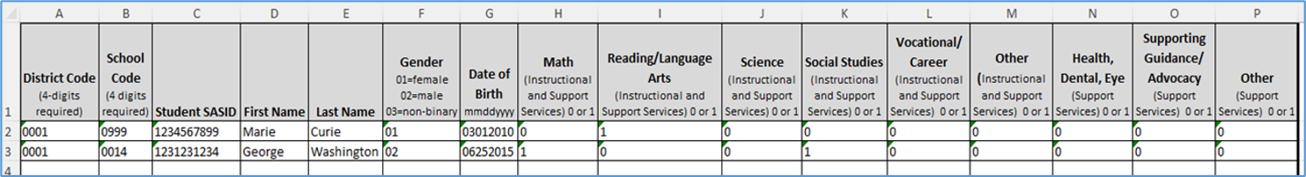
Title I Interchange Targeted Assistance Template
The new Title I file template can be found here: https://www.cde.state.co.us/datapipeline/inter_titlei
Please use the new template as it contains a new option in the Gender column (03 for non-binary).
Make sure to include leading zeros, for example, district codes, school codes, gender, DOB.
Indicate resource(s) students received (reading, math, etc.): 1 for yes, 0 for no. All service cells must be either 1 or 0.
More than 1 school can be listed on the same file for the same district.
Title I
Chaffin_m@cde.state.co.us

Slide 57
Title I Interchange Schoolwide (SW)
SW schools and students are not reported.
There is no need to put SW schools and students in this file as they are automatically provided to the Student October Count when the snapshot is taken.
If you report them, you will get an error.
Title I
Chaffin_m@cde.state.co.us

Slide 58
Title I Status Designation List
Note: 2 different grade spans at the same school can have 2 different Title I status designations, so please make sure your template has students within the TA status grade span.
List of schools and grade spans to check status (TA, SW, NS): http://www.cde.state.co.us/fedprograms/dper/tiaschlst (24-25 should be posted, this list is preliminary due to some ongoing minor changes and will be updated. I will notify those LEAs in which anything should change).
If you think there is a discrepancy in the Title I Part A school/grade span list for your LEA, please email me: Chaffin_m@cde.state.co.us
Title I
Chaffin_m@cde.state.co.us

Slide 59
Title I Common Errors
Most common Title I Interchange data does not match Student Interchange data
  TI003: This school is not a Targeted Assistance school for the grade of the student’s enrollment in the Student Profile.
    Check the Title I Status Designation list for the school and grade span status.
  TI004: There must be a School Association record for this student in the Student Profile at this school for the current School Year.
    Make sure the Student School Association file is uploaded first.
  OC067: At least one student should be reported in the Title I Interchange as participating in Title I services within a school that implements a Targeted Assistance program. Please update/upload your Title I Interchange file.
  May have to refresh October Count file for system to re-read the files.
Wrong formats
  Missing leading zeros: Gender (01,02,03) must have zeros as well as the Birthdate format mmddyyyy.
General data errors
  Invalid SASID, first and last name swapped, missing letters.
Services not marked 0 or 1 in template; blanks=errors.
The full list of business rules for Title I can be found here: https://www.cde.state.co.us/datapipeline/inter_titlei
Title I
Chaffin_m@cde.state.co.us

Slide 60
Questions & Resources:
Collection Name
Melissa Chaffin
chaffin_m@cde.state.co.us
720-908-1379

Slide 61

Thank you for joining today!
Next Town Hall will be September 12th
Reminder:
LAMs, please review your LEA’s list of IdM users and permissions

