Slide 1
August 29, 2024
Data Pipeline Town Hall
The goal of the webinar is to provide updates on the Data Pipeline, current, and upcoming data collections. These webinars also provide a forum for districts, BOCES, and Administrative Units to have questions answered about Data Pipeline.

Slide 2
Colorado Department of Education
Identity Management (IdM)
Identity Management Site
Frequently Asked Questions
How do I add myself or others to the email listserv for town hall emails and/or a specific collection?
  Email lists are dependent on a person’s access rights in IdM. Contact your LAM to get an account or be assigned to a specific collection.
Where can I find the IdM role mappings for Data Pipeline and other applications?
  Role Mapping (XLS)
I am a LAM. How do I update the user permissions for someone in my district?
  Follow the steps outlined in the IdM Quick Guide for Access Management (DOCX)
Important: Users are not automatically removed from IdM when their email address is no longer active in your district. The LAM must deactivate their IdM account to ensure only designated staff can access CDE’s data reporting system.
Notes:
LAMs, please check the IdM roles for your district. Remove permissions for users who have retired, left your district, or are no longer assigned to a collection. Add roles for new hires and newly assigned respondents for specific collections.

Slide 3

What is PII?
Student Personally Identifiable Information (PII) is defined by state and federal laws as information that, alone or in combination, personally identifies an individual
  This includes direct identifiers
  (i.e. student and staff names, SASID, EDID, etc.)
  Includes information that when combined is identifiable
Colorado’s Student Data Transparency and Security Act outlines requirements for how Student PII is collected, used and shared
See the Data Privacy and Security website for prepared guidance on how to comply with this and other privacy laws.

Slide 4

Sharing Data
Use secure methods to transfer any PII to CDE
  Contact Data Collection leads with questions about how to transmit PII securely
    Each Data Collection leads maintains their own Syncplicity folders for specific collections, reach out to the collection lead for access
  Use Syncplicity to encrypt emails to CDE
Avoid sending PII via unencrypted email or to unsecured faxes when sharing data between or within districts
  Use Syncplicity to encrypt emails to CDE
Check local policies for restrictions, requirements, etc. regarding PII
  Do not use PII in trainings, presentations, etc.
  Do not share PII with unauthorized individuals
  Do not share passwords
  Follow local policies when transmitting PII to any third party

Slide 5
Today’s Agenda
Agenda Topic | Presenter
Open Data Collections and Upcoming Deadlines in Data Pipeline
Staff Evaluation | Dawna Gudka
Human Resources | Dawna Gudka
Special Education End of Year | Lindsey Heitman
Student End of Year | Reagan Ward
Student October | Brooke Wenzel
School Auditing Office Updates | Rebecca McRee
At Risk Interchange Updates | Rebecca McRee
READ Staff Training | Tara Rhodes
S-EBT | Collin Slutzky

Slide 6
Open Collections and
Upcoming Deadlines in
Data Pipeline

Slide 7
Open Collections and Upcoming Dates:
Year-Round & Interchanges
Name | Category | Status | Key Dates
RITS | Year Round | Open
EDIS | Year Round | Open
Directory | Year Round | Open | District Calendars Due 9/2/2024
Student | Interchange | Open | 2023-2024 and 2024-2025 are open
At-Risk | Interchange | Open
Title I | Interchange | Open
Special Education IEP | Interchange | Open
Staff | Interchange | Open | 2023-2024 open 2024-2025 will open 9/4
TSDL | Interchange | Open
Discipline | Interchange | Open
Data Pipeline Resources: Data Pipeline Collection Dates (XLS)

Slide 8
Open Collections and Upcoming Dates:
Snapshots
Name | Category | Status | Final Deadline Date | Next Milestone | Looking Ahead
TSDL | Snapshot | Open | Aug. 30, 2024 | Report Review: 8/23/2024 – 8/30/2024 Review TSDL data | Collection Deadline: 8/30/2024
Staff Evaluation | Snapshot | Open | Oct. 15, 2024 | Interim Deadline: 8/7/2024-9/30/2024 Report Review | Collection Deadline: 10/15/2024
Student Discipline | Snapshot | Closed | July 31, 2024 | Embargoed Data Release: 8/27/2024 | Published Reports 8/30/2024 Profile Reports published 9/3/2024
Student October | Snapshot | Open | Nov. 8, 2024 | Official Count Date: 10/1/2024 | Interim Deadline: 10/2/2024 Upload initial interchange files
Student End of Year | Snapshot | Open | Nov. 19, 2024 | Report Review: 8/9/2024 to 9/5/2024 | State Deadline: 9/5/2024 Submit SEY Snapshot
Special Education Discipline | Snapshot | Closing Today | Aug. 29, 2024 | Final Report Review 8/22/2024 – 8/29/2024 | Collection Deadline: Signed Reports and Snapshot Submission Due by 8/29/2024
Special Education End of Year | Snapshot | Open | Sept. 27, 2024 | Interim Deadline: 8/29/2024 All exception requests due | Interim Deadline: 9/5/2024 All errors resolved
Data Pipeline Resources: Data Pipeline Collection Dates (XLS)

Slide 9
Open Collections and Upcoming Dates: Periodic
Name | Category | Status | Final Deadline Date | Looking Ahead
READ Training | Periodic | Open | Aug. 30, 2024
Designated Agency | Periodic | Open | Aug. 30, 2024
S-EBT (corrections period) | Periodic | Open | Aug. 30, 2024
Data Pipeline Resources: Data Pipeline Collection Dates (XLS)

Slide 10
Staff Evaluation
Dawna Gudka

Slide 11
Collection Status
Staff Evaluation Interchange
Staff Evaluation Snapshot
Staff Evaluation-Dawna Gudka
StaffEvaluation@cde.state.co.us

Slide 12
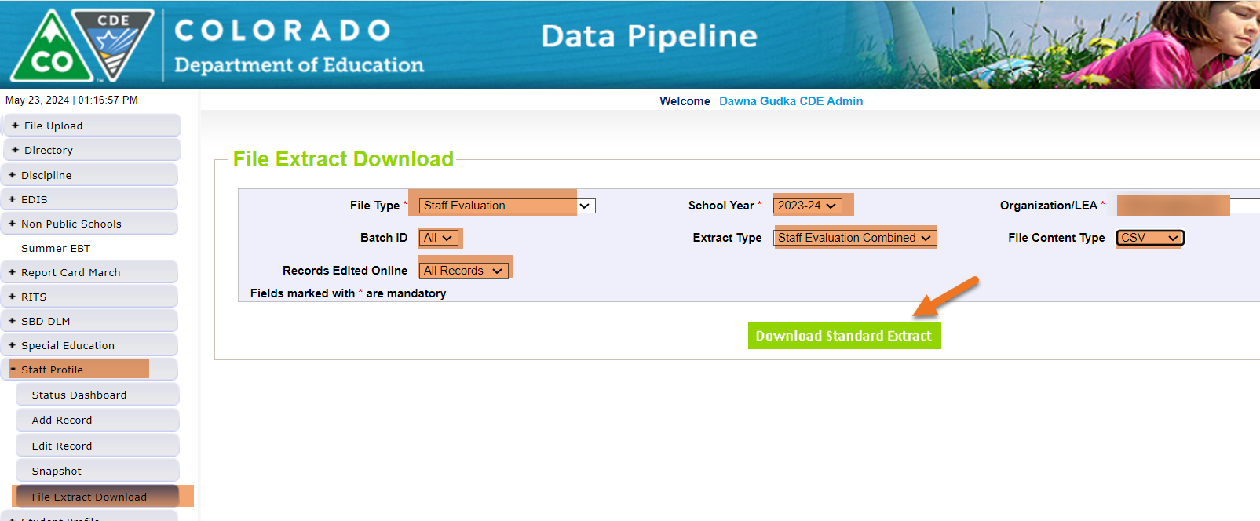
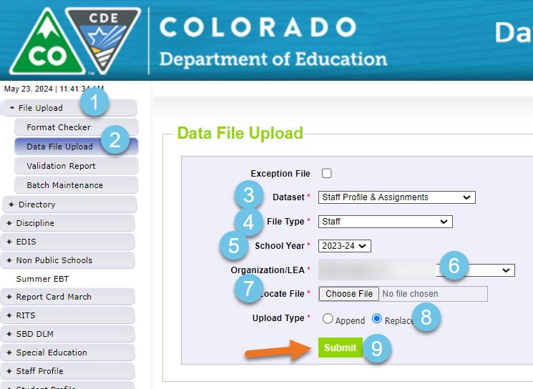
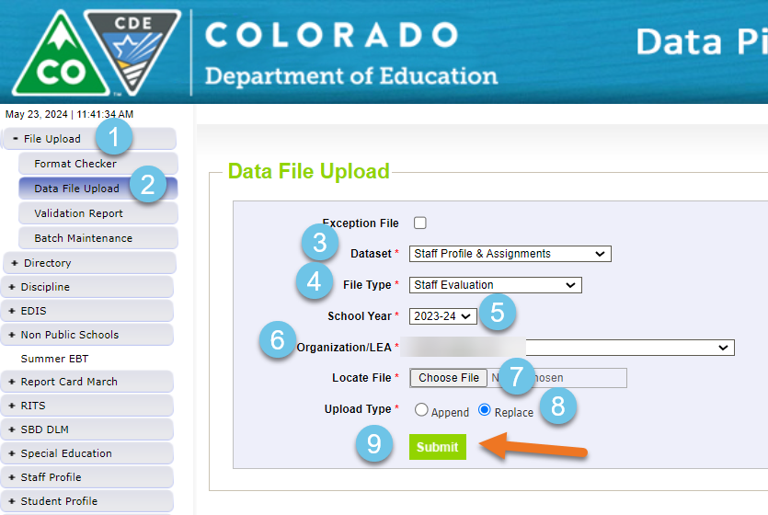
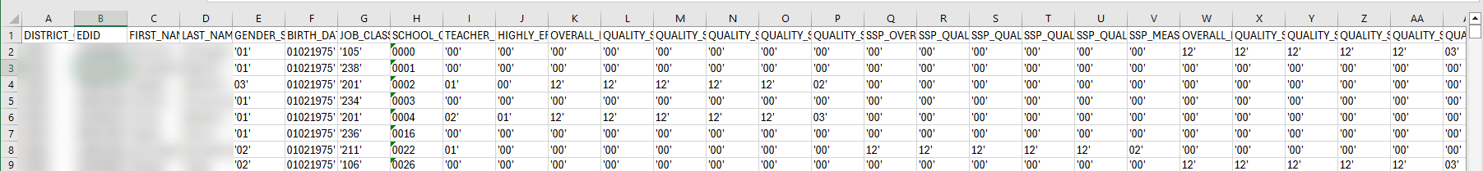
Staff Evaluation Process
1. Need to upload Staff Evaluation Interchange file
2. Extract the Combined
4. Upload the Combined extract
3. Complete the data in combined extract
Staff Evaluation-Dawna Gudka
StaffEvaluation@cde.state.co.us

Slide 13
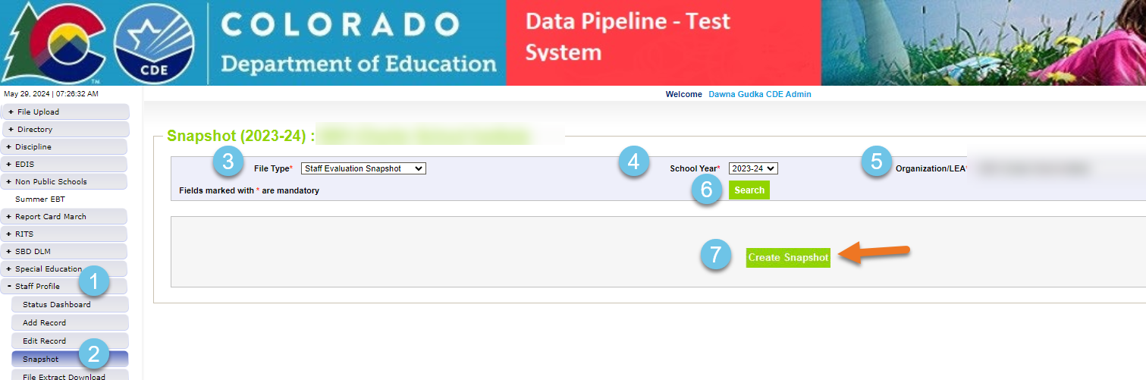
Staff Evaluation
Interchange error free, now create a snapshot
Staff Evaluation-Dawna Gudka
StaffEvaluation@cde.state.co.us

Slide 14
Staff Evaluation: Questions & Resources
Staff Evaluation Snapshot Collection
Staff Evaluation File Layout
Staff Evaluation Timeline
Collection Training Recording
StaffEvaluation@cde.state.co.us
Dawna Gudka-Collection lead
(303) 598-7901

Slide 15
Human Resources
Dawna Gudka

Slide 16
Human Resources Snapshot Collection
Date | Event | Event Description
9/4 | Open | Staff Profile and Staff Assignment Interchange open
9/11/24 | Training Event | New Data Respondents 9AM Join the meeting
9/11/24 | Training Event | Data Respondents 10AM Join the meeting
10/31/24 | Interim Deadline | Upload at least one Staff Profile
11/7/24 | Interim Deadline | Upload at least one Staff Assignment Interchange file
11/1/24 | Open | Human Resources Snapshot open
12/1/24 | Count Day | Official Annual Staff Count Date
12/18/24 | Interim Deadline | Interchange files error free
1/10/25 | Interim Deadline | Create at least one Human Resources Snapshot
1/24/25 | Interim Deadline | Human Resources Snapshot Error Free
1/24-1/31/25 | Report Review | Review Special Education Staff Report via Cognos in the Human Resources folder) for accuracy to ensure all special education staff reported within your district is appropriate. Collaborate with your LEA’s Administrative Unite during this process. Verify that all staff are accurately reported.
2/14/25 | Interim Deadline | Staff Profile and Staff Assignment interchange files, and Human Resources Snapshot Error Free
2/21/25 | Deadline* | Human Resources Snapshot must be submitted to CDE and verification emailed to Human Resources Snapshot
Human Resources Snapshot Collection Timeline
HumanResourcesData@cde.state.co.us

Slide 17
Staff Profile and Staff Assignment
Human Resources and SPED December Count
What Staff get reported?
All employed staff and purchased service staff that are servicing your students on December 1st!
Administrators
Principals
Classroom Teachers
Instructional Support
Other Support
Professional-Other
Paraprofessionals
Office/Administrative Support
Crafts/Trades Services
Purchase Service Staff Resource
Human Resources Collection Lead, Dawna Gudka
HumanResourcesData@cde.state.co.us

Slide 18
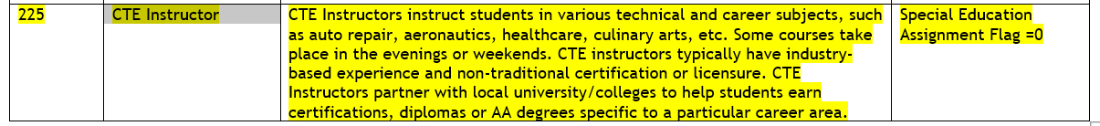
New Job Code
225
All job codes can be found in the Staff Assignment File Layout, starting on page 7
Human Resources Snapshot Collection-Dawna Gudka
HumanResourcesData@cde.state.co.us

Slide 19
Human Resources: Questions & Resources
Human Resources Snapshot Collection
HumanResourcesData@cde.state.co.us
Dawna Gudka-Collection Lead
(303) 598-7901
Staff Interchange website
Staff Profile File Layout
Staff Assignment File Layout
Human Resources Snapshot website
Human Resources Timeline
Human Resources File Layout

Slide 20
Special Education End of Year
Lindsey Heitman

Slide 21
Special Education Discipline Snapshot:
Submission Status
AU Status
AUs w/ Errors= 2 ☹
AUs Approved and Locked in Pipeline = 50 ☺☺
AUs Not Yet Approved but Error Free= 13 ☺
August 29, 2024 - Final Submission approval in Data Pipeline and reports uploaded to DMS.
DUE TODAY!
You must complete both steps by the end business today to meet the deadline:
Approve and lock your final SPED Discipline Snapshot in the Data Pipeline
Upload signed reports to the DMS (2 reports in full, plus flag explanations doc if necessary)
    THANK YOU!
SpedDiscipline@cde.state.co.us
Special Education Discipline – Lindsey Heitman

Slide 22

Special Education End of Year:
Timeline and Upcoming Training
2023-2024 Special Education EOY Snapshot Timeline
May 1, 2024 - SPED EOY Snapshot official open
June 27, 2024 – IEP Interchange files error-free
August 29, 2024 - All Exception requests submitted to CDE
September 5, 2024 – All errors resolved at snapshot/interchange
September 5 -13, 2024 -Initial Report Review
September 16 - 20, 2024 – Resolving duplicates
September 20 - 27, 2024 – Final Report Review
September 27, 2024 - Final approval in Data Pipeline and reports uploaded to DMS
TODAY!
  Sped EOY Reports and Final Steps Webinar:
  Thursday Sept 5th 1:00 – 2:00
  Join the meeting now
Special Education EOY – Lindsey Heitman
SpedEndofYear@cde.state.co.us

Slide 23
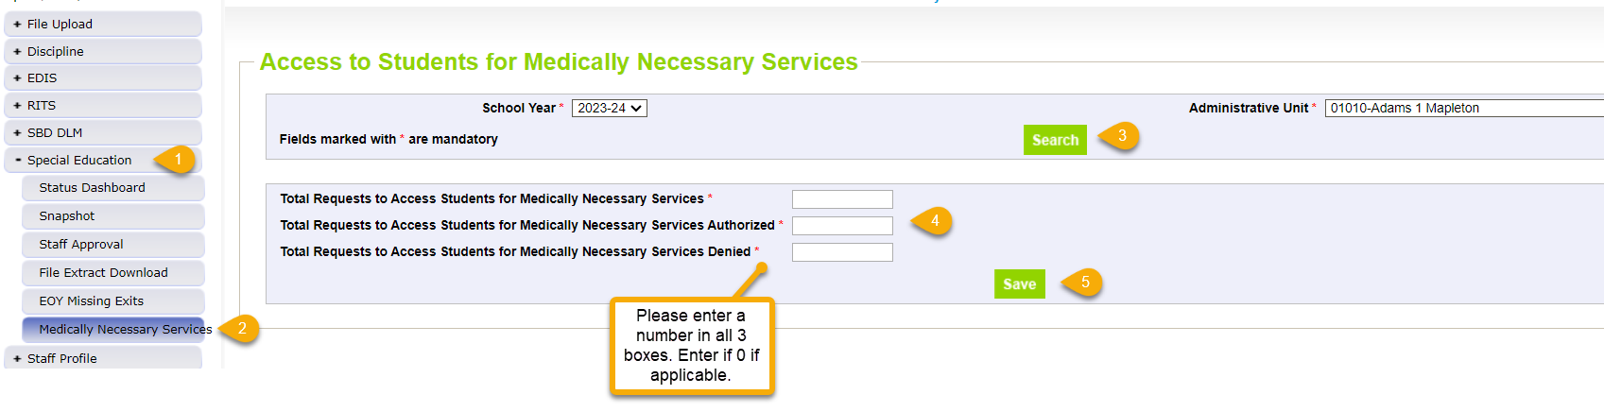
Medically Necessary Services:
Steps to Submit Counts to Data Pipeline
Notes:
Counts must reflect all districts within AU from July 1, 2023 – June 30, 2024
Must be completed by the time Sped EOY is approved – by 9/27/24
AUs are able to modify counts until their final Sped EOY is locked/approved
pop up message will ensure each box is populated with a number
pop up message will ensure total # box (1st box) is the sum of those authorized and denied
Steps
1. Click Special Education tab
2. Click Medically Necessary Services tab
3. Select School Year/AU and click Search button
4. Enter a number in all 3 boxes
5. Click Save button
# Requests Authorized
# Requests Denied
Total # of Requests
Special Education End of Year – Lindsey Heitman
SpedEndofYear@cde.state.co.us

Slide 24
Special Education End of Year
Reporting Reminders
Compare exits to your district’s Student EOY records
  Be sure you are capturing all exits from Special Education that occurred between 7/1/23 – 6/30/24
  Check all warnings that help you locate possible exit data that is coded incorrectly
  Check ‘Records Not in Snapshot’ to be sure records aren’t being excluded due to a criteria issue
  Those uploading/maintaining a manual file after 7/1 may need to physically recollect your data again and compare to the file you’ve been working in
Don’t forget to add your Medically Necessary Services counts to the Data Pipeline
  The counts may be added or modified up until you approve and lock your final Sped EOY Snapshot
  Screen found under ‘Special Education’ tab
Check your Year-to-Year Comparison Report #’s 8 and 9 to find possible missing data
  Found in Special Education EOY Cognos folder
Special Education EOY – Lindsey Heitman
SpedEndofYear@cde.state.co.us

Slide 25
Key Warnings
Key Warnings:
SY258- These students were reported on the previous EOY as exiting due to 01-Reached Maximum Age for Services, 02-Death, 90-Graduated or 92-Completed (non-diploma certificate); please verify attendance.
SY263 - This Path 3 student was reported in your AU last year as a Path 3 student, please verify whether your current reporting is correct.
SY295 - student is being reported as exiting with an exit type of 70, 90, 92, 93, or 94 in the regular EOY collection- please double check the student's exit records to ensure you're reporting applicable exits from Special Education. Ignore the warning on transition students that met graduation requirements in regular EOY, this is a valid difference.
SY297 - No graduates (Exit Type code= 90) are reported by your AU this year. Please double check your records.
SY308 - Your AU has not reported any records as not eligible (04), all initial evaluations should be reported regardless of the eligibility outcome
SY309 - If student is currently in or will begin a Sped transition program next year, the Sped EOY Basis of Exit should be zero-filled.
SY282 - Possible Transfer, this student is reported as in attendance (not exited) at another AU/SOP. Please check with your Regular EOY counterpart to see if this student actually transferred instead of dropping out.
SY501-SY507 – records missing from snapshot due to criteria issues. You will find details under Pipeline Reports/Records Not in Snapshot.
Special Education EOY – Lindsey Heitman
SpedEndofYear@cde.state.co.us

Slide 26
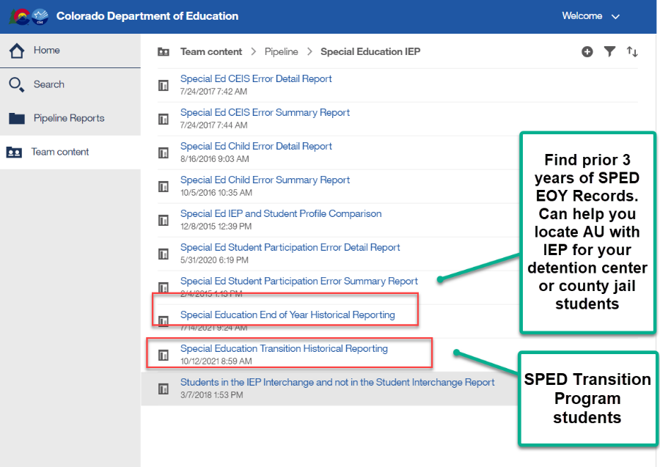
Special Education EOY
Sped Transition students, Detention Center students, county jail students
Sped Transition Program Students – warnings for these type of records
SY309: If student is currently in or will begin a Sped transition program next year, the Sped EOY Basis of Exit should be zero-filled.
    Check to be sure you are not exiting your students moving to a transition program.
    They may be reported with exit code 90 in Student EOY snapshot if they met grad requirements, but should not be exited in Sped EOY until they exit the program or age out
    Reference SPED transition Cognos report to see transition students based on district reporting
SY315: Student is reported as completing transition in the Student EOY Snapshot with a School Exit Type of 28, indicating they met graduation requirements in a prior year. Please report a 90 in the Sped Basis of Exit field.
Must have ‘SPE User’ role to access these reports
Special Education EOY – Lindsey Heitman
SpedEndofYear@cde.state.co.us

Slide 27
SpED End of Year:
Questions & Resources

Slide 28
Student End of Year
Reagan Ward

Slide 29
SEY Collection Timeline:
Upcoming Events
5 Business Days Remaining Until State Deadline
Date | Event | Event Description
8/9/2024 to 9/5/2024 | Report Review | • Validate Student End of Year data using CEDAR/COGNOS reports. • Submit snapshot as soon as review is complete
9/5/2024 | State Deadline | Submit Student End of Year snapshot
8/18/2024 2:30-3:30pm | Training Event | September SEY Office Hours: Focus – Cross LEA Phase Registration Link
9/19/2024 | Cross LEA Open | Districts may begin creating snapshots as soon as they receive a ‘snapshot unlocked’ notification from data pipeline; approximately mid-day.
10/17/2024 | Deadline | Resubmit SEY snapshot
10/24/2024 | Post-Cross LEA Open | Districts may begin updating their snapshot to address Post-Cross LEA business rules.
11/19/2024 | Deadline | Post-Cross phase ends. Districts must have error free SEY snapshot and have addressed any necessary post-cross changes.
12/3/2024 | Deadline | Collection closes. • Superintendent Verification (sign-off) form due. • Data remains embargoed until the official release in January
Visit the SEY Website to download the complete SEY Collection Timeline with Training Dates
Student End of Year – Reagan Ward
StudentEndOfYear@cde.state.co.us

Slide 30
File Status as of 8:00 am on 8/29
Snapshot Status
Notes
LEAs who are error free and have reviewed their initial SEY data may submit their snapshot when ready.
LEAs with potential summer graduates/completers are encouraged to wait until August to submit their snapshot after they’ve updated any school exit types for grad/completers.
Student End of Year – Reagan Ward
StudentEndOfYear@cde.state.co.us

Slide 31
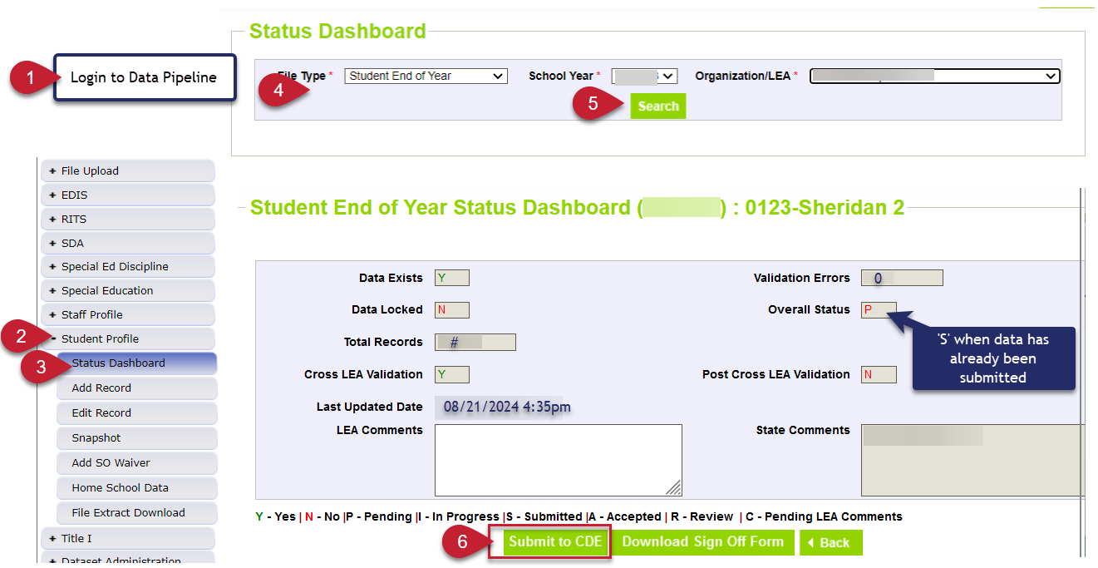
Submit to CDE
Student End of Year – Reagan Ward
StudentEndOfYear@cde.state.co.us

Slide 32
Looking Ahead: Cross LEA Phase
Purpose
Required LEA Tasks
Second phase of SEY collection
CDE runs a process to cross validate student educational history across all school districts/BOCES
  SE700 series errors/warnings are triggered
  NEW: SE800 series has been deactivated since they were duplicates of many SE700 rules
Ensures accuracy of education statistics
  Graduate/completers
  Dropouts
  Exit one district and recovered by another
  Completed HSED
NEW: Updated CEDAR/COGNOS reports for Cross LEA errors/warnings
Review errors/warnings
Create at least one SEY snapshot
Resubmit by October 17, 2024
Review data, making updates as needed
  All data fields may be corrected during this phase
  Last chance to correct any miscoded student demographic information
Student End of Year – Reagan Ward
StudentEndOfYear@cde.state.co.us

Slide 33
Graduation, Dropout, and Completion Rates:
Understanding and Use for Continuous Improvement
Upcoming Webinar
Host: Accountability Unit and SEY Collection Lead
Topics:
  Overview of how graduation, completion, and dropout rates are used for state accountability determinations and improvement efforts.
  Explore how graduation, completion, and dropout rates are calculated in the state of Colorado
Audience:
  District Accountability Contacts
  District Leaders
  District data staff who support SEY rates
  Interested district staff
Date/Time: September 12, 2024, 1:00-2:00pm
Registration Link
Student End of Year – Reagan Ward
StudentEndOfYear@cde.state.co.us

Slide 34
Questions & Answers:
Student End of Year
StudentEndOfYear@cde.state.co.us
720-484-9057
Student End of Year Website
Student Interchange Website
Graduation Guidelines Website

Slide 35
Student October
Brooke Wenzel

Slide 36
Student October Timeline – Regular Phase
Date | Event | Event Description
07/15/2024 | Open | Districts may begin uploading Student Interchange Files (Student Demographic and Student School Association).
08/23/2024 | Open | Districts may begin creating snapshots. Student October Snapshot dependencies are the Student Demographic File, Student School Association File, Title I File (if applicable) and At-Risk File.
08/28/2024 | Training Event | Data Pipeline Training 10-11 a.m.
09/05/2024 | Training Event | New Respondent Training 1-2 p.m.
09/10/2024 | Training Event | English Language Learner Training 11-12 p.m.
09/12/2024 | Training Event | Veteran Respondent Training 11-12 p.m.
09/16/2024 | Training Event | Postsecondary Program Coding Training 11-12 p.m.
09/24/2024 | Other Date | First day of Student October Count Window for districts with 5-day school week.
10/01/2024 | Other Date | Official Count Day 2024
10/02/2024 | Interim Deadline | Upload Student Demographic and Student School Association Files. Upload Title I Interchange File (if applicable). Upload At-Risk Interchange File.
10/08/2024 | Other Date | Last day of Student October Count Window for districts with 5-day school week.
10/09/2024 | Interim Deadline | Error free Student Interchange File uploads
10/14/2024 | Training Event | Mid-Collection Office Hours 10-11 a.m.
10/14/2024 | Interim Deadline | Create an initial Student October Snapshot
10/22/2024 | Interim Deadline | Error free Student October Snapshot
10/24/2024 | Training Event | Data Validation, Transfer Enrollment Exceptions and Cognos Reports 1-2 p.m.
10/28/2024 | Training Event | Data Pipeline Duplicate Process and Submission 9-10 a.m.
11/01/2024 | Report Review | Review Student October Cognos Reports for data validation. Submit Student October Snapshot data as soon as review is complete.
11/08/2024 12:00 p.m. | State Deadline | Submit Student October Snapshot data
Student October
StudentOctober@cde.state.co.us

Slide 37
Student October Timeline – Duplicate Process
Date | Event | Event Description
11/12/2024 12:00 p.m. | Deadline | Duplicate funding documentation due to School Auditing Office
11/18/2024 | Other Date | School Auditing makes decisions on funding duplicates
11/27/2024 | Deadline | Resubmit Student October Snapshot data to CDE based on decisions from School Auditing
12/06/2024 | Deadline | Collection closes Secretary of the Board of Education Verification (sign-off) form due. Data remains embargoed until the official release in January.
01/15/2025 | Data Release | Official data release
Student October
StudentOctober@cde.state.co.us

Slide 38
Student October Training Schedule
Note: Join live training on the Student October Website. Training and PPT will be posted after the training has happened.
New Respondent Training
Date/Time: 09/05/2024, 1-2 p.m.
Click here to join the teams meeting.
English Language Learner Training
Date/Time: 09/10/2024, 11-12 p.m.
Click here to join the teams meeting.
Veteran Respondent Training
Date/Time: 09/12/2024 11-12 p.m.
Click here to join the teams meeting.
Postsecondary Program Coding Training
Date/Time: 09/18/2024, 2-3 p.m.
Click here to join the teams meeting.
Mid-Collection Office Hours
Date/Time: 10/14/2024 10-11 a.m.
Click here to join the teams meeting.
Data Validation, Transfer Enrollment Exceptions and Cognos Reports Training
Date/Time: 10/23/2024 1-2 p.m.
Click here to join the teams meeting.
Data Pipeline Duplicate Process and Submission Training
Date/Time: 10/28/2024 9-10 a.m.
Click here to join the teams meeting.
Student October
StudentOctober@cde.state.co.us

Slide 39
Snapshot Visual
Student October
Student Demographic
Student School Association
At-Risk
Title I (if applicable)
Supporting Files (TREP Allocation, Foster, etc.)
Light Green – District Uploads
Gray – CDE Uploads
Light Blue – District “Triggers”

Slide 40
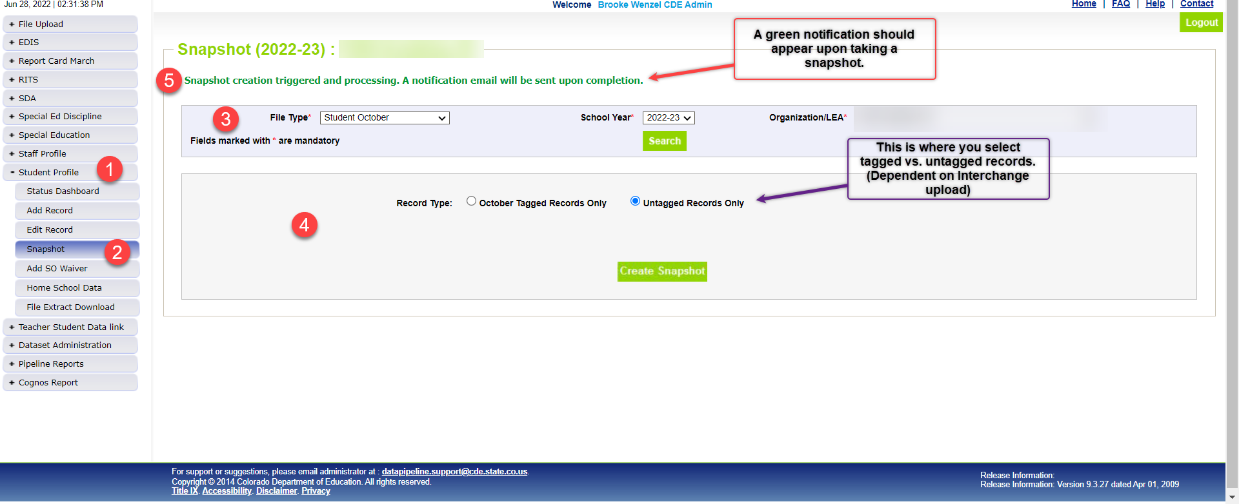
Snapshot Screen

Slide 41
Questions & Resources:
Brooke Wenzel
StudentOctober@cde.state.co.us
720-441-7963
Student October Webpage
Student Interchange Webpage

Slide 42
School Auditing Office Updates
Rebecca McRee

Slide 43
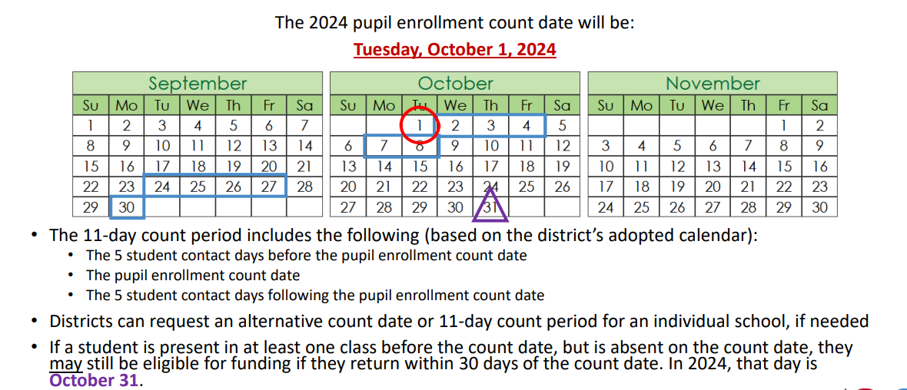
Student October Count Day 2024
School Auditing Office
Audit@cde.state.co.us

Slide 44
Audit Resource Guides
These Guides contain the funding and audit documentation requirements that districts and BOCES may be required to provide during the Annual Audit Review or subsequent expanded audits.
Student October (Pupil) Count Audit Resource Guide
At-Risk Count Audit Resource Guide
English Language Learner (ELL) Audit Resource Guide
School Auditing Office
Audit@cde.state.co.us

Slide 45
New: Annual Audit Review Process (Required)
Beginning with the 2024 Student October Count data collection, the School Auditing Office is changing its approach to the required compliance audits.
Annual Audit Review Process (Overview- PDF)
  Pupil Count Audit Questionnaire
  At-Risk Count Audit Questionnaire
  English Language Learner (ELL) Count Questionnaire
Audit District Contact Form
Initial audit documentation upload (as described on each questionnaire) will be due by December 11, 2024.
A training on the new process was held on 7/23/24. Visit the School Auditing Office's Training and Office Hours website to access the recording.
School Auditing Office
Audit@cde.state.co.us

Slide 46
Training and Office Hours
Upcoming Trainings:
English Language Learner Count Audit Overview September 17, 2024 (10AM)
Duplicate Count Office Hours November 5, 2024 (10AM)
School Auditing Office's Training and Office Hours website
School Auditing Office
Audit@cde.state.co.us

Slide 47
Questions & Answers:
School Auditing Office
Audit@cde.state.co.us
Pupil Count Website
At-Risk Count Website
English Language Learner Count Website
Training and Office Hours Website

Slide 48
At-Risk Interchange
Rebecca McRee

Slide 49
New: At-Risk Measure Interchange File -
Overview
Beginning with the 2024/2025 school year, there is a new Data Pipeline At-Risk Interchange.
The purpose of the At-Risk Interchange is to obtain student-level census block data needed to implement the new at-risk measure as described in HB22-1202 with data collection to begin with the 2024-2025 school year as provided for under SB24-188.
The new at-risk measure will be implemented starting with the 2025/2026 school year, and included in the Total Program funding calculation as described in the Public-School Finance Act which will continue to utilize student level data reported through the Student October Count data collection.
This interchange opened on July 15, 2024 and closes November 8, 2024. It will only be open during the Student October Count Collection.
At-Risk Interchange
ARMeasure@cde.state.co.us

Slide 50
New: At-Risk Measure Interchange File -
Resources
At-Risk Interchange Website
  File Layout
  Business Rules
  Interchange Upload Template (XLS)
  Timeline
  Trainings
    Overview of the Geocoder Tool (PDF) (Recorded Training)
    Overview of the Data Pipeline At-Risk Interchange File (PDF) (Recorded Training)
  Additional Resources
    Instructions for Using the Geocode Tool
    Valid Census Block Data Combinations (XLS)
At-Risk Interchange
ARMeasure@cde.state.co.us

Slide 51
New: At-Risk Measure Interchange File -
Timeline
Date | Event | Event Description
7/15/2024 | Open | Districts may begin to upload the At-Risk Interchange file to the data pipeline.
8/23/2024 | Open | Districts may begin creating Student October Snapshots. This Snapshot is dependent on the Student Demographic File, Student School Association File, Title 1 File (if applicable) and the At-Risk File.
8/13/2024 | Training Event | Overview of the Census Geocoder Tool (10-11am)
8/20/2024 | Training Event | Overview of the At-Risk Interchange File (1-2pm)
9/13/2024 | Other Date | Gather, review, clean-up and validate student addresses
9/27/2024 | Other Date | Obtain census block data for all student addresses
10/2/2024 | Interim Deadline | Upload the At-Risk Interchange File
10/9/2024 | Interim Deadline | Obtain error-free At-Risk Interchange File upload
10/22/2024 | Interim Deadline | Obtain error-free Student October Snapshot
11/1/2024 | Report Review | Review Student October Cognos Reports for data validation. Submit Student October Snapshot data as soon as review is complete
11/8/2024 | State Deadline | Submit Student October Snapshot data
At-Risk Interchange
ARMeasure@cde.state.co.us

Slide 52
New: At-Risk Measure Interchange File - Syncplicity Folders
Syncplicity folders are being shared on a rolling basis with ARM LEAUSERS and LEAVEWIERS.
The folder naming convention is:
  District Code_ District Name_ ARMeasure Interchange
These folders will be used to share files containing PII between the district or BOCES and CDE when requesting assistance with the At-Risk Interchange or Census Geocoding tool.
If you have been assigned the user or view role for this interchange file and you do not receive notification that this file has been shared with you within 48 hours, email ARMeasure@cde.state.co.us.
At-Risk Interchange
ARMeasure@cde.state.co.us

Slide 53
New: Census Block Data
Required and valid census block data combinations include 4 data fields:
  State Code
  County Code*
  Track Code
  Block Code
To obtain this data, districts will need to first gather, clean and validate student address data.
Then districts will need to "geocode" each student's primary physical residential address to obtain this information.
  District's GIS system (such as ARC)
  Census Geocoder Tool
  Other (if your district has some other tool, please reach out to ARMeasure@cde.state.co.us)
At-Risk Interchange
ARMeasure@cde.state.co.us

Slide 54
Student Information Systems- Update
For many districts, their student informaton system (SIS) has built-in report/extracts for the various interchange files need for upload to Data Pipeline (example: Student Demographic and Student School Association files).
At this time, CDE is not sure if this fuction will be available for the At-Risk Interchange file for the 2024-2025 school year.
Districts should contact their SIS provider directly for clarification.
If this functionality will not be available, then there are some general steps the district will need to take to meet this requirement.
At-Risk Interchange
ARMeasure@cde.state.co.us

Slide 55
Geeral High-Level Steps
Ensure you have physical residential addresses for all studets included in your Student Demographic file.
Export these addressses out of your student information system (SIS).
Verify that the addresses are valid.
Geocode student addresses using the Census Geocoder Tool.
  This tool should return State, County, Track, and Block codes needed.
  However, if tool does not return census block data for valid addresses, districts can opt to use the default coding patters for missing census block data found on page 3 of the At-Risk interchange File Layout
Use the file upload template (xls) located on the Interchange website to create a file to be uploaded to Data Pipeline.
Upload Interchange File to Data Pipeline.
Work through errors.
Retain student census block data for potential upload to SIS at a later date.
At-Risk Interchange
ARMeasure@cde.state.co.us

Slide 56
File Layout and Definitions (page 3):
Missing Census Block Data- Coding Patterns
Description | State Code | County Code | Track Code | Block Code
Address on File- Did Not Attempt to Obtain Census Block Data: The district has a primary physical address on file but did NOT attempt to obtain census block data using the geocode tool. | 08 | 000 | 000001 | 0001
Address on File- No Census Block Data Returned: The district confirmed that the primary physical address is valid using USPS but the geocode tool did not return census block data. | 08 | 000 | 000002 | 0002
Confidentiality Program: No census block data was provided because the district has confirmed the student is participating in a confidentiality program. | 08 | 000 | 000003 | 0003
No Physical Primary Address on File- Identified Group: The district does not have a primary physical address on file and the student is confirmed homeless, migrant, foster child, or attending a detention center. | 08 | 000 | 000004 | 0004
No Physical Primary Address on File- No Identified Group: The district does not have a primary physical address on file and the student is not confirmed homeless, migrant, foster child, or attending a detention center. | 08 | 000 | 000005 | 0005
Out of State codes: The district has a primary physical address on file that is not in Colorado. | 08 | 000 | 000006 | 0006
At-Risk Interchange
ARMeasure@cde.state.co.us

Slide 57
Questions & Answers:
ARMeasure@cde.state.co.us
Data Pipeline At-Risk Interchange website

Slide 58
READ Training
Tara Rhodes

Slide 59
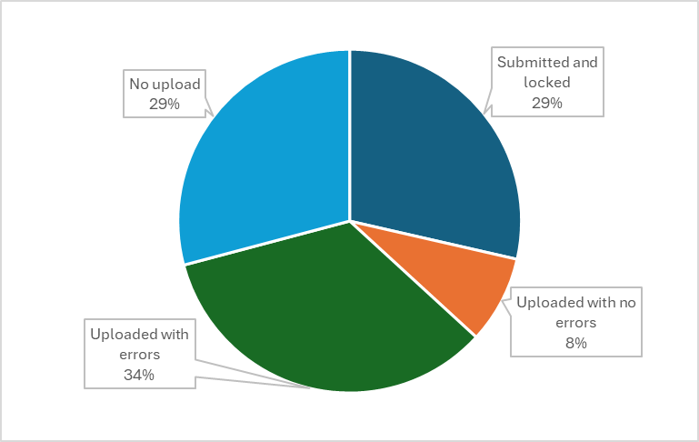
READ Training Collection
Timeline and Status
Current Status:
The collection close date is tomorrow, August 30.
Please upload if you have yet to do so.
READ Training Collection
READActData@cde.state.co.us

Slide 60
READ Training Collection
Error Resolution – TR026 and TR035
There are a series of steps that have to happen in order to clear the TR026 and TR035 errors.
Educator has to fill out the designation application in COOL. (This is a very short application.)
This goes to the Ed Talent team to manually review.
Ed Talent notifies educator of approval status via email.
After approval email, COOL must sync to Pipeline. (These happen nightly.)
Then, the district must reupload their file to get Pipeline to reprocess the business rules and clear any of the TR026 and TR035 errors.
READ Training Collection
READActData@cde.state.co.us

Slide 61
READ Training Collection
Recordings and Resources
Recordings:
Thursday, 6/27 - Slides have been posted here.
Thursday, 7/11 - Recording has been posted here.
Thursday, 7/25 - Recording has been posted here.
Thursday, 8/8 - Recording has been posted here.
Resources:
Cognos Report 1: READ Training Educators Reported in Prior Years (select 24-25)
Cognos Report 2: HR December Educators and READ Training Status (select 23-24)
24-25 File Layout
Business Rules
READ Training Website
Data Collection Guide – Updated for 2024-25
READ Training Collection
READActData@cde.state.co.us
Notes:
People reported previously by that district
2. People currently in their district and may have been reported in a prior year by their district or another district.

Slide 62
READ Training Collection
Questions & Answers:
Email: READActData@cde.state.co.us
Phone: 720.601.4125
READ Act Training Website

Slide 63

Thank you for joining today!
Next Town Hall will be September 5th
Reminder:
LAMs, please review your LEA’s list of IdM users and permissions

