Slide 1
August 22, 2024
Data Pipeline Town Hall
The goal of the webinar is to provide updates on the Data Pipeline, current, and upcoming data collections. These webinars also provide a forum for districts, BOCES, and Administrative Units to have questions answered about Data Pipeline.

Slide 2
Colorado Department of Education
Identity Management (IdM)
Identity Management Site
Frequently Asked Questions
How do I add myself or others to the email listserv for town hall emails and/or a specific collection?
  Email lists are dependent on a person’s access rights in IdM. Contact your LAM to get an account or be assigned to a specific collection.
Where can I find the IdM role mappings for Data Pipeline and other applications?
  Role Mapping (XLS)
I am a LAM. How do I update the user permissions for someone in my district?
  Follow the steps outlined in the IdM Quick Guide for Access Management (DOCX)
Important: Users are not automatically removed from IdM when their email address is no longer active in your district. The LAM must deactivate their IdM account to ensure only designated staff can access CDE’s data reporting system.
Notes:
LAMs, please check the IdM roles for your district. Remove permissions for users who have retired, left your district, or are no longer assigned to a collection. Add roles for new hires and newly assigned respondents for specific collections.

Slide 3

What is PII?
Student Personally Identifiable Information (PII) is defined by state and federal laws as information that, alone or in combination, personally identifies an individual
  This includes direct identifiers
  (i.e. student and staff names, SASID, EDID, etc.)
  Includes information that when combined is identifiable
Colorado’s Student Data Transparency and Security Act outlines requirements for how Student PII is collected, used and shared
See the Data Privacy and Security website for prepared guidance on how to comply with this and other privacy laws.

Slide 4

Sharing Data
Use secure methods to transfer any PII to CDE
  Contact Data Collection leads with questions about how to transmit PII securely
    Each Data Collection leads maintains their own Syncplicity folders for specific collections, reach out to the collection lead for access
  Use Syncplicity to encrypt emails to CDE
Avoid sending PII via unencrypted email or to unsecured faxes when sharing data between or within districts
  Use Syncplicity to encrypt emails to CDE
Check local policies for restrictions, requirements, etc. regarding PII
  Do not use PII in trainings, presentations, etc.
  Do not share PII with unauthorized individuals
  Do not share passwords
  Follow local policies when transmitting PII to any third party

Slide 5
Today’s Agenda
Agenda Topic | Presenter
Open Data Collections and Upcoming Deadlines in Data Pipeline
Teacher Student Data Link (TSDL) | Peter Hoffman
Special Education Discipline | Lindsey Heitman
Student End of Year | Reagan Ward
Student October | Brooke Wenzel
School Auditing Office Updates | Rebecca McRee
At Risk Interchange Updates | Rebecca McRee
READ Staff Training | Tara Rhodes
S-EBT | Collin Slutzky

Slide 6
Open Collections and
Upcoming Deadlines in
Data Pipeline

Slide 7
Open Collections and Upcoming Dates:
Year-Round & Interchanges
Name | Category | Status | Key Dates
RITS | Year Round | Open
EDIS | Year Round | Open
Directory | Year Round | Open | District Calendars Due 9/2/2024
Student | Interchange | Open | 2023-2024 and 2024-2025 are open
At-Risk | Interchange | Open
Title I | Interchange | Open
Special Education IEP | Interchange | Open
Staff | Interchange | Open | 2023-2024 open 2024-2025 will open 9/4
TSDL | Interchange | Open
Discipline | Interchange | Open
Data Pipeline Resources: Data Pipeline Collection Dates (XLS)

Slide 8
Open Collections and Upcoming Dates:
Snapshots
Name | Category | Status | Final Deadline Date | Next Milestone | Looking Ahead
TSDL | Snapshot | Open | Aug. 30, 2024 | Interim Deadline: 8/23/2024 Snapshot Completed | 8/23/2024 – 8/30/2024 Review TSDL data before final submission deadline
Staff Evaluation | Snapshot | Open | Oct. 15, 2024 | Interim Deadline: 8/7/2024-9/30/2024 Report Review | Collection Deadline: 10/15/2024
Student Discipline | Snapshot | Closed | July 31, 2024 | Embargoed Data Release: 8/27/2024 | Published Reports 8/30/2024 Profile Reports published 9/3/2024
Student October | Snapshot | Open Soon | Nov. 8, 2024 | Opens: 8/23/2024 | Official Count Date: 10/1/2024
Student End of Year | Snapshot | Open | Nov. 19, 2024 | Report Review: 8/9/2024 to 9/5/2024 | State Deadline: 9/5/2024 Submit SEY Snapshot
Special Education Discipline | Snapshot | Open | Aug. 29, 2024 | Final Report Review 8/22/2024 – 8/29/2024 | Collection Deadline: Signed Reports and Snapshot Submission Due by 8/29/2024
Special Education End of Year | Snapshot | Open | Sept. 27, 2024 | Interim Deadline: 8/29/2024 All exception requests due | Interim Deadline: 9/5/2024 All errors resolved
Data Pipeline Resources: Data Pipeline Collection Dates (XLS)

Slide 9
Open Collections and Upcoming Dates: Periodic
Name | Category | Status | Final Deadline Date | Looking Ahead
READ Training | Periodic | Open | Aug. 30, 2024
Designated Agency | Periodic | Open | Aug. 30, 2024
S-EBT (corrections period) | Periodic | Open | Aug. 30, 2024
Data Pipeline Resources: Data Pipeline Collection Dates (XLS)

Slide 10
Teacher Student Data Link
(TSDL)
Peter Hoffman

Slide 11
Teacher Student Data Link Timeline
Date | Event | Event Description
Friday August 23, 2024 | Interim Deadline | TARGET: Date by which you should have a complete Teacher Student Data Link Snapshot. Complete Teacher Student Data Link Snapshot means: ◻ All TSDL interchange errors are resolved ◻ All TSDL snapshot errors are resolved If you anticipate that you will not be able to meet this deadline, please contact CDE at TeacherStudentDataLink@cde.state.co.us
Monday August 26, 2024 – Thursday August 29, 2024 | Report Review | Final Snapshot Report Review – This is your opportunity to review reports in detail and make any data corrections you deem necessary to make sure you are reporting valid and reliable data. All data corrections must be completed during this time.
Friday August 30, 2024 | Deadline | Required to have TSDL snapshot error free and finalized before or on this date. TSDL closed and final report is signed and provided to CDE via email TeacherStudentDataLink@cde.state.co.us
Teacher Student Data Link
TeacherStudentDataLink@cde.state.co.us

Slide 12
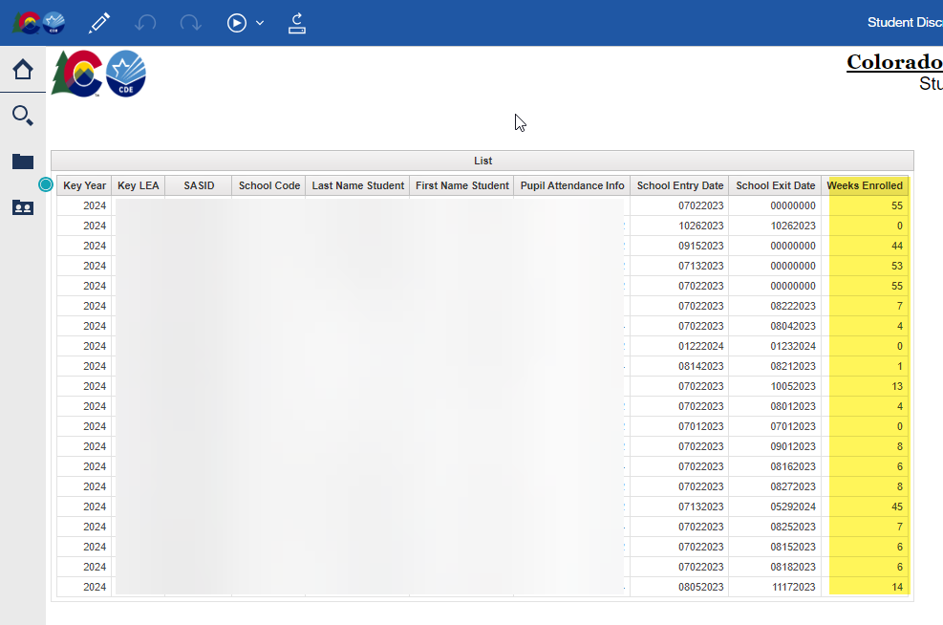
Teacher Student Data Link
COGNOS/CEDAR Reports:
  Student Discrepancy Report is all students reported in the Student Interchange that were not included in the TSDL Snapshot. Verify if the omission is correct using the weeks enrolled field.
If you are getting TD110, TD111, TD112 or TD113 snapshot errors, and it is accurate that a class of that course code should not be appearing at that school, please reach out for an exception.
Teacher Student Data Link
TeacherStudentDataLink@cde.state.co.us

Slide 13
Questions & Resources:
TSDL
Peter Hoffman
720-925-8611
TeacherStudentDataLink@cde.state.co.us
TSDL Interchange Webpage

Slide 14
Special Education Discipline
Lindsey Heitman

Slide 15
Special Education Discipline Snapshot:
Submission Status
AU Status
AUs w/ Errors= 2 ☹
AUs Approved and Locked in Pipeline = 25 ☺☺
AUs Not Yet Approved but Error Free= 38 ☺
Remaining Timeline:
August 22, 2024 - Snapshot error-free
Aug. 22 – Aug. 29, 2024 - Report Review
August 29, 2024 - Final Submission approval in Data Pipeline and reports uploaded to DMS.
SpedDiscipline@cde.state.co.us
Special Education Discipline – Lindsey Heitman

Slide 16
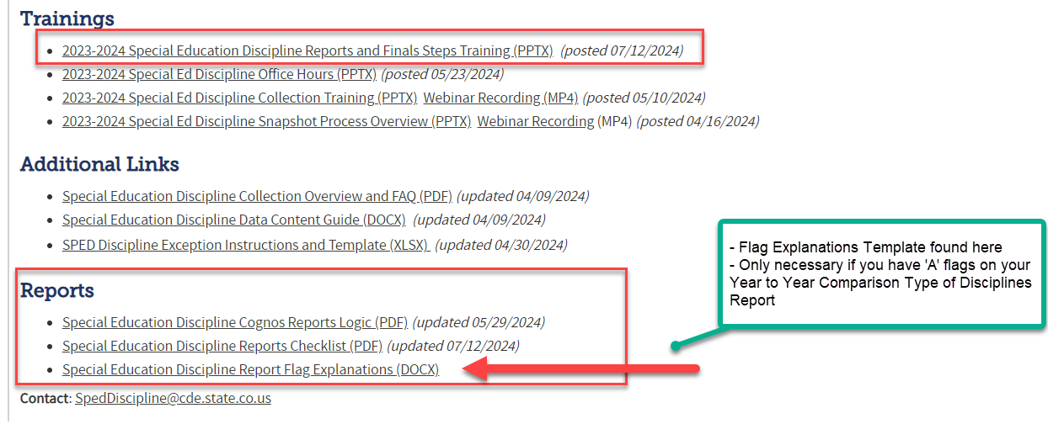
Special Education
Reports Online Resources
Special Education Discipline Snapshot Webpage
SpedDiscipline@cde.state.co.us
Special Education Discipline – Lindsey Heitman

Slide 17

Special Education Discipline
Signature Reports
DISTRICT
District Authority Sign-Off Form
*District please send to AU
  (requested by Special Education Directors for data assurance purposes and found in the Discipline Interchange folder in COGNOS)
  *For your records- no need to send to CDE!
ADMINISTRATIVE UNIT
SPED Discipline Data Summary Report (10 Pages)
SPED Discipline Year-to-Year Comparison Type of Disciplines Report (1 Page)
Year-to-Year Flag Explanation Document (Word)
  *AUs please upload to ESSU Data Management System
SpedDiscipline@cde.state.co.us
Special Education Discipline – Lindsey Heitman

Slide 18
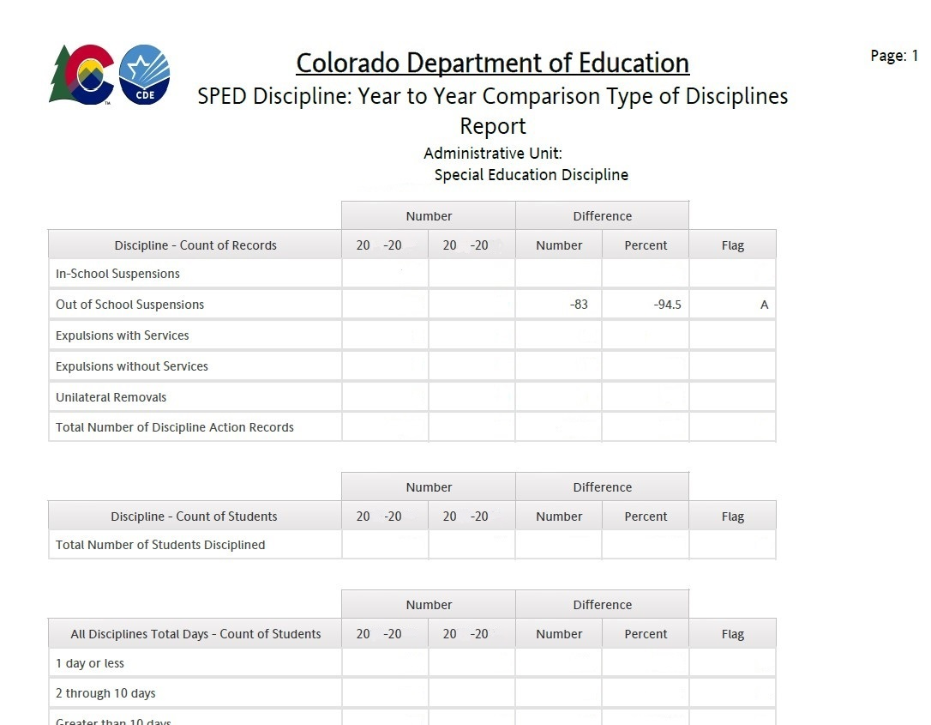
Year-to-Year Comparison Report example
You will only see flags - “A” – if both the number of the change is over 20 students AND the Percent of the Change is over 20%
These are the only data points that require explanation on the Flag Explanations sheet
18

Slide 19
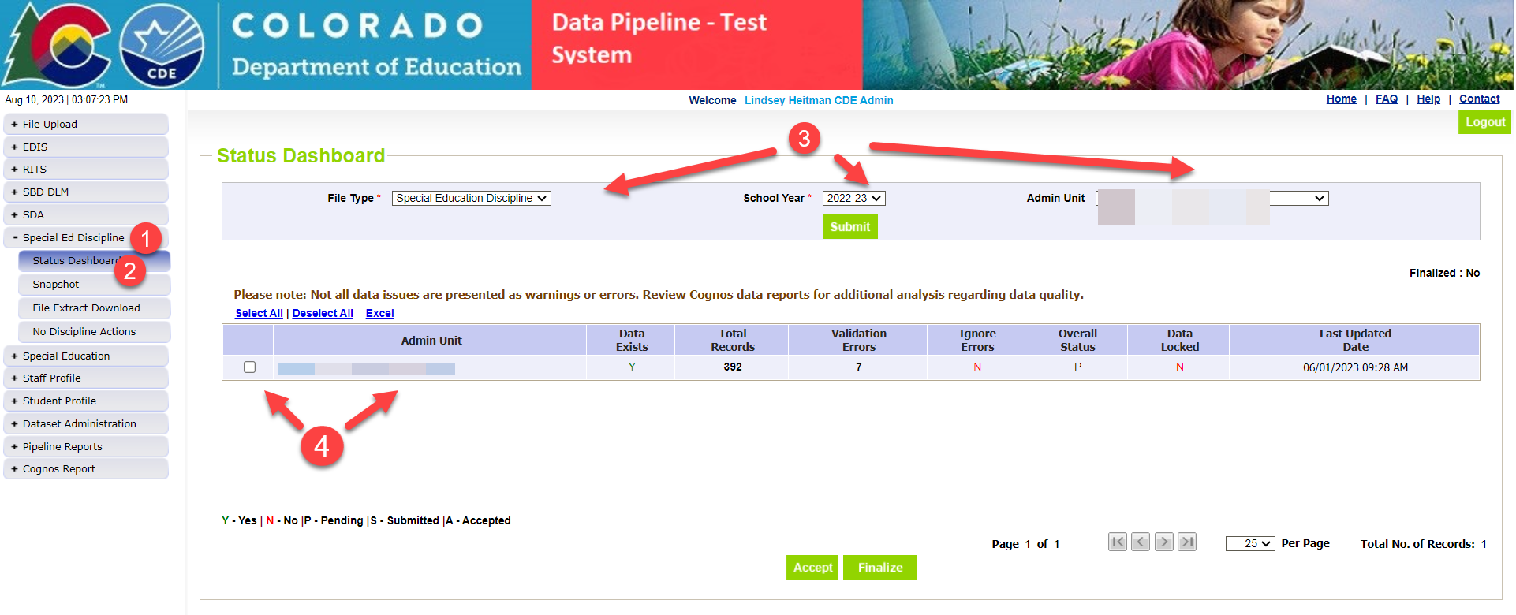
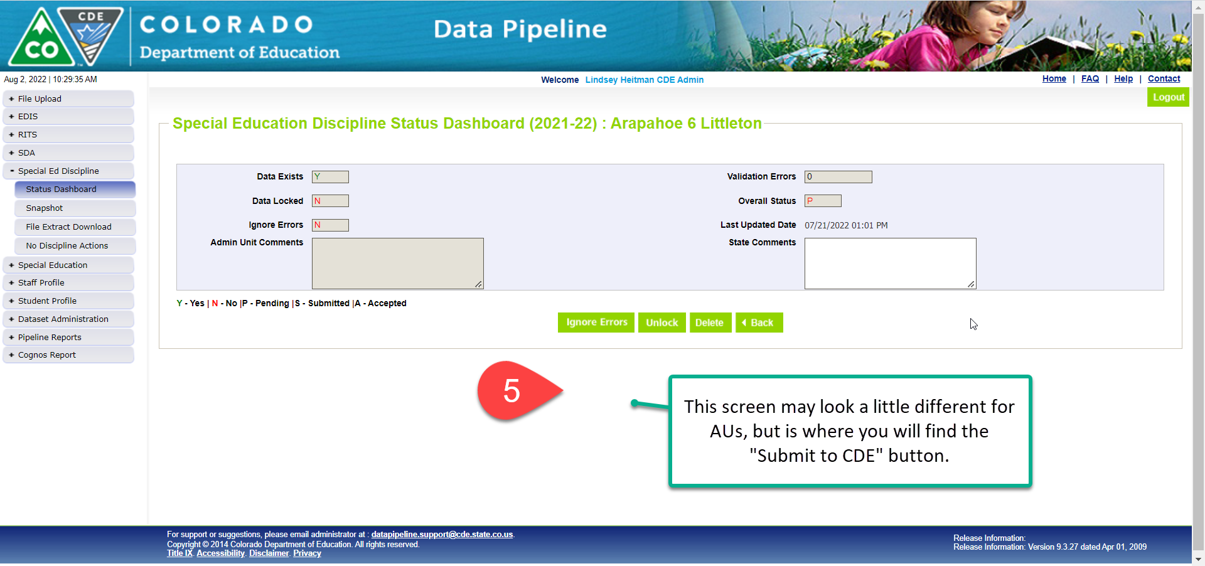
How to Approve and Lock Snapshot
Within Data Pipeline
1. Click Discipline on the left menu
2. Click Status Dashboard
3. Use the drop downs to select the appropriate values
  File Type: SPED Discipline Snapshot
  School Year: 2023-24
  Organization/LEA: defaults to your AU
Check the box next to your Admin Unit name and number and then hover over and click on your actual Admin Unit number and name to get to the next screen which contains the ‘Submit to CDE’ button.
Click the Submit to CDE button (Only SPI-APPROVERS will have this ability - must have 0 errors)
Click OK
  A green message should display above the File Type box indicating the data was submitted
  The Data Locked value should change to Y
  The Overall Status should change to S
Special Education Discipline – Lindsey Heitman

Slide 20
Questions & Resources:
Special Education Discipline
Lindsey Heitman
SpedDiscipline@cde.state.co.us
Discipline Interchange Webpage
Special Education Discipline Snapshot Webpage

Slide 21
Student End of Year
Reagan Ward

Slide 22
SEY Collection Timeline:
Upcoming Events
10 Business Days Remaining Until State Deadline
Date | Event | Event Description
8/9/2024 to 9/5/2024 | Report Review | • Validate Student End of Year data using CEDAR/COGNOS reports. • Submit snapshot as soon as review is complete
9/5/2024 | State Deadline | Submit Student End of Year snapshot
9/19/2024 | Cross LEA Open | Districts may begin creating snapshots as soon as they receive a ‘snapshot unlocked’ notification from data pipeline; typically mid-day.
10/17/2024 | Deadline | Resubmit SEY snapshot
10/24/2024 | Post-Cross LEA Open | Districts may begin updating their snapshot to address Post-Cross LEA business rules.
11/19/2024 | Deadline | Post-Cross phase ends. Districts must have error free SEY snapshot and have addressed any necessary post-cross changes.
12/3/2024 | Deadline | Collection closes. • Superintendent Verification (sign-off) form due. • Data remains embargoed until the official release in January
Visit the SEY Website to download the complete SEY Collection Timeline with Training Dates
Student End of Year – Reagan Ward
StudentEndOfYear@cde.state.co.us

Slide 23
File Status as of 4:30 pm on 8/21
Snapshot Status
Notes
LEAs who are error free and have reviewed their initial SEY data may submit their snapshot when ready.
LEAs with potential summer graduates/completers are encouraged to wait until August to submit their snapshot after they’ve updated any school exit types for grad/completers.
Student End of Year – Reagan Ward
StudentEndOfYear@cde.state.co.us

Slide 24
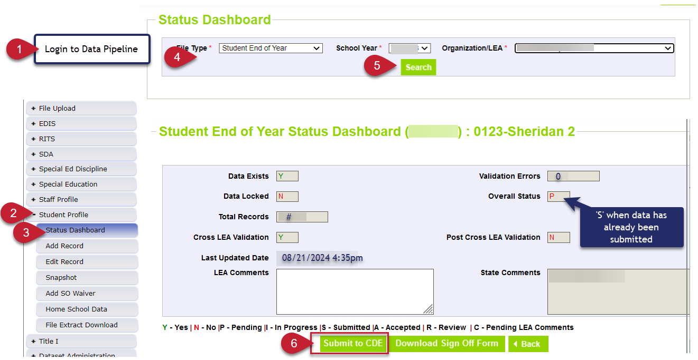
Submit to CDE
Student End of Year – Reagan Ward
StudentEndOfYear@cde.state.co.us

Slide 25
Graduation, Dropout, and Completion Rates:
Understanding and Use for Continuous Improvement
Upcoming Webinar
Host: Accountability Unit and SEY Collection Lead
Topics:
  Overview of how graduation, completion, and dropout rates are used for state accountability determinations and improvement efforts.
  Explore how graduation, completion, and dropout rates are calculated in the state of Colorado
Audience:
  District Accountability Contacts
  District Leaders
  District data staff who support SEY rates
  Interested district staff
Date/Time: September 12, 2024, 1:00-2:00pm
Registration Link
Student End of Year – Reagan Ward
StudentEndOfYear@cde.state.co.us

Slide 26
Questions & Answers:
Student End of Year
StudentEndOfYear@cde.state.co.us
720-484-9057
Student End of Year Website
Student Interchange Website
Graduation Guidelines Website

Slide 27
Student October
Brooke Wenzel

Slide 28
Student October Timeline – Regular Phase
Date | Event | Event Description
07/15/2024 | Open | Districts may begin uploading Student Interchange Files (Student Demographic and Student School Association).
08/23/2024 | Open | Districts may begin creating snapshots. Student October Snapshot dependencies are the Student Demographic File, Student School Association File, Title I File (if applicable) and At-Risk File.
08/28/2024 | Training Event | Data Pipeline Training 10-11 a.m.
09/05/2024 | Training Event | New Respondent Training 1-2 p.m.
09/10/2024 | Training Event | English Language Learner Training 11-12 p.m.
09/12/2024 | Training Event | Veteran Respondent Training 11-12 p.m.
09/16/2024 | Training Event | Postsecondary Program Coding Training 11-12 p.m.
09/24/2024 | Other Date | First day of Student October Count Window for districts with 5-day school week.
10/01/2024 | Other Date | Official Count Day 2024
10/02/2024 | Interim Deadline | Upload Student Demographic and Student School Association Files. Upload Title I Interchange File (if applicable). Upload At-Risk Interchange File.
10/08/2024 | Other Date | Last day of Student October Count Window for districts with 5-day school week.
10/09/2024 | Interim Deadline | Error free Student Interchange File uploads
10/14/2024 | Training Event | Mid-Collection Office Hours 10-11 a.m.
10/14/2024 | Interim Deadline | Create an initial Student October Snapshot
10/22/2024 | Interim Deadline | Error free Student October Snapshot
10/24/2024 | Training Event | Data Validation, Transfer Enrollment Exceptions and Cognos Reports 1-2 p.m.
10/28/2024 | Training Event | Data Pipeline Duplicate Process and Submission 9-10 a.m.
11/01/2024 | Report Review | Review Student October Cognos Reports for data validation. Submit Student October Snapshot data as soon as review is complete.
11/08/2024 12:00 p.m. | State Deadline | Submit Student October Snapshot data
Student October
StudentOctober@cde.state.co.us

Slide 29
Student October Timeline – Duplicate Process
Date | Event | Event Description
11/12/2024 12:00 p.m. | Deadline | Duplicate funding documentation due to School Auditing Office
11/18/2024 | Other Date | School Auditing makes decisions on funding duplicates
11/27/2024 | Deadline | Resubmit Student October Snapshot data to CDE based on decisions from School Auditing
12/06/2024 | Deadline | Collection closes Secretary of the Board of Education Verification (sign-off) form due. Data remains embargoed until the official release in January.
01/15/2025 | Data Release | Official data release
Student October
StudentOctober@cde.state.co.us

Slide 30
Student October Training Schedule
Data Pipeline Training
Date/Time: 08/28/2024, 10-11 a.m.
Click here to register for the teams meeting.
New Respondent Training
Date/Time: 09/05/2024, 1-2 p.m.
Click here to register for the teams meeting.
English Language Learner Training
Date/Time: 09/10/2024, 11-12 p.m.
Click here to register for the teams meeting.
Veteran Respondent Training
Date/Time: 09/12/2024 11-12 p.m.
Click here to register for the teams meeting.
Postsecondary Program Coding Training
Date/Time: 09/18/2024, 2-3 p.m.
Click here to register for the teams meeting.
Mid-Collection Office Hours
Date/Time: 10/14/2024 10-11 a.m.
Click here to register for the teams meeting.
Data Validation, Transfer Enrollment Exceptions and Cognos Reports Training
Date/Time: 10/23/2024 1-2 p.m.
Click here to register for the teams meeting.
Data Pipeline Duplicate Process and Submission Training
Date/Time: 10/28/2024 9-10 a.m.
Click here to register for the teams meeting.
Student October
StudentOctober@cde.state.co.us

Slide 31
OCT: Students attending BOCES or District Schools/Programs
Contract with a BOCES or District?
School: Has own school code
Home District: OCT record,
Group B PAI = 31 or 33,
Funding Code = Applicable
BOCES/District: OCT record,
Group A PAI = 02 or 04,
Funding Code = not funded
Program: Does NOT have a school code
Home District: OCT Record with Group A PAI 01-08 and Non-School Program Code 03
Program: no state reporting
Notes:
PAI Codes (on the SSA file):
Group A = Pupils attending an educational program operated by the reporting district
Group B = Resident Pupils attending an educational program not operated by the reporting district
Special Education PAI Codes:
See the Special Education IEP Interchange – Child Participation file layout for information
Based upon students within the Administrative Unit (AU) – which means codes may vary from the PAI codes used on the SSA file since those are based upon district level information

Slide 32
Questions & Resources:
Brooke Wenzel
StudentOctober@cde.state.co.us
720-441-7963
Student October Webpage
Student Interchange Webpage

Slide 33
School Auditing Office Updates
Rebecca McRee

Slide 34
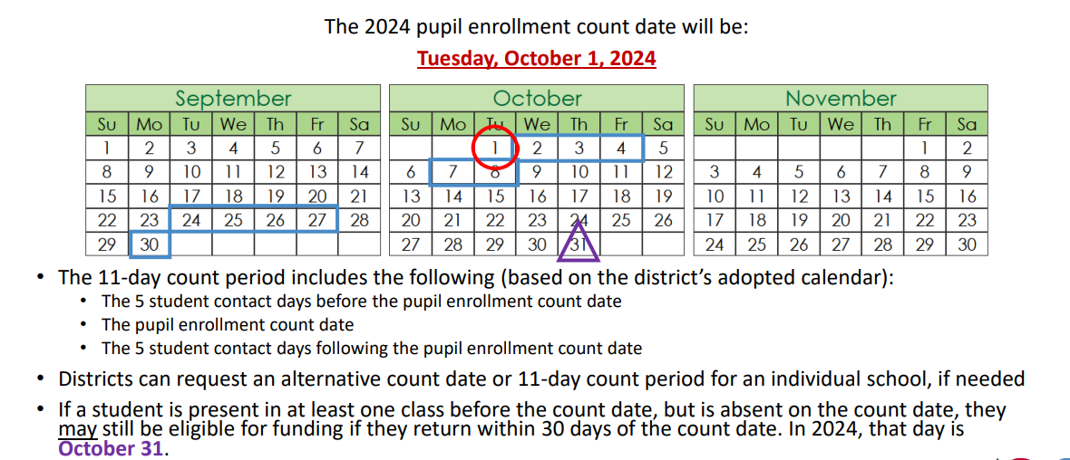
Student October Count Day 2024
School Auditing Office
Audit@cde.state.co.us

Slide 35
New: Annual Audit Review Process (Required)
Beginning with the 2024 Student October Count data collection, the School Auditing Office is changing its approach to the required compliance audits.
Annual Audit Review Process (Overview- PDF)
  Pupil Count Audit Questionnaire
  At-Risk Count Audit Questionnaire
  English Language Learner (ELL) Count Questionnaire
Audit District Contact Form
Initial audit documentation upload (as described on each questionnaire) will be due by December 11, 2024.
A training on the new process was held on 7/23/24. Visit the School Auditing Office's Training and Office Hours website to access the recording.
School Auditing Office
Audit@cde.state.co.us

Slide 36
Training and Office Hours
Upcoming Trainings:
English Language Learner Count Audit Overview September 17, 2024 (10AM)
Duplicate Count Office Hours November 5, 2024 (10AM)
School Auditing Office's Training and Office Hours website
School Auditing Office
Audit@cde.state.co.us

Slide 37
Audit Resource Guides
These Guides contain the funding and audit documentation requirements that districts and BOCES may be required to provide during the Annual Audit Review or subsequent expanded audits.
Student October (Pupil) Count Audit Resource Guide
At-Risk Count Audit Resource Guide
English Language Learner (ELL) Audit Resource Guide
School Auditing Office
Audit@cde.state.co.us

Slide 38
Questions & Answers:
School Auditing Office
Audit@cde.state.co.us
Pupil Count Website
At-Risk Count Website
English Language Learner Count Website
Training and Office Hours Website

Slide 39
At-Risk Interchange
Rebecca McRee

Slide 40
New: At-Risk Measure Interchange File -
Overview
Beginning with the 2024/2025 school year, there is a new Data Pipeline At-Risk Interchange.
The purpose of the At-Risk Interchange is to obtain student-level census block data needed to implement the new at-risk measure as described in HB22-1202 with data collection to begin with the 2024-2025 school year as provided for under SB24-188.
The new at-risk measure will be implemented starting with the 2025/2026 school year, and included in the Total Program funding calculation as described in the Public-School Finance Act which will continue to utilize student level data reported through the Student October Count data collection.
This interchange opened on July 15, 2024 and closes November 8, 2024. It will only be open during the Student October Count Collection.
At-Risk Interchange
ARMeasure@cde.state.co.us

Slide 41
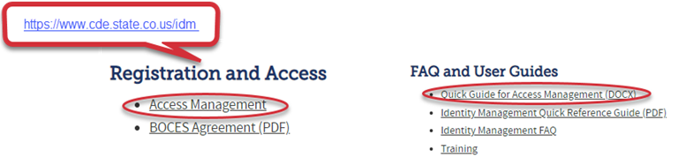
New: At-Risk Measure Interchange File -
Identity Management Role
Don’t have access?
Talk to your District’s Local Access Manager (LAM)!
Note: To receive communication about the at-risk interchange, you must have this role!
75% of LEAs have assigned a User to this Interchange File
Application | Collection | Role | Access Level
Pipeline | At Risk Measure (ARM) | LEA User | Upload and Edit Records for the At-Risk Measure File
Pipeline | At-Risk Measure (ARM) | LEA Viewer | View Cognos reports – cannot edit data
At-Risk Interchange
ARMeasure@cde.state.co.us

Slide 42
New: At-Risk Measure Interchange File - Syncplicity Folders
Syncplicity folders are being shared on a rolling basis with ARM LEAUSERS and LEAVEWIERS.
The folder naming convention is:
  District Code_ District Name_ ARMeasure Interchange
These folders will be used to share files containing PII between the district or BOCES and CDE when requesting assistance with the At-Risk Interchange or Census Geocoding tool.
If you have been assigned the user or view role for this interchange file and you do not receive notification that this file has been shared with you within 48 hours, email ARMeasure@cde.state.co.us.
At-Risk Interchange
ARMeasure@cde.state.co.us

Slide 43
New: Census Block Data
Required and valid census block data combinations include 4 data fields:
  State Code
  County Code*
  Track Code
  Block Code
To obtain this data, districts will need to first gather, clean and validate student address data.
Then districts will need to "geocode" each student's primary physical residential address to obtain this information.
  District's GIS system (such as ARC)
  Census Geocoder Tool
  Other (if your district has some other tool, please reach out to ARMeasure@cde.state.co.us)
At-Risk Interchange
ARMeasure@cde.state.co.us

Slide 44
New: At-Risk Measure Interchange File -
Resources
At-Risk Interchange Website
  File Layout
  Business Rules
  Interchange Upload Template (XLS)
  Instructions for Using the Geocode Tool
  Valid Census Block Data Combinations (XLS)
At-Risk Interchange
ARMeasure@cde.state.co.us

Slide 45
New: At-Risk Measure Interchange File-
Trainings
Scheduled Trainings:
  Overview of the Geocode Tool - Complete
    The recording for this training is posted to the AR Interchange website
  Overview of the Geocode Tool - Complete
    The recording for this training is posted to the AR Interchange website
  Overview of the Data Pipeline At-Risk Interchange File - Complete
    The recording for this training should be posted to the AR Interchange website next week
For questions, contact ARMeasure@cde.state.co.us
At-Risk Interchange
ARMeasure@cde.state.co.us

Slide 46
New: At-Risk Measure Interchange File -
Timeline
Date | Event | Event Description
7/15/2024 | Open | Districts may begin to upload the At-Risk Interchange file to the data pipeline.
8/23/2024 | Open | Districts may begin creating Student October Snapshots. This Snapshot is dependent on the Student Demographic File, Student School Association File, Title 1 File (if applicable) and the At-Risk File.
8/13/2024 | Training Event | Overview of the Census Geocoder Tool (10-11am)
8/20/2024 | Training Event | Overview of the At-Risk Interchange File (1-2pm)
9/13/2024 | Other Date | Gather, review, clean-up and validate student addresses
9/27/2024 | Other Date | Obtain census block data for all student addresses
10/2/2024 | Interim Deadline | Upload the At-Risk Interchange File
10/9/2024 | Interim Deadline | Obtain error-free At-Risk Interchange File upload
10/22/2024 | Interim Deadline | Obtain error-free Student October Snapshot
11/1/2024 | Report Review | Review Student October Cognos Reports for data validation. Submit Student October Snapshot data as soon as review is complete
11/8/2024 | State Deadline | Submit Student October Snapshot data
At-Risk Interchange
ARMeasure@cde.state.co.us

Slide 47
Questions & Answers:
ARMeasure@cde.state.co.us
Data Pipeline At-Risk Interchange website

Slide 48
READ Training
Tara Rhodes

Slide 49
READ Training Collection
Purpose and Timeline
Purpose:
Districts must annually ensure and report that the following groups have successfully completed evidence-based training in teaching reading:
all kindergarten through third grade (K-3) teachers who provide literacy instruction to students
all teachers who provide reading intervention in grades 4-12 (NEW!)
all kindergarten through third grade (K-3) principals and administrators (NEW!)
and/or personnel who the district determines meet the statute criteria as needing to complete the kindergarten through third grade Principal/Administrator training. (NEW!)
Important Dates:
August 1: Collection is open
August 15: Teachers, principals, and administrators should have their respective READ training designations added to their COOL accounts
August 30: Collection scheduled to close- 1 WEEK LEFT!
READ Training Collection
READActData@cde.state.co.us

Slide 50
READ Training Collection
General Process for Collection Completion
General Process for Collection Completion:
This collection starts with an export out of Data Pipeline of a list of educators who may be required to take either the teacher or administrator training.
  This is based on certain job class codes from the previous year's Human Resources collection.
Districts can then add, edit, or remove educators as it relates to this export based on their job function and whether the district has determined if the educator needs to take the training.
After this is complete, districts then upload this file back into Data Pipeline, check for errors, and officially submit.
READ Training Collection
READActData@cde.state.co.us

Slide 51
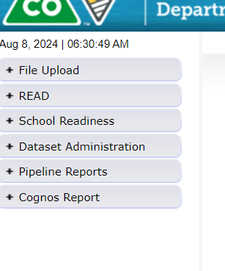
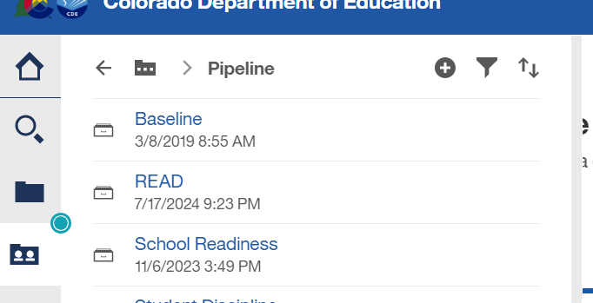



READ Training Collection
How to Pull the Export Report
Log into Data Pipeline.
Find the "Cognos Report" button at the bottom of the gray menu options along the left-hand side.
This will open up Cognos > Select the dark folder icon > "READ"
READ Training Collection
READActData@cde.state.co.us

Slide 52
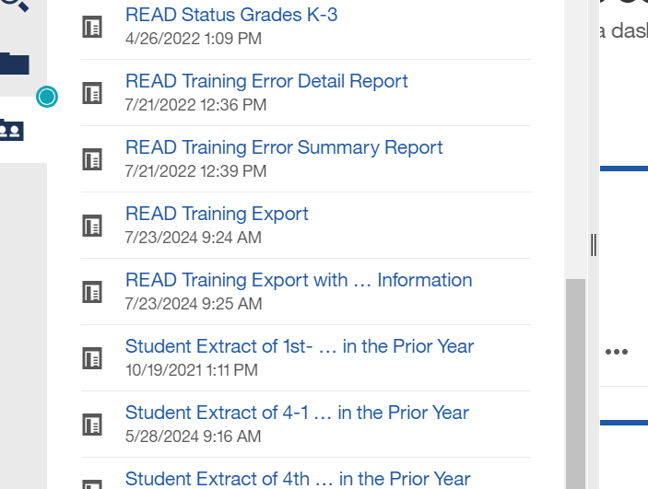

READ Training Collection
How to Pull the Export Report (continued)
4. Then select the READ Training Export Report. It's towards the bottom of the listing of reports.
This report pulls all staff who have certain job class codes from the previous year's HR collection that was in your district.
READ Training Collection
READActData@cde.state.co.us

Slide 53
READ Training Collection
Modifications to the READ Training Export Report
Add:
  Any new staff hired after June 1st of the current year who are required to take the training
  Any staff who may have changed into a position that requires the training (ex., 5th grade teacher > 3rd grade)
  Any 4-12 reading interventionists and other staff who are required to take the READ teacher training.
  Any permanent substitutes, special educators, non-licensed staff, and/or additional staff who are required to take the teacher training as determined by the function of their positions.
  K-3 administrators, principals, and others required to take the Principal/Admin training as determined by licenses and the function of their position(s).
  Any staff required who took the READ Principal/Admin training, regardless of their license.
Remove:
  Any individuals who appeared on the export who are not required to take either training based on their position and statute definition.
  Any teachers who are currently no longer working for your district.
READ Training Collection
READActData@cde.state.co.us

Slide 54
READ Training Collection
Error Resolution – TR026
TR026 (Teacher version):
Has the teacher completed the training? If so:
Have they added the designation to their license in COOL?
  Note: The teacher designation can be added to any type of license.
  Note: In COOL, there is a short application to actually add the designation. Ensure that the educator has worked through this application. Linking to Pepper, if that pathway was used, is part of this application. If not, uploading their evidence of completion is also an option in this application. Instructions can be found here.
  Note: This can take at least 24 hours to sync and update Data Pipeline.
If the teacher is not licensed, please email READActData@cde.state.co.us and I will explain how these individuals can be reported.
READ Training Collection
READActData@cde.state.co.us

Slide 55
READ Training Collection
Error Resolution – TR035
TR035 (Administrator version):
Has the administrator completed the training? If so:
Have they added the designation to their license in COOL?
Note: The administrator designation can be added to only 4 different license types:
  Principal or administrator license
  Principal authorization
  Emergency authorization with either a principal or administrator endorsement
  Interim authorization with either endorsement .
  Note: In COOL, there is a short application to actually add the designation. Ensure that the educator has worked through this application. The administrator application requires an upload of the evidence of completion into COOL.
  Note: This can take at least 24 hours to sync and update Data Pipeline.
If the administrator does not have one of the license types mentioned above, please email READActData@cde.state.co.us and I will explain the process for these individuals.
READ Training Collection
READActData@cde.state.co.us

Slide 56
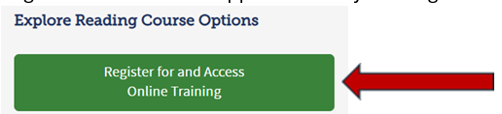

READ Training Collection
Screenshots for How to Add the Teacher Designation in COOL (1 of 3)
Directions for downloading a certificate of completion from Pepper (CDE online training platform):
Log into the READ Act Pepper course by clicking on the green button located on the CDE webpage titled: CDE-Provided Reading Training - Online
Click on the dropdown arrow next to the word “Me” under the orange person shaped icon in the upper right corner of the blue banner at the top of the landing page in the online training.
READ Training Collection
READActData@cde.state.co.us

Slide 57
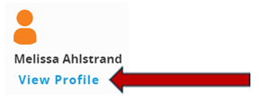
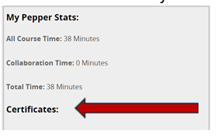
READ Training Collection
Screenshots for How to Add the Teacher Designation in COOL (2 of 3)
Select “view profile”
Under “certificates” you should find a link to your certificate of completion. Download a copy of your certificate of completion and save it to your desktop
READ Training Collection
READActData@cde.state.co.us

Slide 58
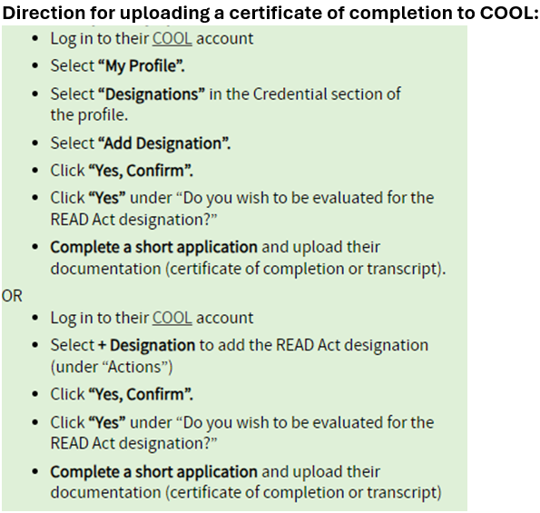
READ Training Collection
Screenshots for How to Add the Teacher Designation in COOL (3 of 3)
Directions for uploading a certificate of completion to COOL are found in the green box here.
These are also linked on the website here.
Instructions for adding the administrator designation can be found here.
READ Training Collection
READActData@cde.state.co.us

Slide 59
READ Training Collection
Recordings and Resources
Recordings:
Thursday, 6/27 - Slides have been posted here.
Thursday, 7/11 - Recording has been posted here.
Thursday, 7/25 - Recording has been posted here.
Thursday, 8/8 - Recording has been posted here.
Resources:
Cognos Report 1: READ Training Educators Reported in Prior Years (select 24-25)
Cognos Report 2: HR December Educators and READ Training Status (select 23-24)
24-25 File Layout
Business Rules
READ Training Website
Data Collection Guide – Updated for 2024-25
READ Training Collection
READActData@cde.state.co.us
Notes:
People reported previously by that district
2. People currently in their district and may have been reported in a prior year by their district or another district.

Slide 60
S-EBT
Collin Slutzky

Slide 61
Summer EBT Data Collection
Corrections will be accepted from May 22nd to August 30th
Use the corrections period for:
  Errors in submitted student data
  Adding students who were accidentally missed
  Including students that became newly eligible after April 30th
  Capturing students who enrolled in your district after April 30th
  Updating addresses that have changed
We encourage you to download a new full report from your SIS vendor to ensure you are uploading the most current data
Summer EBT
s-ebt@cde.state.co.us
Notes:
Your district schools are most likely receiving calls from families to update their address, make sure you are in contact with the appropriate people to make sure this updated information is being captured in the summer EBTcorrections.

Slide 62
How to Submit Corrections
You must email s-ebt@cde.state.co.us for us to unlock your collection
The file format for corrections is identical to the format of the original collection
Your corrected file must include all students you submitted during the initial collection
  Correction files with fewer students will cause an error in Data Pipeline
When uploading your data in Pipeline, select the “Replace” option for Upload Type
We will be available for office hours as needed to help during the corrections period
Summer EBT
s-ebt@cde.state.co.us

Slide 63
S-EBT File Layout
 | Name of Field | Field Length | Text Start Position | Text End Position | CSV Order | Excel Column | Examples | Remarks
1 | School District Code* | 4 | 1 | 4 | 1 | A2 | 0000
2 | School Code* | 4 | 5 | 8 | 2 | B2 | 0000
3 | Entry Date* | 8 | 9 | 16 | 3 | C2 | 08152021 | Format is MMDDYYYY
4 | Exit Withdraw Date* | 8 | 17 | 24 | 4 | D2 | 10152021 | Format is MMDDYYYY; 0 fill if N/A
5 | Student’s State ID (SASID)* | 10 | 25 | 34 | 5 | E2 | 0000000000
6 | Local ID (LASID)* | 10 | 35 | 44 | 6 | F2 | 0000000000
7 | Student’s First Name* | 30 | 45 | 74 | 7 | G2 | Valid Name
8 | Student’s Middle Name* | 30 | 75 | 104 | 8 | H2 | Valid Name | NMN if none
9 | Student’s Last Name* | 30 | 105 | 134 | 9 | I2 | Valid Name
10 | Student’s Gender* | 2 | 135 | 136 | 10 | J2 | 01, 02
11 | Student’s Date of Birth* | 8 | 137 | 144 | 11 | K2 | 08152008 | Format is MMDDYYYY
12 | Student’s Grade Level* | 3 | 145 | 147 | 12 | L2 | 060
13 | Student’s Language Background | 3 | 148 | 150 | 13 | M2 | ENG
14 | Primary Parent/Guardian First Name* | 30 | 151 | 180 | 14 | N2 | Valid Name
15 | Primary Parent/Guardian Last Name* | 30 | 181 | 210 | 15 | O2 | Valid Name
16 | Primary Parent/Guardian Telephone Number | 10 | 211 | 220 | 16 | P2 | 5551231234; None
17 | Student’s Primary Mailing Address 1* | 44 | 221 | 264 | 17 | Q2 | 123 Star Quarry Road
18 | Student’s Primary Mailing Address 2 | 42 | 265 | 306 | 18 | R2 | Apt. 2 | Try to avoid special characters, i.e., #, &, @, etc.
19 | Student’s Primary Mailing City* | 50 | 307 | 356 | 19 | S2 | Nowhere
20 | Student’s Primary Mailing State* | 2 | 357 | 358 | 20 | T2 | CO
21 | Student’s Primary Mailing Postal Code* | 10 | 359 | 368 | 21 | U2 | 99999-0000, 99999
22 | Free/Reduced Lunch Price Eligible* | 2 | 369 | 370 | 22 | V2 | 00, 01, 02
23 | FRPL Eligibility Date | 8 | 371 | 378 | 23 | W2 | 10152021 | Format is MMDDYYYY
Summer EBT
s-ebt@cde.state.co.us

Slide 64
Questions & Resources:
Summer EBT
S-EBT General Email
Data Collection FAQ – This is a great resource if you are having issues with formatting or uploading
School Nutrition Summer-EBT webpage
Data Pipeline S-EBT webpage
Office Hours Sign-up
S-EBT Support Center:
Call: 800-536-5298
Text: 720-741-0550
Email: cdhs_sebt_supportcenter@state.co.us

Slide 65

Thank you for joining today!
Next Town Hall will be August 29th
Reminder:
LAMs, please review your LEA’s list of IdM users and permissions

