Slide 1
August 15, 2024
Data Pipeline Town Hall
The goal of the webinar is to provide updates on the Data Pipeline, current, and upcoming data collections. These webinars also provide a forum for districts, BOCES, and Administrative Units to have questions answered about Data Pipeline.

Slide 2
Colorado Department of Education
Identity Management (IdM)
Identity Management Site
Frequently Asked Questions
How do I add myself or others to the email listserv for town hall emails and/or a specific collection?
  Email lists are dependent on a person’s access rights in IdM. Contact your LAM to get an account or be assigned to a specific collection.
Where can I find the IdM role mappings for Data Pipeline and other applications?
  Role Mapping (XLS)
I am a LAM. How do I update the user permissions for someone in my district?
  Follow the steps outlined in the IdM Quick Guide for Access Management (DOCX)
Important: Users are not automatically removed from IdM when their email address is no longer active in your district. The LAM must deactivate their IdM account to ensure only designated staff can access CDE’s data reporting system.
Notes:
LAMs, please check the IdM roles for your district. Remove permissions for users who have retired, left your district, or are no longer assigned to a collection. Add roles for new hires and newly assigned respondents for specific collections.

Slide 3

What is PII?
Student Personally Identifiable Information (PII) is defined by state and federal laws as information that, alone or in combination, personally identifies an individual
  This includes direct identifiers
  (i.e. student and staff names, SASID, EDID, etc.)
  Includes information that when combined is identifiable
Colorado’s Student Data Transparency and Security Act outlines requirements for how Student PII is collected, used and shared
See the Data Privacy and Security website for prepared guidance on how to comply with this and other privacy laws.

Slide 4

Sharing Data
Use secure methods to transfer any PII to CDE
  Contact Data Collection leads with questions about how to transmit PII securely
    Each Data Collection leads maintains their own Syncplicity folders for specific collections, reach out to the collection lead for access
  Use Syncplicity to encrypt emails to CDE
Avoid sending PII via unencrypted email or to unsecured faxes when sharing data between or within districts
  Use Syncplicity to encrypt emails to CDE
Check local policies for restrictions, requirements, etc. regarding PII
  Do not use PII in trainings, presentations, etc.
  Do not share PII with unauthorized individuals
  Do not share passwords
  Follow local policies when transmitting PII to any third party

Slide 5
Today’s Agenda
Agenda Topic | Presenter
Open Data Collections and Upcoming Deadlines in Data Pipeline
Teacher Student Data Link (TSDL) | Peter Hoffman
RITS Updates | Jessica Tribbett
Student End of Year | Reagan Ward
Attendance Data Release | Brooke Wenzel
Student October | Brooke Wenzel
School Auditing Office Updates | Rebecca McRee
At Risk Interchange Updates | Rebecca McRee
READ Staff Training | Tara Rhodes

Slide 6
Open Collections and
Upcoming Deadlines in
Data Pipeline

Slide 7
Open Collections and Upcoming Dates:
Year-Round & Interchanges
Name | Category | Status | Key Dates
RITS | Year Round | Open
EDIS | Year Round | Open
Directory | Year Round | Open | District Calendars Due 9/2/2024
Student | Interchange | Open | 2023-2024 and 2024-2025 are open
At-Risk | Interchange | Open
Title I | Interchange | Open
Special Education IEP | Interchange | Open
Staff | Interchange | Open | 2023-2024 open
TSDL | Interchange | Open
Discipline | Interchange | Open
Data Pipeline Resources: Data Pipeline Collection Dates (XLS)

Slide 8
Open Collections and Upcoming Dates:
Snapshots
Name | Category | Status | Final Deadline Date | Next Milestone | Looking Ahead
TSDL | Snapshot | Open | Aug. 30, 2024 | Interim Deadline: 8/23/2024 Snapshot Completed | 8/23/2024 – 8/30/2024 Review TSDL data before final submission deadline
Staff Evaluation | Snapshot | Open | Oct. 15, 2024 | Interim Deadline: 8/7-9/30 Report Review | Collection Deadline: 10/15/2024
Student Discipline | Snapshot | Closed | July 31, 2024 | Embargoed Data Release 8/20/24 | Published Reports 8/23/24 Profile Reports published 9/3/24
Attendance | Snapshot | Closed | July 26, 2024 | Data Release: 8/22/2024 | Data is embargoed until 8/22/2024
Student End of Year | Snapshot | Open | Nov. 19, 2024 | Report Review: 8/9/2024 to 9/5/2024 | State Deadline: 9/5/2024 Submit SEY Snapshot
Special Education Discipline | Snapshot | Open | Aug. 29, 2024 | Student Discipline Snapshot is due 7/31/2024 | Resolve all errors and ask Sped Director to review signature reports prior to 7/31/24
Special Education End of Year | Snapshot | Open | Sept. 27, 2024 | Interim Deadline: 8/29/2024 All exception requests due | Interim Deadline: 9/05/2024 All errors resolved
Data Pipeline Resources: Data Pipeline Collection Dates (XLS)

Slide 9
Open Collections and Upcoming Dates: Periodic
Name | Category | Status | Final Deadline Date | Looking Ahead
READ Training | Periodic | Open | Aug. 30, 2024
Designated Agency | Periodic | Open | Aug. 30, 2024
S-EBT (corrections period) | Periodic | Open | Aug. 30, 2024
Data Pipeline Resources: Data Pipeline Collection Dates (XLS)

Slide 10
Data Pipeline Maintenance
Data Pipeline, RITS and EDIS
will be unavailable Tuesday, Aug 13th at 5pm
until the morning of Wednesday, August 14th
for general maintenance
Thank you for your patience during this time!

Slide 11
Teacher Student Data Link
(TSDL)
Peter Hoffman

Slide 12
Teacher Student Data Link Timeline
Date | Event | Event Description
Friday August 23, 2024 | Interim Deadline | TARGET: Date by which you should have a complete Teacher Student Data Link Snapshot. Complete Teacher Student Data Link Snapshot means: ◻ All TSDL interchange errors are resolved ◻ All TSDL snapshot errors are resolved If you anticipate that you will not be able to meet this deadline, please contact CDE at TeacherStudentDataLink@cde.state.co.us
Monday August 26, 2024 – Thursday August 29, 2024 | Report Review | Final Snapshot Report Review – This is your opportunity to review reports in detail and make any data corrections you deem necessary to make sure you are reporting valid and reliable data. All data corrections must be completed during this time.
Friday August 30, 2024 | Deadline | Required to have TSDL snapshot error free and finalized before or on this date. TSDL closed and final report is signed and provided to CDE via email TeacherStudentDataLink@cde.state.co.us
Teacher Student Data Link
TeacherStudentDataLink@cde.state.co.us

Slide 13
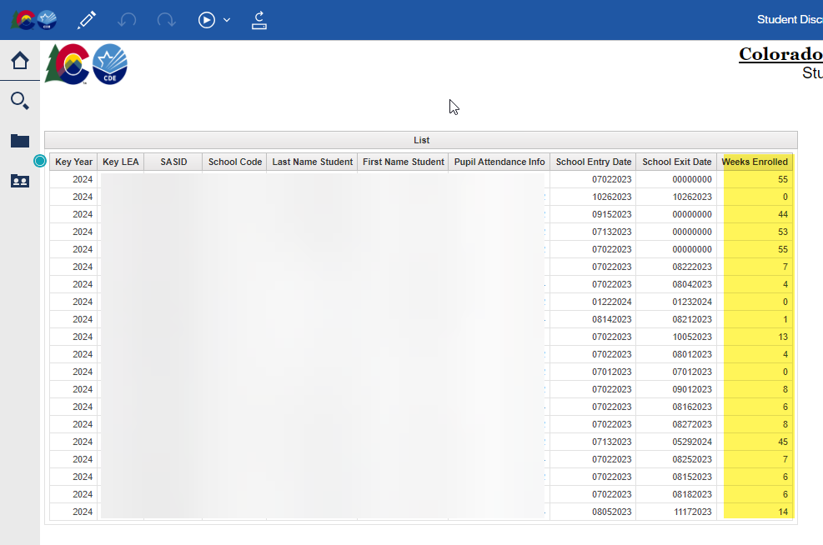
Teacher Student Data Link
COGNOS/CEDAR Reports:
  Student Discrepancy Report is all students reported in the Student Interchange that were not included in the TSDL Snapshot. Verify if the omission is correct using the weeks enrolled field.
If you are getting TD110, TD111, TD112 or TD113 snapshot errors, and it is accurate that a class of that course code should not be appearing at that school, please reach out for an exception.
Teacher Student Data Link
TeacherStudentDataLink@cde.state.co.us

Slide 14
Questions & Resources:
TSDL
Peter Hoffman
720-925-8611
TeacherStudentDataLink@cde.state.co.us
TSDL Interchange Webpage

Slide 15
RITS Updates
Jessica Tribbett

Slide 16
RITS: SASID Request & Update Reminders
Do not resubmit records – if there is a delay, please do not resubmit, but reach out to myself or the RITS email
Use 'Comments' section of RITS Web and Data Pipeline to make notes – however, please do not name country of origin - 'New to state'.
Request for more information – please be timely in response, making sure to not share PII via email
Duplicates – Use Syncplicity if you have found a duplicate; SASID Merge Report issues are being researched – please be sure your district is selected from the drop-down.
RITS matching percentage logic
SASID Request & Update Reminders
RITS@cde.state.co.us

Slide 17
Questions & Resources:
Directory
Jessica Tribbett
RITS@cde.state.co.us
RITS Information Webpage
RITS Web

Slide 18
Student End of Year
Reagan Ward

Slide 19
SEY Collection Timeline:
Upcoming Events
Date | Event | Event Description
8/14/2024 2:30-3:30pm | Training Event | August SEY Office Hours: Reviewing Reports and Data Validation Registration Link
8/9/2024 to 9/5/2024 | Report Review | • Validate Student End of Year data using CEDAR/COGNOS reports. • Submit snapshot as soon as review is complete
9/5/2024 | State Deadline | Submit Student End of Year snapshot
9/19/2024 | Cross LEA Open | Districts may begin creating snapshots as soon as they receive a ‘snapshot unlocked’ notification from data pipeline; typically mid-day.
10/17/2024 | Deadline | Resubmit SEY snapshot
10/24/2024 | Post-Cross LEA Open | Districts may begin updating their snapshot to address Post-Cross LEA business rules.
11/19/2024 | Deadline | Post-Cross phase ends. Districts must have error free SEY snapshot and have addressed any necessary post-cross changes.
12/3/2024 | Deadline | Collection closes. • Superintendent Verification (sign-off) form due. • Data remains embargoed until the official release in January
Visit the SEY Website to download the complete SEY Collection Timeline with Training Dates
Student End of Year – Reagan Ward
StudentEndOfYear@cde.state.co.us

Slide 20
File Status as of 11:00 pm on 8/14
Snapshot Status
Notes
Expect Frequent communication
  LEAs without data
  LEAs with remaining errors
LEAs who are error free and have reviewed their initial SEY data may submit their snapshot when ready.
LEAs with potential summer graduates/completers are encouraged to wait until August to submit their snapshot after they’ve updated any school exit types for grad/completers.
Student End of Year – Reagan Ward
StudentEndOfYear@cde.state.co.us

Slide 21
Report Review Window
8/9/2024 – 9/5/2024
Final data updates
Validate/Review Data
Update exit types for summer graduates/completers
  Students have until Aug. 31, 2024, to finish requirements to be a graduate or completer of the 2023-2024 school year.
Check retention codes
  Students beginning 2024-2025 in the same grade level that they finished in 2023-2024 should have a retention code in SEY 2023-2024
Collaborate with schools to review student lists.
  Student List: Dropouts
  Student List: AYG Cohort
  Student List: District and School Mobility
Review initial rates.
  Graduation: 3-,4-,5-,6-,7-year rates by School Year
  Graduation Rates: District and School by AYG
  Dropout: District and School Rates
  Mobility: District and School Rates
Student End of Year – Reagan Ward
StudentEndOfYear@cde.state.co.us

Slide 22
Prior SEY Office Hours Topics
All recordings posted on SEY website in the Training Section
August
  Operational Reports
  Reports to Preview Rates
July
  Exception Request Reminders
  Adequate Documentation of Transfer
  Expelled Students
  SE301 Graduation Guidelines Errors
June
  Monitoring summer graduates
  Retention Codes
  Grade Reassignment
  School Level Errors
  Mid-Year EL Changes
May
  Collaborating with program staff
  FRL Business Rules
  BOCES Schools vs BOCES programs (contract scenarios)
  Capturing enrollment status changes
  Investigating errors with the report SASID Lookup: SEY and OCT (prior, current, subsequent year)
Student End of Year – Reagan Ward
StudentEndOfYear@cde.state.co.us

Slide 23
Questions & Answers:
Student End of Year
StudentEndOfYear@cde.state.co.us
720-484-9057
Student End of Year Website
Student Interchange Website
Graduation Guidelines Website

Slide 24
Attendance Data Release
Brooke Wenzel

Slide 25
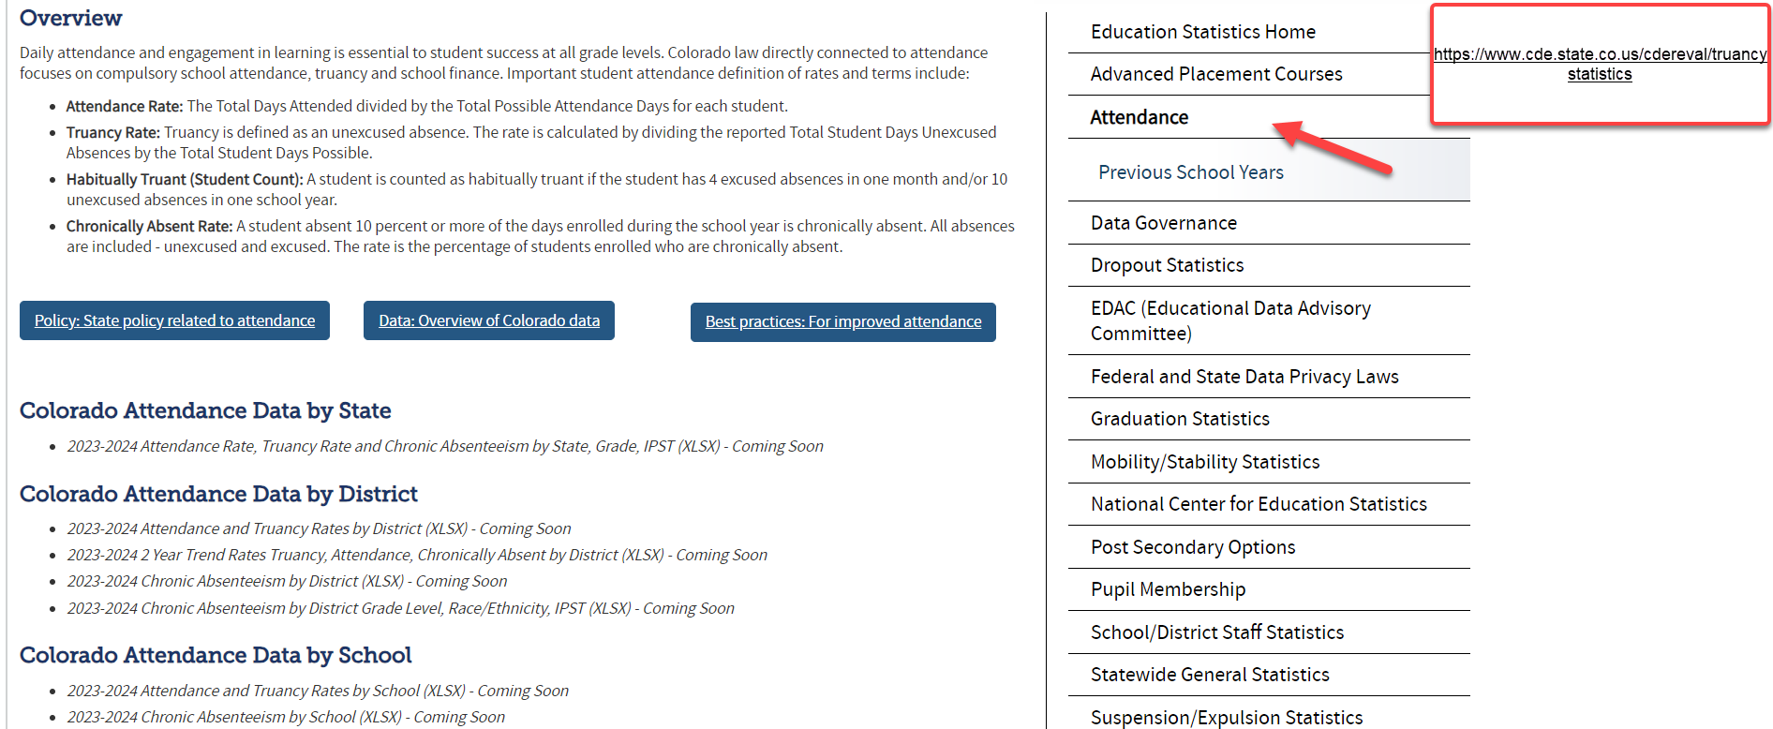
Attendance Data Release Info
August 22nd – Public Data Release
  Education statistics based upon this collection are publicly released and the embargo is lifted for this dataset (cannot send/use this data externally until embargo is lifted)
August 15th – Embargoed Data Was Sent
    2 Year Trend Rates Truancy, Attendance, Chronically Absent by District
    Attendance Rate, Truancy Rate and Chronic Absenteeism by State, Grade, IPST
Attendance
Attendance@cde.state.co.us

Slide 26
Questions & Resources:
Attendance
Brooke Wenzel
Attendance@cde.state.co.us
720-441-7963
Attendance Webpage
Student Interchange Webpage

Slide 27
Student October
Brooke Wenzel

Slide 28
Student October Timeline – Regular Phase
Date | Event | Event Description
07/15/2024 | Open | Districts may begin uploading Student Interchange Files (Student Demographic and Student School Association).
08/23/2024 | Open | Districts may begin creating snapshots. Student October Snapshot dependencies are the Student Demographic File, Student School Association File, Title I File (if applicable) and At-Risk File.
08/28/2024 | Training Event | Data Pipeline Training 10-11 a.m.
09/05/2024 | Training Event | New Respondent Training 1-2 p.m.
09/10/2024 | Training Event | English Language Learner Training 11-12 p.m.
09/12/2024 | Training Event | Veteran Respondent Training 11-12 p.m.
09/16/2024 | Training Event | Postsecondary Program Coding Training 11-12 p.m.
09/24/2024 | Other Date | First day of Student October Count Window for districts with 5-day school week.
10/01/2024 | Other Date | Official Count Day 2024
10/02/2024 | Interim Deadline | Upload Student Demographic and Student School Association Files. Upload Title I Interchange File (if applicable). Upload At-Risk Interchange File.
10/08/2024 | Other Date | Last day of Student October Count Window for districts with 5-day school week.
10/09/2024 | Interim Deadline | Error free Student Interchange File uploads
10/14/2024 | Training Event | Mid-Collection Office Hours 10-11 a.m.
10/14/2024 | Interim Deadline | Create an initial Student October Snapshot
10/22/2024 | Interim Deadline | Error free Student October Snapshot
10/24/2024 | Training Event | Data Validation, Transfer Enrollment Exceptions and Cognos Reports 1-2 p.m.
10/28/2024 | Training Event | Data Pipeline Duplicate Process and Submission 9-10 a.m.
11/01/2024 | Report Review | Review Student October Cognos Reports for data validation. Submit Student October Snapshot data as soon as review is complete.
11/08/2024 12:00 p.m. | State Deadline | Submit Student October Snapshot data
Student October
StudentOctober@cde.state.co.us

Slide 29
Student October Timeline – Duplicate Process
Date | Event | Event Description
11/12/2024 12:00 p.m. | Deadline | Duplicate funding documentation due to School Auditing Office
11/18/2024 | Other Date | School Auditing makes decisions on funding duplicates
11/27/2024 | Deadline | Resubmit Student October Snapshot data to CDE based on decisions from School Auditing
12/06/2024 | Deadline | Collection closes Secretary of the Board of Education Verification (sign-off) form due. Data remains embargoed until the official release in January.
01/15/2025 | Data Release | Official data release
Student October
StudentOctober@cde.state.co.us

Slide 30
Student October Training Schedule
Data Pipeline Training
Date/Time: 08/28/2024, 10-11 a.m.
Click here to register for the teams meeting.
New Respondent Training
Date/Time: 09/05/2024, 1-2 p.m.
Click here to register for the teams meeting.
English Language Learner Training
Date/Time: 09/10/2024, 11-12 p.m.
Click here to register for the teams meeting.
Veteran Respondent Training
Date/Time: 09/12/2024 11-12 p.m.
Click here to register for the teams meeting.
Postsecondary Program Coding Training
Date/Time: 09/18/2024, 2-3 p.m.
Click here to register for the teams meeting.
Mid-Collection Office Hours
Date/Time: 10/14/2024 10-11 a.m.
Click here to register for the teams meeting.
Data Validation, Transfer Enrollment Exceptions and Cognos Reports Training
Date/Time: 10/23/2024 1-2 p.m.
Click here to register for the teams meeting.
Data Pipeline Duplicate Process and Submission Training
Date/Time: 10/28/2024 9-10 a.m.
Click here to register for the teams meeting.
Student October
StudentOctober@cde.state.co.us

Slide 31
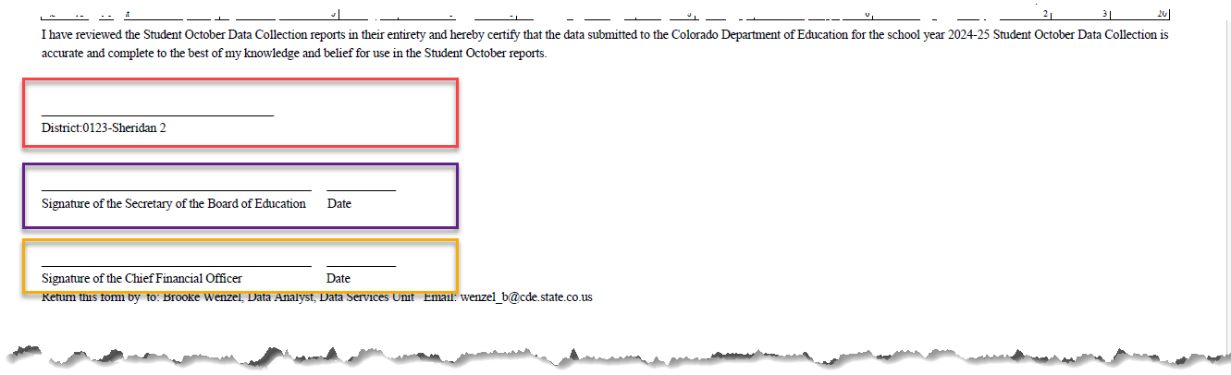
Signoff Form Updates
Red Box: Sometimes used for the data respondent’s signature or another signature not listed
Purple Box: Signature of the Secretary of the Board of Education
Yellow Box: Signature of the Chief Financial Officer (NEW)
Student October
StudentOctober@cde.state.co.us

Slide 32
Warnings – Helpful Tool for Data Reporting
OC182: This year's Student October grade level is not showing an advance (+1) from last year's Student October grade level. Please verify the student's grade level.
OC183/OC184 (BOCES School Contract Situations): You currently have a student that is being contracted through a BOCES (Pupil Attendance Information = '31' or '33') and is not being picked up by a BOCES. Please verify with your BOCES contact(s) that this student will be picked up by the BOCES for educational services…. You currently have a student that is coded as a Schools of Choice student (Pupil Attendance Information = '02' or '04') and is not being picked up by a district. Please verify with your district contact(s) that this student will be picked up by the district for funding purposes.
OC201: Possible PAI Duplicate: The following students were submitted by another district causing an enrollment duplicate. Verify the Pupil Attendance Information Code for enrollment purposes.
Various Codes: Your district reported no _____ students.
Various Codes: Your district’s ____ count for October is considerably different compared to last year's count. The tolerance for this warning is +- 25% and only includes K-12 students.
Student October
StudentOctober@cde.state.co.us

Slide 33
Questions & Resources:
Brooke Wenzel
StudentOctober@cde.state.co.us
720-441-7963
Student October Webpage
Student Interchange Webpage

Slide 34
School Auditing Office Updates
Rebecca McRee

Slide 35
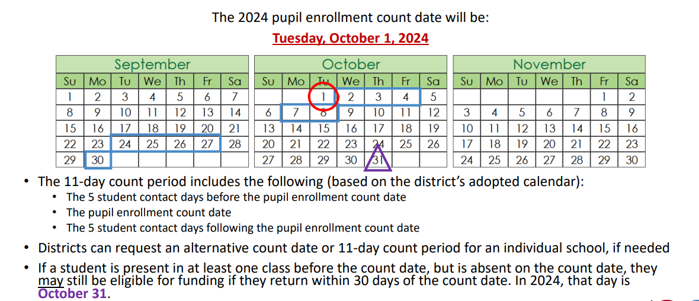
Student October Count Day 2024
School Auditing Office
Audit@cde.state.co.us

Slide 36
New: Annual Audit Review Process (Required)
Beginning with the 2024 Student October Count data collection, the School Auditing Office is changing its approach to the required compliance audits.
Annual Audit Review Process (Overview- PDF)
  Pupil Count Audit Questionnaire
  At-Risk Count Audit Questionnaire
  English Language Learner (ELL) Count Questionnaire
Audit District Contact Form
Initial audit documentation upload (as described on each questionnaire) will be due by December 11, 2024.
A training on the new process was held on 7/23/24. Visit the School Auditing Office's Training and Office Hours website to access the recording.
School Auditing Office
Audit@cde.state.co.us

Slide 37
Training and Office Hours
Upcoming Trainings:
Transportation CDE-40 Overview FY23/24 August 15, 2024 (10AM)
English Language Learner Count Audit Overview September 17, 2024 (10AM)
Duplicate Count Office Hours November 5, 2024 (10AM)
School Auditing Office's Training and Office Hours website
School Auditing Office
Audit@cde.state.co.us

Slide 38
Audit Resource Guides
These Guides contain the funding and audit documentation requirements that districts and BOCES may be required to provide during the Annual Audit Review or subsequent expanded audits.
Student October (Pupil) Count Audit Resource Guide
At-Risk Count Audit Resource Guide
English Language Learner (ELL) Audit Resource Guide
School Auditing Office
Audit@cde.state.co.us

Slide 39
Questions & Answers:
School Auditing Office
Audit@cde.state.co.us
Pupil Count Website
At-Risk Count Website
English Language Learner Count Website
Training and Office Hours Website

Slide 40
At-Risk Interchange
Rebecca McRee

Slide 41
New: At-Risk Measure Interchange File -
Overview
Beginning with the 2024/2025 school year, there is a new Data Pipeline At-Risk Interchange.
The purpose of the At-Risk Interchange is to obtain student-level census block data needed to implement the new at-risk measure as described in HB22-1202 with data collection to begin with the 2024-2025 school year as provided for under SB24-188.
The new at-risk measure will be implemented starting with the 2025/2026 school year, and included in the Total Program funding calculation as described in the Public-School Finance Act which will continue to utilize student level data reported through the Student October Count data collection.
This interchange opened on July 15, 2024 and closes November 8, 2024. It will only be open during the Student October Count Collection.
At-Risk Interchange
ARMeasure@cde.state.co.us

Slide 42
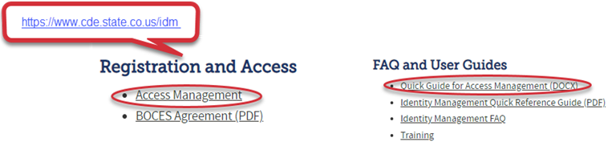
New: At-Risk Measure Interchange File -
Identity Management Role
Don’t have access?
Talk to your District’s Local Access Manager (LAM)!
Note: To receive communication about the at-risk interchange, you must have this role!
66% of LEAs have assigned a User to this Interchange File
Application | Collection | Role | Access Level
Pipeline | At Risk Measure (ARM) | LEA User | Upload and Edit Records for the At-Risk Measure File
Pipeline | At-Risk Measure (ARM) | LEA Viewer | View Cognos reports – cannot edit data
At-Risk Interchange
ARMeasure@cde.state.co.us

Slide 43
New: At-Risk Measure Interchange File - Syncplicity Folders
Syncplicity folders are being shared on a rolling basis with ARM LEAUSERS and LEAVEWIERS.
The folder naming convention is:
  District Code_ District Name_ ARMeasure Interchange
These folders will be used to share files containing PII between the district or BOCES and CDE when requesting assistance with the At-Risk Interchange or Census Geocoding tool.
If you have been assigned the user or view role for this interchange file and you do not receive notification that this file has been shared with you within 48 hours, email ARMeasure@cde.state.co.us.
At-Risk Interchange
ARMeasure@cde.state.co.us

Slide 44
New: Census Block Data
Required and valid census block data combinations include 4 data fields:
  State Code
  County Code*
  Track Code
  Block Code
To obtain this data, districts will need to first gather, clean and validate student address data.
Then districts will need to "geocode" each student's primary physical residential address to obtain this information.
  District's GIS system (such as ARC)
  Census Geocoder Tool
  Other (if your district has some other tool, please reach out to ARMeasure@cde.state.co.us)
At-Risk Interchange
ARMeasure@cde.state.co.us

Slide 45
New: At-Risk Measure Interchange File -
Resources
At-Risk Interchange Website
  File Layout
  Business Rules
  Interchange Upload Template (XLS)
  Instructions for Using the Geocode Tool
  Valid Census Block Data Combinations (XLS)
At-Risk Interchange
ARMeasure@cde.state.co.us

Slide 46
New: At-Risk Measure Interchange File-
Trainings
Scheduled Trainings:
  Overview of the Geocode Tool - Comlete
    The recording for this training is posted to the AR Interchange website
  Overview of the Geocode Tool - Complete
    The recording for this training should be posted to the AR Interchange website next week
  Overview of the Data Pipeline At-Risk Interchange File August 20, 2024 (1PM)
To access these trainings, click on the link found in the green box located on the At-Risk Interchange website. The link will be activated approximately 15 minutes prior to the start of the training.
For questions, contact ARMeasure@cde.state.co.us
At-Risk Interchange
ARMeasure@cde.state.co.us

Slide 47
New: At-Risk Measure Interchange File -
Timeline
Date | Event | Event Description
7/15/2024 | Open | Districts may begin to upload the At-Risk Interchange file to the data pipeline.
8/23/2024 | Open | Districts may begin creating Student October Snapshots. This Snapshot is dependent on the Student Demographic File, Student School Association File, Title 1 File (if applicable) and the At-Risk File.
8/13/2024 | Training Event | Overview of the Census Geocoder Tool (10-11am)
8/20/2024 | Training Event | Overview of the At-Risk Interchange File (1-2pm)
9/13/2024 | Other Date | Gather, review, clean-up and validate student addresses
9/27/2024 | Other Date | Obtain census block data for all student addresses
10/2/2024 | Interim Deadline | Upload the At-Risk Interchange File
10/9/2024 | Interim Deadline | Obtain error-free At-Risk Interchange File upload
10/22/2024 | Interim Deadline | Obtain error-free Student October Snapshot
11/1/2024 | Report Review | Review Student October Cognos Reports for data validation. Submit Student October Snapshot data as soon as review is complete
11/8/2024 | State Deadline | Submit Student October Snapshot data
At-Risk Interchange
ARMeasure@cde.state.co.us

Slide 48
Questions & Answers:
ARMeasure@cde.state.co.us
Data Pipeline At-Risk Interchange website

Slide 49
READ Training
Tara Rhodes

Slide 50
READ Training Collection
Purpose and Timeline
Purpose:
Districts must annually ensure and report that the following groups have successfully completed evidence-based training in teaching reading:
all kindergarten through third grade (K-3) teachers who provide literacy instruction to students
all teachers who provide reading intervention in grades 4-12 (NEW!)
all kindergarten through third grade (K-3) principals and administrators (NEW!)
and/or personnel who the district determines meet the statute criteria as needing to complete the kindergarten through third grade Principal/Administrator training. (NEW!)
Important Dates:
August 1: Collection is open
August 15: Teachers, principals, and administrators should have their respective READ training designations added to their COOL accounts
August 30: Collection scheduled to close- 2 WEEKS LEFT!
READ Training Collection
READActData@cde.state.co.us

Slide 51
READ Training Collection
General Process for Collection Completion
General Process for Collection Completion:
This collection starts with an export out of Data Pipeline of a list of educators who may be required to take either the teacher or administrator training.
  This is based on certain job class codes from the previous year's Human Resources collection.
Districts can then add, edit, or remove educators as it relates to this export based on their job function and whether the district has determined if the educator needs to take the training.
After this is complete, districts then upload this file back into Data Pipeline, check for errors, and officially submit.
READ Training Collection
READActData@cde.state.co.us

Slide 52
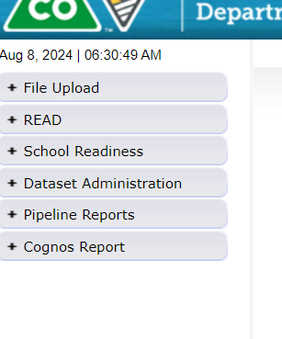
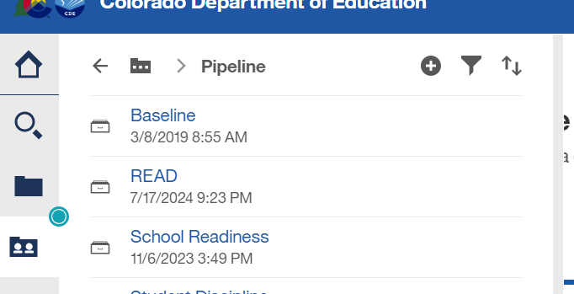



READ Training Collection
How to Pull the Export Report
Log into Data Pipeline.
Find the "Cognos Report" button at the bottom of the gray menu options along the left-hand side.
This will open up Cognos > Select the dark folder icon > "READ"
READ Training Collection
READActData@cde.state.co.us

Slide 53
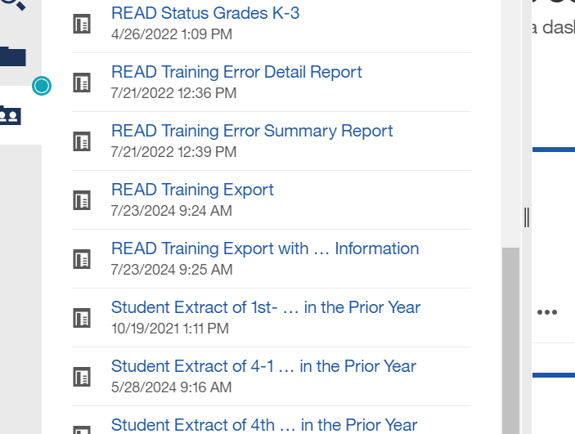

READ Training Collection
How to Pull the Export Report (continued)
4. Then select the READ Training Export Report. It's towards the bottom of the listing of reports.
This report pulls all staff who have certain job class codes from the previous year's HR collection that was in your district.
READ Training Collection
READActData@cde.state.co.us

Slide 54
READ Training Collection
Modifications to the READ Training Export Report
Add:
  Any new staff hired after June 1st of the current year who are required to take the training
  Any staff who may have changed into a position that requires the training (ex., 5th grade teacher > 3rd grade)
  Any 4-12 reading interventionists and other staff who are required to take the READ teacher training.
  Any permanent substitutes, special educators, non-licensed staff, and/or additional staff who are required to take the teacher training as determined by the function of their positions.
  K-3 administrators, principals, and others required to take the Principal/Admin training as determined by licenses and the function of their position(s).
  Any staff required who took the READ Principal/Admin training, regardless of their license.
Remove:
  Any individuals who appeared on the export who are not required to take either training based on their position and statute definition.
  Any teachers who are currently no longer working for your district.
READ Training Collection
READActData@cde.state.co.us

Slide 55
READ Training Collection
Error Resolution – TR026
TR026 (Teacher version):
Has the teacher completed the training? If so:
Have they added the designation to their license in COOL?
  Note: The teacher designation can be added to any type of license.
  Note: In COOL, there is a short application to actually add the designation. Ensure that the educator has worked through this application. Linking to Pepper, if that pathway was used, is part of this application. If not, uploading their evidence of completion is also an option in this application. Instructions can be found here.
  Note: This can take at least 24 hours to sync and update Data Pipeline.
If the teacher is not licensed, please email READActData@cde.state.co.us and I will explain how these individuals can be reported.
READ Training Collection
READActData@cde.state.co.us

Slide 56
READ Training Collection
Error Resolution – TR035
TR035 (Administrator version):
Has the administrator completed the training? If so:
Have they added the designation to their license in COOL?
Note: The administrator designation can be added to only 4 different license types:
  Principal or administrator license
  Principal authorization
  Emergency authorization with either a principal or administrator endorsement
  Interim authorization with either endorsement .
  Note: In COOL, there is a short application to actually add the designation. Ensure that the educator has worked through this application. The administrator application requires an upload of the evidence of completion into COOL.
  Note: This can take at least 24 hours to sync and update Data Pipeline.
If the administrator does not have one of the license types mentioned above, please email READActData@cde.state.co.us and I will explain the process for these individuals.
READ Training Collection
READActData@cde.state.co.us

Slide 57
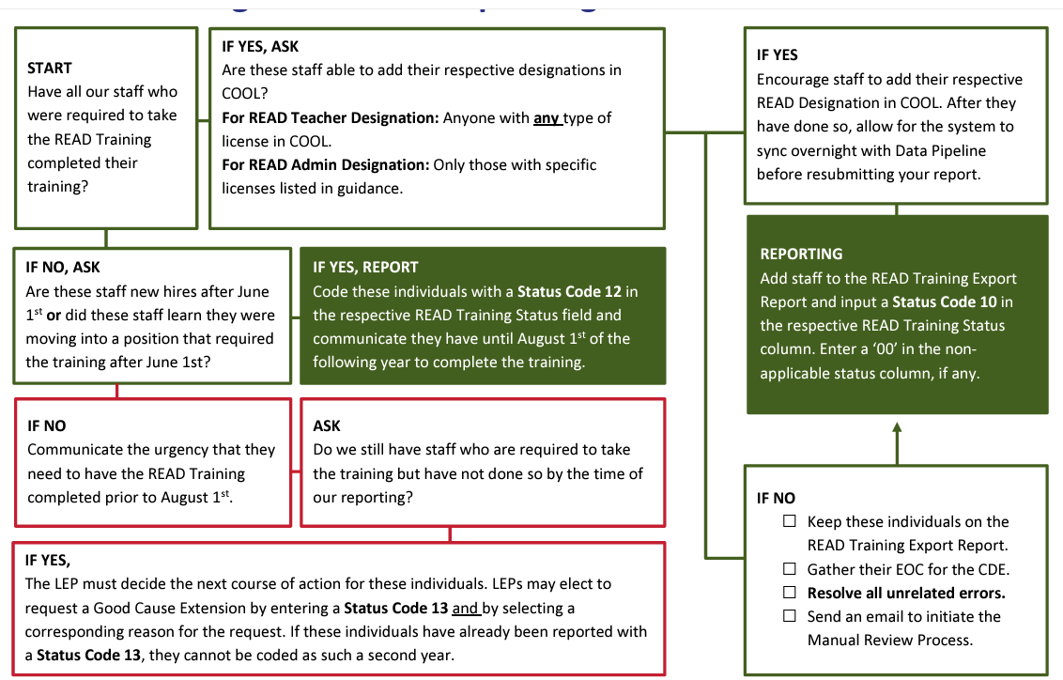
READ Training Collection
Decision Tree
READ Training Data Collection Guide
Please see page 16.
READ Training Collection
READActData@cde.state.co.us

Slide 58
READ Training Collection
Recordings and Resources
Recordings:
Thursday, 6/27 - Slides have been posted here.
Thursday, 7/11 - Recording has been posted here.
Thursday, 7/25 - Recording has been posted here.
Thursday, 8/8 - Recording has been posted here.
Resources:
24-25 File Layout
Business Rules
READ Training Website
Data Collection Guide – Updated for 2024-25
READ Training Collection
READActData@cde.state.co.us

Slide 59
Questions & Resources:
READ Training
Tara Rhodes
Email: READActData@cde.state.co.us
Phone: 720.601.4125
READ Training Website

Slide 60

Thank you for joining today!
Next Town Hall will be August 22nd
Reminder:
LAMs, please review your LEA’s list of IdM users and permissions

