Slide 1
August 8, 2024
Data Pipeline Town Hall
The goal of the webinar is to provide updates on the Data Pipeline, current, and upcoming data collections. These webinars also provide a forum for districts, BOCES, and Administrative Units to have questions answered about Data Pipeline.

Slide 2
Colorado Department of Education
Identity Management (IdM)
Identity Management Site
Frequently Asked Questions
How do I add myself or others to the email listserv for town hall emails and/or a specific collection?
  Email lists are dependent on a person’s access rights in IdM. Contact your LAM to get an account or be assigned to a specific collection.
Where can I find the IdM role mappings for Data Pipeline and other applications?
  Role Mapping (XLS)
I am a LAM. How do I update the user permissions for someone in my district?
  Follow the steps outlined in the IdM Quick Guide for Access Management (DOCX)
Important: Users are not automatically removed from IdM when their email address is no longer active in your district. The LAM must deactivate their IdM account to ensure only designated staff can access CDE’s data reporting system.
Notes:
LAMs, please check the IdM roles for your district. Remove permissions for users who have retired, left your district, or are no longer assigned to a collection. Add roles for new hires and newly assigned respondents for specific collections.

Slide 3

What is PII?
Student Personally Identifiable Information (PII) is defined by state and federal laws as information that, alone or in combination, personally identifies an individual
  This includes direct identifiers
  (i.e. student and staff names, SASID, EDID, etc.)
  Includes information that when combined is identifiable
Colorado’s Student Data Transparency and Security Act outlines requirements for how Student PII is collected, used and shared
See the Data Privacy and Security website for prepared guidance on how to comply with this and other privacy laws.

Slide 4

Sharing Data
Use secure methods to transfer any PII to CDE
  Contact Data Collection leads with questions about how to transmit PII securely
    Each Data Collection leads maintains their own Syncplicity folders for specific collections, reach out to the collection lead for access
  Use Syncplicity to encrypt emails to CDE
Avoid sending PII via unencrypted email or to unsecured faxes when sharing data between or within districts
  Use Syncplicity to encrypt emails to CDE
Check local policies for restrictions, requirements, etc. regarding PII
  Do not use PII in trainings, presentations, etc.
  Do not share PII with unauthorized individuals
  Do not share passwords
  Follow local policies when transmitting PII to any third party

Slide 5
Today’s Agenda
Agenda Topic | Presenter
Open Data Collections and Upcoming Deadlines in Data Pipeline
Special Education Discipline | Lindsey Heitman
Special Education End of Year | Lindsey Heitman
Student End of Year | Reagan Ward
Attendance Data Release | Brooke Wenzel
Student October | Brooke Wenzel
School Auditing Office Updates | Rebecca McRee
At Risk Interchange Updates | Rebecca McRee
READ Staff Training | Tara Rhodes

Slide 6
Open Collections and
Upcoming Deadlines in
Data Pipeline

Slide 7
Open Collections and Upcoming Dates:
Year-Round & Interchanges
Name | Category | Status | Key Dates
RITS | Year Round | Open
EDIS | Year Round | Open
Directory | Year Round | Open | District Calendars Due 9/2/2024
Student | Interchange | Open | 2023-2024 and 2024-2025 are open
At-Risk | Interchange | Open
Title I | Interchange | Open
Special Education IEP | Interchange | Open
Staff | Interchange | Open | 2023-2024 open
TSDL | Interchange | Open
Discipline | Interchange | Open
Data Pipeline Resources: Data Pipeline Collection Dates (XLS)

Slide 8
Open Collections and Upcoming Dates:
Snapshots
Name | Category | Status | Final Deadline Date | Next Milestone | Looking Ahead
TSDL | Snapshot | Open | Aug. 30, 2024 | Interim Deadline: 8/23/2024 Snapshot Completed | 8/23/2024 – 8/30/2024 Review TSDL data before final submission deadline
Staff Evaluation | Snapshot | Open | Oct. 15, 2024 | Interim Deadline: 8/7/2024 Error free snapshot | Interim Deadline: 8/7-9/30 Report Review
Student Discipline | Snapshot | Closed | July 31, 2024 | Embargoed Data Release 8/20/24 | Published Reports 8/23/24 Profile Reports published 9/3/24
Attendance | Snapshot | Closed | July 26, 2024 | Data Release: 8/22/2024 | Data is embargoed until 8/22/2024
Student End of Year | Snapshot | Open | Nov. 19, 2024 | Interim Deadline: 8/8/2024 Error free SEY snapshot | Training Event: 8/14/2024 2:30-3:30pm August SEY Office Hours
Special Education Discipline | Snapshot | Open | Aug. 29, 2024 | Student Discipline Snapshot is due 7/31/2024 | Resolve all errors and ask Sped Director to review signature reports prior to 7/31/24
Special Education End of Year | Snapshot | Open | Sept. 27, 2024 | Interim Deadline: 8/29/2024 All exception requests due | Interim Deadline: 9/05/2024 All errors resolved
Data Pipeline Resources: Data Pipeline Collection Dates (XLS)

Slide 9
Open Collections and Upcoming Dates: Periodic
Name | Category | Status | Final Deadline Date | Looking Ahead
READ Training | Periodic | Open | Aug. 30, 2024
Designated Agency | Periodic | Open | Aug. 30, 2024
S-EBT (corrections period) | Periodic | Open | Aug. 30, 2024
Data Pipeline Resources: Data Pipeline Collection Dates (XLS)

Slide 10
Data Pipeline Maintenance
Data Pipeline, RITS and EDIS
will be unavailable Tuesday, Aug 13th at 5pm
until the morning of Wednesday, August 14th
for general maintenance
Thank you for your patience during this time!

Slide 11
Special Education Discipline
Lindsey Heitman

Slide 12
Special Education Discipline Snapshot:
Submission Status
August 22, 2024 - Snapshot error-free
Aug. 22 – Aug. 29, 2024 - Report Review
August 29, 2024 - Final Submission approval in Data Pipeline and reports uploaded to DMS.
NOTE: Lindsey will be out of the office from 8/12-8/16
    THANK YOU!
SpedDiscipline@cde.state.co.us
Special Education Discipline – Lindsey Heitman

Slide 13
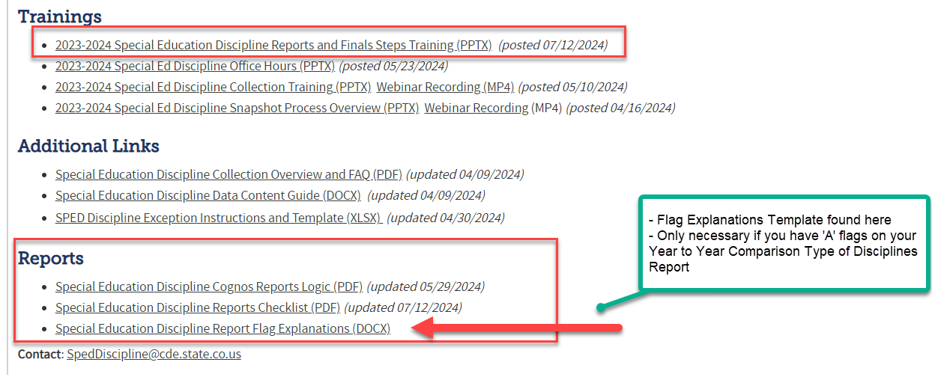
Special Education
Reports Online Resources
Special Education Discipline Snapshot Webpage
SpedDiscipline@cde.state.co.us
Special Education Discipline – Lindsey Heitman

Slide 14
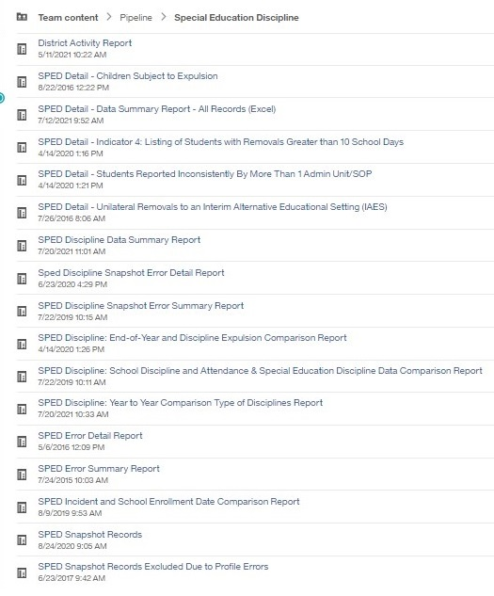
Review Week COGNOS Reports
*Detail Reports - for your information
Signature Report - PDF
Signature Report- PDF
*More about this report on the next slide
Notes:
`

Slide 15

Special Education Discipline
Signature Reports
DISTRICT
District Authority Sign-Off Form
*District please send to AU
  (requested by Special Education Directors for data assurance purposes and found in the Discipline Interchange folder in COGNOS)
  *For your records- no need to send to CDE!
ADMINISTRATIVE UNIT
SPED Discipline Data Summary Report (10 Pages)
SPED Discipline Year-to-Year Comparison Type of Disciplines Report (1 Page)
Year-to-Year Flag Explanation Document (Word)
  *AUs please upload to ESSU Data Management System
SpedDiscipline@cde.state.co.us
Special Education Discipline – Lindsey Heitman

Slide 16
Questions & Resources:
Special Education Discipline
Lindsey Heitman
SpedDiscipline@cde.state.co.us
Discipline Interchange Webpage
Special Education Discipline Snapshot Webpage

Slide 17
Special Education End of Year
Lindsey Heitman

Slide 18

Special Education End of Year:
Timeline and Office Hours
2023-2024 Special Education EOY Snapshot Timeline
May 1, 2024 - SPED EOY Snapshot official open
June 27, 2024 – IEP Interchange files error-free
August 29, 2024 - All Exception requests submitted to CDE
September 5, 2024 – All errors resolved at snapshot/interchange
September 5 -13, 2024 -Initial Report Review
September 16 - 20, 2024 – Resolving duplicates
September 20 - 27, 2024 – Final Report Review
September 27, 2024 - Final approval in Data Pipeline and reports uploaded to DMS
  Sped EOY Reports and Final Steps Webinar:
  Thursday Sept 5th 1:00 – 2:00
  Join the meeting now
Special Education EOY – Lindsey Heitman
SpedEndofYear@cde.state.co.us

Slide 19
Special Education End of Year: Exception Requests
Exception Requests Due to CDE By August 29
To find the Sped EOY Exception template click here and go to Additional Resources section
Please save your filled out exception template in your AU # Syncplicity folder and email SpedEndofYear@cde.state.co.us to let us know it’s ready for upload. I will email you if I have questions and/or once it has been uploaded to the Data Pipeline. The errors should resolve once you create a new snapshot.
Explanation box must have 400 characters or less
  LEN Function under “Formulas/Insert Function” tells you how many characters are in a cell
Be sure to download the Sped EOY template and not the EOY template – they are different
Format on the template must be exactly as specified or file won’t upload – double check SASID, error code, number of characters in explanation is < 400
SY247 exceptions (for dropouts under the age of 17 on exit date)? Check Warning SY282 first to be sure the student didn’t transfer to a different AU
Special Education EOY – Lindsey Heitman
SpedEndofYear@cde.state.co.us

Slide 20
Exception Edits
EXCEPTION TYPE
ERROR CODE (S)
INFORMATION NEEDED IN "COMMENTS AND EXPLANATION"
Grade to Age
SY250
Please provide student's age and details of why student is not
in an age appropriate grade. EXAMPLE:
Please provide the
Date of Birth, Date of Exit, and an
Student Dropped
SY247
explanation of details regarding the student's drop out prior to
Out Prior to Age 17
the age of 17 and attempts made to retain the student in
school. EXAMPLE:
Primary Disability
of 11 or 12 and
Please provide the
Date of Birth, The Sped Part C Referral Code
outside acceptable
SY113
being reported, and an explanation of why the student's
age range
disability has not been updated. EXAMPLE:
Student Reported
Please provide the
Date of Exit, Basis of Exit and the reason the
in Error on Previous
SY108
student was reported in error on the previous SPED EOY.
SPED EOY
EXAMPLE:
Student Reported
Please provide the
Date of Exit, Basis of Exit, and reason the
in Error on
SY107, SY109
student was reported in error on the previous December Count.
December Count
EXAMPLE:
Business rules at the Snapshot level that may require an exception request.
Snapshot Exception Template found here under Additional Links.

Slide 21
Special Education EOY:
C to B Referrals Comparison Spreadsheet
Find this comparison spreadsheet in your AU Syncplicity folder
Please compare to your records - path 2 initial referrals
This information was shared with CDE by the Department of Early Childhood and contains a list of children referred from Part C Early Intervention services to Part B Special Education services in your AU during 2023-24. Please review this information and compare to your records to be sure your 2023-24 Participation File path 2 information is accurate. If something is incorrect in the spreadsheet that is shared to you no need to contact CDE, just update your data as you see fit.
Note from the ESSU team:
The data that we share via Syncplicity to the AU data respondents is data that the CCBs (Community Centered Boards) submitted to Dept of Early Childhood via their monthly data collection. CDEC is required to share the notification data with CDE as well, and we share it to the AUs to support data reconciliation at the local level. Unfortunately, we cannot verify its accuracy or completeness and are simply passing along what was shared to us. Communication between the AU and CCB is the best way to verify accuracy and pinpoint any data discrepancies.
Special Education EOY – Lindsey Heitman
SpedEndofYear@cde.state.co.us

Slide 22
Questions & Resources:
Special Education End of Year
Lindsey Heitman
SpedEndofYear@cde.state.co.us
(303) 866-5759
Special Education IEP Interchange Webpage
Special Education End of Year Snapshot Webpage

Slide 23
Student End of Year
Reagan Ward

Slide 24
SEY Collection Timeline:
Upcoming Events
Date | Event | Event Description
8/8/2024 | Interim Deadline | Error free SEY Snapshot
8/14/2024 2:30-3:30pm | Training Event | August SEY Office Hours: Reviewing Reports and Data Validation Registration Link
8/9/2024 to 9/5/2024 | Report Review | • Validate Student End of Year data using CEDAR/COGNOS reports. • Submit snapshot as soon as review is complete
9/5/2024 | State Deadline | Submit Student End of Year snapshot
9/19/2024 | Cross LEA Open | Districts may begin creating snapshots as soon as they receive a ‘snapshot unlocked’ notification from data pipeline; typically mid-day.
10/17/2024 | Deadline | Resubmit SEY snapshot
10/24/2024 | Post-Cross LEA Open | Districts may begin updating their snapshot to address Post-Cross LEA business rules.
11/19/2024 | Deadline | Post-Cross phase ends. Districts must have error free SEY snapshot and have addressed any necessary post-cross changes.
12/3/2024 | Deadline | Collection closes. • Superintendent Verification (sign-off) form due. • Data remains embargoed until the official release in January
Visit the SEY Website to download the complete SEY Collection Timeline with Training Dates
Student End of Year – Reagan Ward
StudentEndOfYear@cde.state.co.us

Slide 25
File Status as of 7:30am on 8/8
Snapshot Status
Notes
Expect Frequent communication
  LEAs without data
  LEAs with more than 100 errors
  LEAs with 1-99 errors who haven’t attempted a snapshot in August
LEAs who are error free and have reviewed their initial SEY data may submit their snapshot when ready.
LEAs with potential summer graduates/completers are encouraged to wait until August to submit their snapshot after they’ve updated any school exit types for grad/completers.
Student End of Year – Reagan Ward
StudentEndOfYear@cde.state.co.us

Slide 26
Questions & Answers:
Student End of Year
StudentEndOfYear@cde.state.co.us
720-484-9057
Student End of Year Website
Student Interchange Website
Graduation Guidelines Website

Slide 27
Attendance Data Release
Brooke Wenzel

Slide 28
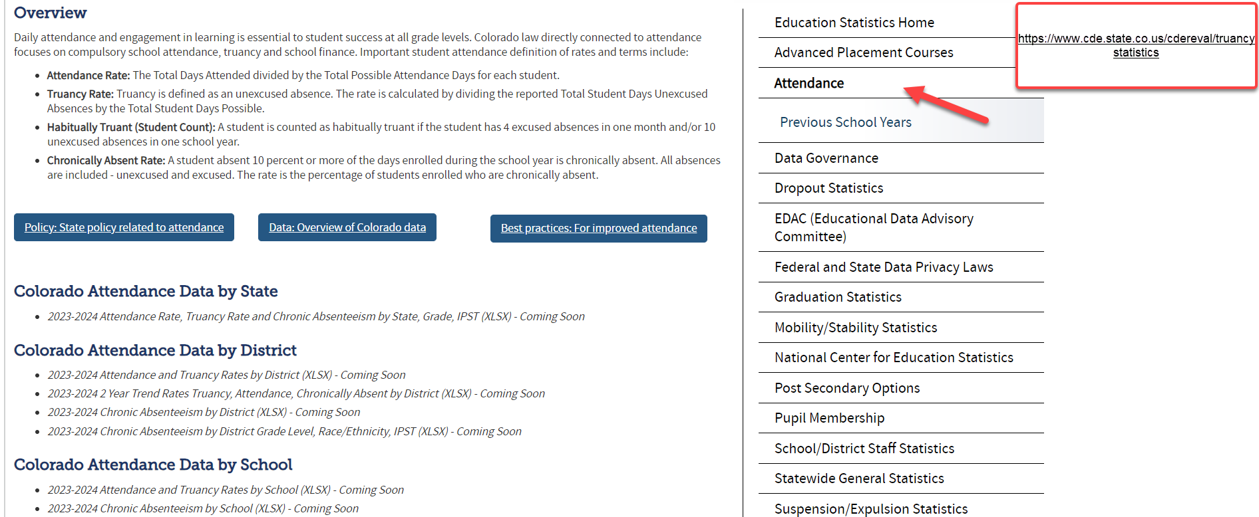
Attendance Data Release Info
August 22nd – Public Data Release
  Education statistics based upon this collection are publicly released and the embargo is lifted for this dataset (cannot send/use this data externally until embargo is lifted)
August 15th – Embargoed Data Will be Sent
  Will be sent:
    2 Year Trend Rates Truancy, Attendance, Chronically Absent by District
    Attendance Rate, Truancy Rate and Chronic Absenteeism by State, Grade, IPST
Attendance
Attendance@cde.state.co.us

Slide 29
Questions & Resources:
Attendance
Brooke Wenzel
Attendance@cde.state.co.us
720-441-7963
Attendance Webpage
Student Interchange Webpage

Slide 30
Student October
Brooke Wenzel

Slide 31
Student October Timeline – Regular Phase
Date | Event | Event Description
07/15/2024 | Open | Districts may begin uploading Student Interchange Files (Student Demographic and Student School Association).
08/23/2024 | Open | Districts may begin creating snapshots. Student October Snapshot dependencies are the Student Demographic File, Student School Association File, Title I File (if applicable) and At-Risk File.
08/28/2024 | Training Event | Data Pipeline Training 10-11 a.m.
09/05/2024 | Training Event | New Respondent Training 1-2 p.m.
09/10/2024 | Training Event | English Language Learner Training 11-12 p.m.
09/12/2024 | Training Event | Veteran Respondent Training 11-12 p.m.
09/16/2024 | Training Event | Postsecondary Program Coding Training 11-12 p.m.
09/24/2024 | Other Date | First day of Student October Count Window for districts with 5-day school week.
10/01/2024 | Other Date | Official Count Day 2024
10/02/2024 | Interim Deadline | Upload Student Demographic and Student School Association Files. Upload Title I Interchange File (if applicable). Upload At-Risk Interchange File.
10/08/2024 | Other Date | Last day of Student October Count Window for districts with 5-day school week.
10/09/2024 | Interim Deadline | Error free Student Interchange File uploads
10/14/2024 | Training Event | Mid-Collection Office Hours 10-11 a.m.
10/14/2024 | Interim Deadline | Create an initial Student October Snapshot
10/22/2024 | Interim Deadline | Error free Student October Snapshot
10/24/2024 | Training Event | Data Validation, Transfer Enrollment Exceptions and Cognos Reports 1-2 p.m.
10/28/2024 | Training Event | Data Pipeline Duplicate Process and Submission 9-10 a.m.
11/01/2024 | Report Review | Review Student October Cognos Reports for data validation. Submit Student October Snapshot data as soon as review is complete.
11/08/2024 12:00 p.m. | State Deadline | Submit Student October Snapshot data
Student October
StudentOctober@cde.state.co.us

Slide 32
Student October Timeline – Duplicate Process
Date | Event | Event Description
11/12/2024 12:00 p.m. | Deadline | Duplicate funding documentation due to School Auditing Office
11/18/2024 | Other Date | School Auditing makes decisions on funding duplicates
11/27/2024 | Deadline | Resubmit Student October Snapshot data to CDE based on decisions from School Auditing
12/06/2024 | Deadline | Collection closes Secretary of the Board of Education Verification (sign-off) form due. Data remains embargoed until the official release in January.
01/15/2025 | Data Release | Official data release
Student October
StudentOctober@cde.state.co.us

Slide 33
Student October Training Schedule
Data Pipeline Training
Date/Time: 08/28/2024, 10-11 a.m.
Click here to register for the teams meeting.
New Respondent Training
Date/Time: 09/05/2024, 1-2 p.m.
Click here to register for the teams meeting.
English Language Learner Training
Date/Time: 09/10/2024, 11-12 p.m.
Click here to register for the teams meeting.
Veteran Respondent Training
Date/Time: 09/12/2024 11-12 p.m.
Click here to register for the teams meeting.
Postsecondary Program Coding Training
Date/Time: 09/18/2024, 2-3 p.m.
Click here to register for the teams meeting.
Mid-Collection Office Hours
Date/Time: 10/14/2024 10-11 a.m.
Click here to register for the teams meeting.
Data Validation, Transfer Enrollment Exceptions and Cognos Reports Training
Date/Time: 10/23/2024 1-2 p.m.
Click here to register for the teams meeting.
Data Pipeline Duplicate Process and Submission Training
Date/Time: 10/28/2024 9-10 a.m.
Click here to register for the teams meeting.
Student October
StudentOctober@cde.state.co.us

Slide 34
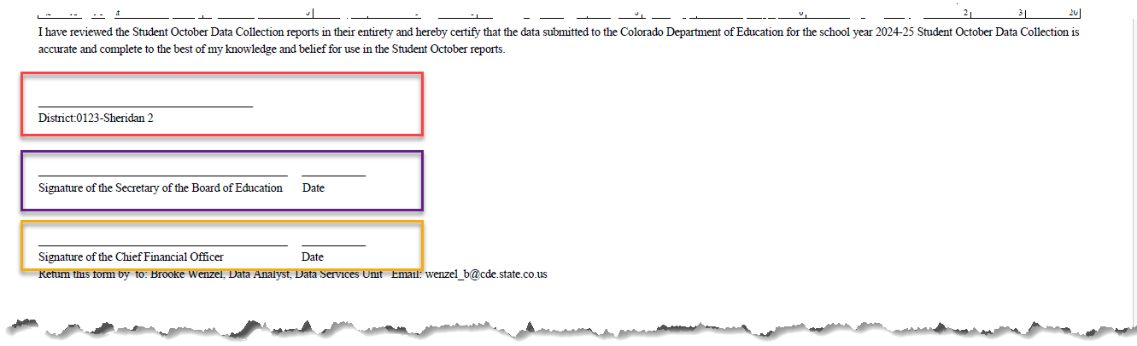
Signoff Form Updates
Red Box: Sometimes used for the data respondent’s signature or another signature not listed
Purple Box: Signature of the Secretary of the Board of Education
Yellow Box: Signature of the Chief Financial Officer (NEW)
Student October
StudentOctober@cde.state.co.us

Slide 35
Other New Things – More Information Coming Soon
New Cognos Reports
  Demographic Information Comparison Report by Student
  Census Block Data Totals
  Etc..
Independent Study Course, Work-Based Learning Opportunity Course, Blended Learning Course and Supplemental Online Course added in Snapshot and new Error Checks
Census Block Data added in Snapshot and error check
Additionally Matched Direct Certification Students (Cognos Report)
  Report will not run in Cognos since data is not populated
  Functionality will be available in mid-October
  More information to come in upcoming Auditing Training (mid-September) and upcoming Town Halls
Student October
StudentOctober@cde.state.co.us

Slide 36
Questions & Resources:
Brooke Wenzel
StudentOctober@cde.state.co.us
720-441-7963
Student October Webpage
Student Interchange Webpage

Slide 37
School Auditing Office Updates
Rebecca McRee

Slide 38
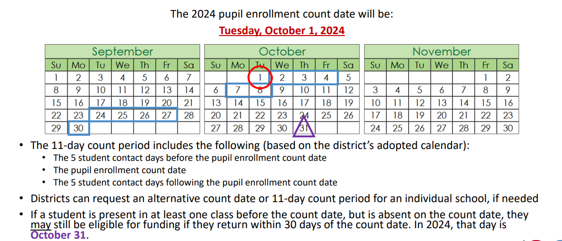
Student October Count Day 2024
School Auditing Office
Audit@cde.state.co.us

Slide 39
New: Annual Audit Review Process (Required)
Beginning with the 2024 Student October Count data collection, the School Auditing Office is changing its approach to the required compliance audits.
Annual Audit Review Process (Overview- PDF)
  Pupil Count Audit Questionnaire
  At-Risk Count Audit Questionnaire
  English Language Learner (ELL) Count Questionnaire
Audit District Contact Form
Initial audit documentation upload (as described on each questionnaire) will be due by December 11, 2024.
A training on the new process was held on 7/23/24. Visit the School Auditing Office's Training and Office Hours website to access the recording.
School Auditing Office
Audit@cde.state.co.us

Slide 40
Training and Office Hours
Upcoming Trainings:
At-Risk Count Audit Overview August 8, 2024 (1PM)
Transportation CDE-40 Overview FY23/24 August 15, 2024 (10AM)
English Language Learner Count Audit Overview September 17, 2024 (10AM)
Duplicate Count Office Hours November 5, 2024 (10AM)
School Auditing Office's Training and Office Hours website
School Auditing Office
Audit@cde.state.co.us

Slide 41
Audit Resource Guides
These Guides contain the funding and audit documentation requirements that districts and BOCES may be required to provide during the Annual Audit Review or subsequent expanded audits.
Student October (Pupil) Count Audit Resource Guide
At-Risk Count Audit Resource Guide
English Language Learner (ELL) Audit Resource Guide
School Auditing Office
Audit@cde.state.co.us

Slide 42
Questions & Answers:
School Auditing Office
Audit@cde.state.co.us
Pupil Count Website
At-Risk Count Website
English Language Learner Count Website
Training and Office Hours Website

Slide 43
At-Risk Interchange
Rebecca McRee

Slide 44
New: At-Risk Measure Interchange File -
Overview
Beginning with the 2024/2025 school year, there is a new Data Pipeline At-Risk Interchange.
The purpose of the At-Risk Interchange is to obtain student-level census block data needed to implement the new at-risk measure as described in HB22-1202 with data collection to begin with the 2024-2025 school year as provided for under SB24-188.
The new at-risk measure will be implemented starting with the 2025/2026 school year, and included in the Total Program funding calculation as described in the Public-School Finance Act which will continue to utilize student level data reported through the Student October Count data collection.
This interchange opened on July 15, 2024 and closes November 8, 2024. It will only be open during the Student October Count Collection.
At-Risk Interchange
ARMeasure@cde.state.co.us

Slide 45
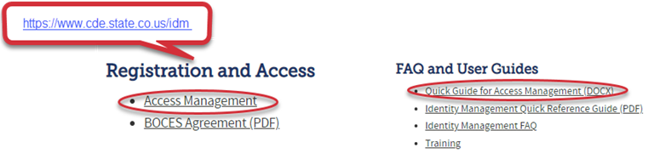
New: At-Risk Measure Interchange File -
Identity Management Role
Don’t have access?
Talk to your District’s Local Access Manager (LAM)!
Note: To receive communication about the at-risk interchange, you must have this role!
62% of LEAs have assigned a User to this Interchange File
Application | Collection | Role | Access Level
Pipeline | At Risk Measure (ARM) | LEA User | Upload and Edit Records for the At-Risk Measure File
Pipeline | At-Risk Measure (ARM) | LEA Viewer | View Cognos reports – cannot edit data
At-Risk Interchange
ARMeasure@cde.state.co.us

Slide 46
New: At-Risk Measure Interchange File - Syncplicity Folders
Syncplicity folders are being shared on a rolling basis with ARM LEAUSERS and LEAVEWIERS.
The folder naming convention is:
  District Code_ District Name_ ARMeasure Interchange
These folders will be used to share files containing PII between the district or BOCES and CDE when requesting assistance with the At-Risk Interchange or Census Geocoding tool.
If you have been assigned the user or view role for this interchange file and you do not receive notification that this file has been shared with you within 48 hours, email ARMeasure@cde.state.co.us.
At-Risk Interchange
ARMeasure@cde.state.co.us

Slide 47
New: Census Block Data
Required and valid census block data combinations include 4 data fields:
  State Code
  County Code*
  Track Code
  Block Code
To obtain this data, districts will need to first gather, clean and validate student address data.
Then districts will need to "geocode" each student's primary physical residential address to obtain this information.
  District's GIS system (such as ARC)
  Census Geocoder Tool
  Other (if your district has some other tool, please reach out to ARMeasure@cde.state.co.us)
At-Risk Interchange
ARMeasure@cde.state.co.us

Slide 48
New: At-Risk Measure Interchange File -
Resources
At-Risk Interchange Website
  File Layout
  Business Rules
  Interchange Upload Template (XLS)
  Instructions for Using the Geocode Tool
  Valid Census Block Data Combinations (XLS)
At-Risk Interchange
ARMeasure@cde.state.co.us

Slide 49
New: At-Risk Measure Interchange File-
Trainings
Scheduled Trainings:
  Overview of the Geocode Tool July 24, 2024
    The recording for this training is posted to the AR Interchange website.
  Overview of the Geocode Tool August 13, 2024 (10AM)
  Overview of the Data Pipeline At-Risk Interchange File August 20, 2024 (1PM)
To access these trainings, click on the link found in the green box located on the At-Risk Interchange website. The link will be activated approximately 15 minutes prior to the start of the training.
For questions, contact ARMeasure@cde.state.co.us
At-Risk Interchange
ARMeasure@cde.state.co.us

Slide 50
New: At-Risk Measure Interchange File -
Timeline
Date | Event | Event Description
7/15/2024 | Open | Districts may begin to upload the At-Risk Interchange file to the data pipeline.
8/23/2024 | Open | Districts may begin creating Student October Snapshots. This Snapshot is dependent on the Student Demographic File, Student School Association File, Title 1 File (if applicable) and the At-Risk File.
8/13/2024 | Training Event | Overview of the Census Geocoder Tool (10-11am)
8/20/2024 | Training Event | Overview of the At-Risk Interchange File (1-2pm)
9/13/2024 | Other Date | Gather, review, clean-up and validate student addresses
9/27/2024 | Other Date | Obtain census block data for all student addresses
10/2/2024 | Interim Deadline | Upload the At-Risk Interchange File
10/9/2024 | Interim Deadline | Obtain error-free At-Risk Interchange File upload
10/22/2024 | Interim Deadline | Obtain error-free Student October Snapshot
11/1/2024 | Report Review | Review Student October Cognos Reports for data validation. Submit Student October Snapshot data as soon as review is complete
11/8/2024 | State Deadline | Submit Student October Snapshot data
At-Risk Interchange
ARMeasure@cde.state.co.us

Slide 51
Questions & Answers:
ARMeasure@cde.state.co.us
Data Pipeline At-Risk Interchange website

Slide 52
READ Training
Tara Rhodes

Slide 53
READ Training Collection
Purpose and Timeline
Purpose:
Districts must annually ensure and report that the following groups have successfully completed evidence-based training in teaching reading:
all kindergarten through third grade (K-3) teachers who provide literacy instruction to students
all teachers who provide reading intervention in grades 4-12 (NEW!)
all kindergarten through third grade (K-3) principals and administrators (NEW!)
and/or personnel who the district determines meet the statute criteria as needing to complete the kindergarten through third grade Principal/Administrator training. (NEW!)
Important Dates:
August 1: Collection is open
August 15: Teachers, principals, and administrators should have their respective READ training designations added to their COOL accounts
August 30: Collection scheduled to close
READ Training Collection
READActData@cde.state.co.us

Slide 54
READ Training Collection
Changes for 2024-25 Collection Year
Changes for the 24-25 Collection Year
Two columns and associated codes were added to the file layout to capture the administrator information. The updated file layout can be viewed here.
New business rules were added for the administrator training columns, which mimic the teacher training business rules: TR035, TR036, TR037, TR038, TR039, TR040, TR041, TR042, TR043. These will be found here.
READ Training Collection
READActData@cde.state.co.us

Slide 55
READ Training Collection
General Process for Collection Completion
General Process for Collection Completion:
This collection starts with an export out of Data Pipeline of a list of educators who may be required to take either the teacher or administrator training.
  This is based on certain job class codes from the previous year's Human Resources collection.
Districts can then add, edit, or remove educators as it relates to this export based on their job function and whether the district has determined if the educator needs to take the training.
After this is complete, districts then upload this file back into Data Pipeline, check for errors, and officially submit.
READ Training Collection
READActData@cde.state.co.us

Slide 56
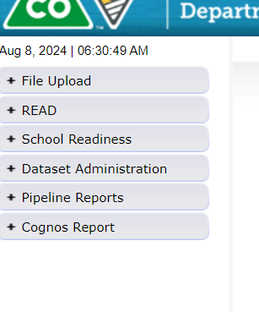
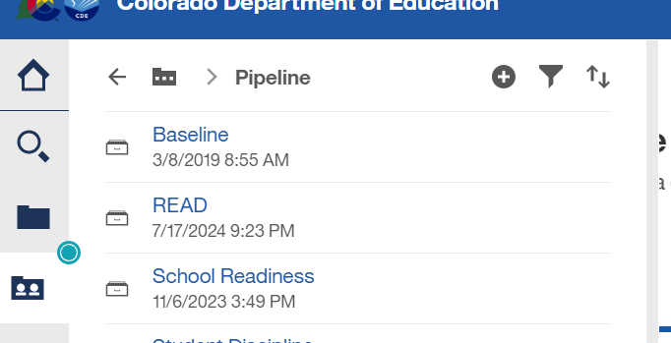



READ Training Collection
How to Pull the Export Report
Log into Data Pipeline.
Find the "Cognos Report" button at the bottom of the gray menu options along the left-hand side.
This will open up Cognos > Select the dark folder icon > "READ"
READ Training Collection
READActData@cde.state.co.us

Slide 57
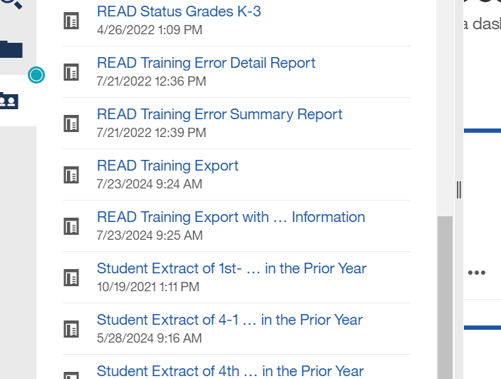

READ Training Collection
How to Pull the Export Report (continued)
4. Then select the READ Training Export Report. It's towards the bottom of the listing of reports.
This report pulls all staff who have certain job class codes from the previous year's HR collection that was in your district.
READ Training Collection
READActData@cde.state.co.us

Slide 58
READ Training Collection
Modifications to the READ Training Export Report
Add:
  Any new staff hired after June 1st of the current year who are required to take the training
  Any staff who may have changed into a position that requires the training (ex., 5th grade teacher > 3rd grade)
  Any 4-12 reading interventionists and other staff who are required to take the READ teacher training.
  Any permanent substitutes, special educators, non-licensed staff, and/or additional staff who are required to take the teacher training as determined by the function of their positions.
  K-3 administrators, principals, and others required to take the Principal/Admin training as determined by licenses and the function of their position(s).
  Any staff required who took the READ Principal/Admin training, regardless of their license.
Remove:
  Any individuals who appeared on the export who are not required to take either training based on their position and statute definition.
  Any teachers who are currently no longer working for your district.
READ Training Collection
READActData@cde.state.co.us

Slide 59
READ Training Collection
Office Hours and Resources
Office Hours:
All office hours are occurring on Thursdays at 3:30pm.
Thursday, 6/27 - Slides have been posted here.
Thursday, 7/11 - Recording has been posted here.
Thursday, 7/25 - Recording has been posted here.
Thursday, 8/8 - Link to register here. Focus: Coding patterns for reporting individuals.
Resources:
24-25 File Layout
READ Training Website
Data Collection Guide – Updated for 2024-25
READ Training Collection
READActData@cde.state.co.us

Slide 60
Questions & Resources:
READ Training
Tara Rhodes
Email: READActData@cde.state.co.us
Phone: 720.601.4125
READ Training Website

Slide 61

Thank you for joining today!
Next Town Hall will be August 15th
Helpful resources to bookmark:
Identity Management Website
Data Pipeline Website

