Slide 1
August 1, 2024
Data Pipeline Town Hall
The goal of the webinar is to provide updates on the Data Pipeline, current, and upcoming data collections. These webinars also provide a forum for districts, BOCES, and Administrative Units to have questions answered about Data Pipeline.

Slide 2
Colorado Department of Education
Identity Management (IdM)
Identity Management Site
Frequently Asked Questions
How do I add myself or others to the email listserv for town hall emails and/or a specific collection?
  Email lists are dependent on a person’s access rights in IdM. Contact your LAM to get an account or be assigned to a specific collection.
Where can I find the IdM role mappings for Data Pipeline and other applications?
  Role Mapping (XLS)
I am a LAM. How do I update the user permissions for someone in my district?
  Follow the steps outlined in the IdM Quick Guide for Access Management (DOCX)
Important: Users are not automatically removed from IdM when their email address is no longer active in your district. The LAM must deactivate their IdM account to ensure only designated staff can access CDE’s data reporting system.
Notes:
LAMs, please check the IdM roles for your district. Remove permissions for users who have retired, left your district, or are no longer assigned to a collection. Add roles for new hires and newly assigned respondents for specific collections.

Slide 3

What is PII?
Student Personally Identifiable Information (PII) is defined by state and federal laws as information that, alone or in combination, personally identifies an individual
  This includes direct identifiers
  (i.e. student and staff names, SASID, EDID, etc.)
  Includes information that when combined is identifiable
Colorado’s Student Data Transparency and Security Act outlines requirements for how Student PII is collected, used and shared
See the Data Privacy and Security website for prepared guidance on how to comply with this and other privacy laws.

Slide 4

Sharing Data
Use secure methods to transfer any PII to CDE
  Contact Data Collection leads with questions about how to transmit PII securely
    Each Data Collection leads maintains their own Syncplicity folders for specific collections, reach out to the collection lead for access
  Use Syncplicity to encrypt emails to CDE
Avoid sending PII via unencrypted email or to unsecured faxes when sharing data between or within districts
  Use Syncplicity to encrypt emails to CDE
Check local policies for restrictions, requirements, etc. regarding PII
  Do not use PII in trainings, presentations, etc.
  Do not share PII with unauthorized individuals
  Do not share passwords
  Follow local policies when transmitting PII to any third party

Slide 5
Today’s Agenda
Agenda Topic | Presenter
Open Data Collections and Upcoming Deadlines in Data Pipeline
Protecting Student Privacy | Annette Severson
Teacher Student Data Link | Peter Hoffman
Student End of Year | Reagan Ward
Student Discipline | Dawna Gudka
School Auditing Office Updates | Rebecca McRee
At-Risk Interchange Updates | Rebecca McRee
READ Staff Training | Tara Rhodes

Slide 6
Open Collections and
Upcoming Deadlines in
Data Pipeline

Slide 7
Open Collections and Upcoming Dates:
Year-Round & Interchanges
Name | Category | Status | Key Dates
RITS | Year Round | Open
EDIS | Year Round | Open
Directory | Year Round | Open | District Calendars Due 9/2/2024
Student | Interchange | Open | 2023-2024 and 2024-2025 are open
At-Risk | Interchange | Open
Title I | Interchange | Open
Special Education IEP | Interchange | Open
Staff | Interchange | Open
TSDL | Interchange | Open
Discipline | Interchange | Open
Data Pipeline Resources: Data Pipeline Collection Dates (XLS)

Slide 8
Open Collections and Upcoming Dates:
Snapshots
Name | Category | Status | Final Deadline Date | Next Milestone | Looking Ahead
TSDL | Snapshot | Open | Aug. 30, 2024 | Interim Deadline: 8/23/2024 Snapshot Completed | 8/23/2024 – 8/30/2024 Review TSDL data before final submission deadline
Staff Evaluation | Snapshot | Open | Oct. 15, 2024 | Interim Deadline: 8/7/2024 Error free snapshot | Interim Deadline: 8/7-9/30 Report Review
Student Discipline | Snapshot | Open | July 31, 2024 | State Deadline: 7/31/2024
Attendance | Snapshot | Closed | July 26, 2024 | Data Release: 8/22/2024 | Data is embargoed until 8/22/2024
Student End of Year | Snapshot | Open | Nov. 19, 2024 | Interim Deadline: 8/8/2024 Error free SEY snapshot | Training Event: 8/14/2024 2:30-3:30pm August SEY Office Hours
Special Education Discipline | Snapshot | Open | Aug. 29, 2024 | Student Discipline Snapshot is due 7/31/2024 | Resolve all errors and ask Sped Director to review signature reports prior to 7/31/24
Special Education End of Year | Snapshot | Open | Sept. 27, 2024 | Interim Deadline: 8/29/2024 All exception requests due | Interim Deadline: 9/05/2024 All errors resolved
Data Pipeline Resources: Data Pipeline Collection Dates (XLS)

Slide 9
Open Collections and Upcoming Dates: Periodic
Name | Category | Status | Final Deadline Date | Looking Ahead
READ Training | Periodic | Open | Aug. 30, 2024
Designated Agency | Periodic | Open | Aug. 30, 2024
S-EBT (corrections period) | Periodic | Open | Aug. 30, 2024
Data Pipeline Resources: Data Pipeline Collection Dates (XLS)

Slide 10
Data Pipeline Maintenance
Data Pipeline, RITS and EDIS
will be unavailable Tuesday, Aug 13th at 5pm
until the morning of Wednesday, August 14th
for general maintenance
Thank you for your patience during this time!

Slide 11
Protecting Student Privacy
Resources

Slide 12
Trainings in August
The US Dept of Education Student Privacy Policy Office is hosting a 3-day National Summer Webinar Series:
  Day 1: FERPA 101 and Data Security Best Practices
    August 14, 2024, 12-2pm MT
    covers the basics of FERPA and provides training on current data security best practices for education data systems.
  Day 2: FERPA 201 and Transparency
    August 21, 2024, 12-2pm MT
    dives into scenarios faced by schools and districts and highlights PTAC’s research on transparency.
  Day 3: Incident Response and Vetting Educational Technology
    August 28, 2024, 12-2pm MT
    leads participants through a simulated data breach and explores how to assess online educational technology for privacy protections and general FERPA compliance.
Student Privacy Policy Office
https://studentprivacy.ed.gov/

Slide 13
Other Resources
Training links and other resources available on the Protecting Student Privacy website; such as:
  A Parent Guide to FERPA
  An Eligible Student Guide to FERPA
  PPRA General Guidance
  Frequently Asked Questions on Photos and Videos
  FERPA and PPRA Regulations
  Top 10 Cybersecurity Tips for Teachers
Student Privacy Policy Office
https://studentprivacy.ed.gov/

Slide 14
Teacher Student Data Link
(TSDL)
Peter Hoffman

Slide 15
Teacher Student Data Link Timeline
Date | Event | Event Description
Friday August 23, 2024 | Interim Deadline | TARGET: Date by which you should have a complete Teacher Student Data Link Snapshot. Complete Teacher Student Data Link Snapshot means: ◻ All TSDL interchange errors are resolved ◻ All TSDL snapshot errors are resolved If you anticipate that you will not be able to meet this deadline, please contact CDE at TeacherStudentDataLink@cde.state.co.us
Monday August 26, 2024 – Thursday August 29, 2024 | Report Review | Final Snapshot Report Review – This is your opportunity to review reports in detail and make any data corrections you deem necessary to make sure you are reporting valid and reliable data. All data corrections must be completed during this time.
Friday August 30, 2024 | Deadline | Required to have TSDL snapshot error free and finalized before or on this date. TSDL closed and final report is signed and provided to CDE via email TeacherStudentDataLink@cde.state.co.us
Teacher Student Data Link
TeacherStudentDataLink@cde.state.co.us

Slide 16
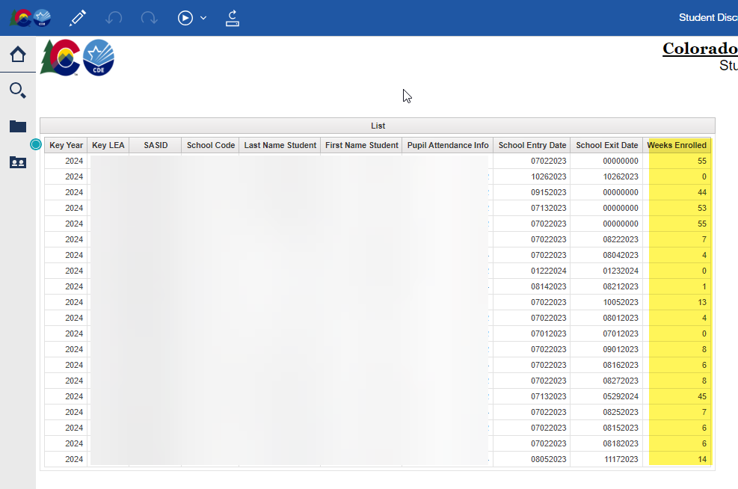
Teacher Student Data Link
COGNOS/CEDAR Reports:
  Student Discrepancy Report is all students reported in the Student Interchange that were not included in the TSDL Snapshot. Verify if the omission is correct using the weeks enrolled field.
If you are getting TD110, TD111, TD112 or TD113 snapshot errors, and it is accurate that a class of that course code should not be appearing at that school, please reach out for an exception.
Teacher Student Data Link
TeacherStudentDataLink@cde.state.co.us

Slide 17
Questions & Resources:
TSDL
Peter Hoffman
720-925-8611
TeacherStudentDataLink@cde.state.co.us
TSDL Interchange Webpage

Slide 18
Student End of Year
Reagan Ward

Slide 19
SEY Collection Timeline:
Upcoming Events
Date | Event | Event Description
8/8/2024 | Interim Deadline | Error free SEY Snapshot
8/14/2024 2:30-3:30pm | Training Event | August SEY Office Hours: Reviewing Reports and Data Validation Registration Link
8/9/2024 to 9/5/2024 | Report Review | • Validate Student End of Year data using CEDAR/COGNOS reports. • Submit snapshot as soon as review is complete
9/5/2024 | State Deadline | Submit Student End of Year snapshot
9/19/2024 | Cross LEA Open | Districts may begin creating snapshots as soon as they receive a ‘snapshot unlocked’ notification from data pipeline; typically mid-day.
10/17/2024 | Deadline | Resubmit SEY snapshot
10/24/2024 | Post-Cross LEA Open | Districts may begin updating their snapshot to address Post-Cross LEA business rules.
11/19/2024 | Deadline | Post-Cross phase ends. Districts must have error free SEY snapshot and have addressed any necessary post-cross changes.
12/3/2024 | Deadline | Collection closes. • Superintendent Verification (sign-off) form due. • Data remains embargoed until the official release in January
Visit the SEY Website to download the complete SEY Collection Timeline with Training Dates
Student End of Year – Reagan Ward
StudentEndOfYear@cde.state.co.us

Slide 20
File Status as of 7am on 8/1
Snapshot Status
Notes
LEAs without data are encouraged to begin working on this collection and can expect frequent communication from the SEY Collection Lead
LEAs with more than 100 errors are encouraged to set aside time to focus on this collection over the next week
LEAs who are error free and have reviewed their initial SEY data may submit their snapshot when ready.
LEAs with potential summer graduates/completers are encouraged to wait until August to submit their snapshot after they’ve updated any school exit types for grad/completers.
Student End of Year – Reagan Ward
StudentEndOfYear@cde.state.co.us

Slide 21
Report Review Window
8/9/2024 to 9/5/2024
August SEY Office Hours
CEDAR/COGNOS Report Highlight
Focused on reviewing reports and validating data
  Student Lists for individual data validation
  Initial Graduation/Completion, Dropout, Mobility/Stability Rates
Important Note: All initial SEY data is embargoed and is subject to change as we work through the Cross LEA and Post-Cross LEA phases
Student List: Dropouts
Student List: AYG Cohort
Student List: District and School Mobility
Graduation: 3-, 4-, 5-, 6-, 7-year rates by School Year
Dropout: District and School Rates
Mobility: District and School Rates
Student End of Year – Reagan Ward
StudentEndOfYear@cde.state.co.us

Slide 22
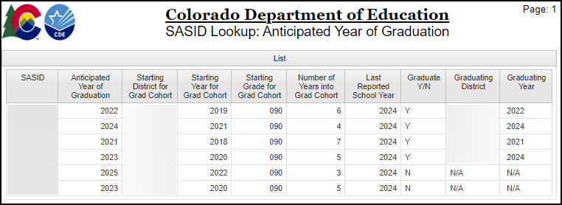
CEDAR/COGNOS Report Highlight
SASID Lookup: Anticipated Year of Graduation
Report Purpose: Verify a student’s Anticipated Year of Graduation
  Reminder: AYG is set based on the student’s first entry into a Colorado Public High School per SEY reporting. See the SEY website for AYG documentation.
Common Use: Verify AYG for students with Retention 2, retained for postsecondary program, because students must meet AYG requirements for postsecondary program.
Update: Added fields
  Graduate Y/N
  Graduating District
  Graduating Year
Update Reason: Support transfer student coding for students participating in SPED 18-21 Transition Services
2024-2025 PS Program | AYG expectation
ASCENT | 2024 (5th year)
PTECH Years 5-6 | 2023 (6th year) or 2024 (5th year)
TREP | 2023 (6th year) or 2024 (5th year)
Student End of Year – Reagan Ward
StudentEndOfYear@cde.state.co.us

Slide 23
Questions & Answers:
Student End of Year
StudentEndOfYear@cde.state.co.us
720-484-9057
Student End of Year Website
Student Interchange Website
Graduation Guidelines Website

Slide 24
Student Discipline
Dawna Gudka

Slide 25

Snapshot Status as of 8/1 8AM
Submitted
Student Discipline Snapshot lead – Dawna Gudka
Student Discipline Snapshot

Slide 26
Student Discipline Snapshot Data Published Timeline
Date | Event | Event Description
7/31/2024 | State Deadline | Collection Deadline
8/9/2024 | State Deadline | Signature page due
8/20/2024 | Embargoed Data | Embargoed Data Released to LEA’s What this means: Data Respondents will get the published reports via email. This data can not be shared out until it has been published on our website.
8/23/2024 | Data Release | Data Published on CDE website
9/3/2024 | Data Release | Data Profile Reports will be Published
Student Discipline Snapshot-Dawna Gudka
StudentDiscipline@cde.state.co.us

Slide 27
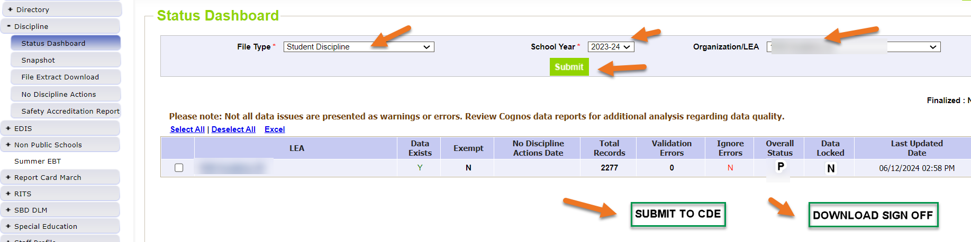
Student Discipline Snapshot Verification forms must be emailed to:
Student Discipline@cde.state.co.us
Student Discipline Snapshot-Dawna Gudka
StudentDiscipline@cde.state.co.us

Slide 28
Questions & Answers:
Student Discipline Snapshot
Discipline Interchange website
Student Discipline Training recording
Student Discipline Snapshot website
Dawna Gudka
(303) 598-7901

Slide 29
School Auditing Office Updates
Rebecca McRee

Slide 30
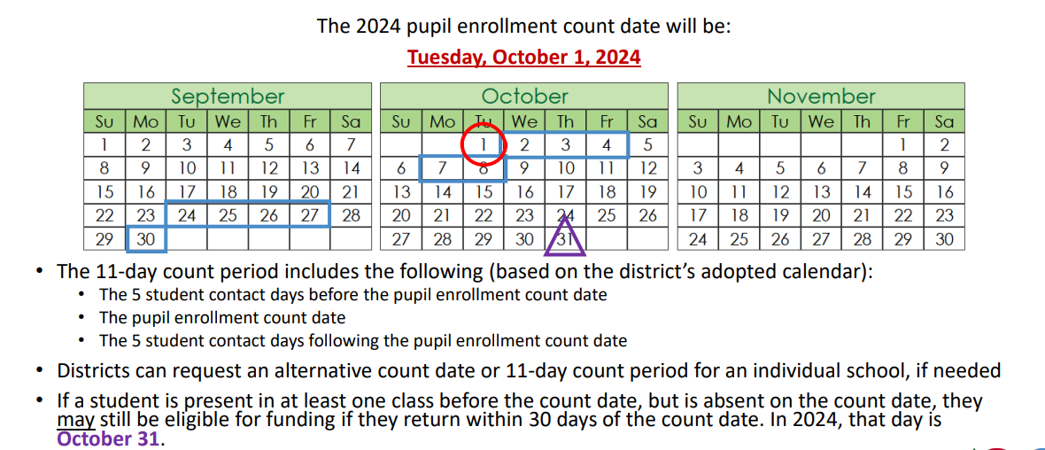
Student October Count Day 2024
School Auditing Office
Audit@cde.state.co.us

Slide 31
New: Annual Audit Review Process (Required)
Beginning with the 2024 Student October Count data collection, the School Auditing Office is changing its approach to the required compliance audits.
Annual Audit Review Process (Overview- PDF)
  Pupil Count Audit Questionnaire
  At-Risk Count Audit Questionnaire
  English Language Learner (ELL) Count Questionnaire
Audit District Contact Form
Initial audit documentation upload (as described on each questionnaire) will be due by December 11, 2024.
A training on the new process was held on 7/23/24. Visit the School Auditing Office's Training and Office Hours website to access the recording.
School Auditing Office
Audit@cde.state.co.us

Slide 32
Training and Office Hours
Upcoming Trainings:
Student October: Intro to the Audit Resource Guide (2 hrs.) August 1, 2024 (1PM)
At-Risk Count Audit Overview August 8, 2024 (1PM)
Transportation CDE-40 Overview FY23/24 August 15, 2024 (10AM)
English Language Learner Count Audit Overview September 17, 2024 (10AM)
Duplicate Count Office Hours November 5, 2024 (10AM)
School Auditing Office's Training and Office Hours website
School Auditing Office
Audit@cde.state.co.us

Slide 33
Audit Resource Guides
These guides contain the funding and audit documentation requirements that districts and BOCES may be required to provide during the Annual Audit Review or subsequent expanded audits.
Student October (Pupil) Count Audit Resource Guide
At-Risk Count Audit Resource Guide
English Language Learner (ELL) Audit Resource Guide
  Will be posted on August 2, 2024 on the ELL Count website
School Auditing Office
Audit@cde.state.co.us

Slide 34
Questions & Answers:
School Auditing Office
Audit@cde.state.co.us
Pupil Count Website
At-Risk Count Website
English Language Learner Count Website
Training and Office Hours Website

Slide 35
At-Risk Interchange
Rebecca McRee

Slide 36
New: At-Risk Measure Interchange File -
Overview
Beginning with the 2024/2025 school year, there is a new Data Pipeline At-Risk Interchange.
The purpose of the At-Risk Interchange is to obtain student level census block information needed to implement the new at-risk measure as described in HB22-1202 with data collection to begin with the 2024-2025 school year as provided for under SB24-188.
The new at-risk measure will be implemented starting with the 2025/2026 school year, and included in the Total Program funding calculation as described in the Public-School Finance Act which will continue to utilize student level data reported through the Student October Count data collection
This interchange opened on July 15, 2024 and closes November 8, 2024. It will only be open during the Student October Count Collection.
  Instructions for Using the Census Geocoder Tool (PDF)- Posted 7/15/24
  Valid Census Block Data Combinations (Excel)- Posted 7/15/24
At-Risk Interchange
ARMeasure@cde.state.co.us

Slide 37
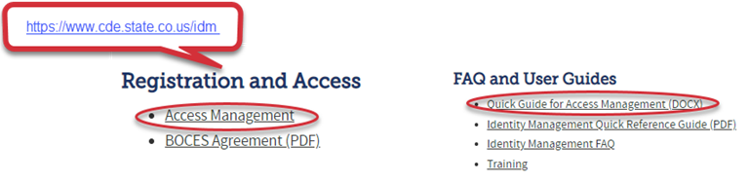
New: At-Risk Measure Interchange File -
Identity Management Role
Don’t have access?
Talk to your District’s Local Access Manager (LAM)!
Note: To receive communication about the at-risk interchange, you must have this role!
Application | Collection | Role | Access Level
Pipeline | At Risk Measure (ARM) | LEA User | Upload and Edit Records for the At-Risk Measure File
Pipeline | At-Risk Measure (ARM) | LEA Viewer | View Cognos reports – cannot edit data
At-Risk Interchange
ARMeasure@cde.state.co.us

Slide 38
New: At-Risk Measure Interchange File - Syncplicity Folders
Starting the week of July 29th, ARMeasure will begin sharing Syncplicity folders with ARMeasure users and viewers.
The folder naming convention will be:
  District Code_ District Name_ ARM Interchange File
These folders will be available as a way to share files containing PII between the district or BOCES and CDE when requesting assistance with the At-Risk Interchange or Census Geocoding tool.
At-Risk Interchange
ARMeasure@cde.state.co.us

Slide 39
New: At-Risk Measure Interchange File-
Trainings
Scheduled Trainings:
  Overview of the Geocode Tool July 24, 2024
    The recording for this training is posted to the AR Interchange website.
  Overview of the Geocode Tool August 13, 2024 (10AM)
  Overview of the Data Pipeline At-Risk Interchange File August 20, 2024 (1PM)
To access these trainings, click on the link found in the green box located on the At-Risk Interchange website. The link will be activated approximately 15 minutes prior to the start of the training.
For questions, contact ARMeasure@cde.state.co.us
At-Risk Interchange
ARMeasure@cde.state.co.us

Slide 40
Questions & Answers:
ARMeasure@cde.state.co.us
Data Pipeline At-Risk Interchange website

Slide 41
READ Training
Tara Rhodes

Slide 42
READ Training Collection
Purpose and Timeline
Purpose:
Districts must annually ensure and report that all kindergarten through third grade teachers who provide literacy instruction to students in kindergarten through third grade and all teachers who provide reading intervention in grades 4-12 have successfully completed evidence-based training in teaching reading.
Districts must also report kindergarten through third grade principals and administrators and/or personnel who the district determines meet the statute criteria as needing to complete the kindergarten through third grade Principal/Administrator training.
Important Dates:
August 1: Collection scheduled to open
August 15: Teachers, principals, and administrators should have their respective READ training designations added to their COOL accounts
August 30: Collection scheduled to close
READ Training Collection
READActData@cde.state.co.us

Slide 43
READ Training Collection
Changes for 2024-25 Collection Year
This is the first year that districts are required to report completion of the READ administrator training for staff as well as the READ teacher training for Grades 4 through 12 staff.
Due to the addition of administrators to this collection, two columns were added to the file layout to capture the administrator information. The updated file layout can be viewed here.
The codes and business rules for the administrator training fields mimic the teacher training status codes and business rules.
READ Training Collection
READActData@cde.state.co.us

Slide 44
READ Training Collection
General Process for Collection Completion
General Process for Collection Completion:
This collection starts with an export out of Data Pipeline of a list of educators who may be required to take either the teacher or administrator training.
  This is based on certain job class codes from the previous year's Human Resources collection.
Districts can then add, edit, or remove educators as it relates to this export based on their job function and whether the district has determined if the educator needs to take the training.
After this is complete, districts then upload this file back into Data Pipeline, check for errors, and officially submit.
READ Training Collection
READActData@cde.state.co.us

Slide 45
READ Training Collection
Office Hours and Resources
Office Hours:
All office hours are occurring on Thursdays at 3:30pm.
Thursday, 6/27 - Slides have been posted here.
Thursday, 7/11 - Recording has been posted here.
Thursday, 7/25 - Recording has been posted here.
Thursday, 8/8 - Link to register here. Focus: Coding patterns for reporting individuals.
Resources:
24-25 File Layout
READ Training Website
Data Collection Guide – Updated for 2024-25
READ Training Collection
READActData@cde.state.co.us

Slide 46
Questions & Resources:
READ Training
Tara Rhodes
Email: READActData@cde.state.co.us
Phone: 720.601.4125
READ Training Website

Slide 47

Thank you for joining today!
Next Town Hall will be August 8th
Helpful resources to bookmark:
Identity Management Website
Data Pipeline Website

