Slide 1
July 25, 2024
Data Pipeline Town Hall
The goal of the webinar is to provide updates on the Data Pipeline, current, and upcoming data collections. These webinars also provide a forum for districts, BOCES, and Administrative Units to have questions answered about Data Pipeline.

Slide 2
Colorado Department of Education
Identity Management (IdM)
Identity Management Site
Frequently Asked Questions
How do I add myself or others to the email listserv for town hall emails and/or a specific collection?
  Email lists are dependent on a person’s access rights in IdM. Contact your LAM to get an account or be assigned to a specific collection.
Where can I find the IdM role mappings for Data Pipeline and other applications?
  Role Mapping (XLS)
I am a LAM. How do I update the user permissions for someone in my district?
  Follow the steps outlined in the IdM Quick Guide for Access Management (DOCX)
Important: Users are not automatically removed from IdM when their email address is no longer active in your district. The LAM must deactivate their IdM account to ensure only designated staff can access CDE’s data reporting system.
Notes:
LAMs, please check the IdM roles for your district. Remove permissions for users who have retired, left your district, or are no longer assigned to a collection. Add roles for new hires and newly assigned respondents for specific collections.

Slide 3

What is PII?
Student Personally Identifiable Information (PII) is defined by state and federal laws as information that, alone or in combination, personally identifies an individual
  This includes direct identifiers
  (i.e. student and staff names, SASID, EDID, etc.)
  Includes information that when combined is identifiable
Colorado’s Student Data Transparency and Security Act outlines requirements for how Student PII is collected, used and shared
See the Data Privacy and Security website for prepared guidance on how to comply with this and other privacy laws.

Slide 4

Sharing Data
Use secure methods to transfer any PII to CDE
  Contact Data Collection leads with questions about how to transmit PII securely
    Each Data Collection leads maintains their own Syncplicity folders for specific collections, reach out to the collection lead for access
  Use Syncplicity to encrypt emails to CDE
Avoid sending PII via unencrypted email or to unsecured faxes when sharing data between or within districts
  Use Syncplicity to encrypt emails to CDE
Check local policies for restrictions, requirements, etc. regarding PII
  Do not use PII in trainings, presentations, etc.
  Do not share PII with unauthorized individuals
  Do not share passwords
  Follow local policies when transmitting PII to any third party

Slide 5
Today’s Agenda
Agenda Topic | Presenter
Open Data Collections and Upcoming Deadlines in Data Pipeline
Teacher Student Data Link | Peter Hoffman
Student Discipline | Dawna Gudka
Special Education Discipline | Lindsey Heitman
Special Education End of Year | Lindsey Heitman
School Auditing Office Updates | Rebecca McRee
READ Training | Tara Rhodes

Slide 6
Open Collections and
Upcoming Deadlines in
Data Pipeline

Slide 7
Open Collections and Upcoming Dates:
Year-Round & Interchanges
Name | Category | Status | Key Dates
RITS | Year Round | Open
EDIS | Year Round | Open
Directory | Year Round | Open | District Calendars Due 9/2/2024
Student | Interchange | Open | 2023-2024 and 2024-2025 are open
At-Risk | Interchange | Open
Title I | Interchange | Open
Special Education IEP | Interchange | Open
Staff | Interchange | Open
TSDL | Interchange | Open
Discipline | Interchange | Open
Data Pipeline Resources: Data Pipeline Collection Dates (XLS)

Slide 8
Open Collections and Upcoming Dates:
Snapshots
Name | Category | Status | Final Deadline Date | Next Milestone | Looking Ahead
TSDL | Snapshot | Open | Aug. 30, 2024 | Interim Deadline: 8/23/2024 Snapshot Completed | 8/23/2024 – 8/30/2024 Review TSDL data before final submission deadline
Attendance | Snapshot | Closed | July 12, 2024 | Deadline: 7/26/2024 Signoff Forms Due
Staff Evaluation | Snapshot | Open | Oct. 15, 2024 | Interim Deadline:8/7/2024 Error free snapshot | Interim Deadline: 8/7-9/30 Report Review
Student Discipline | Snapshot | Open | July 31, 2024 | Report Review: 7/8-7/26 Interchange & Snapshot error free | State Deadline: 7/31/2024
Student End of Year | Snapshot | Open | Nov. 19, 2024 | Interim Deadline: 7/25/2024 Submit exception requests | Interim Deadline: 8/8/2024 Error free SEY snapshot
Special Education Discipline | Snapshot | Open | Aug. 29, 2024 | Student Discipline Snapshot is due 7/31/2024 | Resolve all errors and ask Sped Director to review signature reports prior to 7/31/24
Special Education End of Year | Snapshot | Open | Sept. 27, 2024 | Interim Deadline: 8/29/2024 All exception requests due | Interim Deadline: 9/05/2024 All errors resolved
Data Pipeline Resources: Data Pipeline Collection Dates (XLS)

Slide 9
Open Collections and Upcoming Dates: Periodic
Name | Category | Status | Final Deadline Date | Looking Ahead
READ Training | Periodic | Coming Soon | Aug. 30, 2024 | Aug. 1, 2024 Collection Opens
Designated Agency | Periodic | Open | Aug. 30, 2024
S-EBT (corrections period) | Periodic | Open | Aug. 30, 2024
Data Pipeline Resources: Data Pipeline Collection Dates (XLS)

Slide 10
Teacher Student Data Link
(TSDL)
Peter Hoffman

Slide 11
Teacher Student Data Link Timeline
Date | Event | Event Description
Friday August 23, 2024 | Interim Deadline | TARGET: Date by which you should have a complete Teacher Student Data Link Snapshot. Complete Teacher Student Data Link Snapshot means: ◻ All TSDL interchange errors are resolved ◻ All TSDL snapshot errors are resolved If you anticipate that you will not be able to meet this deadline, please contact CDE at TeacherStudentDataLink@cde.state.co.us
Monday August 26, 2024 – Thursday August 29, 2024 | Report Review | Final Snapshot Report Review – This is your opportunity to review reports in detail and make any data corrections you deem necessary to make sure you are reporting valid and reliable data. All data corrections must be completed during this time.
Friday August 30, 2024 | Deadline | Required to have TSDL snapshot error free and finalized before or on this date. TSDL closed and final report is signed and provided to CDE via email TeacherStudentDataLink@cde.state.co.us
Teacher Student Data Link
TeacherStudentDataLink@cde.state.co.us

Slide 12
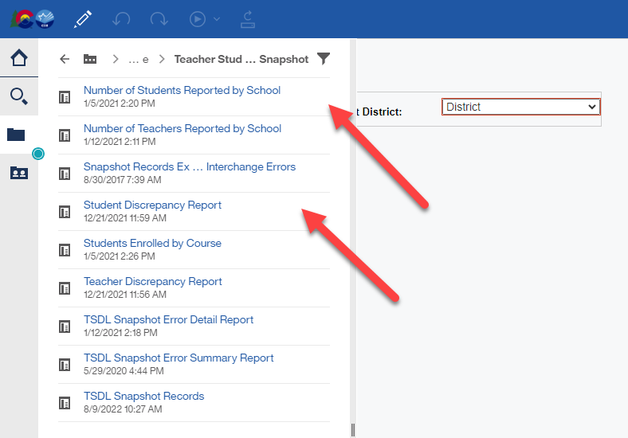
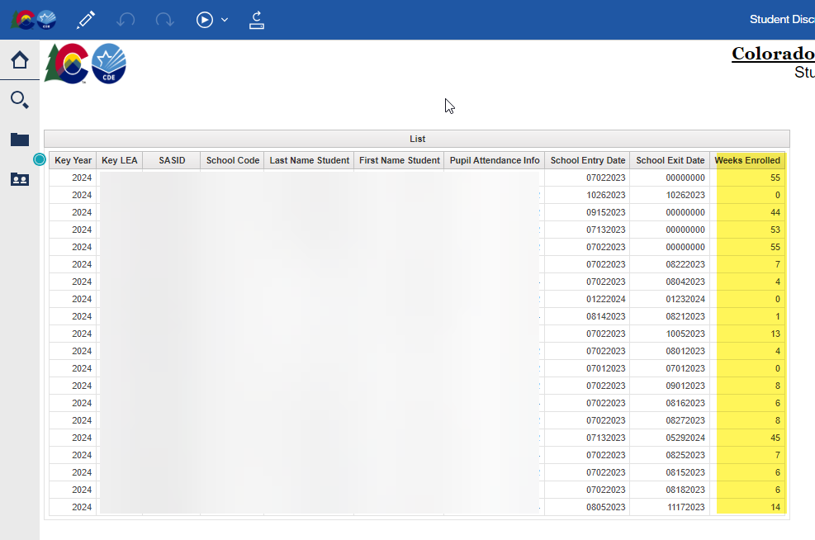
Teacher Student Data Link
COGNOS/CEDAR Reports:
  Number of Students Reported by School is a headcount of unique SASIDS by school code.
  Student Discrepancy Report is all students reported in the Student Interchange that were not included in the TSDL Snapshot. Verify if the omission is correct using the weeks enrolled field.
Teacher Student Data Link
TeacherStudentDataLink@cde.state.co.us

Slide 13
Questions & Resources:
TSDL
Peter Hoffman
720-925-8611
TeacherStudentDataLink@cde.state.co.us
TSDL Interchange Webpage

Slide 14
Student Discipline
Dawna Gudka

Slide 15

Snapshot Status as of 7/18 6AM
Submitted
Student Discipline Snapshot lead – Dawna Gudka
Student Discipline Snapshot

Slide 16
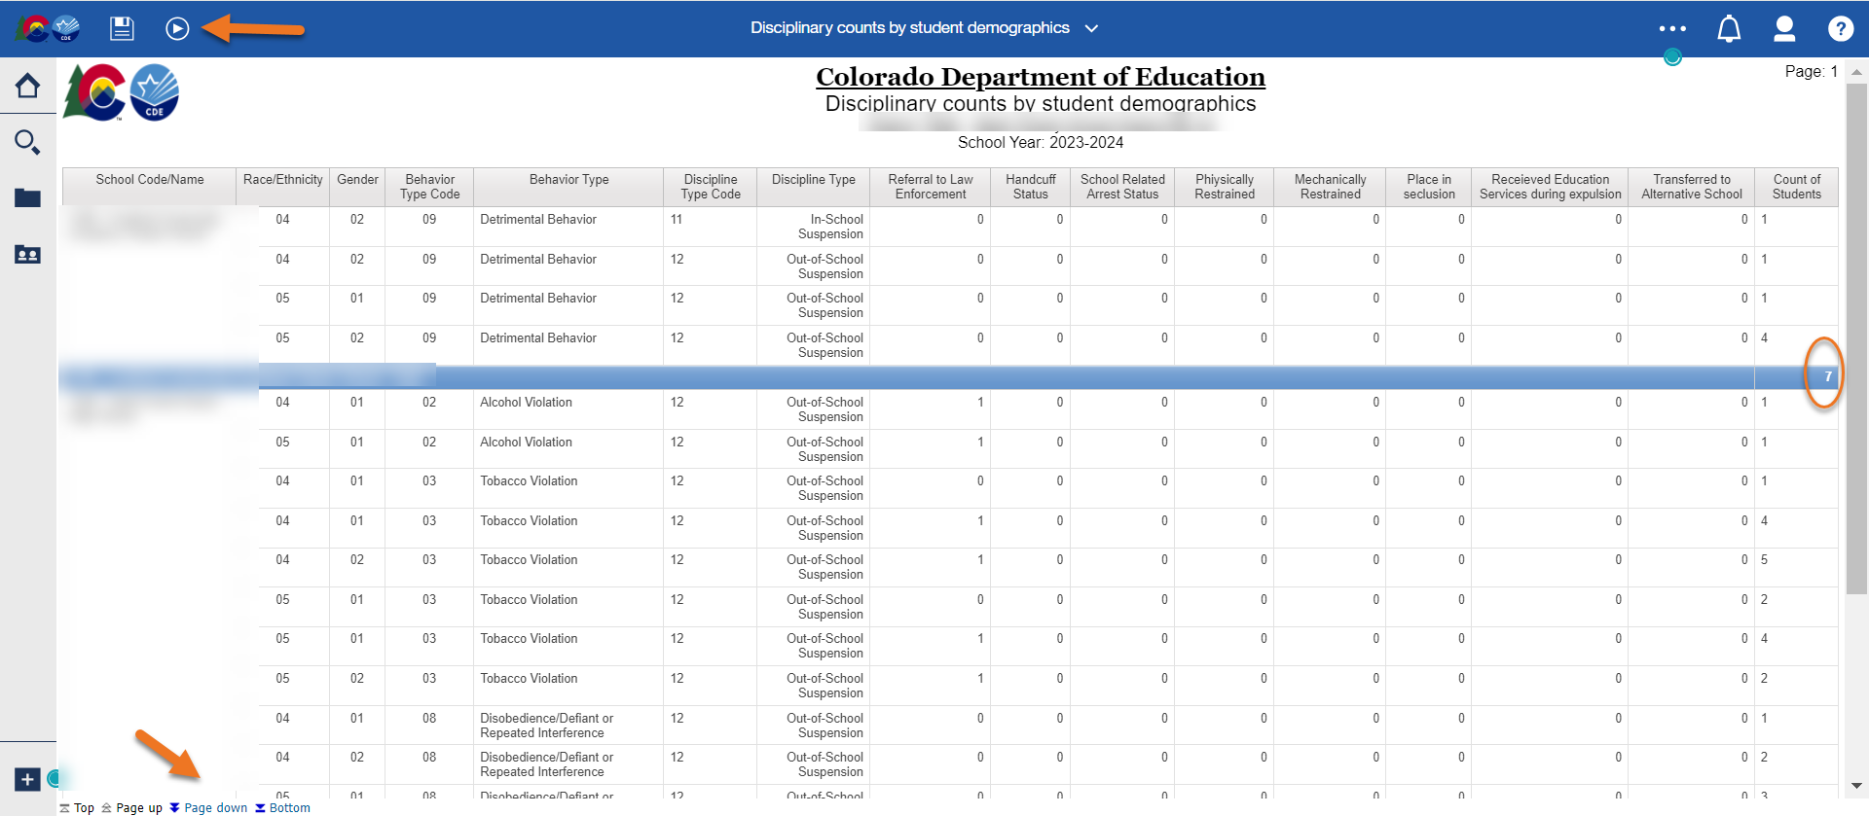
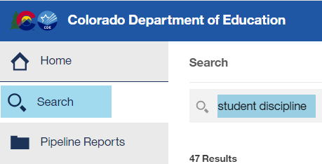
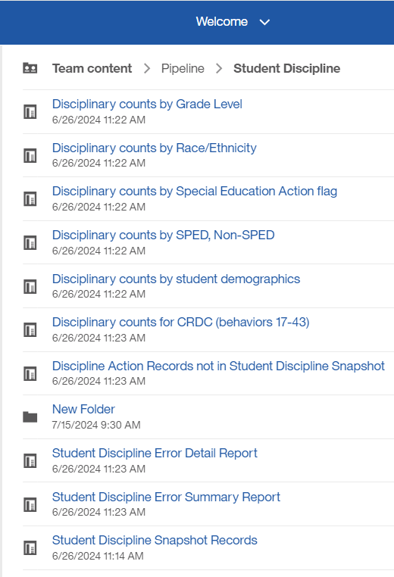
Student Discipline Snapshot-View data in Cognos-
Discipline counts by student demographics report
Student Discipline Snapshot-Dawna Gudka
StudentDiscipline@cde.state.co.us

Slide 17
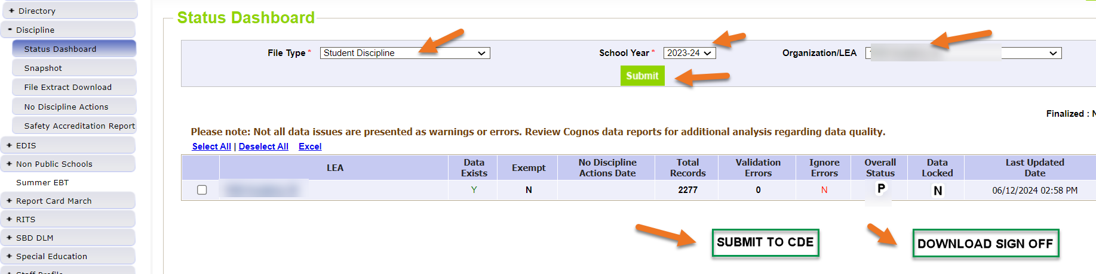
Student Discipline Snapshot-Error free and have validated data
Submitted Data to CDE
Reminder each time you upload a corrected interchange file you must create a snapshot. The snapshot takes a look at your data at the time the create snapshot button is clicked.
Student Discipline Snapshot-Dawna Gudka
StudentDiscipline@cde.state.co.us

Slide 18
Questions & Answers:
Student Discipline Snapshot
Please include your 4-digit LEA when emailing or leaving a voicemail
Discipline Interchange website
Student Discipline Training recording
Student Discipline Snapshot website
Dawna Gudka
(303) 598-7901

Slide 19
Special Education Discipline
Lindsey Heitman

Slide 20

Special Education Discipline Snapshot
Steps to complete by July 31st:
1. Verify all member districts have uploaded a Discipline Action file or marked no actions
  Use ‘District Activity Report’ found in Cognos Reports/Special Education Discipline
2. Create snapshot and clear snapshot errors
  with help of district respondent
3. Submit any exception requests needed
4. Review validation reports found in Special Education Discipline Cognos folder
  SPED Discipline Data Summary Report
  SPED Discipline: Year to Year Comparison Type of Disciplines Report
  *Your reports and final snapshot do not have to be signed or submitted until the August due dates. It’s fine to go ahead and do so now!
SpedDiscipline@cde.state.co.us
Special Education Discipline – Lindsey Heitman

Slide 21
Special Education Discipline Snapshot
Timeline:
May 1, 2024 - SPED Discipline Snapshot official open
May 23, 2024 - All Interchange files that feed into snapshot uploaded or updated at least once
June 27, 2024 - Interchange errors resolved – Discipline Action File, Child File, Participation File and at least one snapshot taken
JULY 31, 2024
August 15, 2024 - All Exception requests submitted to CDE processing
August 22, 2024 - Snapshot error-free
Aug. 22 – Aug. 29, 2024 - Report Review
August 29, 2024 - Final Submission approval in Data Pipeline and reports uploaded to DMS.
July 31st, 2024
Student Discipline Snapshot is due by this date!
**The Student Discipline Snapshot also includes the Sped student records. **
SpedDiscipline@cde.state.co.us
Special Education Discipline – Lindsey Heitman

Slide 22
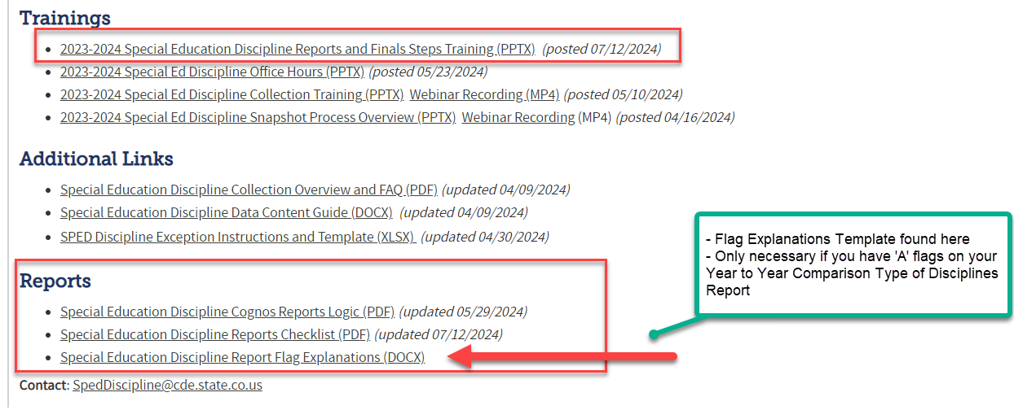
Special Education
Reports Online Resources
Special Education Discipline Snapshot Webpage
SpedDiscipline@cde.state.co.us
Special Education Discipline – Lindsey Heitman

Slide 23
Questions & Resources:
Special Education Discipline
Lindsey Heitman
SpedDiscipline@cde.state.co.us
Discipline Interchange Webpage
Special Education Discipline Snapshot Webpage

Slide 24
Special Education End of Year
Lindsey Heitman

Slide 25

Special Education End of Year:
Timeline and Office Hours
2023-2024 Special Education EOY Snapshot Timeline
May 1, 2024 - SPED EOY Snapshot official open
June 27, 2024 – IEP Interchange files error-free
August 29, 2024 - All Exception requests submitted to CDE
September 5, 2024 – All errors resolved at snapshot/interchange
September 5 -13, 2024 -Initial Report Review
September 16 - 20, 2024 – Resolving duplicates
September 20 - 27, 2024 – Final Report Review
September 27, 2024 - Final approval in Data Pipeline and reports uploaded to DMS
  Sped EOY Office Hours:
  Tuesday July 30th 11:00 – 12:00
  Join the meeting now
  Time for questions
  Discuss rollover in Enrich – any related reporting issues
  Sped EOY Reports and Final Steps Webinar:
  Thursday Sept 5th 1:00 – 2:00
  Join the meeting now
Special Education EOY – Lindsey Heitman
SpedEndofYear@cde.state.co.us

Slide 26
Special Education EOY:
Reconcile Exits
Reporting Reminder:
Reconcile exits with your Student EOY colleague(s) to be sure you have all the latest information (i.e. any exits that may not have been entered when you last pulled your files)
  Be sure all exits that occurred through June 30th are included in your 23-24 Sped EOY
  Check all warnings that help you locate possible exit data that is coded incorrectly
  Check ‘Records Not in Snapshot’ to be sure records aren’t being excluded due to a criteria issue
Special Education EOY – Lindsey Heitman
SpedEndofYear@cde.state.co.us

Slide 27
Special Education End of Year: Exception Requests
Exception Requests Due to CDE By August 29
To find the Sped EOY Exception template click here and go to Additional Resources section
Please save your filled out exception template in your AU # Syncplicity folder and email SpedEndofYear@cde.state.co.us to let us know it’s ready for upload. I will email you if I have questions and/or once it has been uploaded to the Data Pipeline. The errors should resolve once you create a new snapshot.
Explanation box must have 400 characters or less
  LEN Function under “Formulas/Insert Function” tells you how many characters are in a cell
Be sure to download the Sped EOY template and not the EOY template – they are different
Format on the template must be exactly as specified or file won’t upload – double check SASID, error code, number of characters in explanation is < 400
SY247 exceptions (for dropouts under the age of 17 on exit date)? Check Warning SY282 first to be sure the student didn’t transfer to a different AU
Special Education EOY – Lindsey Heitman
SpedEndofYear@cde.state.co.us

Slide 28
Reasons for Delay Codes
The reasons for delay codes are codes reported when an event happened late or did not happen at all during the initial evaluation process. They explain why an event happened beyond the expected timeline or why the event did not happen at all.
Path 2 Part C to Part B Transition (60-day timeline and 3rd birthday timeline):
Path 2 – Reason for Delay in Completing the Evaluation C to B
  Required when the C to B evaluation is completed more than 60 days from the date of parental consent OR if the evaluation was not completed
Path 2 - Reason for Delay in Initial Eligibility Meeting C to B
  Required when the initial eligibility meeting for a C to B transition child is held on or after their third birthday or if the initial eligibility meeting was not completed
Path 2 – Reason for Delay in IEP Implementation C to B
  Required when the IEP for a C to B transition child is implemented after their third birthday or if the IEP is not implemented at all
Path 3 Part B Initial Evaluation (60-day timeline and 90-day timeline):
Path 3 – Reason for Delay in Completing the Evaluation Part B
  Required when the initial Part B evaluation is completed more than 60 days from the date of parental consent OR if the evaluation was not completed
Path 3 – Reason for Delay in Finalizing the Initial IEP Part B
  Required when the initial IEP is finalized more than 90 days after parental consent to evaluate was received.
Path 3 – Reason the IEP was Never Implemented Part B
  Required when an initial Part B IEP is never implemented for a student who was found eligible and had an IEP finalized.
Special Education EOY – Lindsey Heitman
SpedEndofYear@cde.state.co.us

Slide 29
Reasons for Delay
Affect Your AU Indicator 11 and 12 Percentages
Reason for Delay in IEP Implementation C to B
01 - Parent refused to provide consent or revoked consent during the process or child is never enrolled, process ended
03 - Deceased, process ended
41 - Parent chose to extend Part C Services
45 - Parent repeatedly failed or refused to: produce child; give consent, respond to meeting requests; attend scheduled meetings. Includes delays due to illness and any requested meeting delays from parent. Process was delayed but did not end.
46 - Student moved into district after process initiated in another district; current district is making sufficient progress to ensure a prompt completion of the initial referral process by the date which parent and the current district agree.
47 - Student moved out of district after the initial referral process initiated, process ended
49 - Child's 3rd birthday occurred over the summer, parents and district determined the date the IEP services will begin
56 - No educational disability suspected. Prior Written Notice issued.
58 - NOT VALID - Additional evaluations or special evaluations needed
59 - NOT VALID - Other _________________ (provide explanation in exception request)
60 - NOT VALID - Staff missed the timeline
Not all delay codes are available for each delay reason field
Delay code 41 may only be used on students with third birthdays between May – August and parents are choosing to extend Part C services until school starts in the fall when the IEP services begin
Delay code 45 may be reported for parent related delays, including when they wait until the fall to enroll child (report 41 if it fits)
Delay codes that indicate NOT VALID will lower your indicator 11 and 12 percentages
Delay codes 01, 03, 47, 56 indicate process stopped altogether
Delay codes 41, 43, 45, 46, 49, 58, 59, 60 indicate process was delayed but did not stop
Reason the IEP was Never Implemented Part B
01 - Parent refused to provide consent or revoked consent during the process or child is never enrolled, process ended (Path 3 use only if consent revoked or child never enrolled)
03 - Deceased, process ended
47 - Student moved out of district after the initial referral process initiated, process ended
59 - NOT VALID - Other _________________ (provide explanation in exception request)
Special Education EOY – Lindsey Heitman
SpedEndofYear@cde.state.co.us

Slide 30
Questions & Resources:
Special Education End of Year
Lindsey Heitman
SpedEndofYear@cde.state.co.us
(303) 866-5759
Special Education IEP Interchange Webpage
Special Education End of Year Snapshot Webpage

Slide 31
School Auditing Office Updates
Rebecca McRee

Slide 32
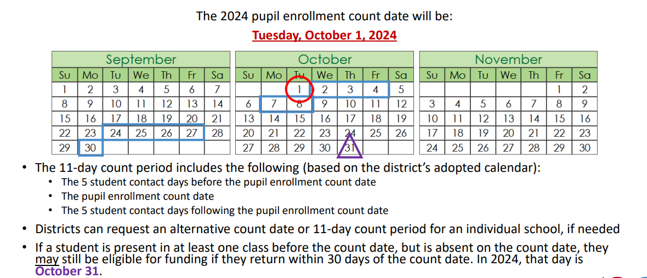
Student October Count Day 2024
School Auditing Office
Audit@cde.state.co.us

Slide 33
Audit Resource Guides for 2024
The pupil and at-risk count guides for the 2024/2025 school year are now available.
  Pupil Count: 2024 Student October Count Audit Resource Guide
  At-Risk Count: 2024 At-Risk Count Audit Resource Guide
The English Language Learner Count Guide will be posted on or before August 1, 2024 to the English Language Learner Count Website.
In all posted Guides, the Delta symbol Δ is used to identify information that has been updated or clarified since the previous edition of the applicable Guide.
  The pupil count guide also includes a "Summary of Changes" which is located at the end of the Guide.
School Auditing Office
Audit@cde.state.co.us

Slide 34
New: Annual Audit Review Process (Required)
Beginning with the 2024 Student October Count data collection, the School Auditing Office is changing its approach to the required compliance audits.
Annual Audit Review Process (Overview- PDF)
  Pupil Count Audit Questionnaire
  At-Risk Count Audit Questionnaire
  English Language Learner (ELL) Count Questionnaire
Audit District Contact Form
Initial audit documentation upload (as described on each questionnaire) will be due by December 11, 2024.
A training on the new process was held on 7/23/24. Visit the School Auditing Office's Training and Office Hours website to access the recording.
School Auditing Office
Audit@cde.state.co.us

Slide 35
Training and Office Hours
Upcoming Trainings:
Student October: Calendar & Bell Schedule Calculations July 25, 2024 (1PM)
Student October: What's New for Pupil Count Audit Contacts? July 30, 2024 (10AM)
Student October: Intro to the Audit Resource Guide (2 hrs.) August 1, 2024 (1PM)
At-Risk Count Audit Overview August 8, 2024 (1PM)
Transportation CDE-40 Overview FY23/24 August 15, 2024 (10AM)
English Language Learner Count Audit Overview September 17, 2024 (10AM)
Duplicate Count Office Hours November 5, 2024 (10AM)
School Auditing Office's Training and Office Hours website
School Auditing Office
Audit@cde.state.co.us

Slide 36
New: At-Risk Measure Interchange File -
Overview
Beginning with the 2024/2025 school year, there is a new Data Pipeline At-Risk Interchange.
The purpose of the At-Risk Interchange is to obtain student level census block information needed to implement the new at-risk measure as described in HB22-1202 with data collection to begin with the 2024-2025 school year as provided for under SB24-188.
The new at-risk measure will be implemented starting with the 2025/2026 school year, and included in the Total Program funding calculation as described in the Public-School Finance Act which will continue to utilize student level data reported through the Student October Count data collection
This interchange opened on July 15, 2024 and closes November 8, 2024. It will only be open during the Student October Count Collection.
  Instructions for Using the Census Geocoder Tool (PDF)- Posted 7/15/24
  Valid Census Block Data Combinations (Excel)- Posted 7/15/24
At-Risk Interchange
ARMeasure@cde.state.co.us

Slide 37
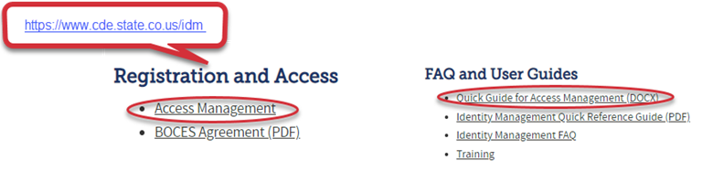
New: At-Risk Measure Interchange File -
Identity Management Role
Don’t have access?
Talk to your District’s Local Access Manager (LAM)!
Note: To receive communication about the at-risk interchange, you must have this role!
Application | Collection | Role | Access Level
Pipeline | At Risk Measure (ARM) | LEA User | Upload and Edit Records for the At-Risk Measure File
Pipeline | At-Risk Measure (ARM) | LEA Viewer | View Cognos reports – cannot edit data
At-Risk Interchange
ARMeasure@cde.state.co.us

Slide 38
New: At-Risk Measure Interchange File - Syncplicity Folders
Starting the week of July 29th, ARMeasure will begin sharing Syncplicity folders with ARMeasure users and viewers.
The folder naming convention will be:
  District Code_ District Name_ ARM Interchange File
These folders will be available as a way to share files containing PII between the district or BOCES and CDE when requesting assistance with the At-Risk Interchange or Census Geocoding tool.
At-Risk Interchange
ARMeasure@cde.state.co.us

Slide 39
New: At-Risk Measure Interchange File-
Trainings
There are currently 3 trainings scheduled:
  Overview of the Geocode Tool July 24, 2024 (1PM)- COMPLETED
  Overview of the Geocode Tool August 13, 2024 (10AM)
  Overview of the Data Pipeline At-Risk Interchange File August 20, 2024 (1PM)
To access these trainings, click on the link found in the green box located on the At-Risk Interchange website. The link will be activated approximately 15 minutes prior to the start of the training.
For questions, contact ARMeasure@cde.state.co.us
At-Risk Interchange
ARMeasure@cde.state.co.us

Slide 40
Questions & Answers:
School Auditing Office
Audit@cde.state.co.us
Pupil Count Website
At-Risk Count Website
English Language Learner Count Website
Training and Office Hours Website

Slide 41
READ Training
Tara Rhodes

Slide 42
READ Training Collection
Purpose and Timeline
Purpose:
Districts must annually ensure and report that all kindergarten through third grade teachers who provide literacy instruction to students in kindergarten through third grade and all teachers who provide reading intervention in grades 4-12 have successfully completed evidence-based training in teaching reading.
Districts must also report kindergarten through third grade principals and administrators and/or personnel who the district determines meet the statute criteria as needing to complete the kindergarten through third grade Principal/Administrator training.
Important Dates:
August 1: Collection scheduled to open
August 15: Teachers, principals, and administrators should have their respective READ training designations added to their COOL accounts
August 30: Collection scheduled to close
READ Training Collection
READActData@cde.state.co.us

Slide 43
READ Training Collection
Changes for 2024-25 Collection Year
This is the first year that districts are required to report completion of the READ administrator training for staff as well as the READ teacher training for Grades 4 through 12 staff.
Due to the addition of administrators to this collection, two columns were added to the file layout to capture the administrator information. The updated file layout can be viewed here.
The codes and business rules for the administrator training fields mimic the teacher training status codes and business rules.
READ Training Collection
READActData@cde.state.co.us

Slide 44
READ Training Collection
General Process for Collection Completion
General Process for Collection Completion:
This collection starts with an export out of Data Pipeline of a list of educators who may be required to take either the teacher or administrator training.
  This is based on certain job class codes from the previous year's Human Resources collection.
Districts can then add, edit, or remove educators as it relates to this export based on their job function and whether the district has determined if the educator needs to take the training.
After this is complete, districts then upload this file back into Data Pipeline, check for errors, and officially submit.
READ Training Collection
READActData@cde.state.co.us

Slide 45
READ Training Collection
Office Hours and Resources
Office Hours:
All office hours are occurring on Thursdays at 3:30pm.
Thursday, 6/27 - Slides have been posted here.
Thursday, 7/11 - Recording has been posted here.
Thursday, 7/25 - Link to register here.
Thursday, 8/8 - Link to register here.
Resources:
24-25 File Layout
READ Training Website
Data Collection Guide – Updated for 2024-25
READ Training Collection
READActData@cde.state.co.us

Slide 46
Questions & Resources:
READ Training
Tara Rhodes
Email: READActData@cde.state.co.us
Phone: 720.601.4125
READ Training Website

Slide 47

Thank you for joining today!
Next Town Hall will be August 1st
Helpful resources to bookmark:
Identity Management Website
•access to all CDE applications
Data Pipeline Website
•links to all collection websites and resources

