Slide 1
July 18, 2024 Data Pipeline Town Hall
The goal of the webinar is to provide updates on the Data Pipeline, current, and upcoming data collections. These webinars also provide a forum for districts, BOCES, and Administrative Units to have questions answered about Data Pipeline.

Slide 2
Colorado Department of Education Identity Management (IdM)
Identity Management Site
Frequently Asked Questions
How do I add myself or others to the email listserv for town hall emails and/or a specific collection?
Email lists are dependent on a person’s access rights in IdM. Contact your LAM to get an account or be assigned to a specific collection.
Where can I find the IdM role mappings for Data Pipeline and other applications?
Role Mapping (XLS)
I am a LAM. How do I update the user permissions for someone in my district?
Follow the steps outlined in the IdM Quick Guide for Access Management (DOCX)
Important: Users are not automatically removed from IdM when their email address is no longer active in your district. The LAM must deactivate their IdM account to ensure only designated staff can access CDE’s data reporting system.
Notes:
LAMs, please check the IdM roles for your district. Remove permissions for users who have retired, left your district, or are no longer assigned to a collection. Add roles for new hires and newly assigned respondents for specific collections.

Slide 3
What is PII?
Student Personally Identifiable Information (PII) is defined by state and federal laws as information that, alone or in combination, personally identifies an individual
This includes direct identifiers (i.e. student and staff names, SASID, EDID, etc.)
Includes information that when combined is identifiable
Colorado’s Student Data Transparency and Security Act outlines requirements for how Student PII is collected, used and shared
See the Data Privacy and Security website for prepared guidance on how to comply with this and other privacy laws.

Slide 4
Sharing Data
Use secure methods to transfer any PII to CDE
Contact Data Collection leads with questions about how to transmit PII securely
Each Data Collection leads maintains their own Syncplicity folders for specific collections, reach out to the collection lead for access
Use Syncplicity to encrypt emails to CDE
Avoid sending PII via unencrypted email or to unsecured faxes when sharing data between or within districts
Use Syncplicity to encrypt emails to CDE
Check local policies for restrictions, requirements, etc. regarding PII
Do not use PII in trainings, presentations, etc.
Do not share PII with unauthorized individuals
Do not share passwords
Follow local policies when transmitting PII to any third party

Slide 5
Today’s Agenda
Agenda Topic | Presenter
Open Data Collections and Upcoming Deadlines in Data Pipeline
Teacher Student Data Link | Peter Hoffman
Student Discipline | Dawna Gudka
Special Education Discipline | Lindsey Heitman
2024-2025 Student Interchange | Brooke Wenzel
School Auditing Office Updates | Rebecca McRee
READ Training | Tara Rhodes
S-EBT | Collin Slutzky

Slide 6
Open Collections and Upcoming Deadlines in Data Pipeline

Slide 7
Open Collections and Upcoming Dates: Year-Round & Interchanges
Name | Category | Status | Key Dates
RITS | Year Round | Open
EDIS | Year Round | Open
Directory | Year Round | Open | District Calendars Due 9/2/2024
Student | Interchange | Open | 2023-2024 and 2024-2025 are open
At-Risk | Interchange | Open
Title I | Interchange | Open
Special Education IEP | Interchange | Open
Staff | Interchange | Open
TSDL | Interchange | Open
Discipline | Interchange | Open
Data Pipeline Resources: Data Pipeline Collection Dates (XLS)

Slide 8
Open Collections and Upcoming Dates: Snapshots
Name | Category | Status | Final Deadline Date | Next Milestone | Looking Ahead
TSDL | Snapshot | Open | Aug. 30, 2024
Attendance | Snapshot | Closed | July 12, 2024 | Deadline: 7/26/2024 Signoff Forms Due
Staff Evaluation | Snapshot | Open | Oct. 15, 2024 | Interim Deadline:7/18/2024 create at least one snapshot | Interim Deadline: 8/7/2024 Error free snapshot
Student Discipline | Snapshot | Open | July 31, 2024 | Report Review: 7/8-7/26 Interchange & Snapshot error free | State Deadline: 7/31/2024
Student End of Year | Snapshot | Open | Nov. 19, 2024 | Interim Deadline: 7/25/2024 Submit exception requests | Interim Deadline: 8/8/2024 Error free SEY snapshot
Special Education Discipline | Snapshot | Open | Aug. 29, 2024 | Student Discipline Snapshot is due 7/31/2024 | Resolve all errors and ask Sped Director to review signature reports prior to 7/31/24
Special Education End of Year | Snapshot | Open | Sept. 27, 2024 | Interim Deadline: 8/29/2024 All exception requests due | Interim Deadline: 9/05/2024 All errors resolved
Data Pipeline Resources: Data Pipeline Collection Dates (XLS)

Slide 9
Open Collections and Upcoming Dates: Periodic
Name | Category | Status | Final Deadline Date | Looking Ahead
READ Training | Periodic | Coming Soon | Aug. 30, 2024 | Aug. 1, 2024 Collection Opens
Designated Agency | Periodic | Open | Aug. 30, 2024
S-EBT (corrections period) | Periodic | Open | Aug. 30, 2024
Data Pipeline Resources: Data Pipeline Collection Dates (XLS)

Slide 10
Teacher Student Data Link (TSDL)
Peter Hoffman

Slide 11
Teacher Student Data Link Timeline
Date | Event | Event Description
Friday August 23, 2024 | Interim Deadline | TARGET: Date by which you should have a complete Teacher Student Data Link Snapshot. Complete Teacher Student Data Link Snapshot means: ◻ All TSDL interchange errors are resolved ◻ All TSDL snapshot errors are resolved If you anticipate that you will not be able to meet this deadline, please contact CDE at TeacherStudentDataLink@cde.state.co.us
Monday August 26, 2024 – Thursday August 29, 2024 | Report Review | Final Snapshot Report Review – This is your opportunity to review reports in detail and make any data corrections you deem necessary to make sure you are reporting valid and reliable data. All data corrections must be completed during this time.
Friday August 30, 2024 | Deadline | Required to have TSDL snapshot error free and finalized before or on this date. TSDL closed and final report is signed and provided to CDE via email TeacherStudentDataLink@cde.state.co.us
Teacher Student Data Link
TeacherStudentDataLink@cde.state.co.us

Slide 12
Teacher Student Data Link
If you cannot see the Status Dashboard or Snapshot options, make sure you have both IDM Roles:
TSL~LEAUSER
and
TLS~LEAAPPROVER
COGNOS/CEDAR Reports:
Number of Students Reported by School is a headcount of unique SASIDS by school code.
Student Discrepancy Report is all students reported in the Student Interchange that were not included in the TSDL Snapshot. Verify if the omission is correct using the weeks enrolled field.
Please make sure to remove all commas from the Local Course Title field. This causes shifting in columns and is the most common error.
If you are getting TD110, TD111, TD112 or TD113 snapshot errors, and it is accurate that a class of that course code should not be appearing at that school, please reach out for an exception.
Teacher Student Data Link
TeacherStudentDataLink@cde.state.co.us

Slide 13
Questions & Resources: TSDL
Peter Hoffman
720-925-8611
TeacherStudentDataLink@cde.state.co.us
TSDL Interchange Webpage

Slide 14
Student Discipline
Dawna Gudka

Slide 15
Snapshot Status as of 7/18 6AM
Submitted
Student Discipline Snapshot lead – Dawna Gudka
Student Discipline Snapshot

Slide 16
Student Discipline-LEA’s that need to take a Snapshot
Error free Student Demographics file
Error free Student School Association file
Error free Discipline Action file
Student Discipline Snapshot-Dawna Gudka
StudentDiscipline@cde.state.co.us

Slide 17
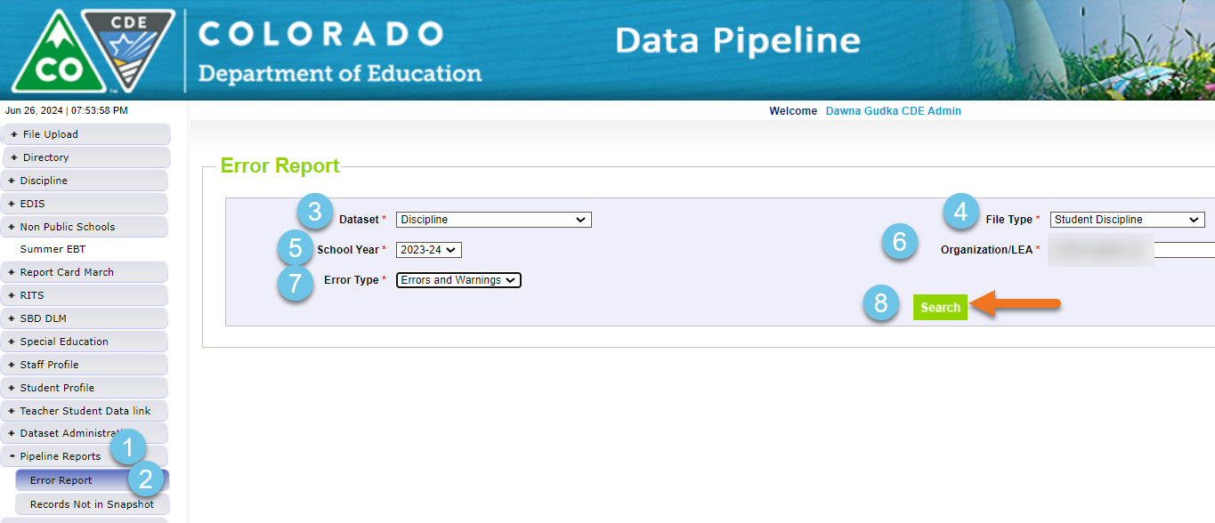
Student Discipline-LEA’s with Errors
Student Discipline Snapshot-Dawna Gudka
StudentDiscipline@cde.state.co.us

Slide 18
Student Discipline-No Discipline Data to report
Student Discipline Snapshot-Dawna Gudka
StudentDiscipline@cde.state.co.us

Slide 19
Student Discipline Snapshot-LEA’s that are error free Once you have validated your data-Submitted Data to CDE
Reminder each time you upload a corrected interchange file you must create a snapshot. The snapshot takes a look at your data at the time the create snapshot button is clicked.
Student Discipline Snapshot-Dawna Gudka
StudentDiscipline@cde.state.co.us

Slide 20
Questions & Answers: Student Discipline Snapshot
Please include your 4-digit LEA when emailing or leaving a voicemail
Discipline Interchange website
Student Discipline Training recording
Student Discipline Snapshot website
Dawna Gudka
(303) 598-7901

Slide 21
Special Education Discipline
Lindsey Heitman

Slide 22
Special Education Discipline Troubleshooting Errors SD026/SD027
SD026: If Type of Suspension/Expulsion is 04 (expulsion without services), the Special Education End of Year Basis of Exit code should be 50 (expulsion without services). If student was expelled and then re-entered later in the school year, an exception may be necessary, please contact CDE.
SD027: If Exit Type is 50 (Expulsion Without Services) in the Sped EOY Snapshot and Type of Suspension/Expulsion is not 04 (Expulsion Without Services) in the Sped Discipline snapshot, double check the data. If correct, please provide an exception request.
These trigger when an expulsion and services received information is not reported consistently between the Sped EOY and Sped Discipline Snapshots.
If student truly had an expulsion without services, an exit code of 50 should be reported in the Participation file record/Sped EOY Snapshot.
If it was an expulsion with services, adjust the ‘Received Services During Expulsion’ field to a 1 (yes) in the Discipline Action file and SD026 should resolve after next snapshot.
If it was an expulsion without services, follow these steps to resolve:
1. Add exit code 50 to Participation file record and upload a new file
2. Create a new Sped EOY Snapshot and verify this record is pulling into the snapshot
3. Create a new Sped Discipline Snapshot
SpedDiscipline@cde.state.co.us
Special Education Discipline – Lindsey Heitman

Slide 23
Special Education Discipline Snapshot
Steps to complete by July 31st:
1. Verify all member districts have uploaded a Discipline Action file or marked no actions
Use ‘District Activity Report’ found in Cognos Reports/Special Education Discipline
2. Create snapshot and clear snapshot errors
with help of district respondent
3. Submit any exception requests needed
4. Review validation reports found in Special Education Discipline Cognos folder
SPED Discipline Data Summary Report
SPED Discipline: Year to Year Comparison Type of Disciplines Report
*Your reports and final snapshot do not have to be signed or submitted until the August due dates. It’s fine to go ahead and do so now!
SpedDiscipline@cde.state.co.us
Special Education Discipline – Lindsey Heitman

Slide 24
Special Education Discipline Snapshot
Timeline:
May 1, 2024 - SPED Discipline Snapshot official open
May 23, 2024 - All Interchange files that feed into snapshot uploaded or updated at least once
June 27, 2024 - Interchange errors resolved – Discipline Action File, Child File, Participation File and at least one snapshot taken
JULY 31, 2024
August 15, 2024 - All Exception requests submitted to CDE processing
August 22, 2024 - Snapshot error-free
Aug. 22 – Aug. 29, 2024 - Report Review
August 29, 2024 - Final Submission approval in Data Pipeline and reports uploaded to DMS.
July 31st, 2024
Student Discipline Snapshot is due by this date!
**The Student Discipline Snapshot also includes the Sped student records. **
SpedDiscipline@cde.state.co.us
Special Education Discipline – Lindsey Heitman

Slide 25
Special Education Reports Online Resources
Special Education Discipline Snapshot Webpage
SpedDiscipline@cde.state.co.us
Special Education Discipline – Lindsey Heitman

Slide 26
Special Education Discipline Signature Reports
DISTRICT
District Authority Sign-Off Form
(requested by Special Education Directors for data assurance purposes and found in the Discipline Interchange folder in COGNOS)
*For your records- no need to send to CDE!
ADMINISTRATIVE UNIT
SPED Discipline Data Summary Report (10 Pages)
SPED Discipline Year-to-Year Comparison Type of Disciplines Report (1 Page)
Year-to-Year Flag Explanation Document (Word)
SpedDiscipline@cde.state.co.us
Special Education Discipline – Lindsey Heitman

Slide 27
Questions & Resources: Special Education Discipline
Lindsey Heitman
SpedDiscipline@cde.state.co.us
Discipline Interchange Webpage Special Education Discipline Snapshot Webpage

Slide 28
Student Interchange 2024-2025
Brooke Wenzel

Slide 29
Student Interchange Opens!
2024-2025 Student Interchange Opened on Monday, July 15th
There are two years of data that are open at the same time! Please make sure you are selecting the right year (Data Pipeline will autofill to 2024-2025)
2023-2024 open for collections wrapping up from last school year (Reagan Ward)
2024-2025 will open in preparation for Student October (Brooke Wenzel)
Student Interchange – Brooke Wenzel and Reagan Ward
StudentOctober@cde.state.co.us

Slide 30
Student Interchange Office Hours - Schedule
July 24th
10:00 – 11:30 am
August 15th
1:00 – 2:30 pm
Join the Office Hours on the Student Interchange Website!
Target Audience: New Respondents/Those who work with Student information on other collections.
Student Interchange – Brooke Wenzel and Reagan Ward
StudentOctober@cde.state.co.us

Slide 31
Short Bytes (Student Interchange Website)
Student Interchange Website
Short Bytes: This section has many short videos focused on various topics within the Student Interchange. Just 5-10 minutes of your time may clear up some questions within a focused topic!
Additional Resources:
Student Interchange Timeline (PDF)
Broad overview of the Student Interchange and how it is utilized throughout school year for data collections. It is laid out on a month-to-month basis on what we recommend doing in terms of Student Interchange work.
Student Enrollment Record Guide (PDF)
Helpful guide to track a student’s educational history. The SSA file should capture all enrollment changes for a student throughout the school year!
English Learner Coding Guide (PDF)
Handout pertaining to all things ELL coding!
Troubleshooting File Uploads/Snapshots (PDF)
Step-by-step guide to help pinpoint file upload and snapshot failures within Data Pipeline
Student Interchange – Brooke Wenzel and Reagan Ward
StudentOctober@cde.state.co.us

Slide 32
What to Look Out for Next Year
New Data Fields in 2024-2025 SSA File Layout
Independent Study Course, Work-Based Learning Course, Blended Learning Course, Supplemental Online Course
English Language Learner Errors
Some year-to-year checks were checking on a district basis, updated it to check via SASID. Only applied to a small number of ELL errors.
Ex: Student was in District A with Language Proficiency X in 2023-2024, student moved to District B with Language Proficiency Y in 2024-2025 (error was not flagging before since district was different)
Gifted and Talented Error
Prior year vs. current year check to verify if a student is gifted in one of the 14 categories, they continue to be identified as such
Updates to Cognos Reports
Student Interchange – Brooke Wenzel and Reagan Ward
StudentOctober@cde.state.co.us

Slide 33
Questions & Resources: Student Interchange
Brooke Wenzel
StudentOctober@cde.state.co.us
720-441-7963
Reagan Ward
StudentEndofYear@cde.state.co.us
720-484-9057
Student Interchange Webpage

Slide 34
School Auditing Office Updates
Rebecca McRee

Slide 35
Student October Count Day 2024
School Auditing Office
School Auditing Office Website

Slide 36
Audit Resource Guides for 2024
The pupil and at-risk count guides for the 2024/2025 school year are now available.
Pupil Count: 2024 Student October Count Audit Resource Guide
At-Risk Count: 2024 At-Risk Count Audit Resource Guide
The English Language Learner Count Guide will be posted on or before August 1, 2024 to the English Language Learner Count Website.
In all posted Guides, the Delta symbol Δ is used to identify information that has been updated or clarified since the previous edition of the applicable Guide.
The pupil count guide also includes a "Summary of Changes" which is located at the end of the Guide.
School Auditing Office
School Auditing Office Website

Slide 37
New Pupil Count Audit Forms (Required)
Detention Center Notification (AUD-101 Form) UPDATED
Compliance Assurances for Contracted Services (AUD-108 Form) NEW! (Updated 7/17/24)
Confirmation of Part-Time Funding Eligibility Form (AUD-109 Form) NEW!
School Auditing Office
School Auditing Office Pupil Count Website

Slide 38
New Pupil Count Forms and Processes (Optional)
Instructions for Applying for an Alternative Count Date UPDATED
Brick-and-Mortar Affidavit of Colorado Residency Sample NEW!
Instructions for Applying for Alternative Attendance for Independent Study Courses NEW!
Pupil Count Document Checklist NEW!
Out of State Transfer Enrollment Eligibility Sample Form NEW!
Online Signature Guidance UPDATED
School Auditing Office
School Auditing Office Pupil Count Website

Slide 39
New: Annual Audit Review Process (Required)
Beginning with the 2024 Student October Count data collection, the School Auditing Office is changing its approach to the required compliance audits.
Annual Audit Review Process (Overview- PDF)
Pupil Count Audit Questionnaire
At-Risk Count Audit Questionnaire
English Language Learner (ELL) Count Questionnaire
Audit District Contact Form
Initial audit documentation upload (as described on each questionnaire) will be due by December 11, 2024.
School Auditing Office
School Auditing Office Website

Slide 40
Training and Office Hours
Upcoming Trainings:
Preparing for the New Annual Audit Review July 23, 2024 (10AM)
Student October: Calendar & Bell Schedule Calculations July 25, 2024 (1PM)
Student October: What's New for Pupil Count Audit Contacts? July 30, 2024 (10AM)
Student October: Intro to the Audit Resource Guide (2 hrs.) August 1, 2024 (1PM)
At-Risk Count Audit Overview August 8, 2024 (1PM)
Transportation CDE-40 Overview FY23/24 August 15, 2024 (10AM)
English Language Learner Count Audit Overview September 17, 2024 (10AM)
Duplicate Count Office Hours November 5, 2024 (10AM)
Audit Trainings Website
School Auditing Office
Audit Trainings Website

Slide 41
Training and Office Hours - Completed
Completed Trainings and Office Hours (in preparation for the 2024/2025 school year):
Public School Finance Act Update--Office Hours June 13, 2024
Student October: What's New for Program & Curriculum Leaders? June 6, 2024
Public School Finance Act Update--Office Hours May 30, 2024
Student October: What's New for AECs (Alternative Education Campuses)? May 22, 2024
At-Risk Funding & CEP for Business Officials May 21, 2024
Student October: What's New for Online Schools and Programs? May 20, 2024
Public School Finance Act Update--Office Hours May 16, 2024
Public School Finance Act Update--Office Hours April 16, 2024
Informational Session Regarding Changes to the Public School Finance Act March 21, 2024
Audit Trainings Website
School Auditing Office
Audit Trainings Website

Slide 42
New: At-Risk Measure Interchange File Overview
Beginning with the 2024/2025 school year, there is a new Data Pipeline At-Risk Interchange.
The purpose of the At-Risk Interchange is to obtain student level census block information needed to implement the new at-risk measure as described in HB22-1202 with data collection to begin with the 2024-2025 school year as provided for under SB24-188.
The new at-risk measure will be implemented starting with the 2025/2026 school year, and included in the Total Program funding calculation as described in the Public-School Finance Act which will continue to utilize student level data reported through the Student October Count data collection
This interchange opened on July 15, 2024 and closes November 8, 2024. It will only be open during the Student October Count Collection.
Instructions for Using the Census Geocoder Tool (PDF)- Posted 7/15/24
Valid Census Block Data Combinations (Excel)- Posted 7/15/24
ARMeasure@cde.state.co.us
At-Risk Interchange

Slide 43
New: At-Risk Measure Interchange Identity Management Role
Don’t have access?
Talk to your District’s Local Access Manager (LAM)!
Note: To receive communication about the at-risk interchange, you must have this role!
Application | Collection | Role | Access Level
Pipeline | At Risk Measure (ARM) | LEA User | Upload and Edit Records for the At-Risk Measure File
Pipeline | At-Risk Measure (ARM) | LEA Viewer | View Cognos reports – cannot edit data
ARMeasure@cde.state.co.us
At-Risk Interchange

Slide 44
New: At-Risk Measure Interchange File
There are currently 3 trainings scheduled:
Overview of the Geocode Tool July 24, 2024 (1PM)
Overview of the Geocode Tool August 13, 2024 (10AM)
Overview of the Data Pipeline At-Risk Interchange File August 20, 2024 (1PM)
To access these trainings, click on the link found in the green box located on the At-Risk Interchange website. The link will be activated approximately 15 minutes prior to the start of the training.
For questions, contact ARMeasure@cde.state.co.us
ARMeasure@cde.state.co.us
At-Risk Interchange

Slide 45
Questions & Answers: School Auditing Office
Audit@cde.state.co.us
Pupil Count Website
At-Risk Count Website
English Language Learner Count Website
Training and Office Hours Website

Slide 46
READ Training
Tara Rhodes

Slide 47
READ Training Collection Purpose and Timeline
Purpose:
Districts must annually ensure and report that all kindergarten through third grade teachers who provide literacy instruction to students in kindergarten through third grade and all teachers who provide reading intervention in grades 4-12 have successfully completed evidence-based training in teaching reading.
Districts must also report kindergarten through third grade principals and administrators and/or personnel who the district determines meet the statute criteria as needing to complete the kindergarten through third grade Principal/Administrator training.
Important Dates:
August 1: Collection scheduled to open
August 15: Teachers, principals, and administrators should have their respective READ training designations added to their COOL accounts
August 30: Collection scheduled to close
READ Training Collection
READActData@cde.state.co.us

Slide 48
READ Training Collection Changes for 2024-25 Collection Year
This is the first year that districts are required to report completion of the READ administrator training for staff as well as the READ teacher training for Grades 4 through 12 staff.
Due to the addition of administrators to this collection, two columns were added to the file layout to capture the administrator information. The updated file layout can be viewed here.
The codes and business rules for the administrator training fields mimic the teacher training status codes and business rules.
READ Training Collection
READActData@cde.state.co.us

Slide 49
READ Training Collection General Process for Collection Completion
General Process for Collection Completion:
This collection starts with an export out of Data Pipeline of a list of educators who may be required to take either the teacher or administrator training.
This is based on certain job class codes from the previous year's Human Resources collection.
Districts can then add, edit, or remove educators as it relates to this export based on their job function and whether the district has determined if the educator needs to take the training.
After this is complete, districts then upload this file back into Data Pipeline, check for errors, and officially submit.
READ Training Collection
READActData@cde.state.co.us

Slide 50
READ Training Collection Office Hours and Resources
Office Hours:
All office hours are occurring on Thursdays at 3:30pm.
Thursday, 6/27 - Slides have been posted here.
Thursday, 7/11 - Recording has been posted here.
Thursday, 7/25 - Link to register here.
Thursday, 8/8 - Link to register here.
Resources:
24-25 File Layout
READ Training Website
Data Collection Guide – Updated for 2024-25
READ Training Collection
READActData@cde.state.co.us

Slide 51
Questions & Resources: READ Training
Tara Rhodes
Email: READActData@cde.state.co.us
Phone: 720.601.4125
READ Training Website

Slide 52
S-EBT
Collin Slutzky

Slide 53
Summer EBT Data Collection
The collection closed on April 30th
Every district submitted on time
Corrections will be accepted from May 22nd to August 30th
Use the corrections period for:
Errors in submitted student data
Adding students who were accidentally missed
Including students that became newly eligible after April 30th
Capturing students who enrolled in your district after April 30th
Updating addresses that have changed
Summer EBT
s-ebt@cde.state.co.us
Notes:
Your district schools are most likely receiving calls from families to update their address, make sure you are in contact with the appropriate people to make sure this updated information is being captured in the summer EBTcorrections.

Slide 54
How to Submit Corrections
You must email s-ebt@cde.state.co.us for us to unlock your collection
The file format for corrections is identical to the format of the original collection
Your corrected file must include all students you submitted during the initial collection
Correction files with fewer students will cause an error in Data Pipeline
When uploading your data in Pipeline, select the “Replace” option for Upload Type
We will be available for office hours as needed to help during the corrections period
Summer EBT
s-ebt@cde.state.co.us

Slide 55
S-EBT File Layout
 | Name of Field | Field Length | Text Start Position | Text End Position | CSV Order | Excel Column | Examples | Remarks
1 | School District Code* | 4 | 1 | 4 | 1 | A2 | 0000
2 | School Code* | 4 | 5 | 8 | 2 | B2 | 0000
3 | Entry Date* | 8 | 9 | 16 | 3 | C2 | 08152021 | Format is MMDDYYYY
4 | Exit Withdraw Date* | 8 | 17 | 24 | 4 | D2 | 10152021 | Format is MMDDYYYY; 0 fill if N/A
5 | Student’s State ID (SASID)* | 10 | 25 | 34 | 5 | E2 | 0000000000
6 | Local ID (LASID)* | 10 | 35 | 44 | 6 | F2 | 0000000000
7 | Student’s First Name* | 30 | 45 | 74 | 7 | G2 | Valid Name
8 | Student’s Middle Name* | 30 | 75 | 104 | 8 | H2 | Valid Name | NMN if none
9 | Student’s Last Name* | 30 | 105 | 134 | 9 | I2 | Valid Name
10 | Student’s Gender* | 2 | 135 | 136 | 10 | J2 | 01, 02
11 | Student’s Date of Birth* | 8 | 137 | 144 | 11 | K2 | 08152008 | Format is MMDDYYYY
12 | Student’s Grade Level* | 3 | 145 | 147 | 12 | L2 | 060
13 | Student’s Language Background | 3 | 148 | 150 | 13 | M2 | ENG
14 | Primary Parent/Guardian First Name* | 30 | 151 | 180 | 14 | N2 | Valid Name
15 | Primary Parent/Guardian Last Name* | 30 | 181 | 210 | 15 | O2 | Valid Name
16 | Primary Parent/Guardian Telephone Number | 10 | 211 | 220 | 16 | P2 | 5551231234; None
17 | Student’s Primary Mailing Address 1* | 44 | 221 | 264 | 17 | Q2 | 123 Star Quarry Road
18 | Student’s Primary Mailing Address 2 | 42 | 265 | 306 | 18 | R2 | Apt. 2 | Try to avoid special characters, i.e., #, &, @, etc.
19 | Student’s Primary Mailing City* | 50 | 307 | 356 | 19 | S2 | Nowhere
20 | Student’s Primary Mailing State* | 2 | 357 | 358 | 20 | T2 | CO
21 | Student’s Primary Mailing Postal Code* | 10 | 359 | 368 | 21 | U2 | 99999-0000, 99999
22 | Free/Reduced Lunch Price Eligible* | 2 | 369 | 370 | 22 | V2 | 00, 01, 02
23 | FRPL Eligibility Date | 8 | 371 | 378 | 23 | W2 | 10152021 | Format is MMDDYYYY
Summer EBT
s-ebt@cde.state.co.us

Slide 56
Questions & Resources: Summer EBT
S-EBT General Email
Data Collection FAQ – This is a great resource if you are having issues with formatting or uploading School Nutrition Summer-EBT webpage
Data Pipeline S-EBT webpage
Office Hours Sign-up
S-EBT Support Center:
Call: 800-536-5298
Text: 720-741-0550
Email: cdhs_sebt_supportcenter@state.co.us

Slide 57
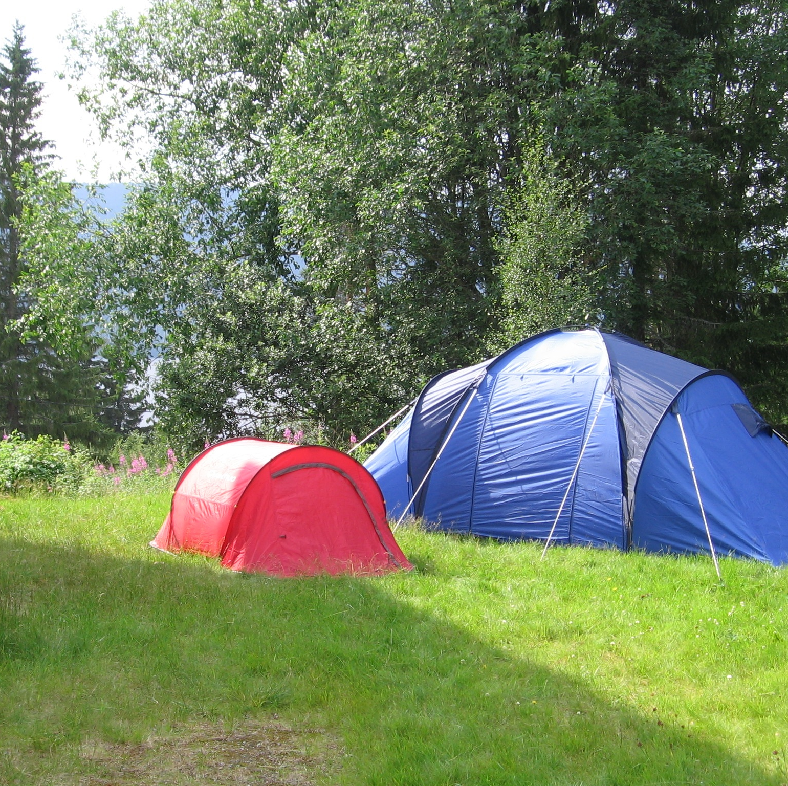
Thank you for joining today!
Next Town Hall will be July 25th
Helpful resources to bookmark:
Identity Management Website
•access to all CDE applications
Data Pipeline Website
•links to all collection websites and resources

