Slide 1
July 11, 2024
Data Pipeline Town Hall
The goal of the webinar is to provide updates on the Data Pipeline, current, and upcoming data collections. These webinars also provide a forum for districts, BOCES, and Administrative Units to have questions answered about Data Pipeline.

Slide 2
Colorado Department of Education
Identity Management (IdM)
Identity Management Site
Frequently Asked Questions
How do I add myself or others to the email listserv for town hall emails and/or a specific collection?
  Email lists are dependent on a person’s access rights in IdM. Contact your LAM to get an account or be assigned to a specific collection.
Where can I find the IdM role mappings for Data Pipeline and other applications?
  Role Mapping (XLS)
I am a LAM. How do I update the user permissions for someone in my district?
  Follow the steps outlined in the IdM Quick Guide for Access Management (DOCX)
Important: Users are not automatically removed from IdM when their email address is no longer active in your district. The LAM must deactivate their IdM account to ensure only designated staff can access CDE’s data reporting system.
Notes:
LAMs, please check the IdM roles for your district. Remove permissions for users who have retired, left your district, or are no longer assigned to a collection. Add roles for new hires and newly assigned respondents for specific collections.

Slide 3

What is PII?
Student Personally Identifiable Information (PII) is defined by state and federal laws as information that, alone or in combination, personally identifies an individual
  This includes direct identifiers
  (i.e. student and staff names, SASID, EDID, etc.)
  Includes information that when combined is identifiable
Colorado’s Student Data Transparency and Security Act outlines requirements for how Student PII is collected, used and shared
See the Data Privacy and Security website for prepared guidance on how to comply with this and other privacy laws.

Slide 4

Sharing Data
Use secure methods to transfer any PII to CDE
  Contact Data Collection leads with questions about how to transmit PII securely
    Each Data Collection leads maintains their own Syncplicity folders for specific collections, reach out to the collection lead for access
  Use Syncplicity to encrypt emails to CDE
Avoid sending PII via unencrypted email or to unsecured faxes when sharing data between or within districts
  Use Syncplicity to encrypt emails to CDE
Check local policies for restrictions, requirements, etc. regarding PII
  Do not use PII in trainings, presentations, etc.
  Do not share PII with unauthorized individuals
  Do not share passwords
  Follow local policies when transmitting PII to any third party

Slide 5
Today’s Agenda
Agenda Topic | Presenter
Open Data Collections and Upcoming Deadlines in Data Pipeline
Teacher Student Data Link | Peter Hoffman
Directory | Jessica Tribbett
Student Discipline | Dawna Gudka
Special Education Discipline | Lindsey Heitman
Student End of Year | Reagan Ward
Attendance | Brooke Wenzel
2024-2025 Student Interchange | Brooke Wenzel
School Auditing Office Updates | Rebecca McRee
READ Staff Training | Tara Rhodes

Slide 6
Open Collections and
Upcoming Deadlines in
Data Pipeline

Slide 7
Open Collections and Upcoming Dates:
Year-Round & Interchanges
Name | Category | Status | Key Dates
RITS | Year Round | Open
EDIS | Year Round | Open
Directory | Year Round | Open
Student | Interchange | Open | 2024-2025 will open on 7/12/2024
Title I | Interchange | Open
Special Education IEP | Interchange | Open
Staff | Interchange | Open
TSDL | Interchange | Open
Discipline | Interchange | Open
Data Pipeline Resources: Data Pipeline Collection Dates (XLS)

Slide 8
Open Collections and Upcoming Dates:
Snapshots
Name | Category | Status | Final Deadline Date | Next Milestone | Looking Ahead
TSDL | Snapshot | Open | Aug. 30, 2024
Attendance | Snapshot | Deadline Tomorrow | July 12, 2024 | Final Deadline: 7/12/2024 Submit Attendance Snapshot | Deadline: 7/26/2024 Signoff Forms Due
Staff Evaluation | Snapshot | Open | Oct. 15, 2024 | Interim Deadline:7/14/2024 Error free Staff Evaluation file | Interim Deadline: 7/18/2024 create at least one snapshot
Student Discipline | Snapshot | Open | July 31, 2024 | Report Review: 7/8-7/26 Interchange & Snapshot error free | State Deadline: 7/31/2024
Student End of Year | Snapshot | Open | Nov. 19, 2024 | Training Event: July SEY Office Hours 7/17/2024 2:30-3:30pm | Interim Deadline: 7/25/2024 Submit exception requests
Special Education Discipline | Snapshot | Open | Aug. 29, 2024 | Student Discipline Snapshot is due 7/31/2024 | Resolve all errors and ask Sped Director to review signature reports prior to 7/31/24
Special Education End of Year | Snapshot | Open | Sept. 27, 2024 | Interim Deadline: 8/29/2024 All exception requests due | Interim Deadline: 9/05/2024 All errors resolved
Data Pipeline Resources: Data Pipeline Collection Dates (XLS)

Slide 9
Teacher Student Data Link
(TSDL)
Peter Hoffman

Slide 10
Teacher Student Data Link Timeline
Date | Event | Event Description
Friday August 23, 2024 | Interim Deadline | TARGET: Date by which you should have a complete Teacher Student Data Link Snapshot. Complete Teacher Student Data Link Snapshot means: ◻ All TSDL interchange errors are resolved ◻ All TSDL snapshot errors are resolved If you anticipate that you will not be able to meet this deadline, please contact CDE at TeacherStudentDataLink@cde.state.co.us
Monday August 26, 2024 – Thursday August 29, 2024 | Report Review | Final Snapshot Report Review – This is your opportunity to review reports in detail and make any data corrections you deem necessary to make sure you are reporting valid and reliable data. All data corrections must be completed during this time.
Friday August 30, 2024 | Deadline | Required to have TSDL snapshot error free and finalized before or on this date. TSDL closed and final report is signed and provided to CDE via email TeacherStudentDataLink@cde.state.co.us
Teacher Student Data Link
TeacherStudentDataLink@cde.state.co.us

Slide 11
Teacher Student Data Link
If you cannot see the Status Dashboard or Snapshot options, make sure you have both IDM Roles:
  TSL~LEAUSER
  and
  TLS~LEAAPPROVER
Record expectations: One record for each student and core course enrolled for 6 weeks or more along with the educator of record and contributing professional if applicable for grades 6-12. “Core course" means a course in English, mathematics, science, social studies. For 8th-12th grade Migrant Students, all courses must be reported.
  It is recommended to also include AP and Computer sciences courses as these are required during CRDC reporting years.
CDE uses NCES SCED codes for State course codes. The latest file can be found here either on the TSDL Interchange or the NCES SCED websites.
Please make sure to remove all commas from the Local Course Title field. This causes shifting in columns and is the most common error.
If you are getting TD110, TD111, TD112 or TD113 snapshot errors, and it is accurate that a class of that course code should not be appearing at that school, please reach out for an exception.
Teacher Student Data Link
TeacherStudentDataLink@cde.state.co.us

Slide 12
Questions & Resources:
TSDL
Peter Hoffman
720-925-8611
TeacherStudentDataLink@cde.state.co.us
TSDL Interchange Webpage

Slide 13
Directory
Jessica Tribbett

Slide 14
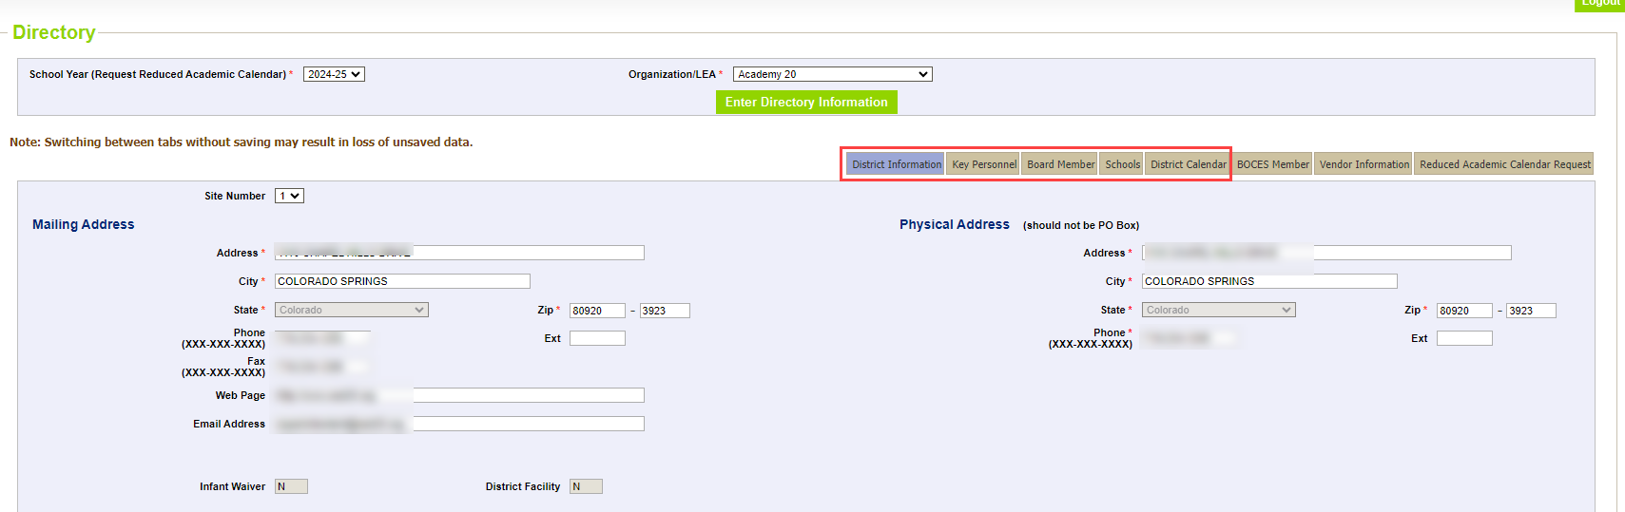
Directory Information Data Checks and Updates
DEADLINE FOR SCHOOL VIEW: JULY 31st
District Information
Key Personnel
Schools - Principal Contact
District Calendar
Directory Data
directorydata@cde.state.co.us

Slide 15
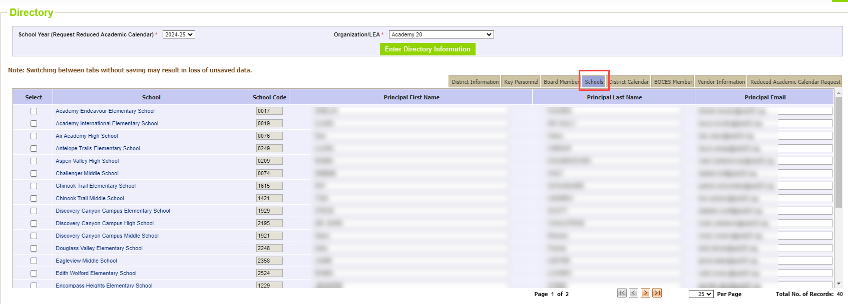
Directory: Schools tab
Data pulled into school view on 8/1. Updates need to be complete by 7/31. Principal contact information is now required.
Directory Data
directorydata@cde.state.co.us

Slide 16
Directory Information Data Checks and Updates
DEADLINE FOR SCHOOL VIEW: JULY 31st
District Information
Key Personnel
Schools - Principal Contact
District Calendar
Directory Data
directorydata@cde.state.co.us

Slide 17
Questions & Resources:
Directory
Jessica Tribbett
directorydata@cde.state.co.us
Directory Data website

Slide 18
Student Discipline
Dawna Gudka

Slide 19

Snapshot Status as of 7/11 8AM
Student Discipline Snapshot lead – Dawna Gudka
Student Discipline Snapshot

Slide 20
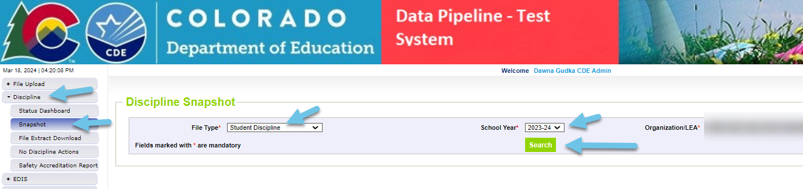
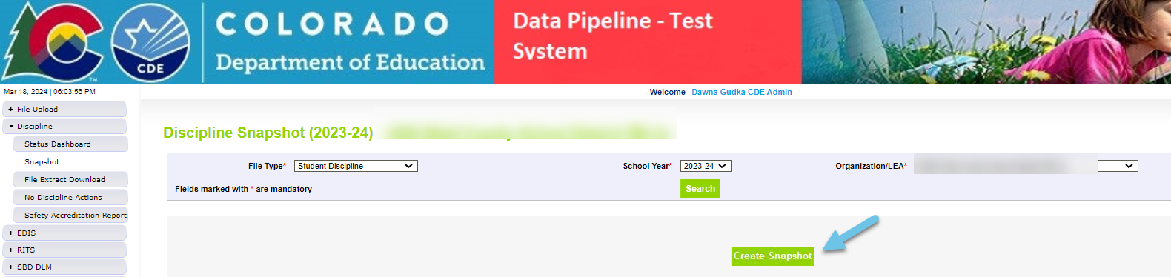
Student Discipline-LEA’s that need to take a Snapshot
Error free Student Demographics file
Error free Student School Association file
Error free Discipline Action file
Student Discipline Snapshot-Dawna Gudka
StudentDiscipline@cde.state.co.us

Slide 21
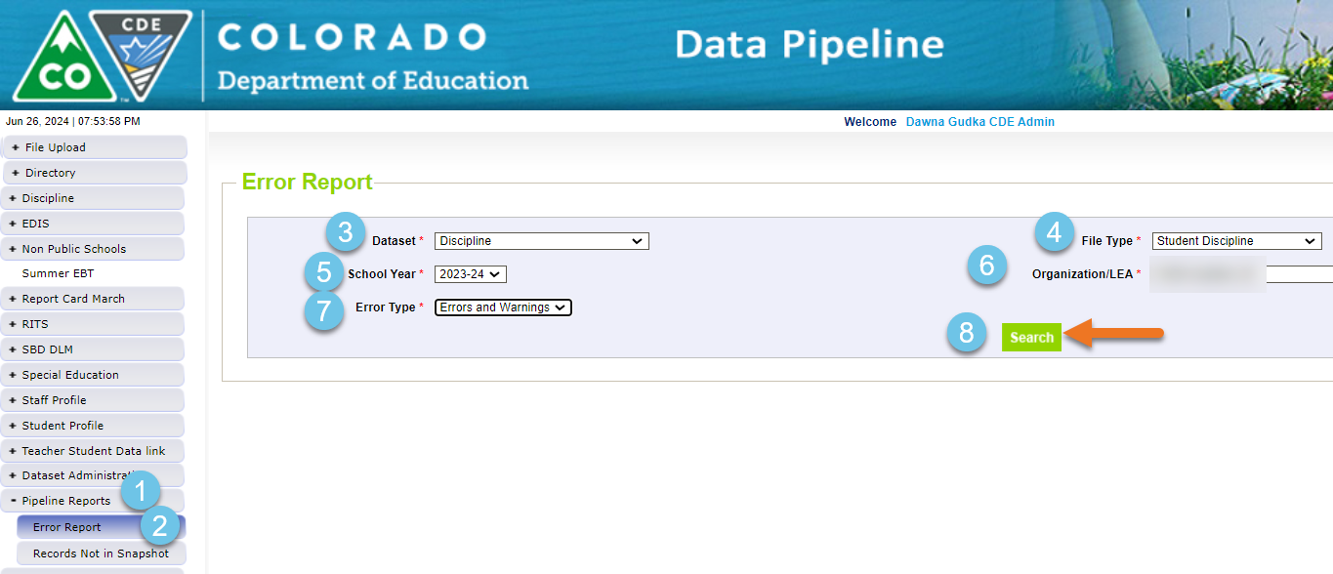
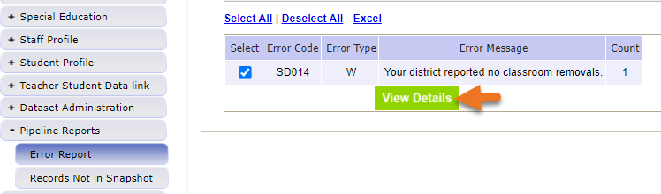
Student Discipline-LEA’s with Errors
Student Discipline Snapshot-Dawna Gudka
StudentDiscipline@cde.state.co.us

Slide 22
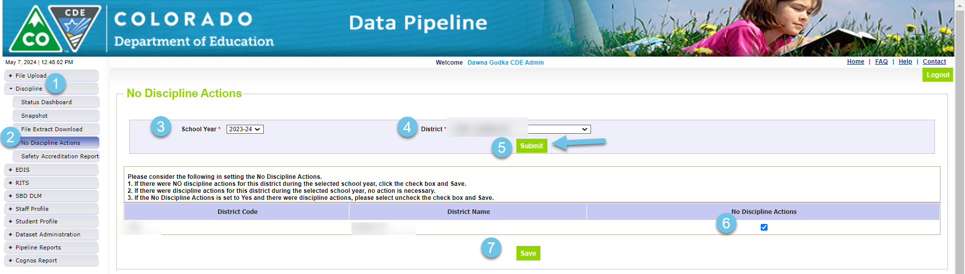
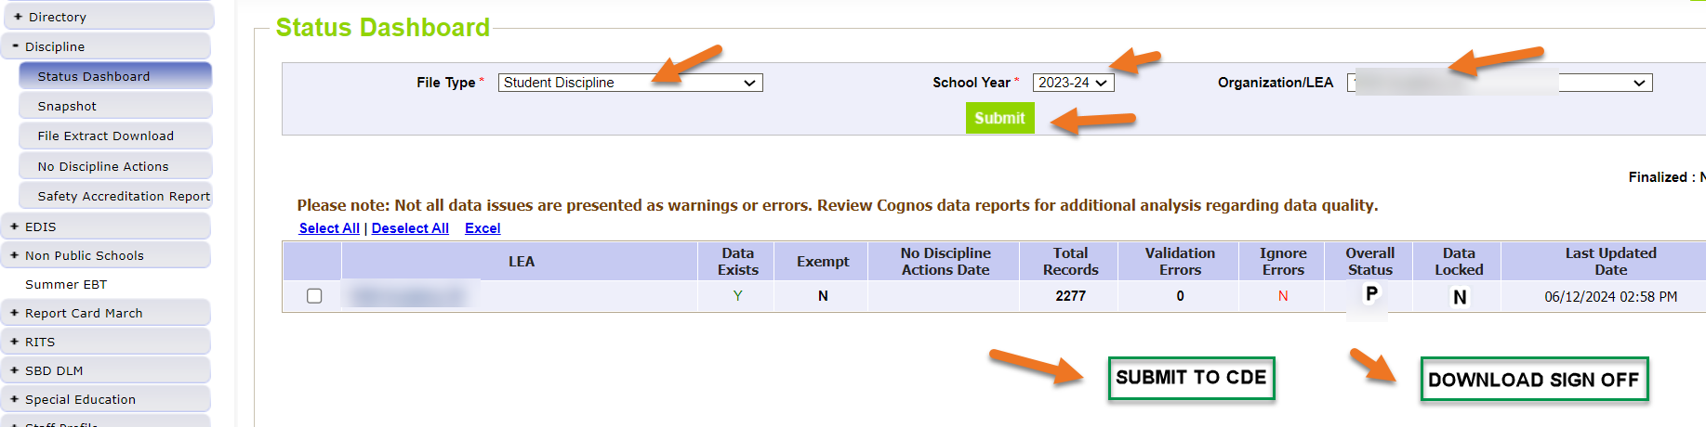
Student Discipline-No Discipline Data to report
Student Discipline Snapshot-Dawna Gudka
StudentDiscipline@cde.state.co.us

Slide 23
Student Discipline Snapshot-LEA’s that are error free
Once you have validated your data-Submitted Data to CDE
Reminder each time you upload a corrected interchange file you must create a snapshot. The snapshot takes a look at your data at the time the create snapshot button is clicked.
Student Discipline Snapshot-Dawna Gudka
StudentDiscipline@cde.state.co.us

Slide 24
Questions & Answers:
Student Discipline Snapshot
Please include your 4-digit LEA when emailing or leaving a voicemail
Discipline Interchange website
Student Discipline Training recording
Student Discipline Snapshot website
Dawna Gudka
(303) 598-7901

Slide 25
Special Education Discipline
Lindsey Heitman

Slide 26
Special Education Discipline Snapshot
Timeline:
May 1, 2024 - SPED Discipline Snapshot official open
May 23, 2024 - All Interchange files that feed into snapshot uploaded or updated at least once
June 27, 2024 - Interchange errors resolved – Discipline Action File, Child File, Participation File and at least one snapshot taken
JULY 31, 2024
August 15, 2024 - All Exception requests submitted to CDE processing
August 22, 2024 - Snapshot error-free
Aug. 22 – Aug. 29, 2024 - Report Review
August 29, 2024 - Final Submission approval in Data Pipeline and reports uploaded to DMS.
July 31st, 2024
Student Discipline Snapshot is due by this date!
**The Student Discipline Snapshot also includes the Sped student records. **
SpedDiscipline@cde.state.co.us
Special Education Discipline – Lindsey Heitman

Slide 27
Special Education Discipline Snapshot
Steps to complete by July 31st:
1. Verify all member districts have uploaded a Discipline Action file or marked no actions
  Use ‘District Activity Report’ found in Cognos Reports/Special Education Discipline
2. Create snapshot and clear snapshot errors
  with help of district respondent
3. Submit any exception requests needed
4. Review validation reports found in Special Education Discipline Cognos folder
  SPED Discipline Data Summary Report
  SPED Discipline: Year to Year Comparison Type of Disciplines Report
SpedDiscipline@cde.state.co.us
Special Education Discipline – Lindsey Heitman

Slide 28
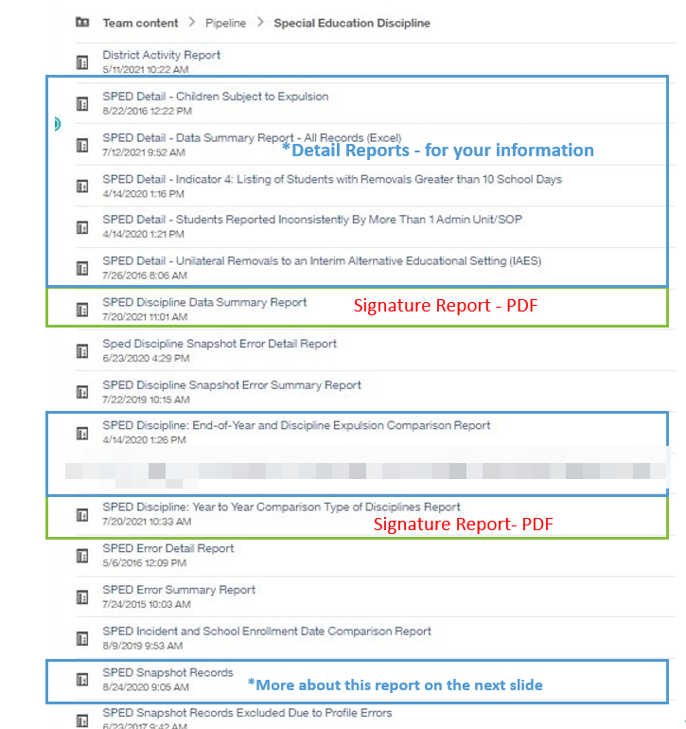
Special Education Discipline – Lindsey Heitman
PLEASE REVIEW
COGNOS Reports:
Help you to validate your data
Summarize your data in ways you may be asked to provide internally
SpedDiscipline@cde.state.co.us

Slide 29
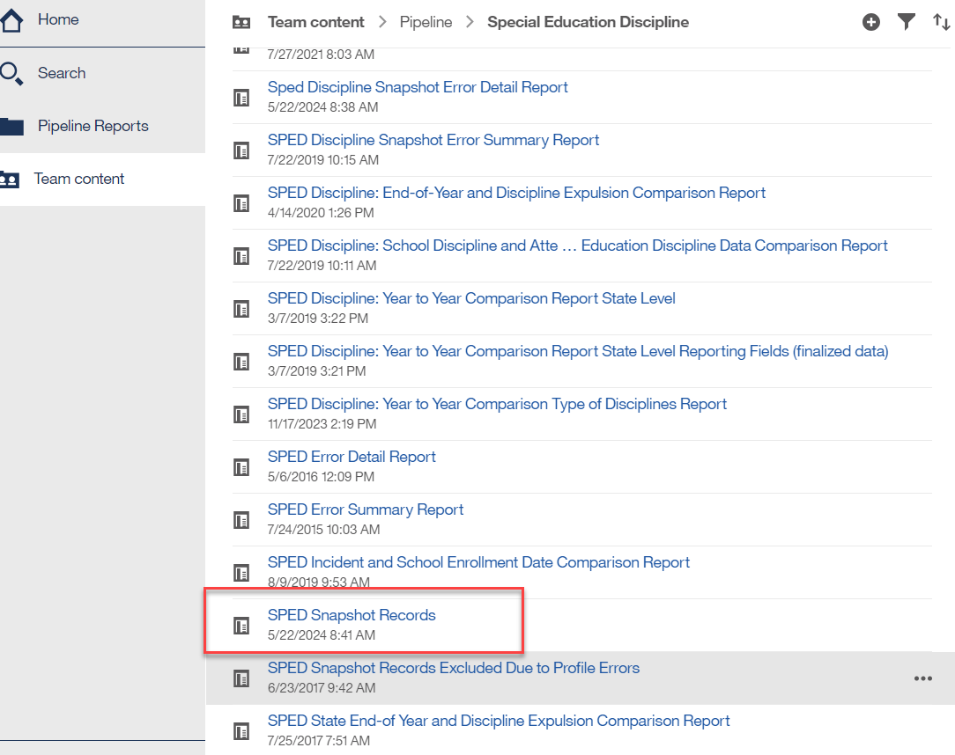
Cognos Report-SPED Snapshot Records
These are all the records in your SPED Discipline Snapshot
You can use this as a reference when questions arise from other reports
It’s a good idea to download and save the report in Excel
SpedDiscipline@cde.state.co.us
Special Education Discipline – Lindsey Heitman

Slide 30
Questions & Resources:
Special Education Discipline
Lindsey Heitman
SpedDiscipline@cde.state.co.us
Discipline Interchange Webpage
Special Education Discipline Snapshot Webpage

Slide 31
Student End of Year
Reagan Ward

Slide 32
SEY Collection Timeline:
Upcoming Events
Date | Event | Event Description
7/17/2024 2:30-3:30pm | Training Event | July SEY Office Hours Registration Link
7/25/2024 | Interim Deadline | Submit any necessary reporting exceptions for review.
8/8/2024 | Interim Deadline | Error free SEY Snapshot
8/14/2024 2:30-3:30pm | Training Event | August SEY Office Hours: Reviewing Reports and Data Validation Registration Link
8/9/2024 to 9/5/2024 | Report Review | • Validate Student End of Year data using CEDAR/COGNOS reports. • Submit snapshot as soon as review is complete
9/5/2024 | State Deadline | Submit Student End of Year snapshot
9/19/2024 | Cross LEA Open | Districts may begin creating snapshots as soon as they receive a ‘snapshot unlocked’ notification from data pipeline; typically mid-day.
10/17/2024 | Deadline | Resubmit SEY snapshot
10/24/2024 | Post-Cross LEA Open | Districts may begin updating their snapshot to address Post-Cross LEA business rules.
11/19/2024 | Deadline | Post-Cross phase ends. Districts must have error free SEY snapshot and have addressed any necessary post-cross changes.
12/3/2024 | Deadline | Collection closes. • Superintendent Verification (sign-off) form due. • Data remains embargoed until the official release in January
Visit the SEY Website to download the complete SEY Collection Timeline with Training Dates
Student End of Year – Reagan Ward
StudentEndOfYear@cde.state.co.us

Slide 33
File Status as of 7:30 am on 7/11
Interchange Status
Snapshot Status
File | Notes
DEM | 12.4% (23/185) LEAs with errors
SSA | 11.4% (21/185) LEAs with errors
GG | 4.3% (8/185) no data 4.9% (9/185) errors remaining
3.8% (7/185) no snapshot attempted
16.8% (31/185) 100+ errors
10.8% (20/185) Submitted
  Districts who are error free and have reviewed their initial SEY data may submit their snapshot when ready.
  Districts with potential summer graduates/completers are encouraged to wait until August to submit their snapshot after they’ve updated any school exit types for grad/completers.
Note: SG15 business rule on the GG file has been fixed. Please upload GG file to clear these errors.
Student End of Year – Reagan Ward
StudentEndOfYear@cde.state.co.us

Slide 34
Reminders
Data Pipeline Maintenance Window
Collection Emails
Every Tuesday evening at 5pm
Avoid creating SEY snapshots after 4pm on Tuesdays because snapshots that are in progress when the maintenance window begins may fail
At times, file uploads may not be available during the maintenance window
Collection News
  Approximately monthly to all LEA Approvers and LEA Users
  Contains pertinent collection information, including notes regarding known issues or recently fixed issues
Other Emails
  Targeted emails are sent when a LEA has a specific need, such as missing an interim deadline or question
  SEY Office Hour agendas if not already included in Collection News
Student End of Year – Reagan Ward
StudentEndOfYear@cde.state.co.us

Slide 35
Questions & Answers:
Student End of Year
StudentEndOfYear@cde.state.co.us
720-484-9057
Student End of Year Website
Student Interchange Website
Graduation Guidelines Website

Slide 36
Attendance
Brooke Wenzel

Slide 37
Attendance Timeline
Date | Event | Event Description
07/12/2024 | Deadline | Submit Attendance Snapshot data.
07/26/2024 | Deadline | Collection closes Superintendent Verification (sign-off) form due. Data remains embargoed until the official release in August.
08/16/2024 | Data Release | Official data release
See the Attendance website for collection timeline
Attendance – Brooke Wenzel
Attendance@cde.state.co.us

Slide 38
Attendance Snapshot Status (6:20 am, 7/11)
Attendance – Brooke Wenzel
Attendance@cde.state.co.us

Slide 39
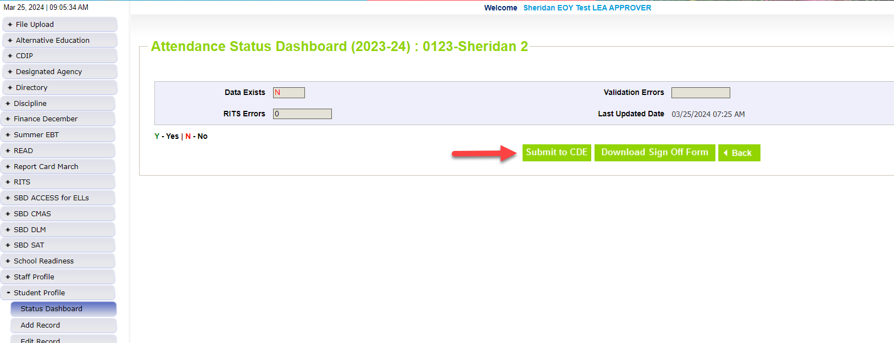
Finalizing Data
Log into Data Pipeline
Click Student Profile
Click Status Dashboard (fill out prompts for Attendance Snapshot)
Click Submit to CDE (must have ATS~LEAAPPROVER role) – Due Tomorrow!
Download Signoff Form (Due July 26th)
Attendance – Brooke Wenzel
Attendance@cde.state.co.us

Slide 40
Questions & Resources:
Attendance
Brooke Wenzel
Attendance@cde.state.co.us
720-441-7963
Attendance Webpage
Student Interchange Webpage

Slide 41
Student Interchange 2024-2025
Brooke Wenzel

Slide 42

Student Interchange Opens!
2024-2025 Student Interchange Opens on Monday, July 15th
There will be two years of data that are open at the same time! Please make sure you are selecting the right year (Data Pipeline will autofill to 2024-2025)
2023-2024 open for collections wrapping up from last school year (Reagan Ward)
2024-2025 will open in preparation for Student October (Brooke Wenzel)
Student Interchange – Brooke Wenzel and Reagan Ward
StudentOctober@cde.state.co.us

Slide 43
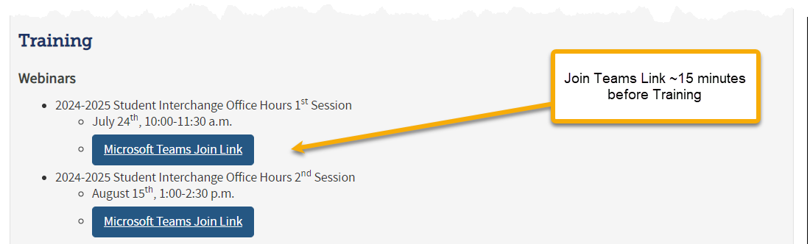
Student Interchange Office Hours - Schedule
July 24th
  10:00 – 11:30 am
August 15th
  1:00 – 2:30 pm
Join the Office Hours on the Student Interchange Website!
Target Audience: New Respondents/Those who work with Student information on other collections.
Student Interchange – Brooke Wenzel and Reagan Ward
StudentOctober@cde.state.co.us

Slide 44
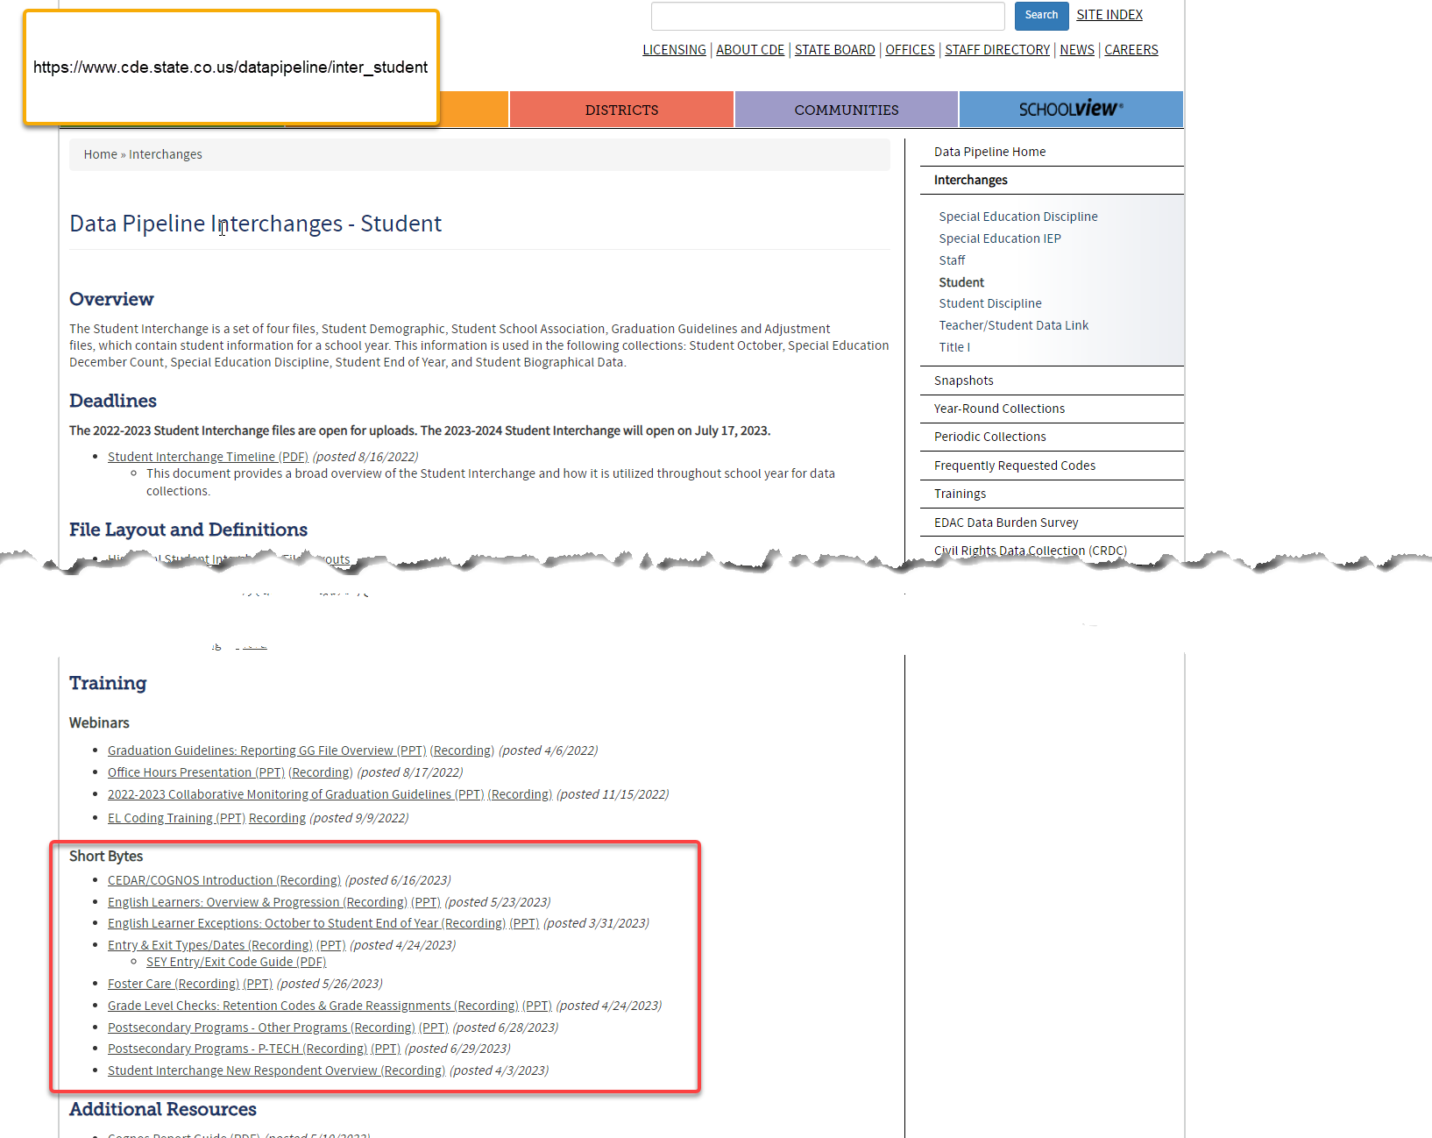
Short Bytes (Student Interchange Website)
Student Interchange Website
  Resources and More!
  Short Bytes: short videos that review specific topics
  Webinars: Office Hours Presentation from last year
Student Interchange – Brooke Wenzel and Reagan Ward
StudentOctober@cde.state.co.us

Slide 45
What to Look Out for Next Year
New Data Fields in 2024-2025 SSA File Layout
  Independent Study Course, Work-Based Learning Course, Blended Learning Course, Supplemental Online Course
English Language Learner Errors
  Some year-to-year checks were checking on a district basis, updated it to check via SASID. Only applied to a small number of ELL errors.
    Ex: Student was in District A with Language Proficiency X in 2023-2024, student moved to District B with Language Proficiency Y in 2024-2025 (error was not flagging before since district was different)
Gifted and Talented Error
  Prior year vs. current year check to verify if a student is gifted in one of the 14 categories, they continue to be identified as such
Updates to Cognos Reports
Student Interchange – Brooke Wenzel and Reagan Ward
StudentOctober@cde.state.co.us

Slide 46
Questions & Resources:
Student Interchange
Brooke Wenzel
StudentOctober@cde.state.co.us
720-441-7963
Student Interchange Webpage

Slide 47
School Auditing Office Updates
Rebecca McRee

Slide 48
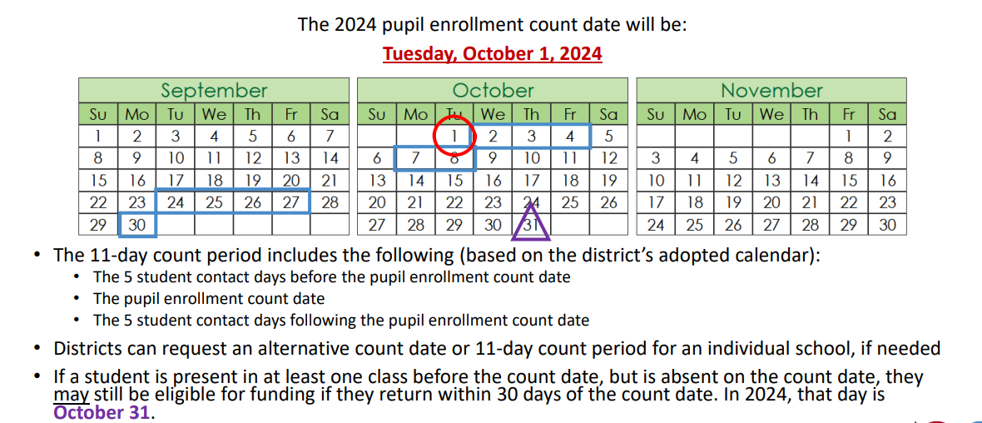
Student October Count Day 2024
School Auditing Office
School Auditing Office Website

Slide 49
Audit Resource Guides for 2024
The pupil and at-risk count guides for the 2024/2025 school year are now available.
  Pupil Count: 2024 Student October Count Audit Resource Guide
  At-Risk Count: 2024 At-Risk Count Audit Resource Guide
The English Language Learner Count Guide will be posted on or before August 1, 2024 to the English Language Learner Count Website.
In all posted Guides, the Delta symbol Δ is used to identify information that has been updated or clarified since the previous edition of the applicable Guide.
  The pupil count guide also includes a "Summary of Changes" which is located at the end of the Guide.
School Auditing Office
School Auditing Office Website

Slide 50
New Pupil Count Audit Forms (Required)
Detention Center Notification (AUD-101 Form) UPDATED
Compliance Assurances for Contracted Services (AUD-108 Form) NEW!
Confirmation of Part-Time Funding Eligibility Form (AUD-109 Form) NEW!
School Auditing Office
School Auditing Office Pupil Count Website

Slide 51
New Pupil Count Forms and Processes (Optional)
Instructions for Applying for an Alternative Count Date UPDATED
Brick-and-Mortar Affidavit of Colorado Residency Sample NEW!
Instructions for Applying for Alternative Attendance for Independent Study Courses NEW!
Pupil Count Document Checklist NEW!
Out of State Transfer Enrollment Eligibility Sample Form NEW!
Online Signature Guidance UPDATED
School Auditing Office
School Auditing Office Pupil Count Website

Slide 52
New: Annual Audit Review Process (Required)
Beginning with the 2024 Student October Count data collection, the School Auditing Office is changing its approach to the required compliance audits.
Annual Audit Review Process (Overview- PDF)
Pupil Count Audit Questionnaire
At-Risk Count Audit Questionnaire
English Language Learner (ELL) Count Questionnaire
Audit District Contact Form
Initial audit documentation upload (as described on each questionnaire) will be due by December 11, 2024.
School Auditing Office
School Auditing Office Website

Slide 53
Training and Office Hours
Upcoming Trainings:
Student October: Intro to the Audit Resource Guide (2 hrs.) July 16, 2024 (1PM)
Student October: Calendar & Bell Schedule Calculations July 18, 2024 (10AM)
Preparing for the New Annual Audit Review July 23, 2024 (10AM)
Student October: What's New for Pupil Count Audit Contacts? July 30, 2024 (10AM)
At-Risk Count Audit Overview August 8, 2024 (1PM)
Transportation CDE-40 Overview FY23/24 August 15, 2024 (10AM)
English Language Learner Count Audit Overview September 17, 2024 (10AM)
Duplicate Count Office Hours November 5, 2024 (10AM)
Audit Trainings Website
School Auditing Office
Audit Trainings Website

Slide 54
Training and Office Hours - Completed
Completed Trainings and Office Hours (in preparation for the 2024/2025 school year):
Public School Finance Act Update--Office Hours June 13, 2024
Student October: What's New for Program & Curriculum Leaders? June 6, 2024
Public School Finance Act Update--Office Hours May 30, 2024
Student October: What's New for AECs (Alternative Education Campuses)? May 22, 2024
At-Risk Funding & CEP for Business Officials May 21, 2024
Student October: What's New for Online Schools and Programs? May 20, 2024
Public School Finance Act Update--Office Hours May 16, 2024
Public School Finance Act Update--Office Hours April 16, 2024
Informational Session Regarding Changes to the Public School Finance Act March 21, 2024
Audit Trainings Website
School Auditing Office
Audit Trainings Website

Slide 55
New: At-Risk Measure Interchange File Overview
Beginning with the 2024/2025 school year, there is a new Data Pipeline At-Risk Interchange.
The purpose of the At-Risk Interchange is to obtain student level census block information needed to implement the new at-risk measure as described in HB22-1202 with data collection to begin with the 2024-2025 school year as provided for under SB24-188.
The new at-risk measure will be implemented starting with the 2025/2026 school year, and included in the Total Program funding calculation as described in the Public-School Finance Act which will continue to utilize student level data reported through the Student October Count data collection
This interchange is tentatively scheduled to open on July 15, 2024 and close November 8, 2024. It will only be open during the Student October Count Collection.
ARMeasure@cde.state.co.us
At-Risk Interchange

Slide 56
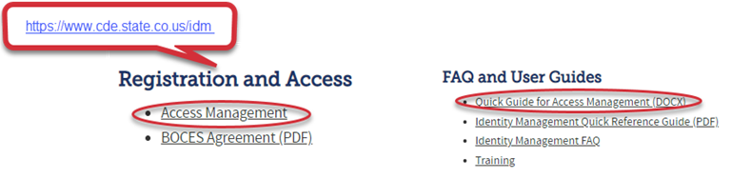
New: At-Risk Measure Interchange Identity Management Role
Don’t have access?
Talk to your District’s Local Access Manager (LAM)!
Note: To receive communication about the at-risk interchange, you must have this role!
Application | Collection | Role | Access Level
Pipeline | At Risk Measure (ARM) | LEA User | Upload and Edit Records for the At-Risk Measure File
Pipeline | At-Risk Measure (ARM) | LEA Viewer | View Cognos reports – cannot edit data
ARMeasure@cde.state.co.us
At-Risk Interchange

Slide 57
New: At-Risk Measure Interchange File
There are currently 3 trainings scheduled:
  Overview of the Geocode Tool July 24, 2024 (1PM)
  Overview of the Geocode Tool August 13, 2024 (10AM)
  Overview of the Data Pipeline At-Risk Interchange File August 20, 2024 (1PM)
To access these trainings, click on the link found in the green box located on the At-Risk Interchange website. The link will be activated approximately 15 minutes prior to the start of the training.
For questions, contact ARMeasure@cde.state.co.us
ARMeasure@cde.state.co.us
At-Risk Interchange

Slide 58
Questions & Answers:
School Auditing Office
Audit@cde.state.co.us
Pupil Count Website
At-Risk Count Website
English Language Learner Count Website
Training and Office Hours Website

Slide 59
READ Training
Tara Rhodes

Slide 60
READ Training Collection
Purpose and Timeline
Purpose:
Districts must annually ensure and report that all kindergarten through third grade teachers who provide literacy instruction to students in kindergarten through third grade and all teachers who provide reading intervention in grades 4-12 have successfully completed evidence-based training in teaching reading.
Districts must also report kindergarten through third grade principals and administrators and/or personnel who the district determines meet the statute criteria as needing to complete the kindergarten through third grade Principal/Administrator training.
Important Dates:
August 1: Collection scheduled to open
August 15: Teachers, principals, and administrators should have their respective READ training designations added to their COOL accounts
August 30: Collection scheduled to close
READ Training Collection
READActData@cde.state.co.us

Slide 61
READ Training Collection
Changes for 2024-25 Collection Year
This is the first year that districts are required to report completion of the READ administrator training for staff as well as the READ teacher training for Grades 4 through 12 staff.
Due to the addition of administrators to this collection, two columns were added to the file layout to capture the administrator information. The updated file layout can be viewed here.
The codes and business rules for the administrator training fields mimic the teacher training status codes and business rules.
READ Training Collection
READActData@cde.state.co.us

Slide 62
READ Training Collection
General Process for Collection Completion
General Process for Collection Completion:
This collection starts with an export out of Data Pipeline of a list of educators who may be required to take either the teacher or administrator training.
  This is based on certain job class codes from the previous year's Human Resources collection.
Districts can then add, edit, or remove educators as it relates to this export based on their job function and whether the district has determined if the educator needs to take the training.
After this is complete, districts then upload this file back into Data Pipeline, check for errors, and officially submit.
READ Training Collection
READActData@cde.state.co.us

Slide 63
READ Training Collection
Office Hours and Resources
Office Hours:
All office hours are occurring on Thursdays at 3:30pm.
Thursday, 6/27 - Slides have been posted here.
Thursday, 7/11 - Link to register here.
Thursday, 7/25 - Link to register here.
Thursday, 8/8 - Link to register here.
Resources:
24-25 File Layout
READ Training Website
READ Training Collection
READActData@cde.state.co.us

Slide 64
Questions & Resources:
READ Training
Tara Rhodes
Email: READActData@cde.state.co.us
Phone: 720.601.4125
READ Training Website

Slide 65

Thank you for joining today!
Next Town Hall will be July 18th
Town Hall will continue to meet weekly throughout the summer.

