Slide 1
January 9, 2025
Data Pipeline Town Hall
The goal of the webinar is to provide updates on the Data Pipeline, current, and upcoming data collections. These webinars also provide a forum for districts, BOCES, and Administrative Units to have questions answered about Data Pipeline.

Slide 2
Colorado Department of Education
Identity Management (IdM)
Identity Management Site
Frequently Asked Questions
How do I add myself or others to the email listserv for town hall emails and/or a specific collection?
  Email lists are dependent on a person’s access rights in IdM. Contact your LAM to get an account or be assigned to a specific collection.
Where can I find the IdM role mappings for Data Pipeline and other applications?
  Role Mapping (XLS)
I am a LAM. How do I update the user permissions for someone in my district?
  Follow the steps outlined in the IdM Quick Guide for Access Management (DOCX)
Important: Users are not automatically removed from IdM when their email address is no longer active in your district. The LAM must deactivate their IdM account to ensure only designated staff can access CDE’s data reporting system.
Notes:
LAMs, please check the IdM roles for your district. Remove permissions for users who have retired, left your district, or are no longer assigned to a collection. Add roles for new hires and newly assigned respondents for specific collections.

Slide 3
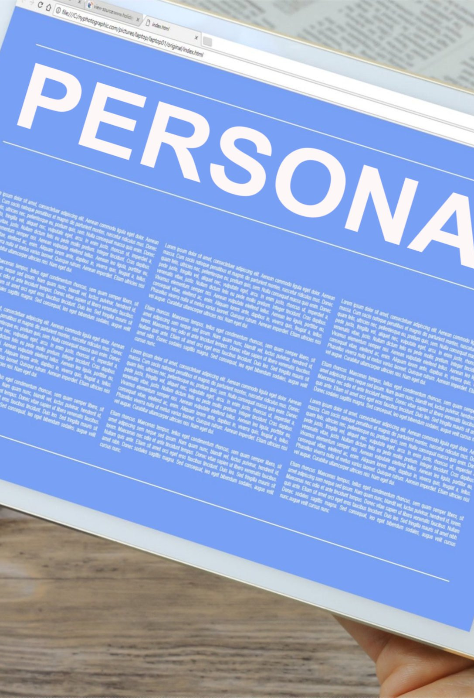
What is PII?
Student and Staff Personally Identifiable Information (PII) is defined by state and federal laws as information that, alone or in combination, personally identifies an individual
  This includes direct identifiers
  (i.e. student and staff names, SASID, EDID, etc.)
  Includes information that when combined is identifiable
Colorado’s Student Data Transparency and Security Act outlines requirements for how Student PII is collected, used and shared
See the Data Privacy and Security website for prepared guidance on how to comply with this and other privacy laws.

Slide 4

Sharing Data
Use secure methods to transfer any PII to CDE
  Contact Data Collection leads with questions about how to transmit PII securely
    Each Data Collection leads maintains their own Syncplicity folders for specific collections, reach out to the collection lead for access
  Use Syncplicity to encrypt emails to CDE
Avoid sending PII via unencrypted email or to unsecured faxes when sharing data between or within districts
  Use Syncplicity to encrypt emails to CDE
Check local policies for restrictions, requirements, etc. regarding PII
  Do not use PII in trainings, presentations, etc.
  Do not share PII with unauthorized individuals
  Do not share passwords
  Follow local policies when transmitting PII to any third party

Slide 5
Today’s Agenda
Agenda Topic | Presenter
Open Data Collections and Upcoming Deadlines in Data Pipeline | Host: Collin Slutzky
Civil Rights Data Collection (CRDC) | Annette Severson
Special Education December Count | Lindsey Heitman
Prevent Harassment or Discrimination | Peter Hoffman
Summer EBT | Collin Slutzky
Human Resources | Dawna Gudka
Student Interchange Reminders | Reagan Ward

Slide 6
Open Collections and
Upcoming Deadlines in
Data Pipeline

Slide 7
Open Collections and Upcoming Dates:
Year-Round & Interchanges
Name | Category | Status | Key Dates
RITS | Year Round | Open | N/A
EDIS | Year Round | Open | N/A
Directory | Year Round | Open | N/A
Student | Interchange | Open | January Recommendation: Update DEM & SSA files
At-Risk | Interchange | Closed | N/A
Title I | Interchange | Open | May 2025: Update file in preparation for SEY reporting
Special Education IEP | Interchange | Open | Error free files required for SPED December Count
Staff | Interchange | Open | Error free files required for SPED December and Human Resources
Teacher Student Data Link | Interchange | Open | Opened 12/11/2024
Data Pipeline Resources: Data Pipeline Collection Dates (XLS)

Slide 8
Open Collections and Upcoming Dates:
Snapshots
Name | Category | Status | Final Deadline Date | Next Milestone | Looking Ahead
Student October | Snapshot | Closed | Nov. 27, 2024 | Data Release: 1/15/2025 Data is embargoed until the release. Data will be posted on the Pupil Membership Ed Stats Website. | n/a
Student End of Year | Snapshot | Closed | Nov. 19, 2024 | Data Release: 1/14/2025 1/22/2025 Data is embargoed until the release. | n/a
Special Education December Count | Snapshot | Open | Feb. 21, 2025 | Interim Deadline: 01/30/2025 Snapshot error-free | 1/30/2025 – 2/07/2025 Report Review
Human Resources | Snapshot | Open | Feb. 21, 2025 | Interim Deadline: 1/10/2025 Create a Human Resource Snapshot | Interim Deadline: 1/24/25 Snapshot error-free
Teacher Student Data Link |  | Closed | Aug. 29, 2025 | Interchange Opened: 12/11/2024 | Snapshot Opens: 2/19/2025
Data Pipeline Resources: Data Pipeline Collection Dates (XLS)

Slide 9
Open Collections and Upcoming Dates:
Periodic
Name | Category | Status | Final Deadline Date | Next Milestone | Looking Ahead
Summer EBT | Periodic | Closed | Feb. 28, 2025 | Collection Opens: 2/3/2025 LEAs may begin uploading Summer EBT files to Pipeline
Data Pipeline Resources: Data Pipeline Collection Dates (XLS)

Slide 10
Civil Rights Data Collection (CRDC)
Annette Severson

Slide 11
Current Status
CDE Pre-populated the data for LEAs on Dec 20th without issues
Collection is open until March 7th – LEAs are responsible for
  Reviewing data to ensure accuracy
  Entering data not pre-populated by CDE
  Mark data as certified once completed
CRDC
crdc@aemcorp.com

Slide 12
Questions & Resources:
Civil Rights Data Collection
CRDC Resource Center
CRDC Partner Support Center - crdc@aemcorp.com
CDE Contact: Annette Severson – Severson_a@cde.state.co.us

Slide 13
Special Education
December Count Snapshot
Lindsey Heitman

Slide 14
Special Education December Count
Timeline
Next deadline is Thursday, January 30th 15 working days!
  Date to have a complete Special Education December Count Snapshot:
    All Staff and IEP Interchange errors resolved
    All Dec Staff Snapshot errors resolved
    All Dec Student Snapshot errors resolved
What to work on now?
  Create December Count Snapshots and work with your staff data respondent(s) until all errors are resolved
  AU respondent is responsible for checking both Dec Student and Staff Snapshot error reports:
    Pipeline Reports/Error Report
      Sp. Ed December Count Staff
      Sp. Ed December Count Student
    OR Cognos Reports/Special Education December folder
      Errors: staff detail report of errors to correct
      Errors: student detail report of errors to correct
Special Education December Count – Lindsey Heitman
SpedDecCount@cde.state.co.us

Slide 15
Special Education December Count
Grade Level Pulls from Student Interchange
Reminder
    Grade field pulls from the district’s Student Interchange SSA file for most records
      This is regardless of what grade is reported in your Participation file
        - Unless it’s a private or facility school student (generally not included in Student Interchange Files)
    Dec Snapshot pulls grade from the district’s SSA record with latest ‘School Entry Date’
    AU respondent will need to work with their district respondent on the issue
      Error DC132
    **Any changes in your snapshot may be the result of changes in the files in the Student Interchange or Staff Interchange. Use District Activity Report to research issue:
AUs will find a District status report found under Cognos Reports/Special Education December folder (DEC role)
District/AU Activity Report
Lists the status of all Staff Profile and Staff Assignment file uploads and # of errors
Breaks it out by district and AU
Special Education December Count- Lindsey Heitman
SpedDecCount@cde.state.co.us

Slide 16
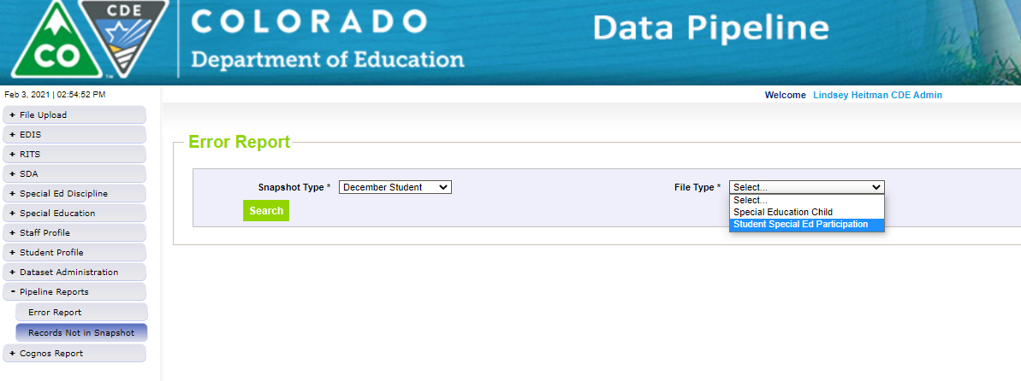
Special Education December Count:
Helpful Report
Records potentially missing from your snapshot may be found in this report.
Records listed in this report do not meet the snapshot criteria (several reasons this could occur)
Use this report to find why a staff or student interchange record is missing from your snapshot
Note: this report will list ALL Staff Interchange and IEP Interchange records that are missing from the snapshot. Keep in mind HR (gen-ed staff records) do not need to be in your snapshot so many of the records may be ignored. Export to Excel and search to find the record you’re looking for.
Filter on Snapshot Type ‘December Student’ or ‘December Staff’ and each file
Missing records= missed funding! Check for records that were receiving SPED services as of 12/01/24.
Pipeline Reports → Records Not in Snapshot
Special Education December Count- Lindsey Heitman
SpedDecCount@cde.state.co.us

Slide 17
Questions & Resources:
Special Education December Count
Lindsey Heitman
SpedDecCount@cde.state.co.us
(720) 456-2033
Special Education IEP Interchange Webpage
Special Education December Snapshot Webpage

Slide 18
Prevent Harassment or Discrimination Collection (PHD Collection)
Peter Hoffman

Slide 19
Prevent Harassment or Discrimination Overview
SB 23-296
Senate Bill 23-296 states that:
(5) (a) ON OR BEFORE JULY 1, 2025, AND ON OR BEFORE JULY 1 OF EACH YEAR THEREAFTER, EACH PUBLIC SCHOOL OF A SCHOOL DISTRICT SHALL REPORT TO THE SCHOOL DISTRICT, AND EACH INSTITUTE CHARTER SCHOOL SHALL REPORT TO THE STATE CHARTER SCHOOL INSTITUTE, THE FOLLOWING INFORMATION, AGGREGATED AND WITHOUT PERSONALLY IDENTIFIABLE INFORMATION ABOUT THE PARTIES, FROM THE PRIOR TWELVE MONTHS:
(I) THE NUMBER OF FORMAL HARASSMENT OR DISCRIMINATION REPORTS RECEIVED BY THE SCHOOL AND THE TYPE OF BIAS REPORTED WHEN HARASSMENT OR DISCRIMINATION WAS FOUND; AND (II) THE TIME TO COMPLETE EACH INVESTIGATION AND TO MAKE FINDINGS RELATED TO EACH REPORT.
(b) ON OR BEFORE AUGUST 1, 2025, AND ON OR BEFORE AUGUST 1 OF EACH YEAR THEREAFTER, THE STATE CHARTER SCHOOL INSTITUTE AND EACH SCHOOL DISTRICT SHALL REPORT TO THE DEPARTMENT OF EDUCATION THE INFORMATION IT RECEIVED FROM EACH SCHOOL PURSUANT TO SUBSECTION (5)(a) OF THIS SECTION.
PHD Collection
Hoffman_p@cde.state.co.us

Slide 20
PHD Collection Timeline
Date | Event | Event Description
January 2025 | Soft Open | PHD Collection to Soft Open for Districts that want to participate early
May 2, 2025 | Official Open | PHD Collection Open
August 1, 2025 | State Deadline | PHD Collection Closes
PHD Collection
Hoffman_p@cde.state.co.us

Slide 21
Prevent Harassment or Discrimination Overview
User Roles
LAMS – Please ensure someone in your district has these one of these roles in Identity Management
PHD~LEAVIEWER
PHD~LEAUSER - Recommended
PHD~LEAAPPROVER - Recommended
Only one of these roles should be assigned per user or they will encounter errors when trying to login to data pipeline.
Application | Collection | User Role | Access Level | Notes
Pipeline | Prevent Harassment and Discrimination | LEA User | Upload and edit records | Users with this role can complete the majority of the collection but will require support from a user with the LEA Approver role.
Pipeline | Prevent Harassment and Discrimination | LEA Approver | Upload and edit records, submit final collection, download sign-off form. | At least one person in the district must have this role. Can do all of the actions that a LEA User role can do.
Pipeline | Prevent Harassment and Discrimination | LEA Viewer | View CEDAR/COGNOS reports related to the collection. Cannot edit data. | Useful role for district staff who need access to collection related CEDAR/COGNOS reports for data validation but are not actively completing the data collection.
PHD Collection
Hoffman_p@cde.state.co.us

Slide 22
Prevent Harassment or Discrimination Overview
Early Frequent Questions
Is the Prevent Harassment or Discrimination Collection for students, staff or both? PHD Data collection is student level only.
What is the a ‘formal’ report? A formal report is one that has an investigation and has findings where the LEP decided if the report of discrimination was founded or unfounded.
Can a single investigation have multiple bias related to it? Yes, a record can have multiple different bias associated with it as being found during the investigation.
PHD Collection
Hoffman_p@cde.state.co.us

Slide 23
Prevent Harassment or Discrimination Overview
Resources
Training Materials, Business Rules, File Layouts can be found at the Prevent Harassment or Discrimination Collection Website.
SIS vendors should already have started on extracts, if not please direct them to the file layout on the PHD website or to hoffman_p@cde.state.co.us with any questions
Additional resources and CDE points of contact surrounding Harassment, Discrimination, Title IX, and Bullying can be found on the Prevention of Harassment, Discrimination, and Bullying in Colorado Schools website.
PHD Collection
Hoffman_p@cde.state.co.us

Slide 24
Questions & Resources:
Prevent Harassment or Discrimination
Peter Hoffman
Hoffman_p@cde.state.co.us
720-925-8611

Slide 25
Summer EBT
Collin Slutzky

Slide 26
Summer EBT Data Collection
Data Collection begins February 3rd.
File layout is unchanged from last year.
Error-free files must be submitted by February 28th.
Districts have the following options for submitting student records:
  Submit data for all students enrolled in National School Lunch Program sites only.
  Submit data for all students enrolled in NSLP sites and data for any F/R eligible transfer students to non-NSLP sites during the school year (any student that was enrolled at a NSLP site, even for a short period of time, would be eligible for S-EBT benefits)
  Submit data for all enrolled students at both NSLP sites and non-NSLP sites.
Submitting data for all enrolled students will be the easiest option for most districts, as your S-EBT reports from your SIS likely use this option.
s-ebt@cde.state.co.us
Summer EBT
Notes:
Your district schools are most likely receiving calls from families to update their address, make sure you are in contact with the appropriate people to make sure this updated information is being captured in the summer EBTcorrections.

Slide 27
Summer EBT Data Collection:
Preparing for the Collection
Verify that Free and Reduced Lunch status is up-to-date for all students.
Check the S-EBT report in your SIS and make sure it matches the S-EBT file layout available on the date collection resource page.
  If the S-EBT report from your SIS is missing or incorrect, please contact your vendor immediately and include Collin Slutzky (slutzky_c@cde.state.co.us) on communications.
Plan to submit your first file by Friday, February 7th so you have plenty of time to correct errors.
Bookmark the form to schedule office hours in case you have issues uploading your file or resolving errors. Schedule a meeting with us in January if you would like additional training.
Summer EBT
s-ebt@cde.state.co.us

Slide 28
Questions & Resources:
Summer EBT
Collin Slutzky
s-ebt@cde.state.co.us
(720) 760-3569
S-EBT Data Collection Resources

Slide 29
Human Resources
Dawna Gudka

Slide 30
Human Resources:
Collection Timeline
Date | Event | Event Description
1/10/25 | Interim Deadline | Create at least one Human Resources Snapshot
1/24/25 | Interim Deadline | Human Resources Snapshot Error Free
1/24-1/31/25 | Report Review | Review Special Education Staff Report via Cognos in the Human Resources folder) for accuracy to ensure all special education staff reported within your district is appropriate. Collaborate with your LEA’s Administrative Unite during this process. Verify that all staff are accurately reported.
2/14/25 | Interim Deadline | Staff Profile and Staff Assignment interchange files, and Human Resources Snapshot Error Free
2/21/25 | Deadline* | Human Resources Snapshot must be submitted to CDE and verification emailed to Human Resources Snapshot
Human Resources Snapshot Collection
HumanResourcesData@cde.state.co.us

Slide 31
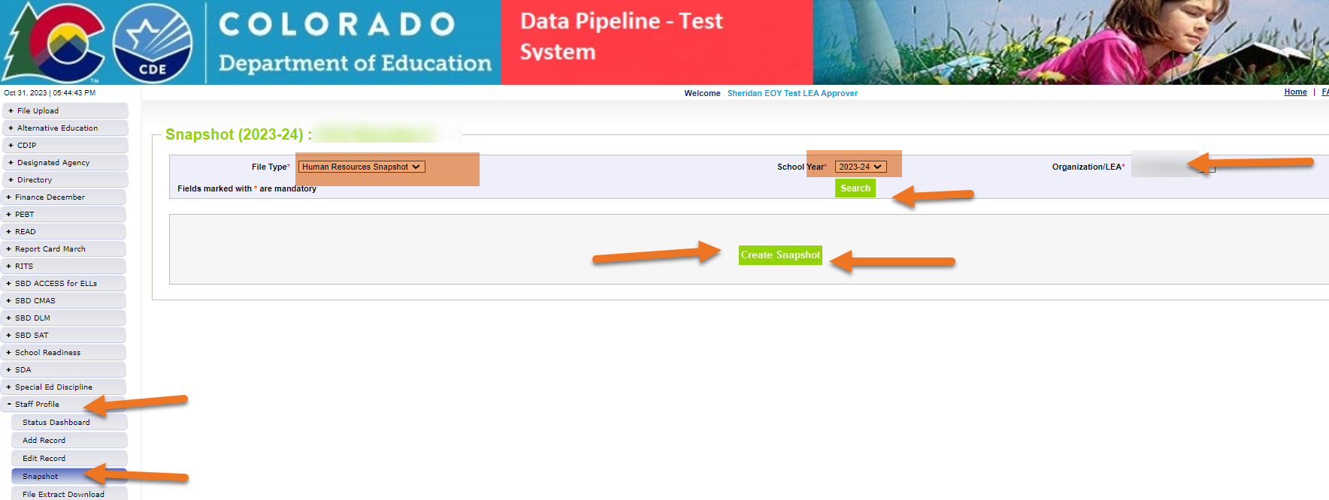
Creating a Human Resources Snapshot
Creating a Snapshot Data Pipeline merges the interchange files together
Human Resources Snapshot Collection
humanresourcesdata@cde.state.co.us

Slide 32
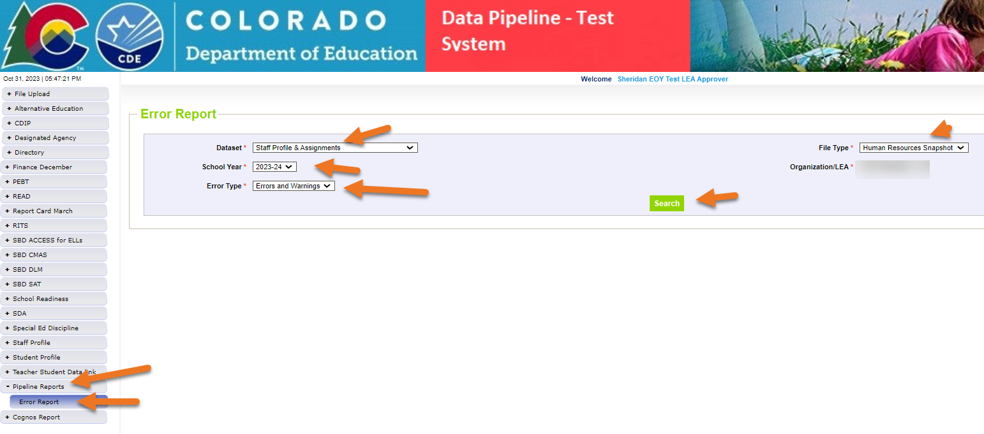
Checking for Snapshot Errors
Click on View Details
Human Resources Snapshot Collection
humanresourcesdata@cde.state.co.us

Slide 33
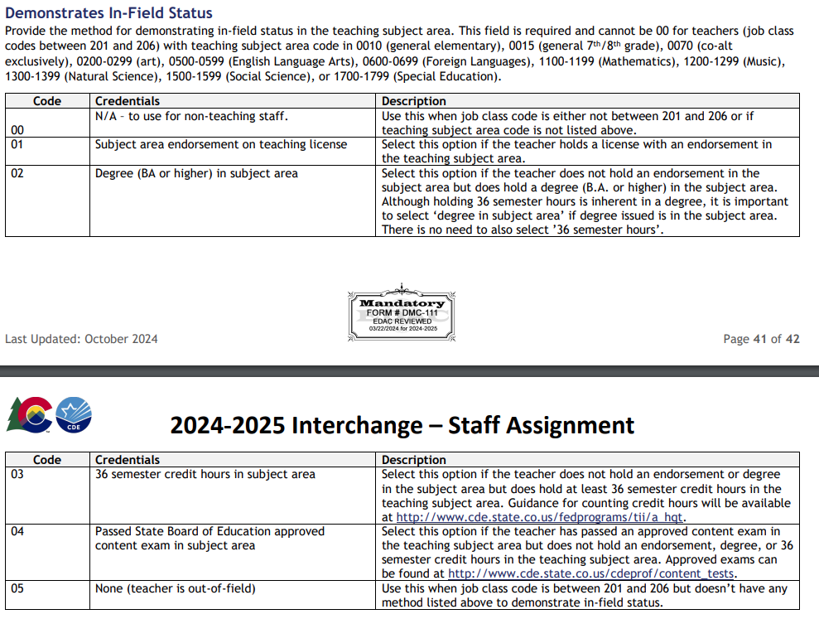
Common Errors
HR053 At least one Subject Area of Degree is required for Classroom Instructional Staff (job class codes between 201 and 206)
  If they do less than a bachelor’s degree, the subject area is no degree
HR200 A matching endorsement for the teaching subject area code and grade level reported was not found for this teacher in the license database. Please update the field 'Demonstrates In-Field Status 1' to another code (02= Degree; 03=36 Semester Hours; 04=Passed Exam; or 05=Out of Field).
  Correct the demonstrates in field status code
Human Resources Snapshot Collection
humanresourcesdata@cde.state.co.us

Slide 34
Common Errors continued
HR208 All teachers reported at a Title I School Wide school OR reported with job class code 206 are required to hold a valid Colorado teaching license which is not evident for this record
  Teachers in School wide Title 1 schools are required to hold a valid Colorado teaching license or district must met requirements of notifying the parents.
HR230 The Educator Shortage Survey has not yet been indicated as completed. This will be updated every Thursday evening. To complete the Educator Shortage Survey
  Survey must be completed
Human Resources Snapshot Collection
humanresourcesdata@cde.state.co.us

Slide 35
Questions & Resources:
Human Resources
Collection Resources:
Staff Interchange website
Human Resources Snapshot website
Dawna Gudka
HumanResourcesData@cde.state.co.us
(303) 598-7901

Slide 36
Student Interchange Reminders
Reagan Ward

Slide 37
Student Interchange 2024-2025 Support:
January 2025 through December 2025
Contact: Direct questions and exception requests to StudentEndOfYear@cde.state.co.us
  Use the ‘SEY 2024-25’ subfolder inside your district’s Student Syncplicity folder for exception requests
New to student interchange reporting?
  Check out the 2024-2025 Student Interchange Office Hours Recording and PPT.
  Reach out to Reagan if you’d like an additional one-on-one time to discuss questions after reviewing training materials.
Check out the recorded training webinars and short bytes to on-demand topic specific information.
Additional resources section of the Student Interchange website include topic specific PDF guides and related resources.
Student Interchange
StudentEndOfYear@cde.state.co.us

Slide 38
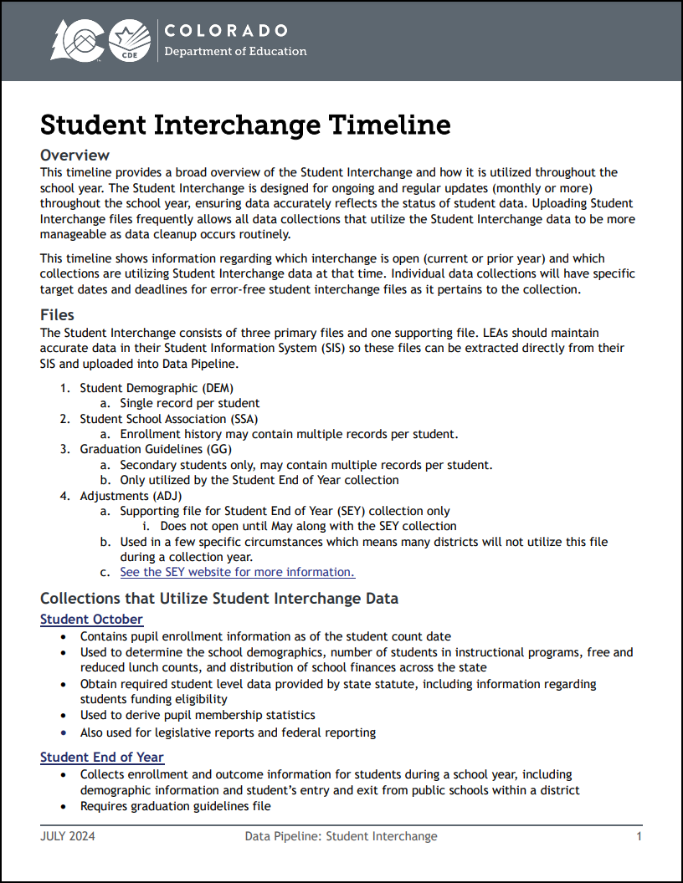
Resource Highlight:
Student Interchange Timeline
Available on Student Interchange Site
January and February Highlights:
  Only current year (2024-2025) interchange is open
  Open collections: SPED December Count, TSDL Snapshot
  Connected Work: Spring Assessments coming soon. Accurate student information needed by District Assessment Coordinators
  Recommendations:
    Upload DEM, SSA, GG files
    Address any EL errors.
      Especially critical for newly enrolled students to ensure screening occurs when needed.
    Begin submitting mid-year change requests if you have a student whose October status will not match SEY due to a known change.
      Especially if October was NEP/LEP but they should be FEP MY1 instead and will not be taking ACCESS
      Some mid-year changes will not trigger interchange level errors but will trigger SEY 2024-2025 errors once that collection opens. May submit a mid-year change form in anticipation of SEY errors. Then would do a regular exception request once SEY opens.
Student Interchange
StudentEndOfYear@cde.state.co.us

Slide 39
December CLDE Update: Data implications
CLDE released guidance 12/6/24 to EL program staff regarding updated redesignation criteria for MLs with the most significant cognitive disabilities based upon WIDA Alternate ACCESS scores from the 2023-2024 school year
Will cause mid-year changes for a small population of students
In most circumstances, no error will trigger until the Student End of Year 2024-2025 collection (SE209)
Use the regular exception request template (XLS) and indicate the reason “Alternate Access Participated redesignated mid-year per updated redesignation criteria” in the request even if the student has 2+ years of EL history.
Other mid-year EL changes for students with 2+ years of EL history will continue to require a mid-year EL change request form (DOC)to accompany the regular exception request.
See the directions for submitting exception request (PDF) on the Student Interchange website for more information.
  Beginning in January, all 2024-2025 requests should be submitted to StudentEndOfYear@cde.state.co.us
Student Interchange – Reagan Ward
StudentEndOfYear@cde.state.co.us

Slide 40
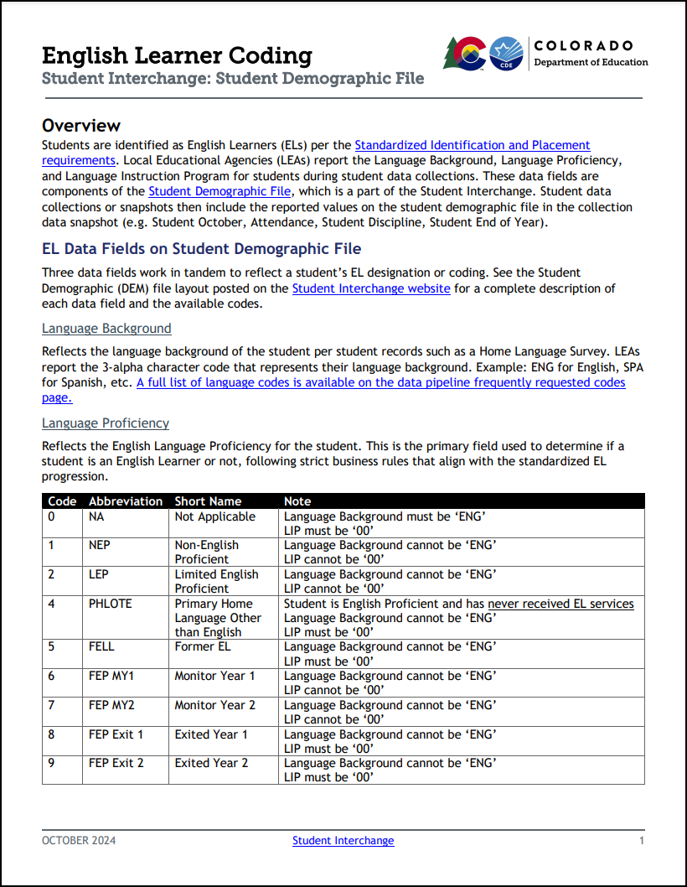
Resource Highlight:
English Learner Coding Guide
Available on Student Interchange & SEY websites in the additional resources section
Includes annual EL data cycle and Standardized EL Progression
Supports coding when students transfer between districts
General information regarding business rules and exceptions
Updated October 2024 to provide additional clarity for HLS/Screening scenarios and Data Best Practices
Best Practices Highlight:
  Some DEM business rules indicate situations that may need further investigation. Uploading regularly allows respondents to find these situations early and communicate with their CLDE teams to allow timely investigation.
Student Interchange
StudentEndOfYear@cde.state.co.us

Slide 41
Questions & Resources:
Student Interchange
Student Interchange Page
2024-2025 Interchange Questions/Exception Requests:
Reagan Ward
StudentEndOfYear@cde.state.co.us
720-484-9057

Slide 42
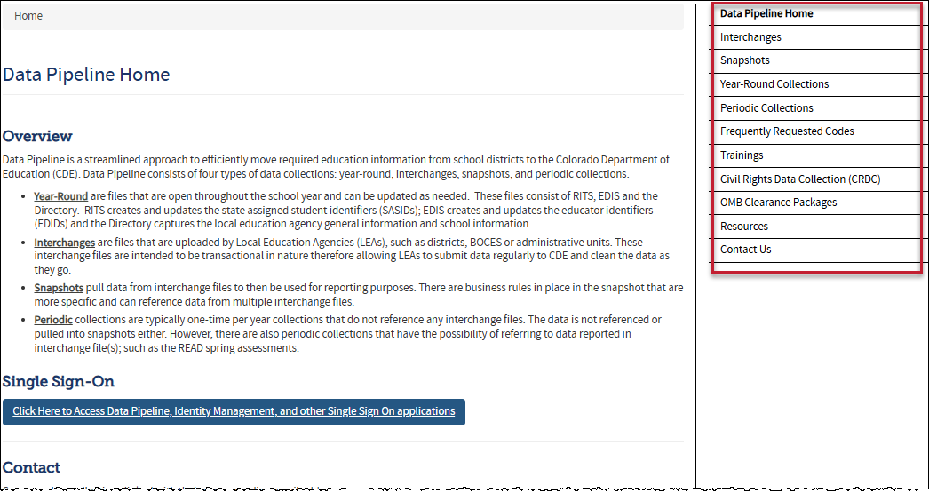
Thank you for joining today!
Next Town Hall will be January 16th
Reminder:
Each data collection has a more detailed timeline, file layout and other helpful resources posted on their corresponding webpage.
Visit the Data Pipeline Homepage to access collection pages.

