Slide 1
ACCESS for ELLs
Student Biographical Data (SBD) Collection
Training for 2023-2024
CDE Assessment Unit

Slide 2
Welcome!
As we are getting started:
  Please mute your microphones.
  Cameras have been turned off for participants for privacy reasons.
  This session will be recorded and posted to the SBD collection webpage as soon as possible after the session ends.

Slide 3
Training Webinar Roadmap
Presentation Outline:
General Information
  Purpose
  Collection Timeline
  Role Assignments in Identity Management (IdM)
SBD Step-by-Step Guide
Deeper Dive into ACCESS SBD:
  Background Information
  Changes for 2023-24
  Specific Fields
Time for Questions

Slide 4
SBD: Purpose
The Student Biographical Data (SBD) Review Process provides districts with an opportunity to verify the accuracy of student data after testing but prior to reporting and accountability calculations.
This process is completed for the following four assessments:
  WIDA ACCESS for ELLs Assessment
  CMAS Assessments
    -ELA/Math (including CSLA) and Science
    -CoAlt Science
  CO PSAT/SAT
  CoAlt Dynamic Learning Maps (DLM)

Slide 5
SBD: General Process
For each collection:
Vendors provide portals for districts to use to validate data prior to testing.
Data used in the SBD review process comes from the vendor system after testing.
The SBD review process can be used to validate/update student information that is not in the vendor portal. One example is SASID validation.
The SBD review process is not required BUT is highly recommended because inaccurate data can impact accountability.

Slide 6
SBD: Collection Timeline
 | Assessment | Dates | Data Pipeline Group Name
1 | ACCESS for ELLs (ACCESS SBD) | 3/11/2024-3/20/2024 | ACC
2 | CMAS (CMAS SBD) ELA (including CSLA) Math Science CoAlt Science | 5/16/2024-5/29/2024 | CMS
3 | CO PSAT/SAT (SAT SBD) | 5/15/2024-5/22/2024 | SAT
4 | CoAlt ELA/Math (DLM SBD) | 5/29/2024-6/5/2024 | DLM

Slide 7
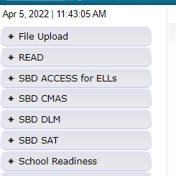
SBD: Group Role Assignments
You can learn whether you have access to the collections by logging into Data Pipeline and reviewing the gray boxes on the left-hand side.
If you do not have access to the collections, please reach out to your district’s local access manager (LAM). Please ensure that the APPROVER role is assigned.
CDE cannot provide access for district users.
Collection | Data Pipeline Group
WIDA ACCESS for ELLs | ACC
CO PSAT/SAT | SAT
CMAS: ELA/Math CoAlt: Science | CMS
CoAlt DLM | DLM
The table to the left shows the group code for each SBD collection (also provided on Slide 6).

Slide 8
SBD: Support Email/Phone
SBD support is available by phone or email
  CDE has a team that responds to emails and to phone calls. Please use the SBD Support phone number and email address. Do not contact a specific person at CDE or the general CDE Helpdesk.
  This provides a single point of contact for all collections.
  Emails create support tickets that can be tracked to ensure that questions are answered quickly – Remember not to send student PII by email!
  Members of multiple CDE units are available to answer different questions (Assessment, Accountability, and Information Management Systems).
Phone Number: 720-696-0185
Email address: sbdsupport@cde.state.co.us

Slide 9
SBD Review: Step-by-Step Guide

Slide 10
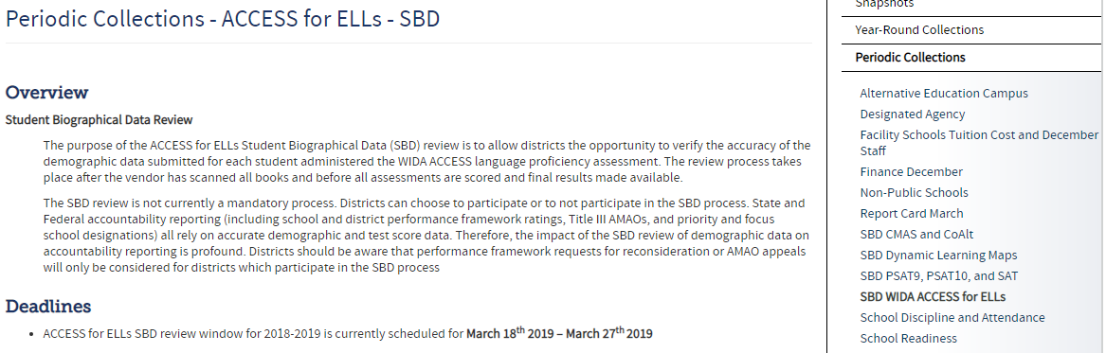
Step 1: Download the SBD Manual and Collection Specific Information
Please download the SBD Manual and collection specific information.
  Link for Manual: SBD Manual 2023-24
    The manual provides a detailed, step-by-step process with screenshots on how to complete the four SBD collections.
  Link for collection specific information: Data Pipeline Collections Website
    Please download and review:
      SBD File Layout (includes specific instructions for each field)
      Business Rules (includes how to resolve errors)
      Training materials (including the SBD Manual)

Slide 11
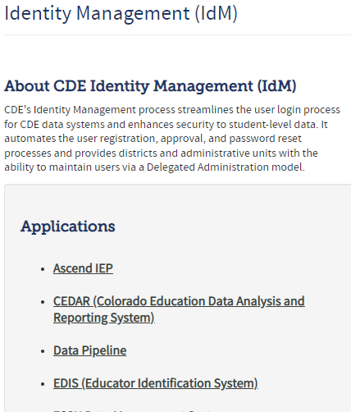
Step 2: Log in to Data Pipeline
On the Identity Management website, select “Data Pipeline” under Applications on the left side of the screen.
Enter your username and password
Check:
  There is no red banner at the top of the screen
  Your user role is correct
  The collection you are working on appears on the left side of the screen
Most log-in issues must be handled by your LAM.

Slide 12
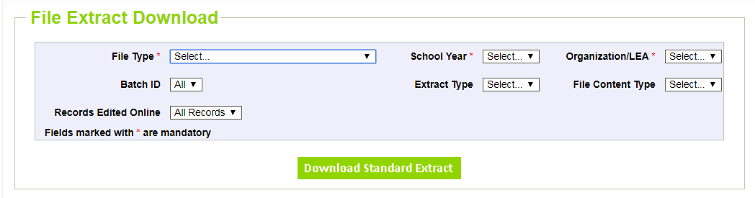
Step 3: Download a Vendor SBD Extract
Navigate to the collection tab along the left-hand side.
Select “File Extract Download” for the appropriate assessment.
Make the following selections:
  File Type: Vendor File
  Extract Type:
    SBD Extract – Vendor demographic data (WIDA ACCESS and CMAS only)
    SBD Extract using Student Profile – Student Interchange demographics
  File Content Type:
    Excel: If you are using Excel for data review use this, not .csv
    CSV: Comma delimited
    Text: Fixed format

Slide 13
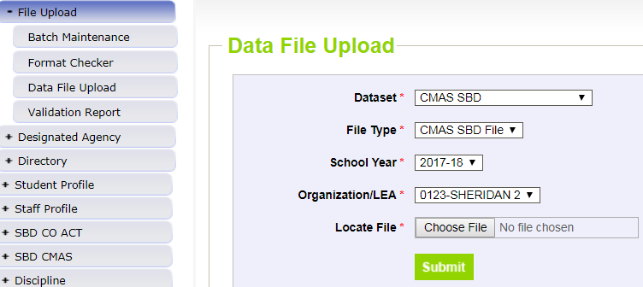
Step 4: Upload Vendor SBD Data Extract
Upload back into Data Pipeline prior to editing the file
  Allows access to COGNOS reports
    Error Summary
    Error Detail
  The number of errors found can help guide data clean up and give a sense of how much work needs to be done on the file
  Activates the Edit Records screen
This is done by:
  Select “File Upload” tab -> Data File Upload
  Choose file and submit
  Emails:
    Submission Notification
    File Upload Summary

Slide 14
Step 5: Review Errors and Warnings
The number of errors and warnings are available in two places:
  Error Report under “Pipeline Reports” along the left-hand side
  COGNOS Error Summary Report under “Cognos Reports”
Identifying specific records with errors can be done in three places:
  COGNOS Error Detail Report
    Download as an Excel file to review
  Pipeline Report – View Details
    Same layout as the Error Detail Report
  Edit Records Page
    Choose records with errors and warnings
    Fields with errors will be red; warnings will be yellow

Slide 15
Step 6: Correct Data Errors
Method 1: Correcting errors using the Vendor SBD Extract File
  Open the vendor file in your chosen program
  Update data in records with errors
    Start with SASID errors
    Use the Data File Layout with field definitions and the Business Rules documents to figure out how to correct the data
      Business rules will explain errors. For example, “Date First Enrolled US cannot be blank”.
  Upload the file periodically to check your progress
    Once you are down to just a few errors, it may be faster to use the Edit Records screen

Slide 16
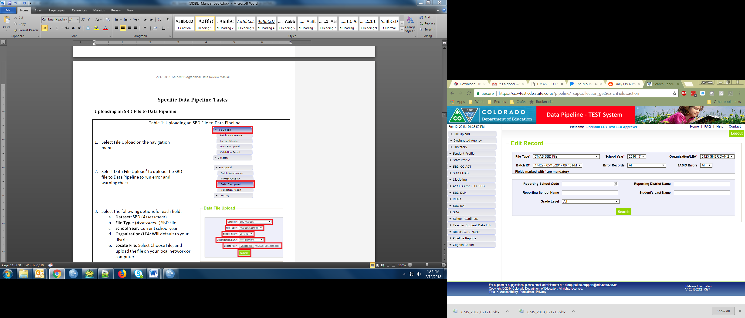
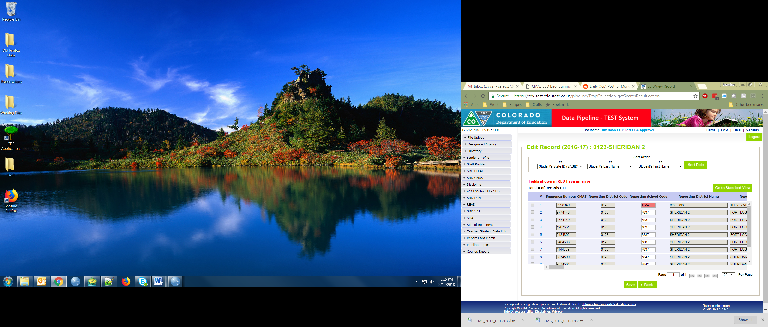
Step 6: Correct Data Errors (Continued)
Method 2: Correcting errors using the Edit Records page
  On the Edit Records page, select the appropriate drop downs
  Check the box next to record you would like to edit
  Correct the data in the fields highlighted in red
  Make sure that the box along the left-hand side is checked, and then click “Save” to save the edits

Slide 17
Step 7: Data Validation
Data Pipeline can only check for certain types of errors
  It cannot check that your demographic data is accurate (i.e., a student is actually Hispanic or not)
  It cannot validate that students have the correct invalidation
    The Data File Layout will have instructions for how to select the appropriate invalidation
Do not change/make up data just to clear errors!
  If you have a lot of missing data, check a different extract
    Maybe the interchange data or vendor data is better
  Making up data can cause issues with reporting and accountability
  If you have an error that cannot be cleared but the data is correct, contact SBD Support.
Warnings
  Warnings are used to inform users of situations that may indicate errors but not necessarily (more than 10% Native American)
  Warnings do not prevent data submission

Slide 18
Step 7: Data Validation (Continued)
Download the COGNOS SBD Summary Report
  Compare your district summary numbers to last year’s final data
    Large changes in the number of students in a category could indicate a coding error or incorrect data submitted to the Interchange or vendor system
  Review Reasons Not Tested and Invalidation codes
    Check for students who have not tested or invalidation codes entered but who may have scores
      ACCESS has 6 Reason Not Tested codes or 1 invalidation code (INV)

Slide 19
Step 8: Submit SBD Data
Download your final SBD extract for your records through the File Extract Download option
  This is especially important if you use the Edit Records screen
Select “Status Dashboard” under the appropriate assessment collection
Review the data on the Status Dashboard to make sure you are ready to submit
  Validation Errors and RITS Errors must be zero unless SBD Support has ignored errors
  If errors are ignored, you must submit without making any additional changes or uploading a new file or it will reset the ignore errors status
Click “Submit to CDE” and “Yes” in the pop-up window
If you need to make additional changes after submission, SBD Support can unlock your data until the end of the window

Slide 20
Troubleshooting
See the SBD Manual for common issues and trouble shooting techniques
Users generally have issues at three different points in the SBD process:
  Logging in to Data Pipeline
    Generally these issues must be resolved by the district LAM.
    CDE cannot change or grant user permissions.
  Uploading a Data file
    This is usually an issue with the file format. See the manual for common issues and how to identify them.
  Clearing Errors
    Usually the Data File Layout and Definitions and Business Rules documents are enough to identify why an error is occurring.
    If you think an error is triggering incorrectly, contact SBD Support.

Slide 21
Deeper Dive into ACCESS SBD:
Background Information

Slide 22
Deeper Dive into ACCESS:
Background Information
WIDA ACCESS for ELLs is the English Language Proficiency assessment.
Students classified as Non-English Proficient (NEP) or Limited English Proficient (LEP) are required to take WIDA ACCESS. No other students take this assessment.
The assessment is offered in all grades, K-12.
There is an alternate version (Alt-ACCESS) used for students with significant cognitive disabilities.
The testing window starts in January, so the data clean up is earlier than other state assessments.

Slide 23
Deeper Dive into ACCESS:
Collection Documentation (Slide 1 of 2)
All documentation can be found on the ACCESS SBD webpage: http://www.cde.state.co.us/datapipeline/per_access-ell
Available Documentation:
  File Layout and Definitions Section:
    The 2023-24 file layout is updated and posted for this collection year. There were three main changes to the file layout from the 22-23 collection year.
    This document provides all fields, as well as their position, length, and valid values, for the collection.
    This document also provides whether the field is updateable.
  Business Rules Section:
    There was the addition of 6 new business rule for the 2023-24 collection year.
  Link to the SBD Manual:
    This links to the manual that is applicable for all SBDs and lays out the SBD process step-by-step.

Slide 24
Deeper Dive into ACCESS:
Collection Documentation (Slide 2 of 2)
All documentation can be found on the ACCESS SBD webpage: http://www.cde.state.co.us/datapipeline/per_access-ell
Available Documentation:
  Failsafe Templates:
  The District Transfers Failsafe Form: This is the document used to move students between districts. There was no change from the 22-23 collection year.
  This should only be used for students who are in your district’s SBD file but moved out of your district before or during the testing window and DID NOT TEST in your district.
  Do not use the Failsafe form to report any students who tested in your district and moved afterward. If they moved after testing, the student data should remain in the district where the student tested.
  The Add a Newly Arrived to the U.S. Student Failsafe Form: Please use this form to submit students to CDE who: 1. were not included in the Colorado October 1 Count collection, 2. recently arrived to the United States and, 3. enrolled in your district as their first enrollment in the US.
  Training information and documentation.
    This powerpoint, as well as the recording, will be posted to the website as soon as it is available.

Slide 25
Deeper Dive into ACCESS SBD:
Changes for 2023-24

Slide 26
Deeper Dive into ACCESS SBD:
Changes for 2023-24
Changes for 2023-24 Collection Year:
The first change is the addition of a nonbinary category (code ’03’) for the gender field.
The second change is the addition of a Not Tested Reason field to the file layout.
  This field provides the reason as to why students did not test. This field is updateable during SBD and blanks are allowed.
    Valid values are:
      00 – Absent
      03 – Withdrew Before Testing
      04 – Student Refusal
      07 – Medical Exemption
      10 – Did Not Attend
      11 – Data Error
  The addition of this field also affected the Do Not Score (DNS) fields. The DNS fields are now not updateable, as any INV cases should have been reported to CDE during administration.
Notes:
Absent: The student was absent for all domains, all five weeks of the test window and one of the other not tested reasons does not apply
Withdrew: The student left the district before they started testing
Student Refusal: The student refused to begin testing all domains when the opportunity was provided
Medical Exemption:
Did Not Attend: The student was not absent but did not attend a scheduled/rescheduled test session for any domain
Data Error: There was an error in the data submitted at October Count and the student is not NEP or LEP

Slide 27
Deeper Dive into ACCESS SBD:
Changes for 2023-24
The third change is the addition of a new failsafe form.
  This failsafe form can be used to submit students to CDE who have newly arrived in the U.S. as recently as February 9.
  If you did not already add recently arrived to the U.S. NEP/LEP students through WIDA AMS in February, you can use the Add a Newly Arrived to the U.S. Student Failsafe Form to add these students during SBD.
    This is for students who are identified as NEP/LEP and:
      Were not included in the Colorado October 1 Count collection,
      Recently arrived to the United States, and
      Enrolled in your district as their first enrollment in the U.S.
  This follows the standard procedure for failsafe forms:
    Submit the failsafe form to CDE using Syncplicity
    Send an email to SBD Support at sbdsupport@cde.state.co.us letting us know that you have uploaded a file. If you do not email us, we will not retrieve it.
Changes are highlighted in yellow on the file layout.

Slide 28
Legislative Considerations
The legislature is considering possible mechanisms for providing additional funding to districts that have experienced an acute increase in enrollment of newcomer students -- and one of the mechanisms that has been considered is ACCESS data. For example, on Friday, March 1, a bill titled School Funding for New Arrival Students was included in the Joint Budget Committee's Potential Legislation Packet 7 (pleg7-02-28-24.pdf (colorado.gov)). Although not officially introduced, if passed, this bill would provide additional funding for some newly arrived NEP/LEP students enrolled after the Student October Count collection and enrolled for the first time in a US School by February 9. The ACCESS for ELLs file would be used to identify the number of these students in each district.
Including all of your students identified as NEP/LEP who: 1) were not included in the CO October 1 Count collection, 2) recently arrived to the United States and 3) enrolled in your district as their first enrollment in the US by February 9 may have financial implications this year.
Please be sure to work closely with your enrollment staff and district assessment coordinator to get these students added, regardless of whether or not they took ACCESS for ELLs this year.

Slide 29
Deeper Dive into ACCESS SBD:
Specific Fields and Rules

Slide 30
Deeper Dive into ACCESS SBD:
Vendor Variables
DRC Student ID
  This is an ID created by DRC for their internal system.
  It is included because it helps SBD Support find records in the vendor file to answer questions or complete Failsafe requests.
Assessment Type
  This field indicates whether a student took the General or Alternate version of the WIDA ACCESS for ELLs.
Reported Record
  This field indicates if a record is being considered a duplicate or primary by DRC and can help resolve duplicates or missing domain issues.

Slide 31
Deeper Dive into ACCESS SBD:
Language Fields
WIDA ACCESS for ELLs is intended for multilingual learners only. The values for the “Language” fields must be correct or the record will be invalidated.
Language Proficiency
  Only 1 (NEP) or 2 (LEP) are valid values.
Language Background
  This field cannot be ENG (English).
  Use only 3-character alpha codes that are used in the Student Interchange:
    https://www.cde.state.co.us/datapipeline/org_orgcodesLanguage Instruction Program
  Students must be in a program if they are NEP or LEP.
  If a student is a multilingual learner but has been opted out of a Language Instruction Program by a parent, use ’98’.
  Using the code of 00 or blank will trigger an error.

Slide 32
Deeper Dive into ACCESS SBD:
Test Cluster
WIDA ACCESS for ELLs tests are based on grade clusters rather than specific grade levels.
Each test domain (Reading, Speaking, Writing, Listening) has a grade cluster field, which indicates the grade cluster the student took for that domain.
The values for grade cluster are provided by WIDA based on the actual test taken by the student for that domain. The cluster CANNOT be changed during the SBD review process. If a student took any domain of the test in the incorrect grade cluster, that domain must be invalidated.
If one of the cluster fields is blank, it may mean that the student did not complete that domain, or the student’s information has been split across multiple records.
  If the student did not complete one or more domains, he/she will not receive an overall score.
  In some cases, domains may be split across multiple records for the student. Instructions for how multiple records for a student can be merged are provided later in this presentation.

Slide 33
Deeper Dive into ACCESS SBD:
Test Clusters by Grade
 | General Assessment | General Assessment | Alternate Assessment
Student’s Grade | Paper – Valid Cluster | Online – Valid Cluster | Paper (Online Not Available) – Valid Cluster
Kindergarten | 0 | N/A (Online not available for Kindergarten) | 0
Grade 1 | 1 | 1 | 0
Grade 2 | 2 | 2 | 0
Grade 3 | 3 | 2 | 3
Grades 4-5 | 4 | 4 | 3
Grades 6-8 | 6 | 6 | 6
Grades 9-12 | 9 | 9 | 9

Slide 34
Deeper Dive into ACCESS SBD:
Do Not Score and Not Tested Reason Codes
Some of the historical Do Not Score codes are now more appropriately captured in the Not Tested Reason codes field, such as “Absent”.
Students who do not test are not included in the WIDA data files unless a Do Not Score code was applied by the district or school during the testing window.
WIDA ACCESS for ELLs does not have a state accountability participation component; none of the Do Not Score or Not Tested Reason codes are classified as “exempt” or “not exempt.” Parent opt-out is not legally allowed for WIDA ACCESS.
Do Not Score codes are used to prevent DRC from creating a score for the student for that domain. Instances where the Do Not Score code may have been applicable should have been reported to CDE during assessment administration.

Slide 35
Deeper Dive into ACCESS SBD:
Do Not Score and Not Tested Reason Codes
Not Tested Reason Codes:
  00 – Absent: Used only for students who were absent for the entire testing window but did not withdraw from the school
  03 – Withdrew Before Testing: The student left the district before they started testing.
  04 – Student Refusal: The student refused to begin testing all domains when the opportunity was provided.
  07 – Medical Exemption
  10 – Did Not Attend: The was not absent but did not attend a scheduled/rescheduled test session for any domain
  11 – Data Error: There was an error in the data submitted at October Count and the student is not NEP or LEP.
Do Not Score Code:
  Invalidation (INV)
  Used if the student completed some of the test but the test session was not valid and should not be scored
  This will be applied by CDE prior to loading the vendor file to Pipeline.
  These fields have now been made non-updateable and are there for your reference.

Slide 36
Troubleshooting:
More than One Record for a Student
Sometimes there will be more than one record for the same student.
  This situation is often caused by information incorrectly bubbled on paper tests. In grades 1-3, all writing test responses are on paper even if the other domains are administered online, so the majority of split records occur for students in these grades.
  Multiple records for a single student are often created when identifying fields bubbled on the paper materials do not match an existing student record in WIDA AMS. In this situation, WIDA will create a new record from the information provided on the paper test.
  Do not try to merge multiple records yourself – this must be done by DRC after the SBD review process ends. Errors will trigger if the records do not match on the necessary fields.

Slide 37
Time for Questions
Questions?
Please feel free to unmute or use the chat box.

Slide 38
Contact Information
Please contact SBD Support with any questions:
Email: sbdsupport@cde.state.co.us
Phone: 720.696.0185
Website:
https://www.cde.state.co.us/datapipeline/per_access-ell

