Slide 1
2024
State Accountability, Measures & Improvement Planning
District Resource Slide Deck to Engage Boards of Education
Prepared by Accountability & Continuous Improvement Unit
Colorado Department of Education

Slide 2
Purpose of this CDE Slide Deck Resource
This resource has been developed by CDE to support the achievement of two primary outcomes:
Support district leadership by training staff to better understand and share district and school performance framework reports and data with their local Board of Education and key stakeholders.
Support Boards of Education in better understanding state accountability and related data within the context of their local policies, priorities, and community context.

Slide 3
General Recommendations for Using the Slide Deck
Slides should be selected to meet the needs of the district context. Slide #4 provides a directory of the available content that can be used to develop a district personalized slide deck.
The template may be changed to reflect the formatting used at the local level and/or as required by district leadership (see slide four).
If this triangle symbol 🔼 is included in the upper right portion of a slide, this indicates that data entry or other information is required (i.e. to capture the local context).
The ‘speaker notes’ section on may slides includes a ‘Narrative’ as a draft script for technical content. Some slides also have a ‘Note to presenter’ that lets the presenter know they need to adjust slide template w/district logo and/or specified information as needed.

Slide 4
Updating Slides with Alternate Template Format
The CDE PowerPoint template on which the content is presented may be replaced as needed.
The slide templates can be changed by selecting the designer button found below the home tab to the far right of the ribbon.
Once the designer button is selected you will see a list of design options on the right. Simply select the desired template to update the presentation or slide.
Notes:
Note to Presenter: this slide explains how to update CDE template formatting to reflect local district templates.

Slide 5
Content Available to Adapt and Share with Local Boards
Topic | Purpose
Colorado Educational Accountability: Role of Local BOE | provides an overview of Colorado’s Accountability System and the role of local Boards of Education (BOE) within the context of accountability
Accreditation Process: Timeline | identifies responsibilities of local educational agencies and their local BOE within the timeline of the accreditation process
District and School Performance Frameworks | defines key elements of the state accountability system and explains what metrics comprise the district and school performance frameworks ~ includes slides for district staff to insert their own district and school framework results with useful context to help with interpreting results
Performance Watch: State Identification | outlines additional stakeholder engagement and planning requirements for schools and districts with an improvement (new in 23-24), priority improvement, or turnaround plan type
Improvement Planning: Current Year Priorities | frames local BOE’s role in improvement planning, sharing plan within UIP template structure, plus facilitator reference sides for planning requirements if improvement, priority improvement or turnaround
Summary | connects to policy, impact of accountability on planning, board involvement and provides additional board resources and contacts
Appendix A. State Accountability: Measures & Metrics | data literacy deep dive about the framework indicators (achievement, growth & postsecondary workforce readiness)
Appendix B. Future Indicators | introduces the on-track growth metric, where the state is at with potential inclusion in frameworks, how it’s calculated and interpretation

Slide 6
Overview of District Performance:
2024 State Data & Results
Presenters Name/Office Here
Date
Notes:
Narrative:
Note to presenter: adjust slide template w/district logo and information as needed.

Slide 7
Colorado Educational Accountability:
Overview & Purpose

Slide 8
Colorado’s Educational Accountability Landscape
Local Accountability
Locally elected boards oversee superintendent and district policies
State Accountability
Colorado Educational Accountability Act
Performance frameworks, Improvement planning, Accountability clock
Federal Accountability
Every Student Succeeds Act – State plan approved
Schools on improvement –
Comprehensive Support, Targeted Support, Additional Targeted Support
State
Local
ESSA
Notes:
Narrative: Colorado’s education accountability system is based on the belief that every student should receive an excellent education and graduate ready to succeed. The accountability system consists of local, state, and federal processes:
Local accountability is driven by locally elected boards and reflects locally-held values. Boards oversee superintendent and district policies.
State accountability is informed by the Education Accountability Act of 2009 and by rules set by the Colorado Board of Education. This policy context drives the creation of performance frameworks, public reporting, improvement planning, performance watch, accreditation contracts, accountability committees, supports and interventions, and several state awards programs.
Federal accountability is informed by the Every Student Succeeds Act (ESSA) and the approved Colorado state plan. The state plan establishes the criteria to identify schools on improvement.
[Note to presenter: Resource - Accountability Fact Sheet]

Slide 9
Role of the Board | Statutory Responsibilities
The Colorado Educational Accountability system statutorily requires the role of local Boards of Education to:
Enter into a District Accreditation Contract with the State
Accredit the District’s schools
Consult with the District’s Accountability Committee
Engage with the District and Schools’ Improvement Plans
Adopt the District’s Improvement Plan in accordance with the assigned accreditation plan
Adopt the Improvement Plans for schools assigned Priority Improvement or Turnaround
Consider the Improvement Plans of all schools in adopting the district’s budget
Notes:
Narrative: Colorado statute clearly indicates that the role of the Board of Education is critical in supporting the Educational accountability system. Statute requires that local boards enter into a district accreditation contract with the state, accredit their schools, consult with and obtain feedback from their district accountability committee, and support work related to their district and school improvement plans.

Slide 10
Role of the Board | Governance Responsibilities
The primary responsibility of a Board of Education is to see that the educational needs of their community are being met.
This happens by connecting with stakeholders, defining important outcomes, and monitoring progress towards those outcomes.
Accountability results are one set of desired learning outcomes (as defined by the legislature) for all students to achieve in the state of Colorado.
Local priorities and policies reflect another layer of accountability that are defined by boards.
Notes:
Narrative: In addition to statutory requirements, boards of education hold a wide range of related governance responsibilities. Most importantly, boards of education exist to ensure that the educational needs and desired outcomes of the community are being met. The board ensures that this happens by connecting with their stakeholders, clearly identifying the desired outcomes of the district and monitoring progress to ensure that those outcomes have been achieved. Boards should recognize that state and federal accountability results are one set of desired outcomes for every student within the state. In addition, local priorities reflect another level of focus and accountability by board members.

Slide 11
How might Accountability Results be Used by Board Members?
The Colorado Department of Education has
identified the following areas as possible applications
of Educational Accountability results by local boards:
As a tool to support community engagement
As an identified district priority (outcome)
As a superintendent performance measure
As a tool to facilitate early action
To inform district resource allocations (budget setting)
Notes:
Narrative: CDE uses state accountability results for determining district performance along with allocating resources and supports. However, at the district level, it may be helpful to consider that the results may be used in a number of additional ways as determined by local boards. Some possibilities are reflected in the slide and include using accountability reports/results as a tool to engage the community, as an identified priority area, as a tool to measure superintendent performance relative to district goals, as a tool to take early actions to improve student outcomes, and as a tool to inform the budget setting process. It is always important that the board collaborate with their local superintendent when identifying these priorities to ensure operational capacity is available to address each one.

Slide 12
Possible Applications of Framework Data by the Board of Education
Use of Performance Framework Data in a School/District
Governance | Purpose of Data | Data
Community Engagement | Establish policy & monitor progress in meeting community needs | Surveys, focus groups, community forums
District Priorities/Goals | Ensure district level outcomes/goals are being met | Data linked to the target outcomes that are identified via policy or other means
Superintendent Evaluation | Determine Executive Performance | Data linked to the target outcomes that are identified via policy or other means
Notes:
Narrative: Examples of how governance responsibilities may be supported by performance framework data are presented in the table. The performance framework reports may serve as a tool to dialogue with stakeholders about district progress towards academic outcomes. Feedback concerning performance may be obtained through community forums, surveys or even focus groups. The objective is to understand the needs and desired outcomes of the community in regards to academic performance. Similarly, for governance, the framework data may be used to inform district priorities and monitor progress towards those priorities when related to academic outcomes. The reports provide an annual tool to determine progress towards those goals. Lastly, when district goals are established they may become the cornerstone of a superintendent evaluation process. In effect, progress towards district goals informed by community feedback are typically expected to be the most significant performance indicator of the success of a superintendent.

Slide 13
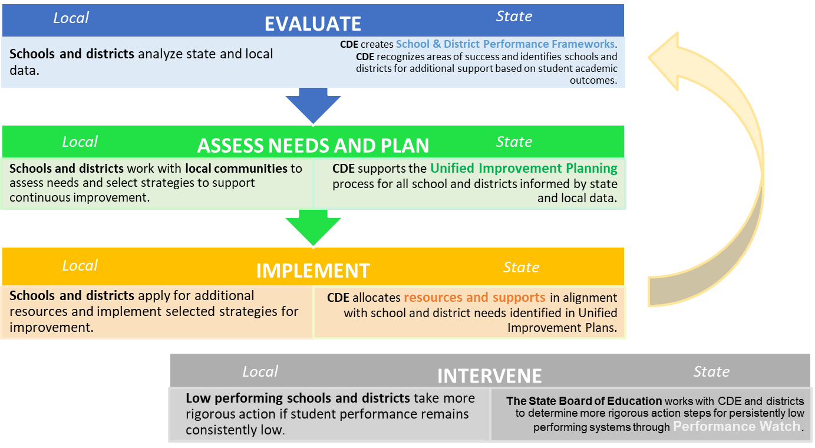
Colorado Accountability & Continuous Improvement
Theory of Action
DPF/SPF
UIP
Accreditation
Notes:
Narrative: This image summarizes the state’s theory of action for how elements of the state accountability system for schools and districts interact each year. The state is expected to evaluate school and district performance (e.g., performance frameworks), schools and districts engage with their data to assess needs, plan (e.g., improvement planning) and implement approaches to improvement. The state also provides supports and interventions to identified schools and districts. Stakeholder engagement is woven through each step.

Slide 14
Accreditation: Process & Timeline

Slide 15
Role of the Board | Statutory Responsibilities
Defined Local Board Role in State Accountability
Enter into a District Accreditation Contract with the State
Accredit the District’s schools
Consult with the District’s Accountability Committee
Engage with the District and Schools’ Improvement Plans
Adopt the District’s Improvement Plan in accordance with the assigned accreditation plan
Adopt the Improvement Plans for school assigned Priority Improvement or Turnaround
Consider the Improvement Plans of all schools in adopting the district’s budget
Notes:
Narrative: The School Board enters into an accreditation contract with the State for the District. We’ll review the process in the next few slides. While the State acredits districts, the district or our board accredits our schools. The board will also consider feedback from the District Accountability Committee regarding Accreditation.
The other elements of the board’s role reflected in this slide relate more to district and school performance frameworks and improvement plan types that we’ll review in the next section.

Slide 16
Accreditation of District & Schools
The Colorado Department of Education assigns district accreditation ratings. They are determined based on the District Performance Framework rating.
The local education agency is responsible for accrediting schools. All schools receive a performance framework ratings which may be used for accreditation determinations. Alternate district approaches to accreditation must be comparable or more stringent compared to the state system.
Notes:
Narrative: The State Board of Education is responsible for the annual accreditation of school districts. All districts are responsible for accrediting their schools based on the state’s appraisal of the school’s performance or a more rigorous local process.

Slide 17
Accreditation Contract Process
🔼
Highlights of current system:
State Board accredits districts; Local boards accredit schools
One-year contract between state board and local boards on the accreditation system and an agreement to implement applicable laws and policies.
Contract includes
Attainment on performance indicators
Adoption and implementation of the district plan type based on performance rating
Accreditation and implementation of plans for schools, including online schools
Good faith effort on implementing statute, regulations and policy
Consequences for non-compliance and monitoring
All District Accreditation Contracts available at: https://www.cde.state.co.us/accountability/districtaccreditation
Notes:
🔼ENTER THE FOLLOWING INFORMATION IN THIS SLIDE:
Consider replacing the link to all district accreditation contracts with the current posted contract of your district OR the accreditation contract plain text (both available from the link in the slide).
Then use the link to your contract (suggest using plain text contract) to walk through what the contract includes.
Narrative: The accreditation process supports a one-year contract between the state and local board that represents an agreement to implement applicable laws and policies.
[NOTE TO PRESENTER…select the appropriate sub-bullet and modify highlighted text]
In our district, since we’re Accredited or accredited w/ distinction our existing contract will automatically renew for five years unless the superintendent and / or board president change.
In our district, since we’re Accredited with Improvement/ Priority Improvement/ Turnaround/ Insufficient State Data ,the board president (name them) and I/name the superintendent will sign the contract.

Slide 18
School & District Accreditation Process
State Accredits Districts
August/September
CDE annually reviews performance through school and district performance frameworks.
Preliminary frameworks released; reviewed by districts, schools and local boards.
Districts Sign Accreditation Contracts
Districts Accredit their Schools
Districts officially sign off on final district accreditation ratings. The superintendent and the local board president sign the contract by the end of December.
Districts submit Accreditation Form to CDE, either accepting or appealing preliminary ratings. If appealing, Districts submit a request to reconsider for school plan types and/or district rates.
By December 31st
September/October
Final Ratings are approved by State Board of Education at November and December meetings.
Notes:
Narrative: There’s three phases to the accreditation process.
At the beginning of the school year, the Colorado Department of Education releases preliminary district and school frameworks and uses the preliminary district rating to accredit districts.
Districts review their preliminary frameworks as well as their schools either accept or appeal the preliminary rating, which is due back to the state late September.
Under some conditions, districts may submit additional evidence to adjust a school or district’s plan type through the request to reconsider process that is then due mid-October.
[NOTE TO PRESENTER…select the appropriate sub-bullet and modify highlighted text]
This year, we do not have any ratings to appeal.
This year we plan to appeal ratings for the district and on behalf of (insert school names)

Slide 19
District and School Accreditation General Process
August
September
October
November/December
December
CDE reviews performance (preliminary frameworks)
Districts review and verify ratings
Districts can request reconsideration
Ratings are finalized by the state board
Districts sign accreditation contracts
The Education Accountability Act of 2009 (S.B. 09-163) and H.B. 18-1355 authorize the Colorado Department of Education to conduct an annual review of the performance of public schools and districts in the state.
Each year, districts have the opportunity to review and verify the state identified district accreditation rating or school plan types.
If the district disagrees with the initial rating/plan type, then additional performance data may be submitted to the department through the request to reconsider process.
Preliminary ratings/plan types and requests to reconsider are approved and finalized by the State Board of Education.
Once the district’s rating and all school plan types are finalized, districts that are rated Improvement or below must sign the district’s accreditation contract. Contracts for districts rated Accredited or above will be automatically renewed unless a new contract is requested.
Notes:
Narrative: There are a few phases to the annual accreditation process that initiates with the release of preliminary district and school performance frameworks.
This timeline provides a more detailed description of the work that goes into the three phases of the accreditation process,
One – that CDE reviews performance and releases preliminary frameworks,
Two – districts review preliminary ratings and either accepts or appeals. The appeals process is called Request to Reconsider.
The final phase is the State Board review and approval of district and school ratings. Those that are not part of the Request to Reconsider process go to the Board in November. For those in the Request to Reconsider process, once the state reviews and either accepts or rejects requests to reconsider, those final ratings go to the State Board in December, after which all ratings and final frameworks are publicly posted.

Slide 20
DISTRICT NAME | Request to Reconsider Process
🔼
Name | Preliminary Rating | Request to Reconsider | District Basis for Request
District name | Improvement | Performance | Accountability participation impact
High School Name | Priority Improvement | Improvement | Accountability participation impact
Elementary School Name | Turnaround | Priority Improvement | Body of Evidence, K-2 i-Ready data
Notes:
Note to Presenter– Use this slide to identify what ratings / plan types you are appealing.
🔼ENTER THE FOLLOWING INFORMATION IN THIS SLIDE:
District or school name by row and move around boxes for which ‘preliminary rating’ to ‘request to reconsider’ rating you’re appealing for.
In the last column on the right, type in the ground for an appeal selecting from the following common pathways:
Body of Evidence, student performance
Accountability participation impact
Impact of Alternative Education Campuses
Refer to the Accreditation & Request to Reconsider Guidance Document posted under ‘Resources and Support’ at this webpage.

Slide 21
District and School Performance Frameworks

Slide 22
Role of the Board: Statutory Responsibilities
The Colorado Educational Accountability system statutorily requires the role of local Boards of Education to:
Enter into a District Accreditation Contract with the State
Accredit the District’s schools
Consult with the District’s Accountability Committee
Engage with the District and Schools’ Improvement Plans
Adopt the District’s Improvement Plan in accordance with the assigned accreditation plan
Adopt the Improvement Plans for schools assigned Priority Improvement or Turnaround
Consider the Improvement Plans of all schools in adopting the district’s budget
Notes:
[Note to Presenter: This slide will call out requirements associated to plan types, such as local boards being required to adopt UIPs of schools with priority improvement and turnaround plan types. It’s possible that your district has the local board approval ALL plan types. Be sure to make adjustments as needed, based on your local board policies / practices that may exceed State Statute and Board Rules.]
Narrative:
To fully understand the role of local Boards of Education in the context of Colorado’s Educational Accountability system, it’s essential to understand Colorado’s District and School Performance Framework. As this slide illustrates under the action to “Engage with the District and Schools’ Improvement Plans” the level of engagement depends on the District and Each school’s “plan type” as prescribed in the Performance Framework. In this section, I’ll provide an overview of the state’s accountability system, including key elements and explain what metrics comprise the district and school performance frameworks. We’ll also review our District and Schools’ PRELIMINARY frameworks.

Slide 23
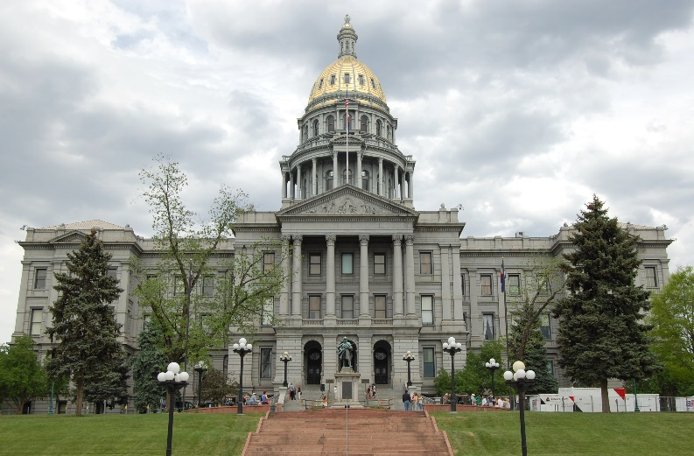
Background to State Accountability | Role of
District and School Performance Frameworks
Based on Colorado statutory requirements in the Colorado Education Accountability (SB 09-163)
CDE annually evaluates districts and schools based on student performance outcomes and provides a common framework through which to understand performance and focus improvement efforts.
The Performance Framework establishes minimum expectations for resources and support from the state.
All districts receive a District Performance Framework (DPF).
This determines their accreditation rating.
All schools receive a School Performance Framework (SPF).
This determines their school plan types.
Notes:
Narrative: CDE annually evaluates districts and schools based on student performance outcomes and provides a common framework through which to understand performance and focus improvement efforts.
State accountability establishes a minimum set of performance expectations to focus support and resources from the state.

Slide 24
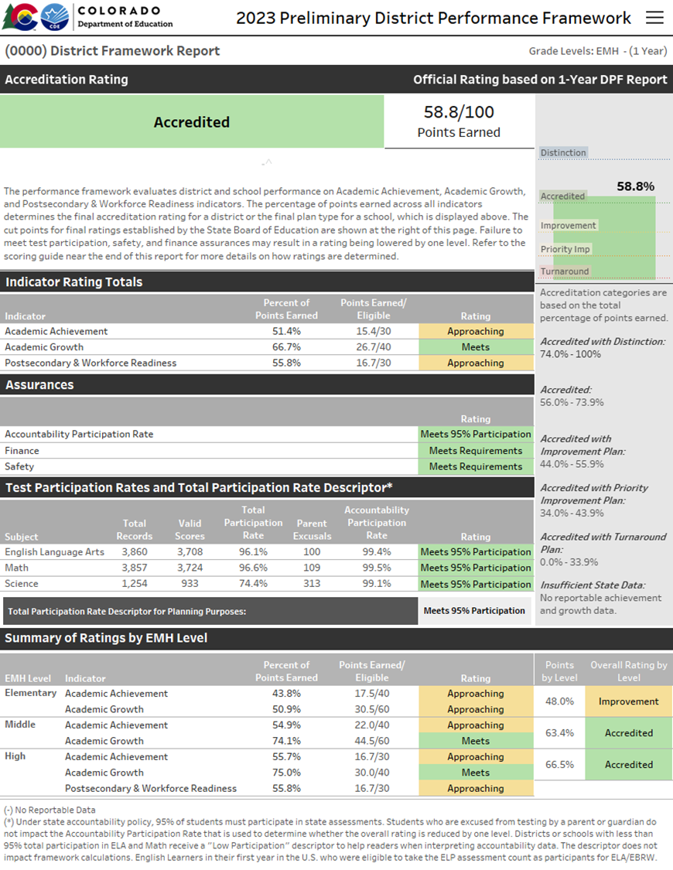
Performance Frameworks | Purpose
Provides a statewide evaluation of student performance that highlights areas of success and areas for improvement.
Identify those districts and schools whose students are lowest-performing based on academic achievement, growth and postsecondary workforce readiness data, and direct state support and intervention appropriately.
Identify those districts and schools whose students are the highest-performing based on academic achievement, growth and postsecondary and workforce readiness data, recognize them and learn from their practices.
Notes:
Narrative: The state’s common framework used, termed the Performance Frameworks provide a statewide evaluation of student performance that highlights areas of success and areas for improvement. The sites with the lowest-performing results in academic achievement, growth and/or postsecondary workforce readiness direct the state’s support and intervention. Sites with the highest-performing results are identified to learn from their practices.

Slide 25
Who’s included in the Framework Reports?
Students who were continuously enrolled from October Count to the administration of the state assessment, and there was no significant break in enrollment*
If continuous in district, then included in achievement and growth calculations in the District Performance Framework (DPF).
If continuous in school, then included in achievement and growth calculations in the School Performance Framework (SPF).
Notes:
Inclusion in participation rates does not factor in the continuous in district/school data
Expelled students are included in the district level results only.
* Break in Enrollment = Between October Count date and testing date, there has been no single enrollment gap lasting 10 or more consecutive instructional days and there have not been multiple non-consecutive enrollment breaks cumulatively equaling 10 or more instructional days.
Notes:
Narrative: We are accountable for students who were continuously enrolled from October Count to the administration of the state assessment, and there has been no significant break in enrollment. For the district’s framework, this includes students continuously enrolled in our district whereas, the students must be continuous at a specific school to be included in the school’s performance framework.

Slide 26
What do the Frameworks Measure?
Academic Achievement
Academic
Growth
Postsecondary and Workforce Readiness
Disaggregation
Notes:
Narrative: Performance frameworks include three primary measures called “performance indicators.” These include Academic Achievement, Academic Growth and Postsecondary and Workforce Readiness. Within each indicator, results are included for all students as well as student groups if the group count meets a minimum value. For achievement and postsecondary & workforce readiness the count is 16, for growth it’s 20.

Slide 27
Performance Frameworks | Performance Indicators
Performance Indicator | Performance Data
Academic Achievement | Mean scale score English language arts, math, and science assessments Overall and for disaggregated groups
Academic Growth | Median student growth percentile English language arts, mathematics and English language proficiency assessments English language proficiency On Track metric Overall and for disaggregated groups
Postsecondary and Workforce Readiness | SAT – Evidence-Based Reading & Writing and Mathematics Graduation Rate Dropout Rate Matriculation Rate (overall and by 2-year, 4-year, Career & Technical Education and Military enlisted) Overall and for disaggregated groups (all subindicators except Matriculation rate)
Notes:
Narrative: To determine performance framework ratings, an overall number of points are calculated based on performance in the three areas, academic achievement, growth, and postsecondary and workforce readiness. This table presents the performance data that is associated with each of these performance indicators.
[note to presenter: based on knowledge of audience, you may choose to read through the data within each indicator or just stress a few key points provided below.]
Academic achievement focus on CMAS and PSAT performance results, in addition to standard student groups, for English Language Arts achievement at the elementary level, it also includes a group for students previously identified for a READ plan.
The Growth indicator includes annual growth from CMAS and PSAT/SAT, it also includes multilingual learners’ annual growth on the ACCESS for ELLs assessment as well as monitoring the percentage of multilingual learners on track to English proficiency.
The Postsecondary and Workforce Readiness indicator includes many subindicators. In addition to college readiness measured by the SAT, it includes graduation, dropout and matriculation rates. With exception to matriculation rates, the other subindicators include overall and student group results while the matriculation rate is provides a breakdown of the rate by the way a student matriculated including a 2-year or 4-year institute of higher ed, career and technical education and/or military enlisted.

Slide 28
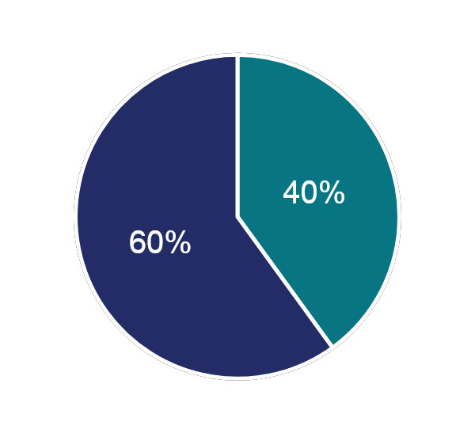
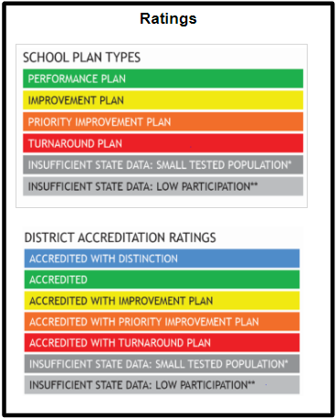
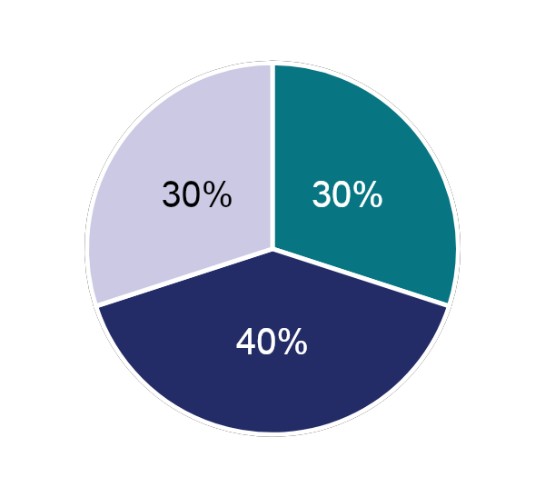
Performance Indicators
Weighted to Determine Ratings
Performance Indicator | Weight
Academic Achievement | 40% Elementary & Middle Schools 30% High Schools & Districts
Academic Growth | 60% Elementary & Middle Schools 40% High Schools & Districts
Postsecondary and Workforce Readiness | 30% High Schools & Districts
Elementary & Middle Schools
High Schools & Districts
Notes:
Narrative: The three performance indicators achievement, growth and postsecondary and workforce readiness, or PWR are weighted to determine ratings. While the weighing varies by grade level, the one constant is that Growth holds the highest weight because 1) annual growth is a precursor to increasing achievement, 2) all students can show growth, and 3) the relationship between growth and student characteristics outside the control of schools (e.g., poverty) is weaker than with the other indicators (e.g., achievement, postsecondary workforce readiness).
Elementary and middle schools only have two indicators, academic and growth where achievement accounts for 40% of the overall rating and growth accounts for 60%.
At the high school level and for districts with the inclusion of all three indicators, growth accounts for 40% of the total rating while academic achievement and PWR each hold 30%.

Slide 29
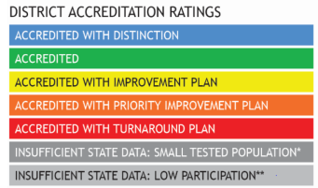
District Name | Preliminary Accreditation Rating
🔼
Meeting the required Accountability Participation Rate of 95% or higher, in two out of three content areas.
Parental excusals do not negatively impact the rating if correctly coded in state test records.
District Name Here
Accredited with …
Points Earned: XX/100
Accountability Participation Rates*
English Language Arts: __%
Math: __%
Science: __%
Decreased Due to Participation: Below 95% accountability participation in at least two content areas; with a note that science participation rates are not included in 2024 frameworks for accountability purposes.
*parental excusals are removed
Notes:
🔼ENTER THE FOLLOWING INFORMATION IN THIS SLIDE:
District Name in title and in box on the right
District points earned out of 100
Accountability Participation rates for each content area
If your district or no school received a rating ‘decreased due to participation,’ you may consider deleting that note on the right side of the slide (and perhaps adding it to the script for background information).
[note to presenter: Either describe what’s possible in terms of ratings on the left side of the slide, or just focus on the right side, sharing with the board what your district’s preliminary rating is. Both are included in the script provided below.]
Narrative:
[left side] Based on framework results, districts are assigned an accreditation rating as follows: accredited with distinction, accredited, or accredited with an improvement plan, a priority improvement plan or a turnaround plan. In some cases, where the population tested is too small or participation in testing was too low, districts might receive a rating of insufficient state data with the plan type based on their most recent rating.
[right side] Our district received a preliminary accreditation rating of XXXX. We received ### points out of 100. Our accountability participation rates were XX% in English Language Arts, XX% in Math and XX% in Science. Note that science participation rates are included in the 2024 frameworks for information only.

Slide 30
District Name | Preliminary Performance Framework
🔼
EXAMPLE
EXAMPLE
Scoring Guide for 2024 District/School Performance Frameworks
Notes:
🔼ENTER THE FOLLOWING INFORMATION IN THIS SLIDE:
Add your district name to the slide title (replace “District Name”)
Take a snapshot of your district’s Indicator Rating Totals, and replace the example in this slide
Take a snapshot of your district’s Summary of Ratings by EMH Level, and replace the example in this slide
Narrative. Here’s our district’s accreditation rating broken down by indicator as well as level.

Slide 31
I’m in a Single School within a District
Why doesn’t my district rating by level match my school rating?
🔼
District Performance Framework | School Performance Framework
Points Earned: XX/100 | Points Earned: XX/100
includes expelled students framework cutpoints: Accredited w/ Distinction – 74.0% to 100% Accredited – 56.0% to 73.9% Accredited with: Improvement – 44.0% to 55.9% Priority Improvement – 34.0% to 43.9% Turnaround – 0.0% to 33.9% | excludes expelled students framework cutpoints: Performance – 53.0% to 100% Improvement – 42.0% to 52.9% Priority Improvement – 34.0% to 41.9% Turnaround – 0.0% to 33.9%
Notes:
[Note to Presenter: Use this slide if your District & Single School have different Plan Types]
🔼ENTER THE FOLLOWING INFORMATION IN THIS SLIDE:
Insert # of points earned on the District Framework in the left column, second row
Insert # of points earned in the School Framework in the right column, second row
Update the narrative / script that is highlighted below.
narrative: Our District and School preliminary rating or plan type are different because of framework cutpoints differ slightly for districts and school with regards to Accredited/Performance and Improvement Plan types. Our District earned ## points while our school yearned ##. Based on the cutpoints, our district was Accredited/Accredited with XX and our School was assigned a XX plan type.

Slide 32
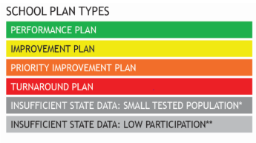
DISTRICT NAME Schools by Plan Type | Preliminary Frameworks
🔼
Performance | Improvement | Priority Improvement | Turnaround | Insufficient State Data
% (#) School Name 1 (optional) School Name 2 (optional) | % (#) School Name 1 (optional) School Name 2 (optional) | %(#) School Name 1 (optional) School Name 2 (optional) | % (#) School Name 1 (optional) School Name 2 (optional) | %(#) School Name 1 (optional) School Name 2 (optional)
The State uses results to assign plan types to each school.
The District accredits its schools.
Meeting the required Accountability Participation Rate of 95% or higher, in two out of three content areas. This does not include parental excusal.
Notes:
[Note to Presenter: Smaller LEAs may choose to list school names within each plan type column rather than including percentages and counts. The latter is more useful for large LEAs that have a lot of schools.]
🔼ENTER THE FOLLOWING INFORMATION IN THIS SLIDE:
Percentage and count of schools that received each rating.
Share out the results, reading off of the updated slide

Slide 33
Who Adopts which Plans Based on Performance Framework Ratings?
Plans | Performance or Improvement | Priority Improvement or Turnaround
District | Local Board | Local Board
School | The school principal and District superintendent, or his or her designee* | Local Board
If a school received an Insufficient State Data rating, then the district must refer back to the last plan type the school received to determine who shall approve the school’s plan.
*Local boards may elect to adopt UIPs for all schools but no statutory requirement for this exists.
Notes:
[Note to Presenter: narrative is written for district whose local boards only adopt school plan types minimally required by state statute. Local Boards that review and adopt all schools’ UIP may delete this slide. Districts that only submit one combined plan for the district and all of its schools may delete too]
Narrative:
Given the framework results of our schools, we plan to bring the draft UIPs for schools with a priority improvement and turnaround plan types to the Board meeting on X date for review, feedback and adoption.

Slide 34
How CDE Currently Handles Data for Smaller Systems?
Current State Practices
For publicly reportable data
N of 16 for achievement has been the historical threshold for reporting achievement data.
N of 20 for Growth was based on observed data and what the Technical Advisory Panel determined to be minimum threshold for reliability with best balance for inclusion.
Calculate a multi-year framework (typically 3 years) to aggregate data over time to generate reports for as many sites as possible.
Created the Insufficient State Data assignment for sites that do not have reportable data for all performance indicators
No tested grades
Small tested population
Limited tested population (e.g., high % of parent excusals)
Key resource: Insufficient State Data Rating Fact Sheet (downloads)
Related Solutions in Other Parts of Accountability System
Created Secure Data Explorer Tool for districts to analyze state data down to an N of 1.
Created improvement planning guidance on how to still engage in continuous improvement without reporting Personally Identifiable Information.
Notes:
[Note to Presenter: The slide is available for smaller systems that may not have data in all indicators/subindicators because of low N or for districts or districts with schools that have an ISD rating. The information in the blue box provide resources for district staff. The presenter might want to remove this blue box for presentation purposes OR highlight the bullet that corresponds to their framework.
Adjust the narrative / script to align with your system; per highlighted text below that correspond to one of the three bullet points in the slide deck.]
Narrative (select what relates to your system):
In our Performance Framework,
our results are limited to an N or total count of 16 students for achievement results and 20 for growth. These are the groups we are able to report on vs. not. {name the groups and share anecdotal information to demonstrate how smaller groups of students are doing}.
Our official framework using multiple years to increase the number of indicators that can be included. While, our multi-year framework rating is ##/100, it’s important to look at the 1-year framework for informational purposes and gauge the direction of our annual progress.
Our district has received an ISD rating. (continue to next slide)

Slide 35
Why did we receive an Insufficient Data Rating (ISD)?
There is not enough data to assign a district rating / plan type
The total participation rate was at or below 25% in both English language arts and math.
Reportable data are not available for all applicable performance indicators (achievement, growth, and postsecondary workforce readiness), or
if one or more levels (e.g., elementary, middle, or high) do not have reportable data for one or more applicable performance indicators
For more information about ISD ratings, refer to the CDE resources webpage understanding school and district performance frameworks.
Notes:
[Note to Presenter: Use if your district or schools received an ISD rating - otherwise may skip/delete.]
Narrative: Insufficient State Data (ISD) ratings are assigned when the state does not have enough data to assign a district rating or school plan type. There are two reasons.
The first is that the total participation rate was at or below 25% in both English language arts and math. Remember that Total Participation Rate is the percentage of students tested over all students eligible to take the test. Parent excusals are included in the calculation denominator.
or two, that reportable data are not available for all applicable performance indicators (i.e., achievement, growth, and postsecondary workforce readiness).
In our case, we received an ISD rating, because the district did not earn any points for the XXX indicator at our XXX level.
[note to presenter: If ISD rating for multi-level schools, one indicator may be missing for a level, but not the whole school (i.e., combined elementary, middle and/or high schools).]

Slide 36
Considerations while reviewing Insufficient State Data (ISD) Frameworks
ISD rating does not imply a value judgment. It means that the state simply did not have enough data to calculate a rating and share a public report.
While some information may be available for particular indicators (e.g., achievement), it is important not to characterize the performance for the whole district / school based on representation of limited performance indicators.
It may be helpful to look at available data over time compared to historical performance to gain context.
Emphasize other local data sources.
Encourage participation in state assessments to help better inform community members of the academic performance of students.
Notes:
[Note to Presenter: In the context of this slide, for ISD frameworks it’s important to bring in local data as it relates to talking points 3 and 4 below // bullets 3 and 4 in the slide too. If participation rate is an issue (point 5), bring in efforts to increase participation while still honoring parental excusals.]
Narrative: As we review this ISD framework it’s important to note the following:
The ISD rating does not imply a value judgement. The state simply did not have enough data to calculate a rating and share a public report.
While some information may be available for particular indicators (e.g., achievement), it is important not to characterize the performance for the whole district / school based on representation of limited performance indicators.
We have local data to provide context to where where are.
{“Emphasize” – this would be a good place for the presenter to add local data to better understand your district’s achievement, growth and postsecondary workforce readiness}
{include if this is an issue // contributes to the ISD rating} We have engaged in the following efforts to encourage participation in state assessments:
…

Slide 37
For Facilitator → Where do you want to go next?
If your district and / or school(s) have Priority Improvement or Turnaround Plan Types, go to the next section Performance Watch: State Identification. Refer to this section to understand all plan type requirements too.
If you board needs a deeper dive into the framework measures and metrics, go to State Accountability: Measures and Metrics.
Update the Board on our UIP efforts → go to Improvement Planning: Current Year Priorities

Slide 38
Performance Watch:
State Identification
Notes:
Note to presenter: This section is helpful for districts that have schools on performance watch. It also includes newer plan type requirements for sites with the improvement plan.

Slide 39
Role of the Board | Statutory Responsibilities
The Colorado Educational Accountability system statutorily requires the role of local Boards of Education to:
Enter into a District Accreditation Contract with the State
Accredit the District’s schools
Consult with the District’s Accountability Committee
Engage with the District and Schools’ Improvement Plans
Adopt the District’s Improvement Plan in accordance with the assigned accreditation plan
Adopt the Improvement Plans for schools assigned Priority Improvement or Turnaround
Consider the Improvement Plans of all schools in adopting the district’s budget
Notes:
[Note to Presenter: This is important to review if the district or any of its schools that received a Priority Improvement or Turnaround Plan type, OR are ISD, but their most recent plan type was PI/T OR they received Improvement/performance, while their previous rating was PI/T.]
Narrative: Performance Watch encompasses all schools and districts that are identified in the State’s Accountability System. This section outlines additional stakeholder engagement and planning requirements for schools and districts with a priority improvement or turnaround plan type. This section also highlights planning requirements connected to improvement ratings based on HB23-1231 enacted in 23-24. While there are newer requirements for improvement plans, sites with an improvement plan are NOT on Performance Watch unless the previous two or more years, the site had a priority improvement or turnaround plan type.
For the context of Board Statutory Responsibilities, the Local School Board MUST adopt each school’s UIP IF they are on “Performance Watch.” Let’s review what this means.

Slide 40
Performance Watch | Overview
PERFORMANCE WATCH
ACCOUNTABILITY CLOCK
On Watch
Priority Improvement or Turnaround
Year 1+
Performance/ Improvement
Year 2+
Sites with State Board Action
Year 5+ and Early Action
Local Boards adopt the Improvement Plans for schools assigned Priority Improvement or Turnaround
Notes:
[Note to Presenter: Resources to support plan type requirements are at this webpage: Performance Watch Expectations. Local Boards shall adopt plans of schools on the Accountability Clock, while districts may chose to have all schools’ plans be adopted by their local boards. Adjust call out box to ensure alignment to local context, as needed.]
Narrative:
Performance watch encompasses districts and schools identified as being on the Accountability clock, whereas the site is identified with a priority improvement or turnaround plan type for one or more consistent years. The red box under the Accountability Clock identifies sites at the so called “end of the clock” that have reached 5 or more consecutive years being “on the clock.” These sites move to state board action.
There are also sites that may be identified On Watch – still under Performance Watch because they were previously on the Accountability Clock for two or more consecutive years and, while they earned a performance or improvement rating this year, must achieve one of those ratings for two consecutive years before exiting Performance Watch.

Slide 41
Performance Watch | Definitions
 | Criteria
On Clock | Earned a Priority Improvement or Turnaround plan type
On Watch | Earned an Improvement or Performance plan type Previously on accountability clock for at least two consecutive years
On Hold | Received Insufficient State Data Last available plan type was on clock
If assigned to “Insufficient State Data,” the Local Board or Institute shall adopt the plan type to which the Local Board or Institute was previously assigned.
Notes:
[Note to Presenter– This slide will be helpful for the District Accountability Contact to identify the additional requirements associated to Performance Watch categories (column “Implications” of their district and schools. Links provide resources to meet different requirements / expectations / implications. IF you do NOT have an ISD rating in your district, you may want to remove the orange call out box in this slide.]
Narrative – There are three categories for being on Performance Watch. The first is known as “On Clock” indicating that the site is on the “accountability clock” when they are assigned a priority improvement or turnaround plan type based on the performance framework.
A site receives an “On Watch” category if it earned an Improvement or Performance plan type AND it was previously on the accountability clock for at least two consecutive years. This is an important distinction. IF a site is assigned Priority Improvement or Turnaround AND receives a Performance or Improvement plan type after one year of being on the accountability clock, then they are off the clock and out of Performance Watch. However, after two consecutive years “On Clock”-- even if earning a Performance or Improvement plan type the next year, the site will be “On Watch” and would only be removed from Performance Watch if they earn an improvement or performance plan type for a second consecutive year.
Finally, the “On Hold” designation is used if the site received an ISD or Insufficient State Data rating and the last available plan type was “On Clock.”

Slide 42
District Name | State-Identified Schools on Performance Watch
🔼
Accountability Clock
On Clock |  | On Hold
Priority Improvement | Turnaround | Insufficient State Data*
ABC Elementary School, Y2 enter schools here | Zen Middle School, Y1 Hope High School, Y2 enter schools here | Alpine School, Y1 enter schools here
Note: * School received an ISD this year and site’s previous plan type was PI or Turnaround, so site remains “Hold On Clock” until it receives a rating. If it receives an PI/T rating the next time there is enough data, then the Clock Year advances for the site.
Notes:
Note to Presenter🔼ENTER THE FOLLOWING INFORMATION IN THIS SLIDE:
Enter in the names of each school that are on the clock / on hold including their Year on the Clock (e.g., Y1, Y2, etc.)
Adjust / add to the script based on your schools on the Accountability Clock.
Narrative: ________ Schools are identified by the State’s Accountability System. For our sites “On Clock” you’ll see that the year on the clock (e.g., ABC Elementary School, Y2), ________ (Alpine) School that has an ISD rating retains its Year 1 status from last year, when it was first identified “On the Clock”.

Slide 43
District Name | State-Identified Schools on Performance Watch
🔼
On Watch
Performance | Improvement | Insufficient State Data*
Sunshine High School, Y2 Enter schools here | Colorado Pk-8 School, Y3 Enter schools here | Big Bird Academy Enter schools here
Note. * School received an ISD this year and site’s previous plan type was Performance or Improvement after being “On Clock” (PI/T or ISD-Hold On Clock). A site that was “On Clock” for 2 or more years, must receive 2 consecutive Performance or Improvement ratings to no longer be “On Watch.”
Notes:
Note to Presenter🔼ENTER THE FOLLOWING INFORMATION IN THIS SLIDE:
Enter in the names of each school that are on the clock including their Year on Watch (e.g., Y1, Y2, etc.).
Narrative: Our district has ______ schools “On Watch.” These schools were On the Clock last year (note that they will only be Year 2 or above) and because of improvement in their performance framework OR due to insufficient state data (after moving to On Watch last year), they are designated On Watch.
Note that the Year On Watch matches the last year that each school was On the Clock. For example, under Performance, the Y2 associated to {Sunshine High School} indicates the number of years the school was on the clock BEFORE receiving a Performance rating this year.

Slide 44
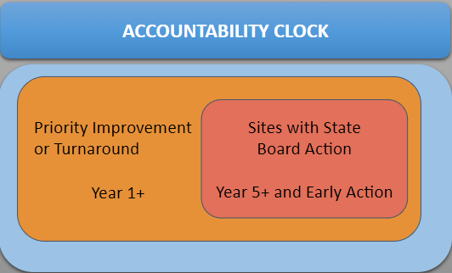
Annual Requirements for districts and schools on the Accountability Clock
Local Boards adopt the Improvement Plans for schools assigned Priority Improvement or Turnaround
Type | What | Improvement* | Priority Improvement | Turnaround
Stakeholder Engagement | Parent Notification and Local Board Hearing & Adoption (Schools) |  | ✔ | ✔
Planning Reqs | Family, School, & Community Partnerships (Schools) |  | ✔ | ✔
 | Math Acceleration* (Schools & Districts) | ✔ | ✔ | ✔
 | Early Learning Needs Assessment** (K-3 Serving, Schools & Districts) |  | ✔ | ✔
 | Turnaround Strategies (Schools & Districts) |  |  | ✔
* Districts/Schools on an Improvement Plan are NOT on the Accountability Clock
** Districts on the Accountability Clock must engaged plan to/conduct an Early Learning Needs Assessment only if the district also has an identified school that serves K-3.
Notes:
[Note to Presenter: This is a quick overview of annual requirements from Year 1 On the Clock. In the next section of this slidedeck – Improvement Planning: Current Year Priorities – slides 54-60, there is an in depth slide for each requirement. Those slides have been hidden from “presenting mode” since they my be more useful for school and district based staff to know the details to implement each requirement. Whereas for a presentation, it may be too much.]
Narrative: For schools on the Accountability Clock, there are both stakeholder engagement and planning requirements. Under newer Colorado law in 2022, the Math Acceleration requirement extends to sites with an Improvement plan type, even though those schools are not identified as on the clock. We’ll review our Math Acceleration efforts at the same time as we hold our local board hearing for our schools with priority improvement and turnaround ratings.

Slide 45
District’s Timeline for Stakeholder Engagement
🔼
Parent Notification Letters
Target Date: within 30 calendar days of receiving initial plan type assignment
Public Hearing at Local School Board Meeting
Target Date: at least 30 calendar days after the date on which the district provides the written notice
Local School Board Adopts the Plan
Target Date: Must occur before the UIP is due mid October or mid January for newly identified schools or schools participating in the Request to Reconsider process
Notes:
Note to Presenter→ This slide is a reminder for the district Accountability Contact regarding the Timeline for the three required steps in Stakeholder engagement.
Here’s the key resource for this required stakeholder engagement process.
🔼
The Facilitator may chose to insert its timeline for these three events, for example:
September 15 – Families received parent notification letter about X School’s performance rating and when the board public hearing will take place
November 1 – Board meeting, public hearing to review draft UIP(s) at identified school(s)
December 1 - Board meeting, final UIP(s) presented for board adoption
Narrative: We have scheduled XXXX date for our local board hearing that must occur at least 30 days after communities are notified at our Schools with Priority Improvement and Turnaround Plan types. At the hearing, we’ll provide an overview of each school’s plan and how we’re incorporating plan type requirements based on each school’s plan type.

Slide 46
Performance Watch | Definitions
 | Criteria | Implications
On Clock | Earned a Priority Improvement or Turnaround plan type | Communication expectations Additional planning requirements and plan review by CDE Eligible for supports and EASI grant funds Hearing with State Board after 5 years or progress monitoring
Newly Identified On Clock | Earned a 2023 Improvement or Performance plan type and then Priority Improvement or Turnaround in 2024 | January UIP submission if the district chooses this flexibility on behalf of newly identified schools. It’s intended to help a newly identified site incorporate additional requirements into their plan with more time, if needed.
On Watch | Earned an Improvement or Performance plan type Previously on accountability clock for at least two consecutive years | Unified Improvement Plan (UIP) review by CDE Eligible for supports and EASI grant funds
On Hold | Received Insufficient State Data Last available plan type was on clock | Communication expectations Additional planning requirements and UIP review by CDE Eligible for supports and EASI grant funds
Notes:
[Note to Presenter– This slide will be helpful for the District Accountability Contact to identify the additional requirements associated to Performance Watch categories (Links included in the “Implications” column provide resources to meet different requirements / expectations / implications.]
Narrative – To wrap this up, let’s revisit the Performance Watch designations for a moment in regards to implications for each type (On Clock, On Watch, On Hold). The requirements or “implications” that we just reviewed are specific to schools “on the clock.” For schools On Watch, those sites do not have the previous requirements we reviewed, while they are still eligible for grants and their UIP will be reviewed by CDE. For a school On Hold, they must still meet communication expectations or the Stakeholder Engagement requirements.

Slide 47
For Facilitator → Where do you want to go next?
Update the Board on our UIP efforts, either for the district or for schools On the Clock→
go to Improvement Planning: Current Year Priorities
This next section includes a slide explaining each plan requirement for schools on the clock (per slide 39)

Slide 48
Improvement Planning:
Current Year Priorities
Notes:
Note to presenter – This section is developed to update your local board on your UIP efforts, either for the district or for schools On the Clock.
This section also includes a slide explaining each plan requirement for schools on the clock that may be more helpful in working with schools as they develop their plans, rather than presenting to the board.

Slide 49
Role of the Board | Statutory Responsibilities
The Colorado Educational Accountability system statutorily requires the role of local Boards of Education to:
Enter into a District Accreditation Contract with the State
Accredit the District’s schools
Consult with the District’s Accountability Committee
Engage with the District and Schools’ Improvement Plans
Adopt the District’s Improvement Plan in accordance with the assigned accreditation plan
Adopt the Improvement Plans for schools assigned Priority Improvement or Turnaround
Consider the Improvement Plans of all schools in adopting the district’s budget
Notes:
Narrative. Before adopting plans, it’s important that the Board and in consultation with the District’s Accountability Committee engage in the district and schools’ improvement plans. In this section, we’ll review our priorities and planned efforts in support of continuous improvement.

Slide 50
Governance & Operational Planning
Key Similarities:
All planning processes reflect the appropriate level of due diligence to ensure district outcomes are met and best practices are followed.
Key Differences:
The Superintendent is responsible for the appropriate design and implementation of district activities that adhere to Board policy, statutory requirements, and district priorities as defined by the Board. The Superintendent is not responsible for defining district wide outcomes.
The Board of Education is responsible for examining planning processes to ensure alignment with policies, district goals and resource allocations. The Board is not responsible for implementation or managerial tasks.
Notes:
Narrative. It is critical that board members have a clear understanding of their responsibilities regarding improvement plans. Most importantly, board members should review the plan from the perspective of ensuring that best practices are being followed. The board is not responsible for the implementation of the plan as this is a primary responsibility of the superintendent and school principal. There are similarities and differences between the board and superintendent roles as reflected in the slide. Both parties should ensure district goals are met and best practices are being utilized. In contrast, superintendents are the implementers and should ensure board policy, statute, and district priorities are being met. Board members will be looking to see that the developed plan is aligned with policy, goals and resources. The board is never responsible for managerial tasks.

Slide 51
Board Considerations when reviewing the District UIP
Does the district UIP align to the district’s priorities and/or strategic plan?
Does the UIP align to our board and community priorities?
Strategic Priorities → UIP Major Improvement Strategies
Indicators of Success → UIP Annual Targets
How might the UIP inform resource allocations (budget setting)?
Does the UIP align with our budget?
Does the UIP require changes to district/board policy? Does the UIP meet requirement of current board policy?
Has feedback been gathered from the District’s Accountability Committee? Has that feedback been considered by the board during the formal UIP adoption process?
*Unified Improvement Plans: The role of the school board in plan development and adoption resource located, here: https://www.cde.state.co.us/uip/uips-theroleoftheschoolboard-plandevelopment-adoption
Notes:
Narrative. As a board member, some primary questions that are often asked related to oversight of plan adoption and implementation are presented in the slide. Typically, the questions asked are less about how? but instead about the Why? The use of why questions tend to be aligned with ensuring appropriate oversight and that best practices were used in plan development. The Colorado Department of Education has also produced a short resource document that explores other questions board members may want to consider asking.

Slide 52
What goes into a UIP | 5 Guiding Questions
Big Five Questions
Does the plan investigate the most critical performance areas and prioritize the most urgent performance challenges?
Does the plan identify root causes that explain the magnitude of performance challenges?
Does the plan identify evidence-based major improvement strategies that are likely to eliminate the root causes?
Does the UIP present a well-designed action plan for implementing the major improvement strategies to bring about dramatic improvement?
Does the plan include elements that effectively monitor the impact and progress of the action plan?
Notes:
[Note to Presenter: Use this slide if your district has selected to use the traditional UIP template. If your district moved to the new streamlined template, delete this slide and use the next slide.]
Narrative: The UIP is organized by five guiding questions that outline the major concepts of the improvement planning process that include Priority Performance Challenges, Root Causes, Major Improvement Strategies, Action Plans & Progress Monitoring. The guiding questions aim to create coherence and emphasize the importance of aligning all elements of the improvement plan.

Slide 53
What goes into the new streamlined UIP | 3 Guiding Questions
“Top Three” Guiding Questions | Does the plan identify high-leverage performance priorities and targets? | Does the plan focus on evidence-based strategies to resolve systemic root causes and drive improvement on identified priorities? | Does the plan outline a coherent approach to implementation and adjustment of the identified strategies?
 | Priorities & Targets | Root Causes & Strategies | Implementation & Actions
Plan Elements within Streamlined Template | Student Performance Priorities Annual Target Setting Interim Targets | Root Causes with validation Major Improvement Strategies (including Evidence Base) Associated Resources | Implementation Milestones Action steps
Notes:
[Note to Presenter: Use this slide if your district has selected to move to the new, streamlined UIP template. If your district stayed with the traditional template, delete this slide and use the previous slide.]
Narrative: The new streamlined UIP is organized by the “top three” guiding questions outlining the major concepts of the improvement planning process that include 1) Priorities & Targets, 2) Root Causes & Strategies, and 3) Implementation & Actions. The new “top three” guiding questions reorganize the layout to align better with school and district planning process, and consistent with the traditional UIP aim to create coherence and emphasize the importance of aligning all elements of the improvement plan.

Slide 54
District Name | Overview of the Unified Improvement Plan
🔼
Notes:
🔼ENTER THE FOLLOWING INFORMATION IN THIS SLIDE:
Take a snapshot of your district / school’s UIP “snapshot” from the online UIP system or the new streamlined system
Narrative: Here’s the executive summary of the district UIP. (note to presenter – insert your content and consider reading it backwards so that it reads like a Theory of Action)
If we implement __[insert MIS #1]__ and __[insert MIS #1]__ (etc.) with fidelity, then we will address the following root causes: ___[insert root causes]___ that will change current trends for all of our students focused on ___[insert priority performance challenges / student performance priorities]___.

Slide 55
Current Status of Major Improvement Strategies
🔼
Add examples here
Notes:
[Note to facilitator→ Highlight key efforts - things being done or progress towards implementation]

Slide 56
For Facilitator → If helpful, consider UIP planning requirements for all schools and those for identified schools and districts
The intent for the remaining slides in this section is to provide background information to support district staff in meeting plan type requirements

Slide 57
READ Act Plan Type Requirements for all Districts & Schools serving K-3
What are the Early Literacy Requirements in the UIP?
Data Narrative
Data and trends from a READ interim assessment for grades K-3.
Strategies (in Action Plans tab)
Specific actions to support students who are identified as having a significant reading deficiency (SRD) and students who are not yet reaching grade level expectations.
Target Setting (in Action Plans tab)
Set targets to improve reading outcomes for students as measured by a READ interim assessment.

Slide 58
Annual Planning Requirements for districts and schools on the Accountability Clock
Type | What | Improvement* | Priority Improvement | Turnaround
Planning Reqs | Family, School, & Community Partnerships (Schools) |  | ✔ | ✔
 | Math Acceleration* (Schools & Districts) | ✔ | ✔ | ✔
 | Early Learning Needs Assessment** (K-3 Serving, Schools & Districts) |  | ✔ | ✔
 | Turnaround Strategies (Schools & Districts) |  |  | ✔
** Districts on the Accountability Clock must engaged plan to/conduct an Early Learning Needs Assessment only if the district also has an identified school that serves K-3.

Slide 59
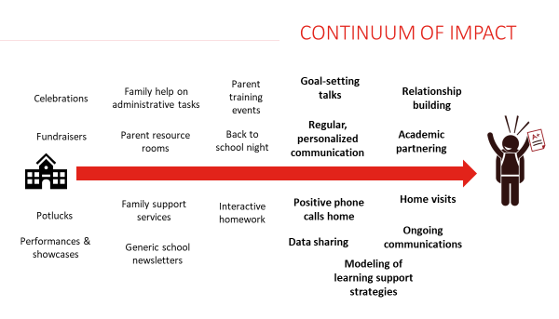
Family & Community Engagement
Family, Community, & School Partnership Resources: Strategy Guide, P-12 Framework, and Promising Partnership Practices
Notes:
[Note to Presenter→ Highlight what schools are doing along the continuum, give specific examples, add photos]
This image depicts the continuum of impact for family engagement activities. These include, on the left, school or system-wide activities; and, on the right, more individualized touchpoints with specific students and families. Note that there is no “good” or “bad” end of this continuum. This image reflects the research findings that individualized activities have a stronger impact on student success than building-wide activities. However, a strong family engagement approach will incorporate a range of activities from across this spectrum.

Slide 60
Math Acceleration
New requirements for those districts and schools with Improvement, Priority Improvement and Turnaround ratings
2023-24 UIP Math Acceleration Requirements
UIP Assurance for Data Analysis – analyze at least two years of math assessment data disaggregated by grade level, performance levels, and student demographics (e.g, FRL, IEP, ML)
Priority Performance Challenges – describe rationale for performance patterns that led to prioritizing math; If the data analysis does not support prioritizing math, then include rationale to document the school wide direction.
2024-25 requirements will be connected to Strategies, Action Planning and Target Setting
For more information, refer to the HB 23-1231 Fact Sheet: Improving Mathematics Outcomes in K-12th Grade Education
Notes:
[Note to Presenter→ Highlight what your district and schools are doing to support K-12 math acceleration]

Slide 61
Early Learning Needs Assessment (ELNA) | Schools serving K-3
School with Priority Improvement / Turnaround Plan Type, and their districts if they are on a PI/Turnaround Plan Type too
Indicate in your current UIP any steps taken to assess the needs of and resources available for children eight and under across your community.
Take advantage of the resources available on the Improvement Planning and Early Learning website to learn about and plan this year to conduct and report on an Early Learning Needs Assessment in your next year’s UIP.
Ideally, districts with identified schools will initiate the ELNA process to coordinate across sites, as needed.
For more information, as referenced in the UIP Quality Criteria:
The ELNA includes a complete analysis of early elementary student achievement data. Plan identifies appropriate research-based next steps to improve early childhood programs and partnerships.
Notes:
Narrative: Schools that are newly identified for Priority Improvement or Turnaround plan types, as well as their District, IF the district is also Priority Improvement or Turnaround should…
Indicate in your current UIP any steps you have taken to assess the (needs of) and (resources available for) children eight and under across your community.
Take advantage of the resources available on the Improvement Planning and Early Learning website to learn about and plan this year to conduct and report on an Early Learning Needs Assessment in your 2024-25 UIP.
Ideally, districts with identified schools will initiate the ELNA process to coordinate across sites, as needed.
For more information, the Early Learning Needs Assessment includes a complete analysis of early elementary student achievement data. Your UIP Plan would identify appropriate research-based next steps to improve early childhood programs and partnerships.

Slide 62
State-Required Turnaround Strategies
All Schools and Districts with Turnaround plan type are required to include a state-required turnaround strategy.
Employing a lead turnaround partner
Reorganizing the oversight and management structure in the district
Converting to an innovation school or school zone
Converting to a charter school
Renegotiating or restructuring a charter contract
Research-based strategies focused on early learning and development
Other actions of comparable or greater significance or effect.
Notes:
[this slide is specific to schools and districts with turnaround plan types]

Slide 63
Summary

Slide 64
Relationship of Educational Accountability to Board Governance
The information shared in this presentation is based on statutory requirements as outlined in the Colorado Educational Accountability Act.
The achievement, growth, and postsecondary focus also aligns to outcomes identified by:
Our local policies (add policy references here)
and District mission (add mission here if applicable).
Best practice suggests educational accountability results are to be viewed as a key outcome(s) to support district governance. this is due to the priority status of academic outcomes based on community needs and legislative requirements.
CDE has created a resource that provides questions for board consideration while examining accountability results, here:
https://www.cde.state.co.us/uip/coeducationalaccountability-overviewforboardsofeducation

Slide 65
District Contact Information
🔼
Mrs. example one
Superintendent of Schools
e-mail: sample@google.net
Mr. example one
Chief Academic Officer
e-mail: sample@google.net
Mr. example two
Data Coach
e-mail: sample@google.net
Notes:
🔼ENTER THE FOLLOWING INFORMATION IN THIS SLIDE:
Name, title, email address, and/or phone number of key contacts related to this presentation.

Slide 66
Related CDE Resources for Board Members
Unified Improvement Plans: The role of the School Board in plan development and adoption. To be posted at: https://www.cde.state.co.us/uip/uips-theroleoftheschoolboard-plandevelopment-adoption
Colorado Educational Accountability: An Overview for Boards of Education. To be posted at: https://www.cde.state.co.us/uip/coeducationalaccountability-overviewforboardsofeducation
Facilitated Board Training for School Improvement, EASI board service. https://www.cde.state.co.us/fedprograms/facilitatedboardtraining
SchoolView, CDE Data Tools/Resources:
https://www.cde.state.co.us/schoolview
Questions for CDE regarding accountability/improvement planning, e-mail:
uiphelp@cde.state.co.us.

Slide 67
Appendix A.
State Accountability: Measures & Metrics

Slide 68
2024 Performance Framework: Key Changes
3-Year frameworks will be calculated in 2024.
CMAS science achievement results will be included for points in fall 2024 frameworks. CDE will not include CMAS science participation results for accountability purposes.
PSAT/SAT digital scores will be included in the frameworks and related sub indicator targets will be recalculated based on the inclusion of this data.
Newcomer Multilingual Learners (MLs) refers to students with a language proficiency designation of Non-English Proficient (NEP) or Limited English Proficient (LEP) who are new to U.S. schools within the last 12 months and who are identified as Limited or Interrupted Formal Education (SLIFE). For accountability, these students are included in participation calculations and the scores for the newcomer MLs who choose to test will not be included in Achievement calculations.
For specific questions associated to newcomers who arrived after October 1 last year, refer to this resource.
Online changes document: https://www.cde.state.co.us/accountability/2024changesdoc
Notes:
Please recognize that additional changes are planned related to the alternative ed framework and ESSA. Please see the online changes document to see the full scope of changes (not specific to accountability frameworks).

Slide 69
Performance Frameworks | Indicators
Performance Indicator | Performance Data
Academic Achievement | Mean scale score English language arts, math, and science assessments Overall and for disaggregated groups
Academic Growth | Median student growth percentile English language arts, mathematics and English language proficiency assessments English language proficiency On Track metric Overall and for disaggregated groups
Postsecondary and Workforce Readiness | SAT – Evidence-Based Reading & Writing and Mathematics Graduation Rate Dropout Rate Matriculation Rate (includes military enlistment) Industry credentials, included in Career and Technical Education and overall matriculation rates calculations Overall and for disaggregated groups (except for Matriculation rate)
Notes:
How are the framework ratings determined?

Slide 70
Performance Indicators
Weighted to Determine Ratings
Performance Indicator | Weight
Academic Achievement | 40% Elementary & Middle Schools 30% High Schools & Districts
Academic Growth | 60% Elementary & Middle Schools 40% High Schools & Districts
Postsecondary and Workforce Readiness | 30% High Schools & Districts
Elementary & Middle Schools
High Schools & Districts

Slide 71
Academic Achievement Indicator
Performance Indicator | Performance Data | Weight (% of Total)
Academic Achievement | Mean scale score English language arts, math, and science assessments Overall and for disaggregated groups | 40% Elementary & Middle Schools 30% High Schools & Districts

Slide 72
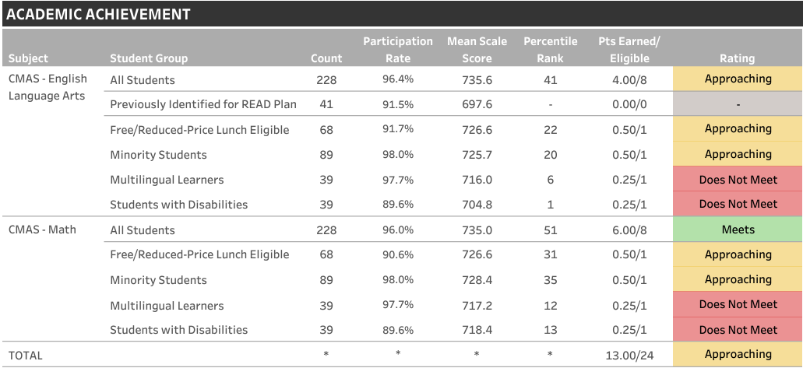
Achievement | District Data by Level Example
🔼
Notes:
🔼ENTER THE FOLLOWING INFORMATION IN THIS SLIDE:
Snapshot of growth results from district performance framework for one level.
The presenter may use this to show board members how the ratings are assigned based on points earned, while board members are referring to the actual PDF for the district school performance framework.
Narrative. This slide reflects the district level academic growth results of all students at the elementary level. It includes the number of points assigned along with the corresponding rating for each content area– English Language Arts and Math, as well as English Language Proficiency measured using the ACCESS for ELLS assessment. Growth data is included for all students and by student group where the count is at least 16 students. The last row in the table reflects the overall number of points earned with the associated growth rating for the elementary level. There are similar tables for each level, elementary, middle and high.

Slide 73
Growth Indicator | Overview
Performance Indicator | Performance Data | Weight (% of Total)
Academic Growth | Median student growth percentile English language arts, mathematics and English language proficiency assessments English language proficiency On Track metric Overall and for disaggregated groups | 60% Elementary & Middle Schools 40% High Schools & Districts

Slide 74
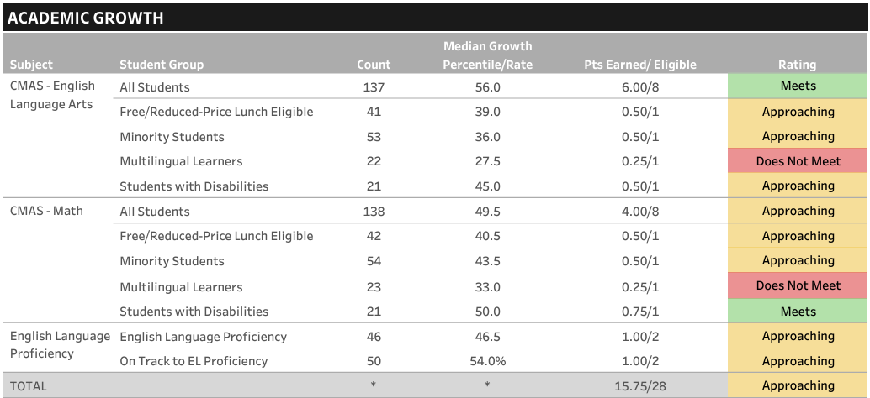
Growth | District Data by Level Example
🔼
Notes:
🔼ENTER THE FOLLOWING INFORMATION IN THIS SLIDE:
Snapshot of growth results from district performance framework for one level.
The presenter may use this to show board members how the ratings are assigned based on points earned, while board members are referring to the actual PDF for the district school performance framework.
Narrative. This slide reflects the district level academic growth results of all students at the elementary level. It includes the number of points assigned along with the corresponding rating for each content area– English Language Arts and Math, as well as English Language Proficiency measured using the ACCESS for ELLS assessment. Growth data is included for all students and by student group where the count is at least 16 students. The last row in the table reflects the overall number of points earned with the associated growth rating for the elementary level. There are similar tables for each level, elementary, middle and high.

Slide 75
Growth Measure | Why growth?
Status (Achievement)
Inform us of performance at a single point in time.
Fails to fully inform us about school effectiveness.
How do students progress over time? How do our schools compare to others?
Growth
Informs us of how much progress students are making in comparison to academic peers over time.
More useful for assessing school/district effectiveness.
Useful for determining progress of one school/program/group relative to another.

Slide 76
Growth Measure | Student Growth Percentiles
The primary metric produced by the Colorado Growth Model is the Student Growth Percentile (SGP).
SGPs are calculated normatively, by comparing each student against an academic peer group with the same score history.
A percentile ranking is assigned to each student based on the observed normative growth between years.
Notes:
Narrative. The Colorado Growth Model was developed by CDE and the National Center for the Improvement in Educational Assessment (NCIES) and first used in 2009. Currently used by about half the states.

Slide 77
Growth Measure | Median Growth Percentiles
SGPs are for single students. How do we describe the growth of a group of students?
The Median Growth Percentile (MGP) tells us how much a group of students is growing in comparison with other groups.
MGPs represent the summary of student growth percentiles for a given student group. (The median is used instead of the mean because it is less sensitive to extreme scores).
MGPs are calculated by CDE for the following groups:
State, district, and schools (overall and by grade)
Minority, migrant, gifted, FRL, IEP, multilingual learners, gender, and performance level.
The state-level cohort MGP will always be about 50.

Slide 78
Post Secondary & Workforce Readiness (PWR)
Indicators | Overview
Performance Indicator | Performance Data | Weight (% of Total)
Postsecondary and Workforce Readiness | SAT – Evidence-Based Reading & Writing and Mathematics Graduation Rate Dropout Rate Matriculation Rate (includes military enlistment) Industry credentials, included in Career and Technical Education and overall matriculation rates calculations Overall and for disaggregated groups (except for Matriculation rate) | 30% High Schools & Districts

Slide 79
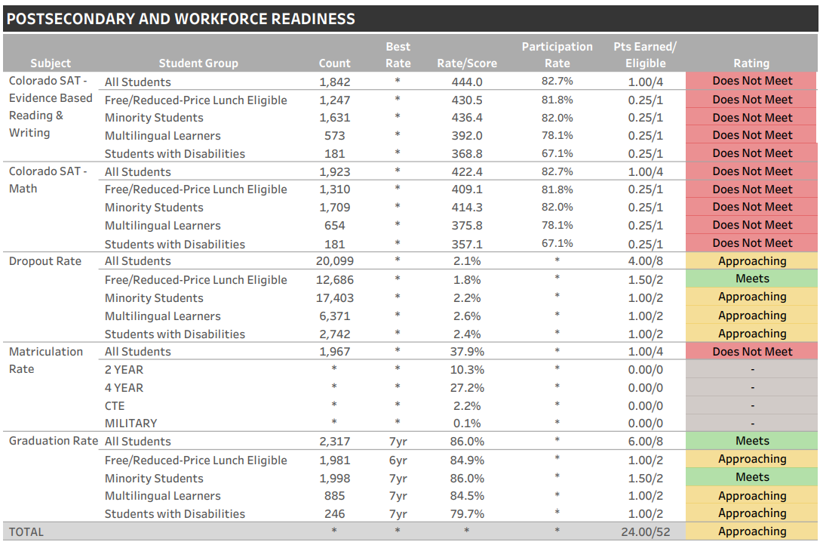
PWR Subindicators | District Data
🔼
Notes:
🔼ENTER THE FOLLOWING INFORMATION IN THIS SLIDE:
Snapshot of postsecondary workforce readiness results from district performance framework.
Narrative. This slide reflects the district level postsecondary and workforce readiness results of all students at the high school level. Also, it includes the number of points assigned along with the corresponding rating for each PWR subindicator including SAT, Dropout rate, matriculation rate, and graduation rates. The last row in the table reflects the overall number of points earned with the associated PWR rating.

Slide 80
PWR | Colorado SAT subindicators
CO SAT -Evidence Based Reading and Writing and CO SAT - Math subindicators
represent juniors who took the SAT during the spring of the most recent school year
SAT scores contribute around 4.6% each (9.2% of all PWR ratings) toward a high school or district’s overall rating, if data is available for all PWR subindicators

Slide 81
PWR Achievement | District Data
🔼
Notes:
🔼ENTER THE FOLLOWING INFORMATION IN THIS SLIDE:
Snapshot of Colorado SAT achievement results within the PWR indicator from district performance framework.
Narrative. This slide reflects the district level Colorado SAT achievement results of all students who took the SAT during the spring of last year, our current seniors (prior year juniors). Also, it includes the number of points assigned along with the corresponding rating for all students and each student group in Evidence Based Reading and Writing, and Math. This section has a total of 16 points, 4 points for all students in both EBRW and then Math, and then 1 point for each student group for each content area. These SAT subindicators contribute 9.2% towards rating.

Slide 82
PWR Graduation Sub-Indicator
Graduation Rates
Results lag behind the year of accountability calculations due to the timing of the official data release.
Colorado reports 4-year, 5-year, 6-year, and 7-year graduation rates, with each rate referring to the number of years that elapse between a student entering ninth grade and graduating.
The Performance Framework used the BEST RATE for each group, All Students and each Student Group
Graduation rates contribute around 9.2% toward a high school or district’s overall PWR rating, if data is available for all PWR subindicators.

Slide 83
PWR graduation | district data
🔼
Notes:
🔼ENTER THE FOLLOWING INFORMATION IN THIS SLIDE:
Snapshot of graduation rate results within the PWR indicator from district performance framework.
Narrative. This slide reflects the district level Graduation results from the 2022-2023 School year (for the 2024 frameworks). These results lag behind the year of accountability calculations due to the timing of all these different collections and the release of official results. In other words, for the 2023-24 school year Performance Frameworks (2024) and ESSA identification (2024), the graduation rates represent the 2022-23 cohort of anticipated graduates.
Again, the framework includes the number of points assigned along with the corresponding rating for all students and each student group taking the BEST graduation rate for each group. This section has a total of 16 points, 8 points for all students and 2 points for each student group. Similar to the SAT subindicators, graduation rates contribute around 9.2% towards rating.

Slide 84
PWR Dropout Rates Sub-Indicator
Dropout Rates
Results lag behind the year of accountability calculations due to the timing of the official data release.
Dropout rates contribute around 9.2% toward a high school or district’s overall PWR rating, if data is available for all PWR subindicators.

Slide 85
PWR Dropouts | District Data
🔼
Notes:
🔼ENTER THE FOLLOWING INFORMATION IN THIS SLIDE:
Snapshot of dropout rate results within the PWR indicator from district performance framework.
Narrative. This slide reflects the district level Dropout Rates from the 2022-2023 School year (for the 2024 frameworks). Consistent with graduation rates, these results lag behind the year of accountability calculations due to the timing of all these different collections and the release of official results. Also consistent with Graduation rates, Dropout rates have a total of 16 points, 8 points for all students and 2 points for each student group that contribute around 9.2% towards rating.

Slide 86
PWR Sub-Indicator | Matriculation
Matriculation Rates
Results lag behind the year of accountability calculations due to the timing of the official data release.
Matriculation rates make up 2.3% toward a high school or district’s overall PWR rating, if data is available for all PWR subindicators.
“Matriculated” includes

Slide 87
PWR Matriculation | District Data
🔼
Notes:
🔼ENTER THE FOLLOWING INFORMATION IN THIS SLIDE:
Snapshot of matriculation rate results within the PWR indicator from district performance framework.
Narrative. This slide reflects the district level Matriculation Rates from the 2022-2023 School year (for the 2024 frameworks). Consistent with graduation and dropout rates, these results lag behind the year of accountability calculations due to the timing of all these different collections and the release of official results. Compared to other PWR subindicators, the matriculation rate is only worth 4 points that makes up 2.3% of the high school or district’s overall rating.

Slide 88
Appendix B.
Future Indicators

Slide 89
On-Track Growth
Colorado’s educational accountability law requires a metric that determines whether a student is making enough growth to reach a target level of achievement within a given timeframe. Called On Track Growth, this measure assesses whether students are catching up to grade-level expectations or keeping up with expectations.
During the Fall of 2024 public reports on the On Track Growth measure, will be provided, for elementary and middle schools. CDE will continue investigating a calculation methodology for high schools and districts.
The measure is expected to be included in future year (after 2024) performance frameworks once all school levels are available.
On-Track Growth factsheet: https://www.cde.state.co.us/accountability/ontrackgrowthfactsheet
On-Track Growth Webinar Series: https://www.cde.state.co.us/uip/otgwebinarmoduleseries

Slide 90
On-Track Growth
Required by Colorado’s educational accountability law, the On-Track Growth performance indicator addresses:
Catch up: Whether student scoring below grade level are catching up to grade-level expectations within two years.
Keep Up: Whether students who are already meeting grade-level expectations are maintaining their performance for two years.
On-Track Growth will account for 10% of the total framework indicator points for elementary and middle schools
CDE stakeholder groups are investigating a methodology for high schools and districts. CDE will discuss options with the state board in the fall.

Slide 91
